Slide 1
Data-Driven Approaches
Independent Component Analysis (ICA)

Slide 2
Hypothesis- vs. Data-Driven Approaches
Hypothesis-driven
Examples: t-tests, correlations, general linear model (GLM)
a priori model of activation is suggested
data is checked to see how closely it matches components of the model
most commonly used approach
Data-driven
Example: Independent Component Analysis (ICA)
blindly separates a set of statistically independent signals from a set of mixed signals
no prior hypotheses are necessary

Slide 3
ICA example
Thanks to Matt Hutchison for providing this great example!
Notes:
Scenario: there are 4 stereos playing simultaneously in the same room, and there are also 4 microphones placed around the room recording the songs

Slide 4
Math behind the method
Thanks to Matt Hutchison for providing this great example!
Notes:
Each microphone (x) signal can be modeled as linear superpositions of the recorded source signals (s) (linear mixture by unknown matrix A)
W= unmixing matrix
u = Uncovered signals
The objective of BSS is to find a matrix (W) allowing to recover the original source signals.
The cocktail party problem applies to EEG recordings. Indeed, at each electrode location, the signal recorded can be considered as a linear mixture of underlying neural generators.

Slide 5
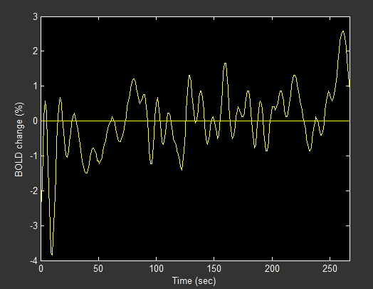
Applying ICA to fMRI data
Threshold = temporal correlation between each voxel and the associated component
1
threshold
7
Magnitude =
Strength of relationship
Signal change (%)
Time (s)
Thanks to Matt Hutchison for providing this great example!
Notes:
The voxel time courses were factored into 40 independent spatial components and then scaled to empirically derived z-scores by dividing the standard deviation of the original time sequence.
The z-scores approximate the temporal correlation between each voxel and the associated component in which the magnitude of the z-score specifies the strength of the linear relationship
Established threshold
5

Slide 6
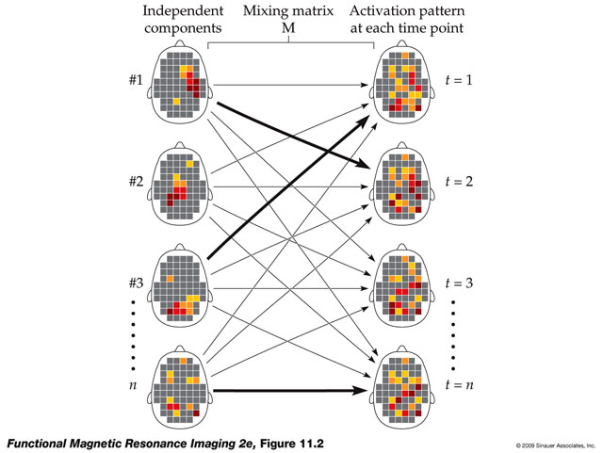
Pulling Out Components
Huettel, Song & McCarthy, 2008

Slide 7
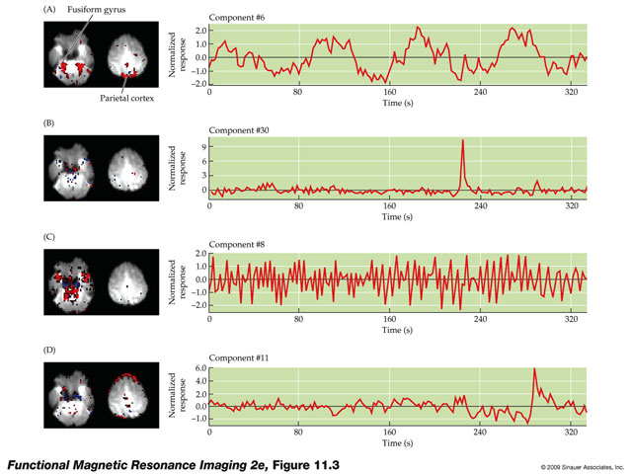
Components
Huettel, Song & McCarthy, 2008
each component has a spatial and temporal profile

Slide 8
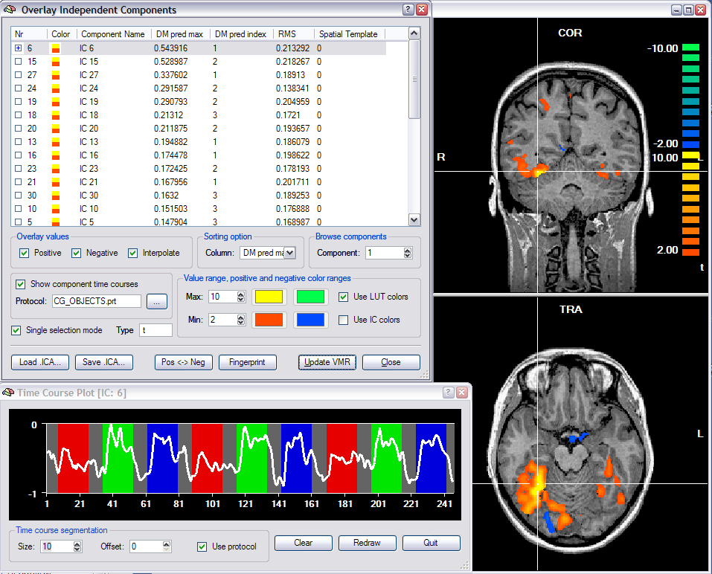
Sample Output

Slide 9
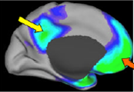
Default Mode Network (DMN)
LP
PCC
mPFC
LTC
decreases activity when task demand increases
self-reflective thought
unconstrained, spontaneous cognition
stimulus-independent thoughts (daydreaming)
(Raichle et al., 2007)
Notes:
DMN Includes:
Posterior cingulate cortex(PCC)/precuneus
Medial prefrontal cortex (mPFC)
Bilateral lateral inferior parietal lobe (LP)
Bilateral lateral temporal cortex (LTC)

Slide 10
ICA doesn’t know positive vs. negative

Slide 11
Why ICA?
Data exploration
time courses that are hard to model
e.g., seizures, hallucinations
understanding artifacts
Data denoising
identify noise components and subtract or model them out to enhance stats for cleaned vs. uncleaned data
Network Identification
especially for resting state data
e.g., find network that matches a default mode network template
Comparisons of networks between groups

Slide 12
Making Sense of Components
how many components?
too many
splitting of components
hard to dig through
too few
clumping of components
20-40 recommended
some algorithms can estimate # components
how do you make sense of them?
visual inspection
sorting
fingerprints

Slide 13
Sorting Components
variance accounted for by component
spatial correlation with known areas
regions of interest (e.g., fusiform face area)
networks of interest (e.g., default mode network)
temporal correlation with known events
task predictors

Slide 14
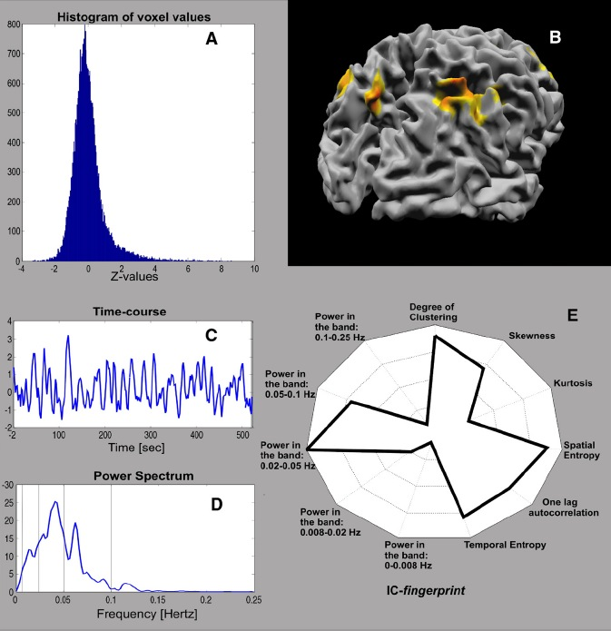
Brain Voyager Fingerprints
fingerprint = multidimensional polar plot characterization of the properties of an ICA component
A good BV fingerprint looks like a slightly tilted Mercedes icon
real activation should be clustered
real activation should have power in medium temporal frequencies
real activation should show temporal autocorrelation
DeMartino et al., 2007, NeuroImage

Slide 15
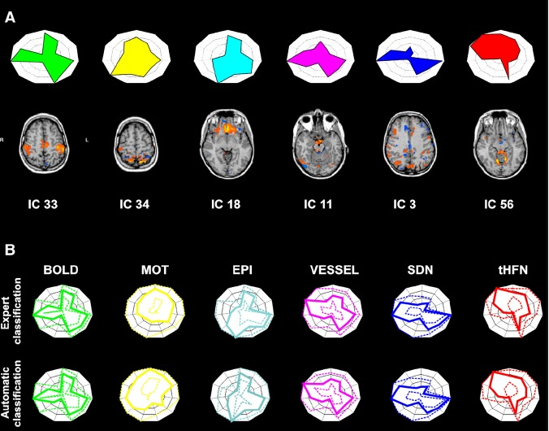
Expert Classification
“activation”
motion
artifacts
susceptibility
artifacts
vessels
spatially
distributed noise
temporal
high freq
noise
DeMartino et al., 2007, NeuroImage

Slide 16
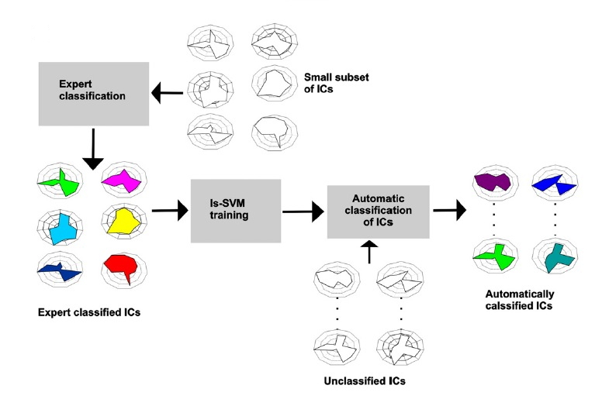
Fingerprint Recognition
train algorithm to characterize fingerprints on one data set; test algorithm on another data set
DeMartino et al., 2007, NeuroImage

