Slide 1
Basic Correlation Approach

Slide 2
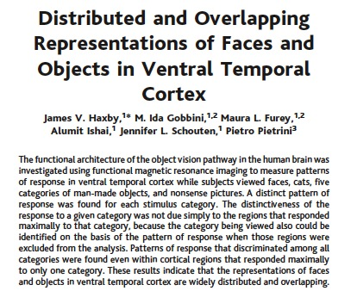
First Demonstration

Slide 3
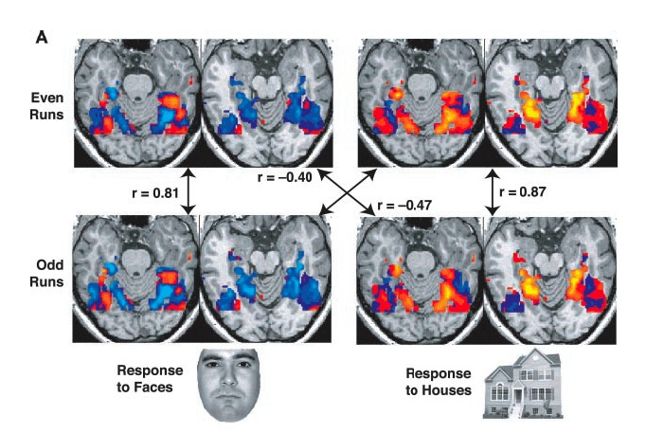
Category-specificity of patterns of response in the ventral temporal cortex
Haxby et al., 2001, Science

Slide 4
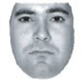
Category-specificity of patterns of response in the ventral temporal cortex
SIMILARITY MATRIX
ODD RUNS
r=.81
high
EVEN RUNS
similarity
r=.87
low
Within-category similarity
Haxby et al., 2001, Science

Slide 5
Category-specificity of patterns of response in the ventral temporal cortex
SIMILARITY MATRIX
ODD RUNS
r=.81
r=-.40
high
EVEN RUNS
similarity
r=-.47
r=.87
low
Between-category similarity
Haxby et al., 2001, Science

Slide 6
Critical Logic
SIMILARITY MATRIX
If an area codes differences between categories, then
within-category similarity
>
between-category similarity
ODD RUNS
r=.81
r=-.40
high
EVEN RUNS
similarity
r=-.47
r=.87
low
Haxby et al., 2001, Science

Slide 7
Correlation Approach Using Representational Similarity Analysis

Slide 8
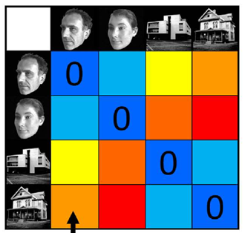
Representational similarity approach (RSA)
Differently from the MVPA correlation, RSA does not separate stimuli into a priori categories
MVPA correlation
RSA
ODD RUNS
high
similarity
(correlation)
EVEN RUNS
low
Kriegeskorte et al (2008)

Slide 9
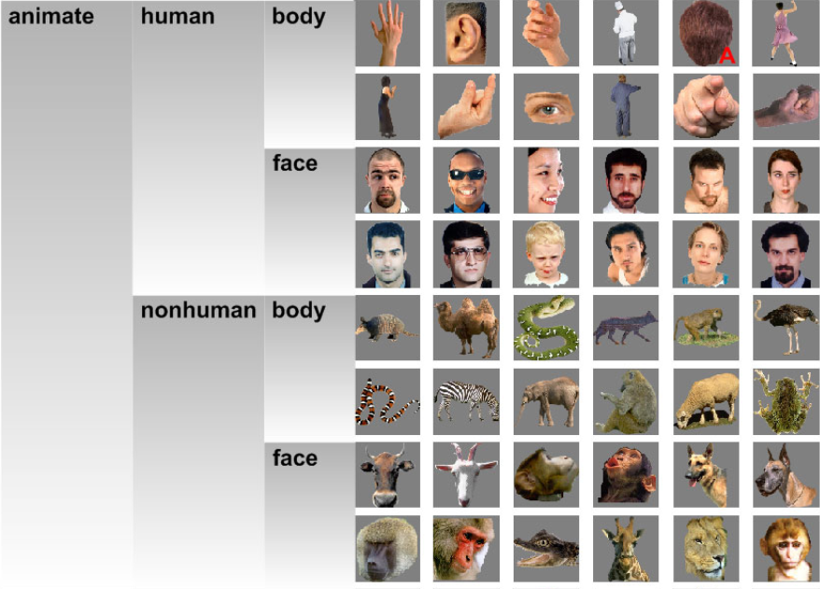
Kriegeskorte’s 92 Stimuli

Slide 10
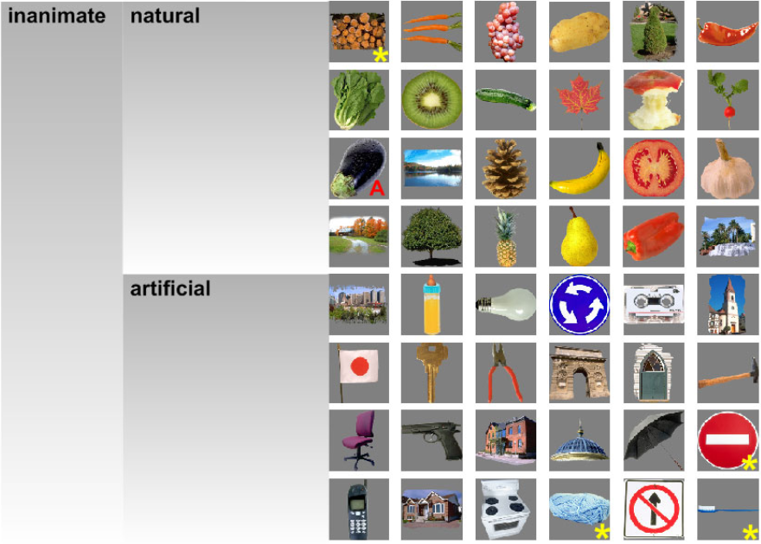
Kriegeskorte’s 92 Stimuli

Slide 11
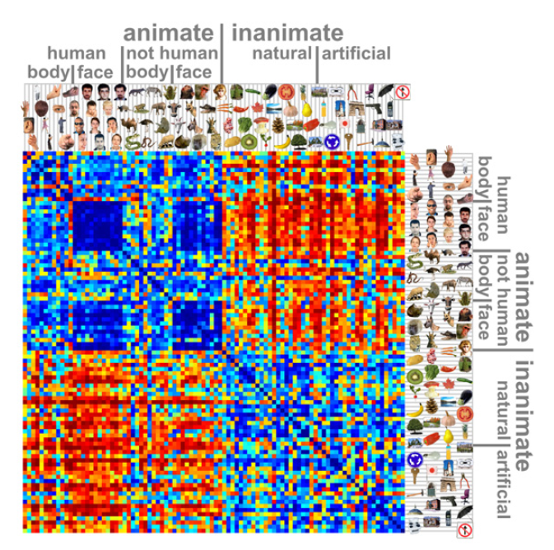
C₁
.
.
.
.
high
.
.
.
.
TRIALS
CONDITIONS
similarity
low
C₉₆
C₁
CONDITIONS
C₉₆

Slide 12
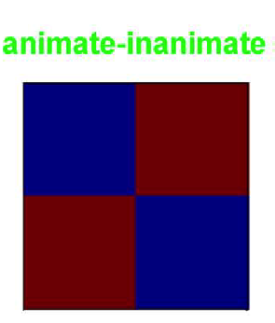
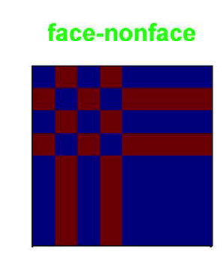
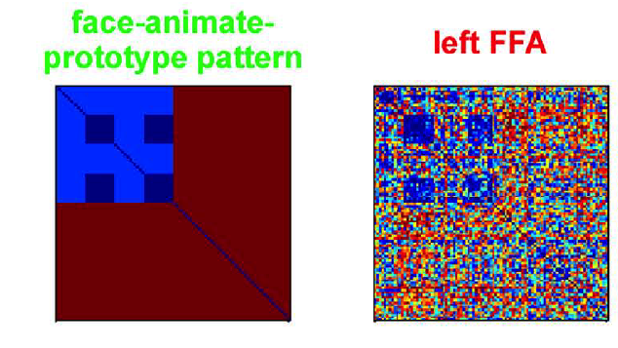
Can compare theoretical models to data
high
similarity
low
Kriegeskorte et al (2008)

Slide 13
Can compare theoretical models to data
Which prediction matrix is more similar to the real data?
high
similarity
low
REAL
DATA
Kriegeskorte et al (2008)

Slide 14
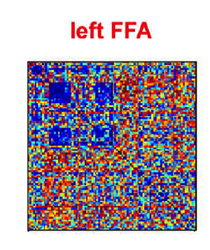
“Metacorrelations”
Calculate correlation between
data correlation matrix
and
model correlation matrix
model can be based on theoretical categories

Slide 15
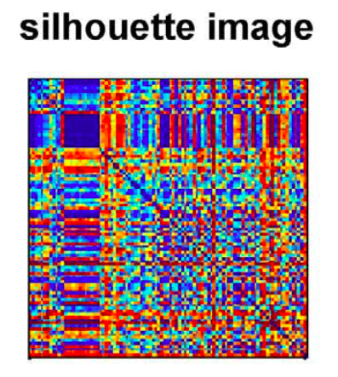
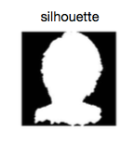
“Metacorrelations”
model can be based on confounds, behavior, etc.
e.g., correlation between silhouettes of diff stims

Slide 16
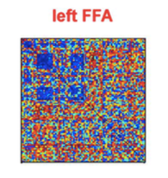
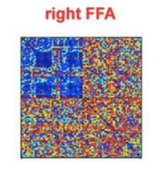
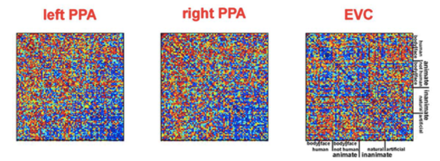
“Metacorrelations”
Calculate correlation between
two regions

Slide 17
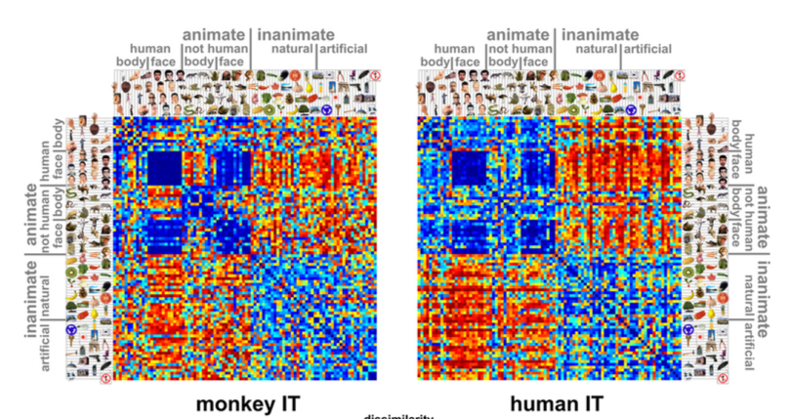
“Metacorrelations”
Calculate correlation between
two species

Slide 18
Multidimensional Scaling (MDS) Input = matrix of distances (km here)
 | Vancouver | Winnipeg | Toronto | Montreal | Halifax | St. John's | Yellowknife | Whitehorse
Vancouver | 0 | 1869 | 3366 | 3694 | 4439 | 5046 | 1566 | 1484
Winnipeg |  | 0 | 1518 | 1825 | 2581 | 3250 | 1753 | 2463
Toronto |  |  | 0 | 503 | 1266 | 2112 | 3078 | 4093
Montreal |  |  |  | 0 | 792 | 1613 | 3194 | 4261
Halifax |  |  |  |  | 0 | 885 | 3768 | 4867
St. John's |  |  |  |  |  | 0 | 4127 | 5233
Yellowknife |  |  |  |  |  |  | 0 | 1109
Whitehorse |  |  |  |  |  |  |  | 0

Slide 19
Multidimensional Scaling (MDS) Output = representational space (2D here)
Halifax
Toronto
Montreal
St. John’s
Winnipeg
Vancouver
Yellowknife
Whitehorse

Slide 20
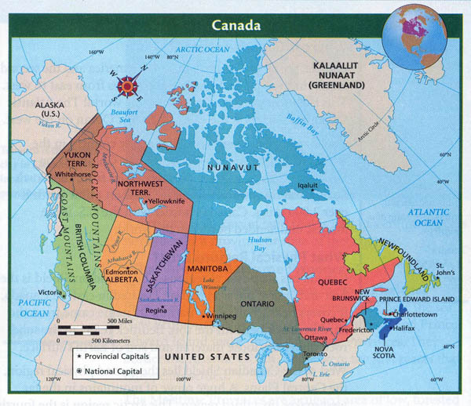
Halifax
Toronto
Montreal
St. John’s
Winnipeg
Vancouver
Yellowknife
Whitehorse

Slide 21
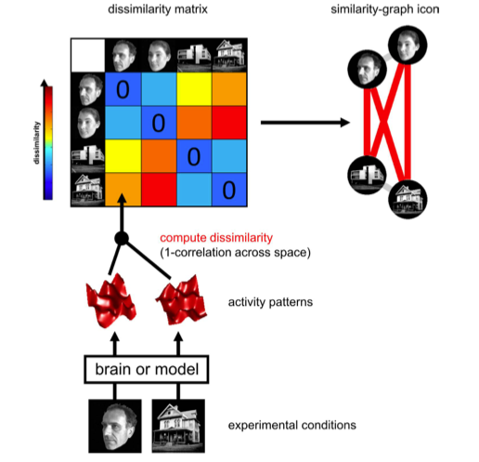
MDS on MVPA Data
MDS

Slide 22
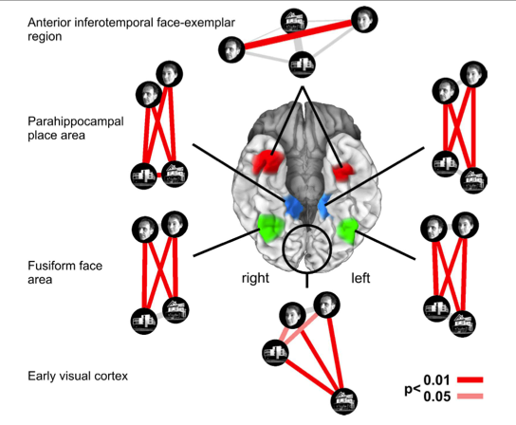
Different Representational Spaces in Different Areas

Slide 23
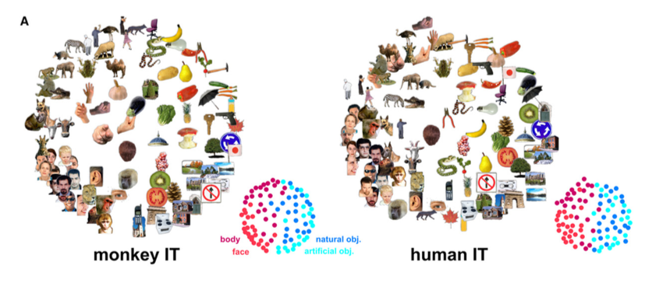

Slide 24
A Few Tricks About RSA
MDS requires dissimiliarity metrics
How far is one thing from another
RSA similarity = r
RSA dissimilarity = 1-r

Slide 25
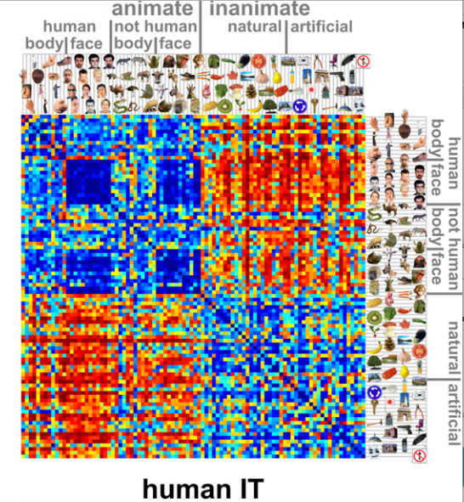
Representational Dissimilarity Matrix

Slide 26
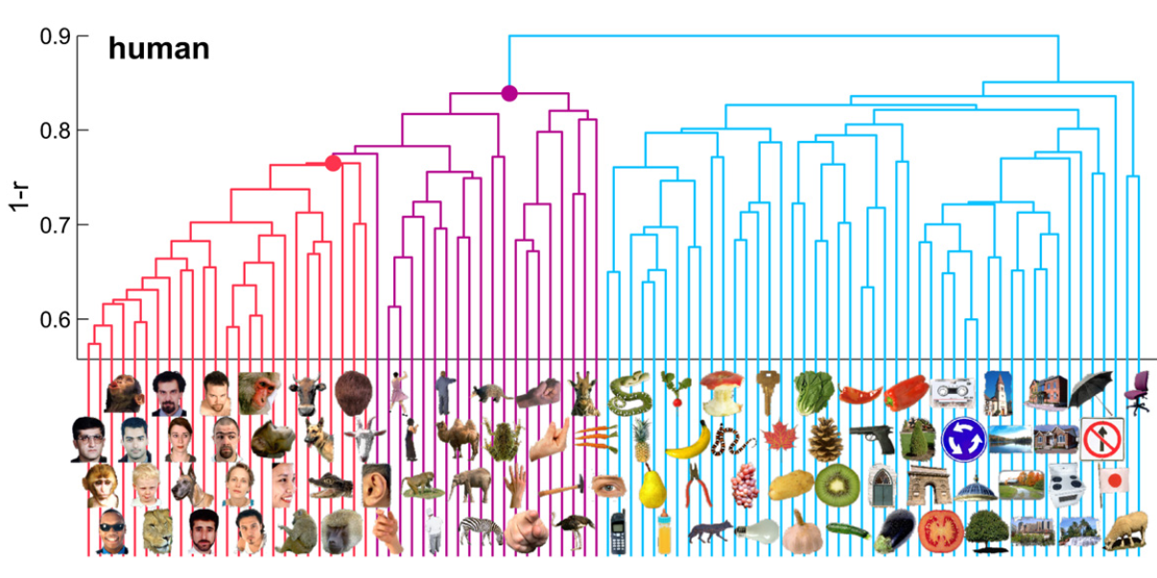
Hierarchical Clustering

Slide 27
Geek Note: Diagonals
MDS requires 0 dissimilarity
on the diagonal and a diagonally symmetric matrix

Slide 28
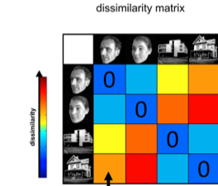
Geek Note: Diagonals
Why split?
Sanity check
Avoid illusion that diagonal is stronger than off-diagonal if it’s actually not
Important for factorial designs to avoid imbalanced contrasts
Why not?
splitting data makes it less reliable
doesn’t work for MDS
DATA SET 1
DATA SET 2
If you can split data sets, you can get (dis)similarity values for the diagonal
Even-Odd
Run 1
Run 2
Run 3
Run 4
Permutations
Run 1 Run 1 Run 1
Run 2 Run 2 Run 2
Run 3 Run 3 Run 3
Run 4 Run 4 Run 4
average r
triangular or symmetric RDM

Slide 29
Geek Note: Other Distance Metrics
I used correlations (r) here because they’re easy to understand
other distance metrics are recommended
Euclidean distance
weights each voxel equally
assumes voxels are uncorrelated (not true)
Mahalanobis distance
downweights noisy voxels
Recommended: cross-validated Mahalanobis distance (“crossnobis” or linear discriminant classifier, LDC)
divides data into folds based on runs

Slide 30
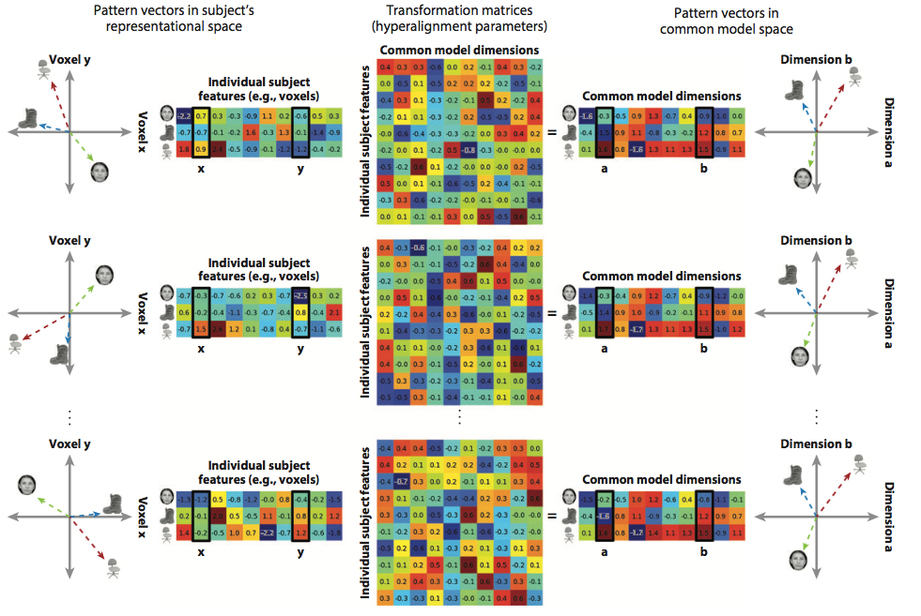
Hyperalignment
Haxby et al., 2014, Ann. Rev. Neurosci.
In case you haven’t had a brain cramp yet…
Even participants’ representational spaces can be aligned

