Slide 1
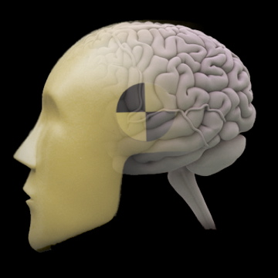
fMRI Techniques to Investigate Neural Coding: Multivoxel Pattern Analysis (MVPA)
Jody Culham
Brain and Mind Institute
Department of Psychology
Western University
http://www.fmri4newbies.com/
Last Update: January 18, 2012
Last Course: Psychology 9223, W2010, University of Western Ontario
Last Update: November 12, 2020
Last Course: Psychology 9223, F2020

Slide 2
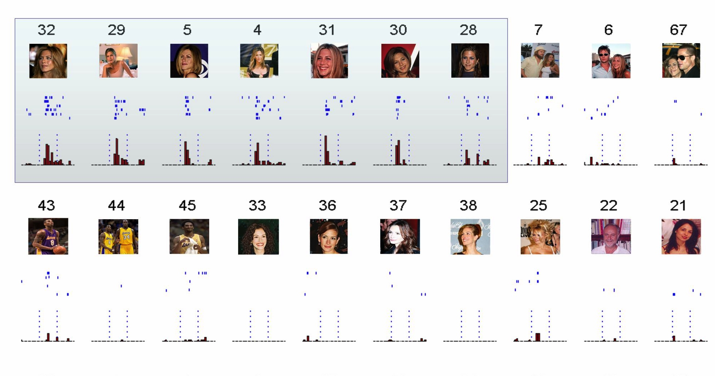
Limitations of Subtraction Logic
Example: We know that neurons in the brain can be tuned for individual faces
“Jennifer Aniston” neuron in human medial temporal lobe; Quiroga et al., 2005, Nature

Slide 3
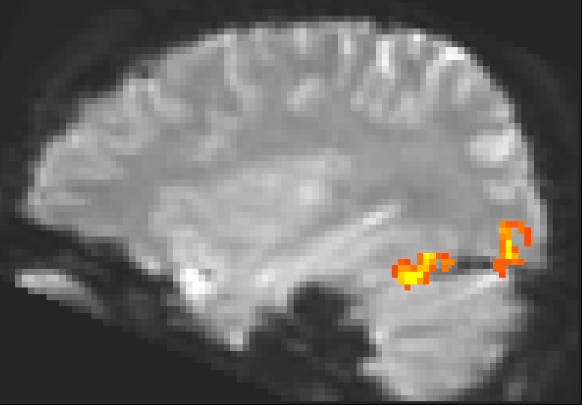
high activity
fMRI spatial resolution: 1 voxel
2 mm
2 mm
3 mm
low activity
2 mm
3 mm
A voxel might contain millions of neurons, so the fMRI signal represents the population activity

Slide 4
Limitations of Subtraction Logic
fMRI resolution is typically around 3 x 3 x 3 mm so each sample comes from millions of neurons. Let’s consider just three neurons.
Neuron 1
“likes”
Jennifer Aniston
Neuron 2
“likes”
Julia Roberts
Neuron 3
“likes”
Brad Pitt
Even though there are neurons tuned to each object, the population as a whole shows no preference
Firing Rate
Firing Rate
Firing Rate
Activation

Slide 5
Two Techniques for Addressing Neural Coding
Multi-Voxel Pattern Analysis (MVPA or decoding or “mind reading”)
fMR Adaptation (or repetition suppression or priming)

Slide 6
Multivoxel Pattern Analyses (or decoding or “mind reading”)

Slide 7
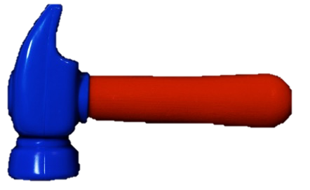
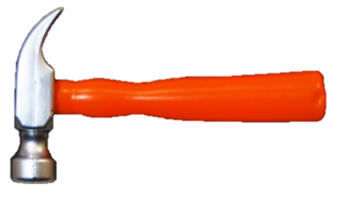
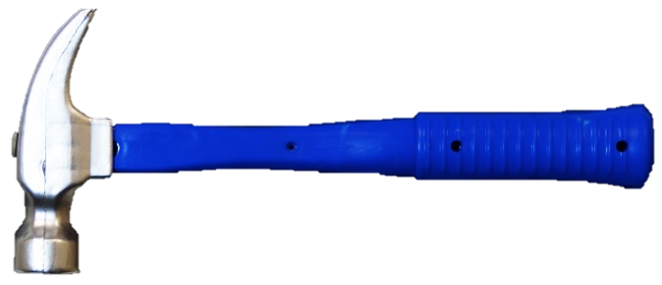
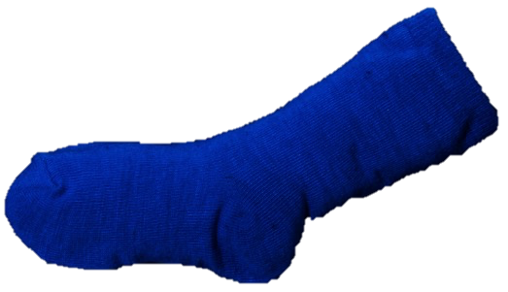
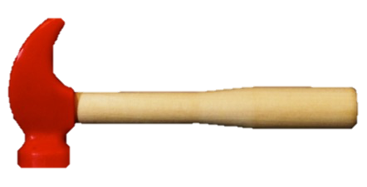
Pattern Similarity
HAMMERS
Even Runs
HAMMERS
Odd Runs
SOCKS
Even Runs
SOCKS
Odd Runs

Slide 8
Region Of Interest (ROI): group of voxels
high activity
low activity

Slide 9
Voxel Pattern Information
Condition 1
e.g., Faces
Condition 2
e.g., Hands
Two regions might have similar average levels of activation but different spatial patterns of activation

Slide 10
Effect of Spatial Smoothing and Intersubject Averaging
Condition 1
e.g., Faces
Condition 2
e.g., Hands
Before Spatial Smoothing
After Spatial Smoothing
Spatial patterns of activation are lost with spatial smoothing and intersubject averaging

Slide 11
Two analysis options
Univariate Analysis
look at one variable at a time
level of activation across a region
average data from each voxel
works well for strong differences
Multivariate Analysis
look at multiple variables at a time
pattern of activation within a region
preserve data from each voxel
works well even if there are weak effects across many voxels

Slide 12
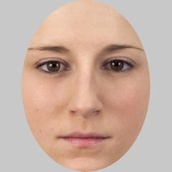
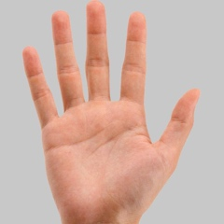
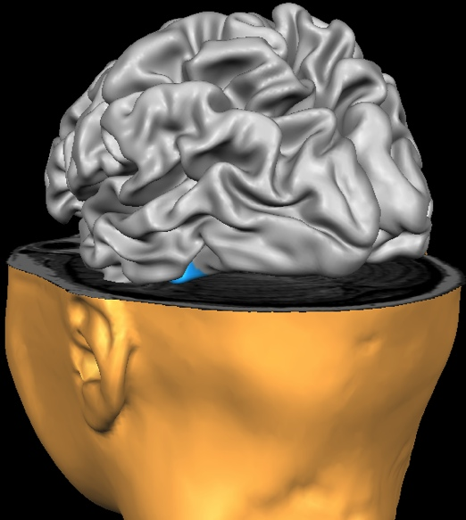
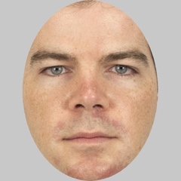
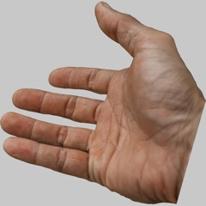
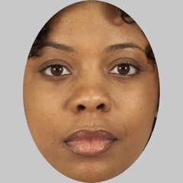
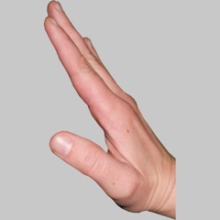
Standard fMRI Analysis: Activation Difference
Faces
Hands
trial 1
trial 1
trial 2
trial 2
trial 3
trial 3
Average Summed
Activation

Slide 13
Standard fMRI Analysis: No Activation Difference
Faces
Hands
trial 1
trial 1
trial 2
trial 2
trial 3
trial 3
Average Summed
Activation

Slide 14
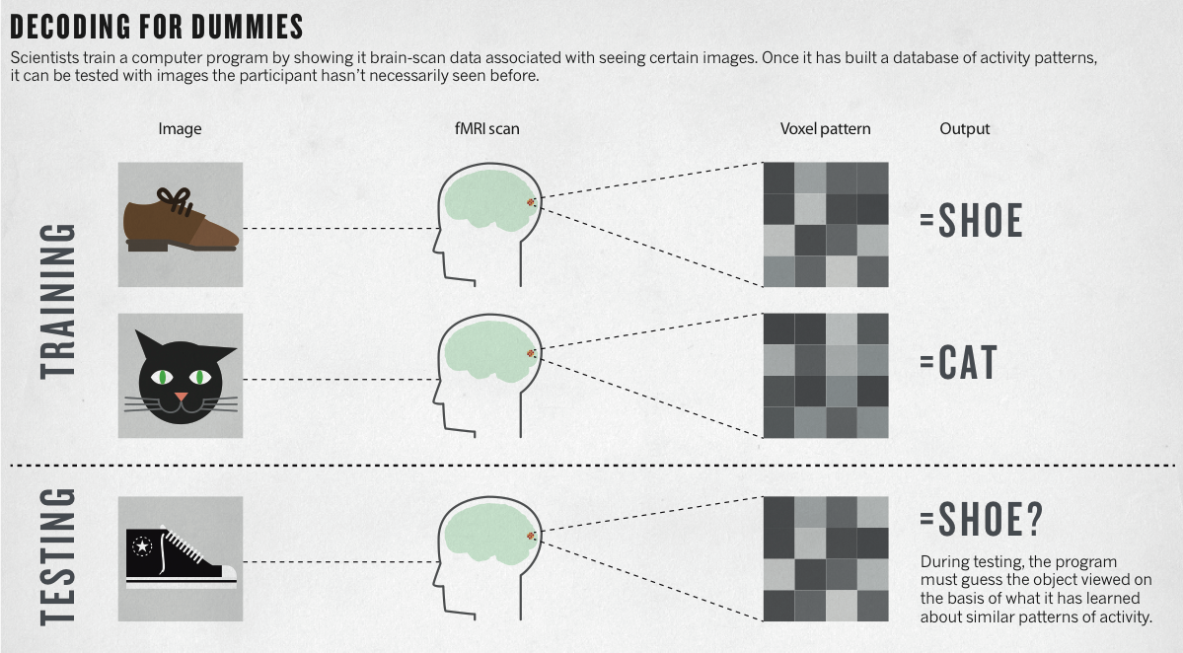
Decoding for Dummies
✅
Kerri Smith, 2013, Nature, “Reading Minds”

Slide 15
Approaches to Multi-Voxel Pattern Analysis
MVPA classifier
MVPA correlation: Basic approach
MVPA correlation: Representational similarity analysis

Slide 16
Preparatory Steps

Slide 17
Initial Steps
Step 1: Select a region of interest (ROI)
DO NOT SPATIALLY SMOOTH THE DATA
Step 2 : Extract a measure of brain activation from each of the functional voxels within the ROI
β weights
%-transformed
z-normalized
% BOLD signal change
minus baseline
t-values
β/error

Slide 18
MVPA Methods
block or event-related data
resolution
works even with moderate resolution (e.g., 3 mm isovoxel)
tradeoff between resolution and coverage, SNR
preprocessing
usually steps apply (slice scan time correction, motion correction, low pass temporal filter)
EXCEPT: No spatial smoothing!
Model single subjects, not combined group data (at least initially)

