Slide 1
The Problem of Intersubject Variability

Slide 2
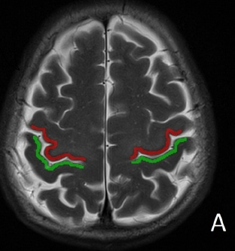
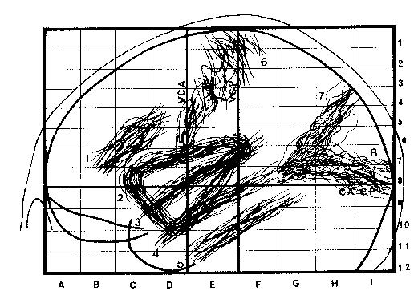
The Problem of Intersubject Variability
The hand area lies in the “hand knob”, a section of the central sulcus that looks like an upside-down omega
Primary Motor Cortex (M1) lies along the anterior bank while Primary Somatosensory Cortex (S1) lies along the posterior bank
Ω
Ω
Although these areas are reliably localized with respect to sulcal landmarks within individuals, the sulcus has high anatomical variability between individuals
2+ cm

Slide 3
The Problem of Intersubject Variability
The hand area lies in the “hand knob”, a section of the central sulcus that looks like an upside-down omega
Primary Motor Cortex (M1) lies along the anterior bank while Primary Somatosensory Cortex (S1) lies along the posterior bank
Although these areas are reliably localized with respect to sulcal landmarks within individuals, the sulcus has high anatomical variability between individuals
Due to this variability, activation of the same area (e.g., the motor hand area during finger tapping) can appear scattered in stereotaxic (Talairach or MNI) space. Given that random effects (RFX) analyses require somewhat consistent effects across participants, this can handicap statistical power
This also means that it can be tricky to isolate effects in one area (e.g., M1) without contamination from adjacent areas (e.g., S1)
Ω
Ω
S1 β = 3
S2 β = 0
S3 β = 0
RFX non-sig
S1
S2
S3
3 Ss superimposed

Slide 4
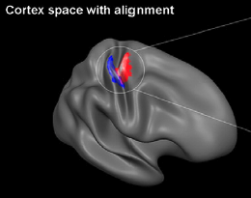
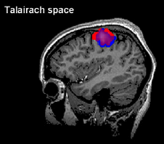
Three Solutions to Intersubject Variability
S1 β = 3
S2 β = 0
S3 β = 0
RFX non-sig
S1 β = 2.5
S2 β = 2.5
S3 β = 1
RFX sig
S1 β = 3
S2 β = 3
S3 β = 3
RFX highly sig
S1 β = 3
S2 β = 3
S3 β = 3
RFX highly sig
S1
S2
S3
Solution 1:
Spatial Smoothing
increase likelihood of consistent effects across Ss
doesn’t solve problem that voxels likely contain combination of different areas (M1 and S1 in this case)
Solution 2:
Cortex-based Alignment
solution works very well and makes it less likely to blur across adjacent functional areas
generation of surfaces can be time-consuming (though automation is getting better)
cortex-centric
Solution 3:
Individual ROIs
identify ROI anatomically in each S (e.g., based on anterior bank of hand knob) or functionally in each S (based on functional localizer)
anatomical ROIs can require manual labour
functional ROIs can be somewhat subjective
doesn’t work for unexpected activation sites
Original Data

Slide 5
Two Approaches to Group Data

Slide 6
Two Major Approaches to Group Data
Voxelwise whole-brain analysis
Region-of-interest analysis

Slide 7
Two Major Approaches to Group Data
Voxelwise whole-brain analysis
can be done in volumetric space (MNI or Tal) or cortex space
run a stats test on every voxel (or surface vertex) in the volume
the volume is typically (but not necessarily) the whole brain

Slide 8
Pros and Cons: Voxelwise Approach
Benefits
Requires no prior hypotheses about areas involved
Includes entire brain
Drawbacks
Requires conservative corrections for multiple comparisons
vulnerable to Type II errors
Neglects individual differences in brain regions
can lead to impure sampling of desired region, esp. with volumetric vs. surface-based data
poor for some types of studies (e.g., topographic areas)
Experimenters must ensure they avoid the non-independence error

Slide 9
Two Major Approaches to Group Data
Region-of-interest analysis
can be done in any space (even native space)
first, identify a region based on one criterion
second, do a statistical test on that region

Slide 10
Ways to Define Regions of Interest
Independent or Non-independent
Independent: ROI is defined in a manner independent of the data to be assessed
Non-independent: ROI is defined using the same data to be assessed
Group or Individual
Group: ROIs are defined at the group level; same ROI for each participant
Individual: ROIs are defined at the single-subject level; different ROIs for each participant
Functional, Anatomical, Known Coordinates, Atlases
Functional: Based on a contrast of functional activation
Anatomical: Based on anatomical landmarks
Known Coordinates: Based on external source (e.g., Neurosynth)
Atlases: e.g., Julich cytoarchitectonic atlases, Wang & Kastner atlas of visual areas, Glasser atlas

Slide 11
Examples
Do a contrast of Faces > [(Bodies and Hands and Scrambled)] in localizer; select group blob; extract betas from 6 conditions in experimental runs
Do a contrast of Faces > Hands in Experimental runs; select group blob; extract betas from 6 conditions in experimental runs
Do a contrast of Faces > [(Bodies and Hands and Scrambled)] in localizer; select different blob for each participant; extract betas from 6 conditions in experimental runs
Select a sphere centred around FFA defined in Kanwisher et al., 1997; extract betas from 6 conditions in experimental runs
Define the fusiform gyrus individually in each participant; extract betas from 6 conditions in experimental runs

Slide 12
Examples
Do a contrast of Faces > [(Bodies and Hands and Scrambled)] in localizer; select group blob; extract betas from 6 conditions in experimental runs
Do a contrast of Faces > Hands in Experimental runs; select group blob; extract betas from 6 conditions in experimental runs
Do a contrast of Faces > [(Bodies and Hands and Scrambled)] in localizer; select different blob for each participant; extract betas from 6 conditions in experimental runs
Select a sphere centred around FFA defined in Kanwisher et al., 1997; extract betas from 6 conditions in experimental runs
Define the fusiform gyrus individually in each participant; extract betas from 6 conditions in experimental runs
Independent
Group
Functional
Non-independent
Group
Functional
Independent
Individual
Functional
Independent
Group
Known
Independent
Group
Anatomical

Slide 13
Pros and Cons: ROI Approach
Benefits
Extraction of ROI data can be subjected to simple stats
Elimination of multiple comparisons problem greatly improves statistical power (e.g., p < .05)
Hypothesis-driven
Useful when hypotheses are motivated by other techniques (e.g., electrophysiology) in specific brain regions
ROI is not smeared due to intersubject averaging
Useful for topographic areas
Enables fully independent definitions of regions
Drawbacks
Neglects other areas that may play a fundamental role
If multiple ROIs need to be considered, you can spend a lot of scan time collecting localizer data (thus limiting the time/power available for experimental runs)
Works best for reliable and robust areas with unambiguous definitions
Sometimes you can’t find an ROI in some subjects
Selection of ROIs can be highly subjective and error-prone

Slide 14
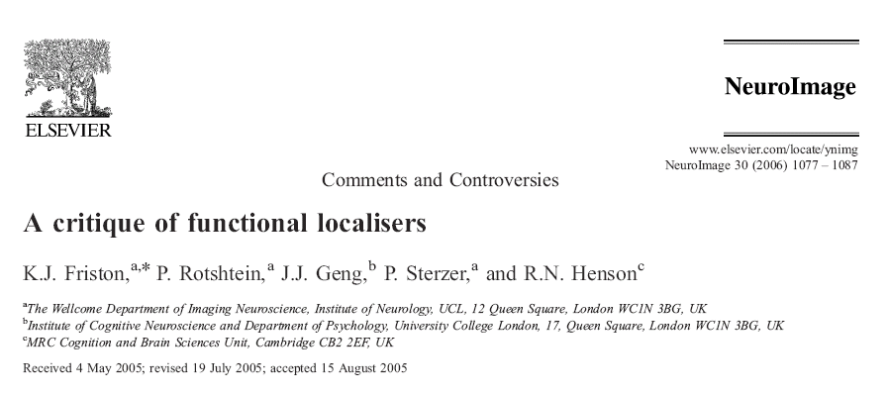
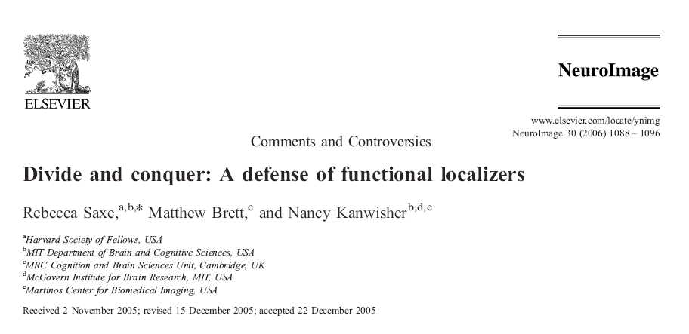
To Localize or Not to Localise?
Neuroimagers can’t even agree how to SPELL localiser/localizer!

Slide 15
Methodological Fundamentalism
The latest review I received…

Slide 16
ROI and Voxelwise Analyses are NOT mutually exclusive
You can decide based on the situation/hypotheses
You can do both ROI analyses and voxelwise analyses
ROI analyses for well-defined key regions
Voxelwise analyses to see if other regions are also involved
Ideally, the conclusions will not differ
If the conclusions do differ, there may be sensible reasons
Effect in ROI but not voxelwise
perhaps region is highly variable in stereotaxic location between subjects
perhaps voxelwise approach is not statistically powerful enough
Effect in voxelwise but not ROI
perhaps ROI is not homogenous

Slide 17
An Aside on Neurosynth

Slide 18
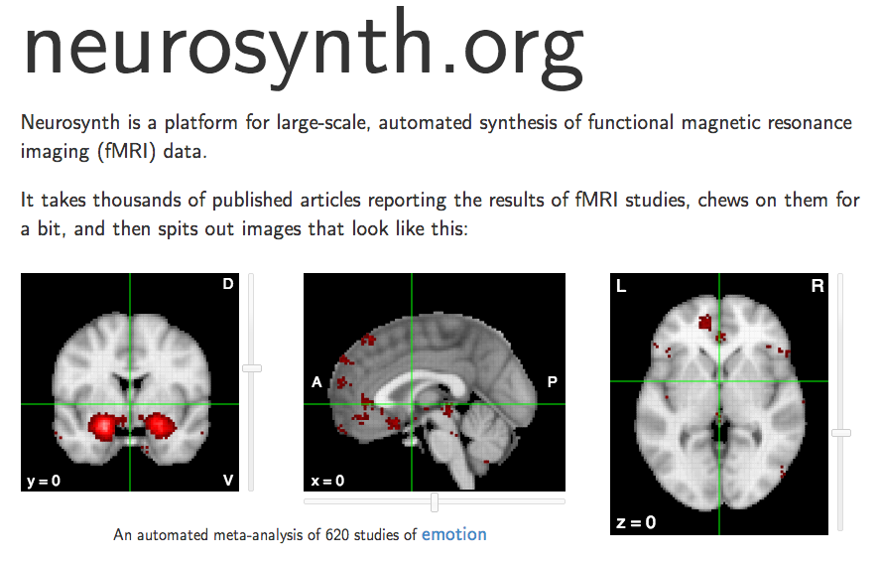
Neurosynth
Neurosynth (Dec. 2014)

Slide 19
Neurosynth: Automated Coordinate Extraction
Yarkoni et al., 2001

Slide 20
Neurosynth Example: Working Memory
META-
ANALYSIS
from previous studies
FORWARD INFERENCE
What is the probability of activation here a study involving working memory?
REVERSE INFERENCE
If there is activation here, what is the probability the study involved working memory?
Yarkoni et al., 2001

Slide 21
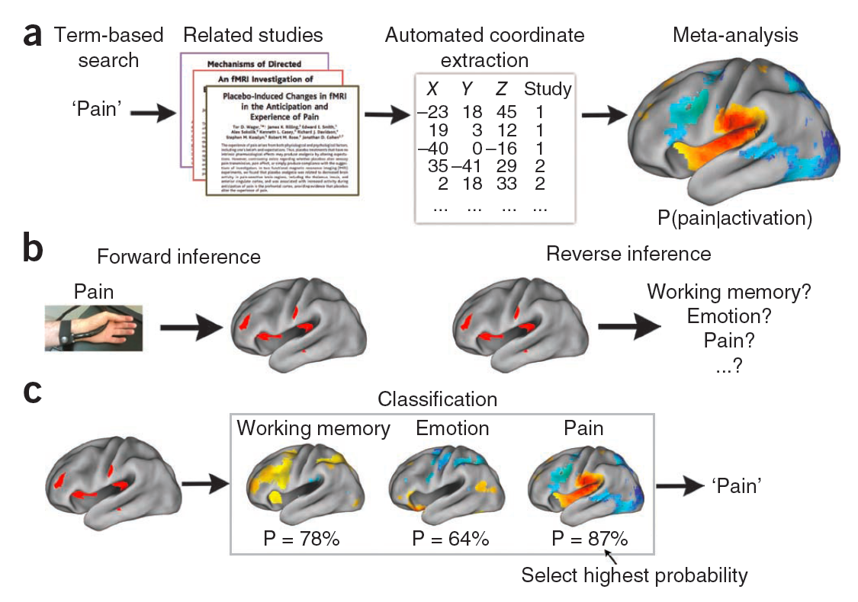
Neurosynth: Automated Coordinate Extraction
Yarkoni et al., 2001

Slide 22
Glasser Atlas

Slide 23
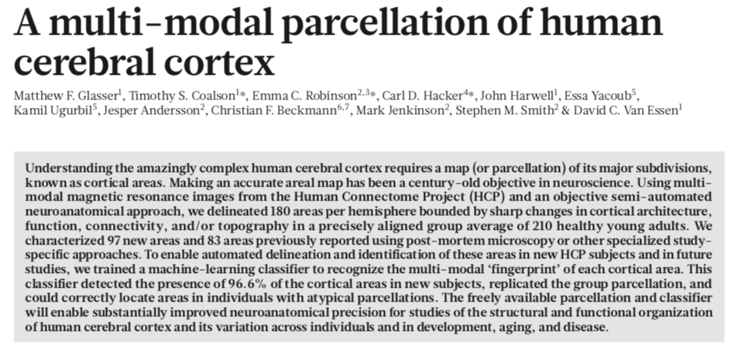
Glasser Atlas
Nature, 2016

Slide 24
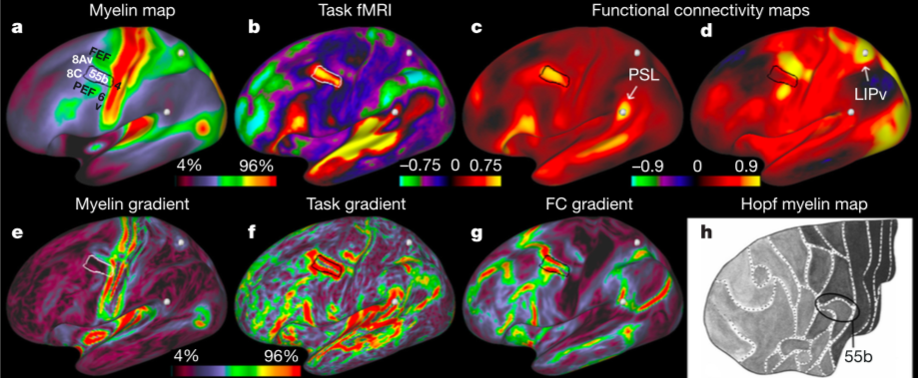
Define Boundaries with Multiple Criteria
ANATOMY
FUNCTION
CONNECTIVITY

Slide 25
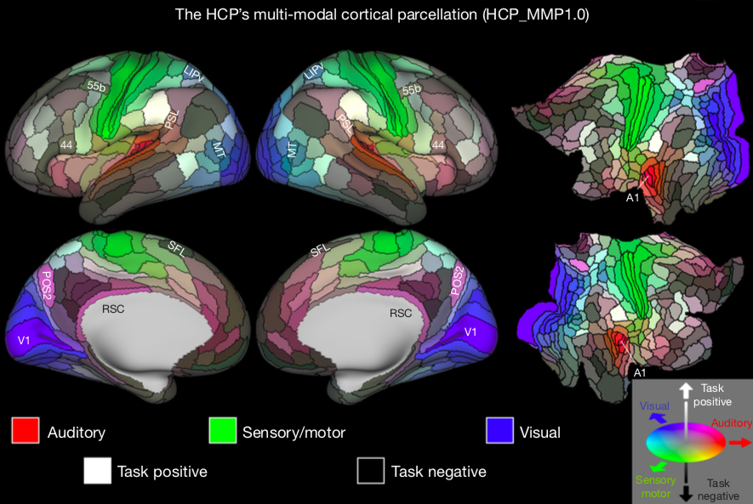
180 Areas

