Slide 1
First- vs. Second-level Analyses
First level analyses
done on individual participants
estimate one beta per condition per subject
look at consistency of effects relative to temporal variability
df = number of volumes – model df – 1
need to correct for serial correlations because they strongly affect df
RFX Second-level analyses
look at consistency of effects relative to intersubject variability
df = number of participants – 1
do not need to correct for serial correlations because df is based on participants rather than temporal variability
some researcher still recommend correcting for serial correlations anyway
RFX allows you to generalize to population

Slide 2
Examples from a real data set

Slide 3
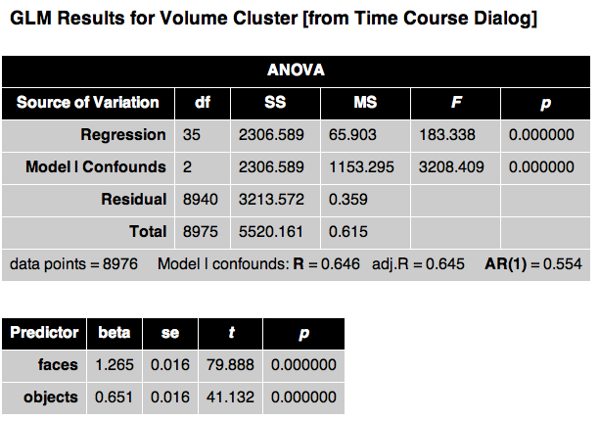
Concatenated FFX (No SPSB)
Example 17 Subjects x 2 runs with Faces & Objects
df = 17 Ss x 2 runs/S x 264 vols/run - 1
one predictor per condition

Slide 4
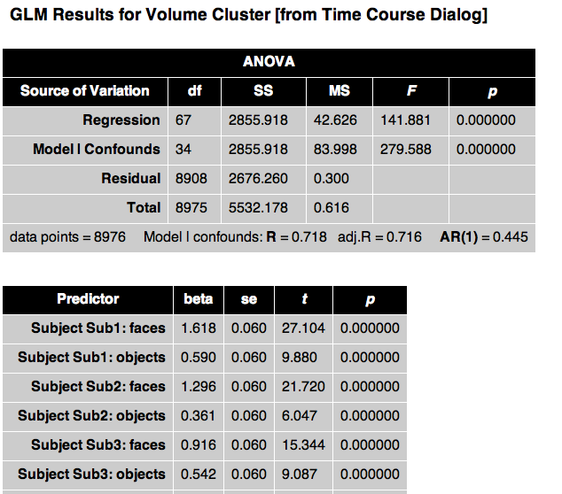
FFX Separate Subjects (SPSB)
If you’re looking at pilot data from a few Ss, with RFX it will be hard to see any effects.
You can do FFX with separate subjects.
It has the same problems as concatenated FFX but at least enables you to examine the consistency between Ss
…

Slide 5
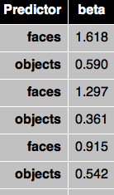
RFX
S1
S2
S3
…
S17
This contrast is just like doing a paired t-test between Faces and Objects with 17 Ss
df = 17 Ss - 1
Now that our df no longer depends on # volumes,
we don’t have to worry about correction for serial correlations with RFX

Slide 6
Random Effects Analysis
Brain Voyager recommends you don’t even toy with random effects unless you’ve got 10 or more subjects (and 50+ is best)
Random effects analyses can really squash your data, especially if you don’t have many subjects.
Though standards were lower in the early days of fMRI, today it’s virtually impossible to publish any group voxelwise data without RFX analysis
As we will see shortly, spatial smoothing is more important for group data, especially RFX than single-subject data

Slide 7
Strategies for Exploration vs. Publication
Deductive approach
Have a specific hypothesis/contrast planned
Run all your subjects
Run the stats as planned
Publish
Inductive approach
Run a few subjects to see if you’re on the right track
Spend a lot of time exploring the pilot data for interesting patterns
“Find the story” in the data
You may even change the experiment, run additional subjects, or run a follow-up experiment to chase the story
While you need to use rigorous corrections for publication, do not be overly conservative when exploring pilot data or you might miss interesting trends

Slide 8
Why would you ever want to do FFX SPSB instead of RFX?
For publication, you will usually need RFX
Rule of thumb: RFX needs 12+ Ss to have decent power (more is better)
For investigating pilot data, FFX SPSB can be useful
If you have a small number of subjects
beware you cannot generalize to population
If you want to explore individual data and want to save some time by making 1 GLM/all subjects instead of 1 GLM/subject
can do contrasts like
+ S1_Faces – S1_Objects

