Slide 1
Group Analyses
1. Get all the subjects’ brains into a common space
Talairach space
MNI space
cortex-based alignment
2A. Do group statistics
Random Effects GLM
and/or
2B. Use a Region of Interest Approach

Slide 2
Voxelwise Group Analyses
Fixed vs. Random Effects

Slide 3
Caveat: I wasn’t able to get all the course data in time to update these slides so they use different data set
This other data set has conditions with faces and objects
In the tutorial, you will work with the course dataset

Slide 4
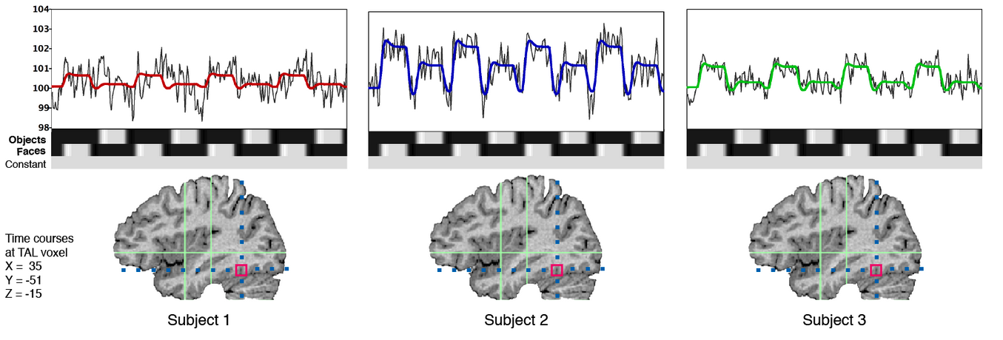
Example
Three subjects
Three conditions: Baseline, Faces, Objects
For simplicity, just consider one voxel in FFA

Slide 5
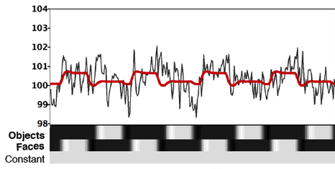
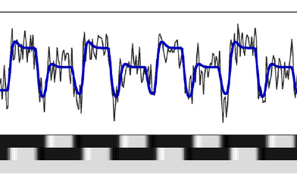
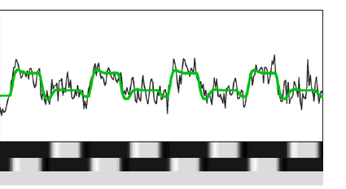
Stupid Way: Concatenated Fixed Effects (FFX)
Concatenate data, pretend you have one subject who did three runs
(Pay attention to the black line; ignore colored lines)

Slide 6
Stupid Way: Concatenated Fixed Effects (FFX)
Make one predictor for Faces and one for Objects (2 df)
Scale predictors (by beta weights)
Note why this is stupid
Assumes all subject show same magnitude of activation
Errors in this assumption → ⬆ residuals

Slide 7
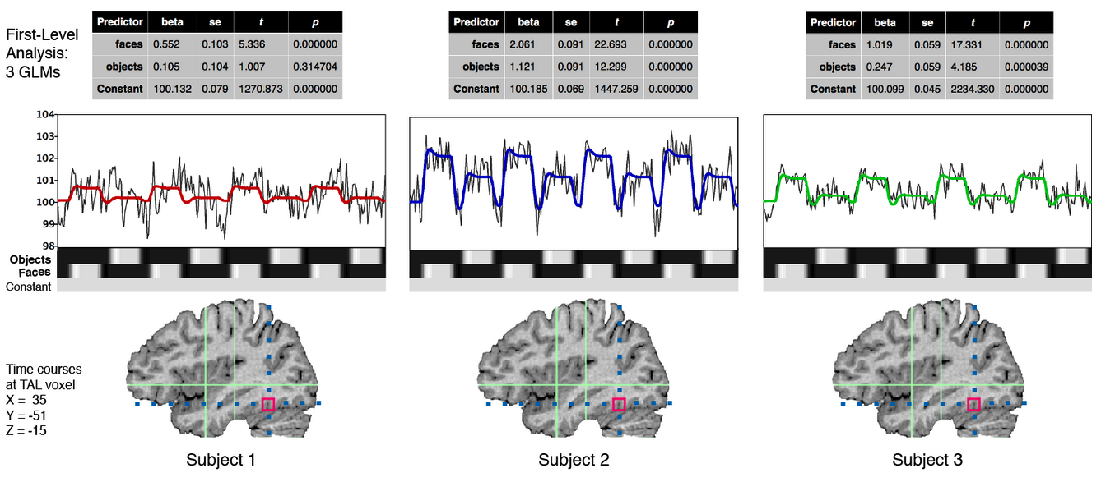
Better Way: Separate Subjects FFX (SPSB in BV)
Don’t concatenate
Separate predictors for 3 subjects x 2 conditions
6 df

Slide 8
Problem: Separate Subjects FFX
We could do business-as-usual GLM and see if predictors account for significant variance considering noise
Effectively, we are asking how confident we are that this effect is true (not due to chance) in these three subjects (and only these three subjects)
BUT usually, we want to generalize to the population from which we sampled

Slide 9
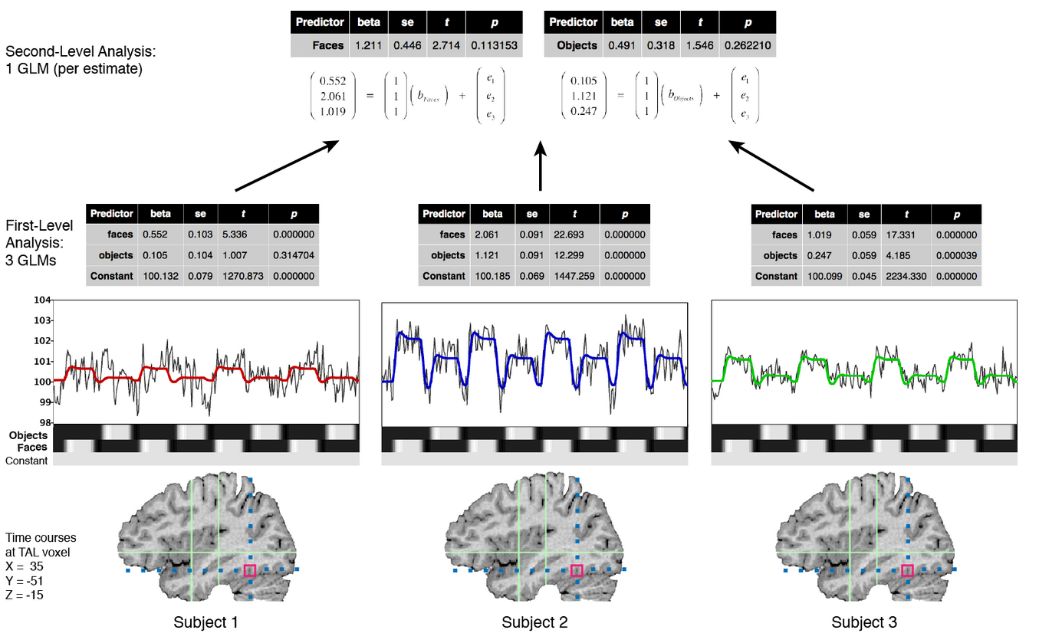
Best Way: Random Effects (RFX)

Slide 10
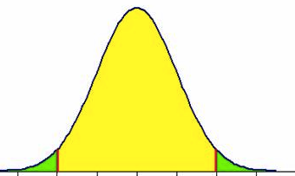
Second-level analysis
Nothing too complicated… it’s effectively just a paired-samples t test
A paired-samples t test is the same as a one-sample t test on differences
Subject | β_{Faces} | β_{Objects} | Difference β_{Faces} - β_{Objects}
S1 | 0.552 | 0.105 | 0.447
S2 | 2.061 | 1.121 | 0.940
S3 | 1.019 | 0.247 | 0.772
Mean |  |  | 0.719
SD |  |  | 0.250
SEM [=SD/sqrt(N)] |  |  | 0.145
t_{crit}(df=3) |  |  | 4.3
95%CI lower (= mean – (t*SEM)) |  |  | 0.097
95%CI lower (= mean + (t*SEM)) |  |  | 1.34
Estimated Distribution
of Differences
does not include zero
→ significant (p<.05)
Oops, this should’ve been df=2
need to redo
X
X
95% CI
X
0
0.097
0.719
1.34

Slide 11
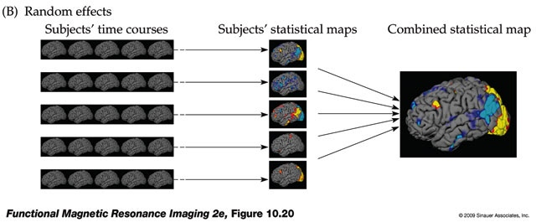
Repeat for the other 194,000 voxels…
Huettel, Song & McCarthy, 2008
First-level analysis
Second-level analysis

Slide 12
If you really want to be correct…
We often refer to this type of analysis as random effects (RFX)
Since subjects is a random effect but other aspects (e.g., stimulus categories) are fixed effects, technically the proper term is Mixed Effects Analysis
Other common jargon = Second-level Analysis

