Slide 1
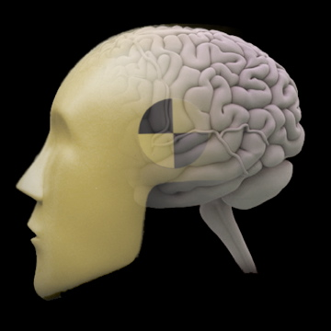
Group Analyses in fMRI
Jody Culham
Brain and Mind Institute
Department of Psychology
Western University
http://www.fmri4newbies.com/
Last Update: November 5, 2020
Last Course: Psychology 9223, F2020, Western University

Slide 2
Group Analyses
1. Get all the subjects’ brains into a common space
Talairach space
MNI space
cortex-based alignment
2A. Do group statistics
Random Effects GLM
and/or
2B. Use a Region of Interest Approach

Slide 3
Combining Group Data Using Standardized Spaces

Slide 4
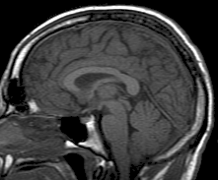
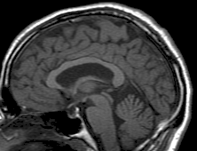
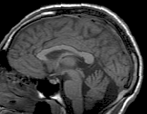
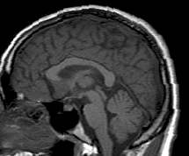
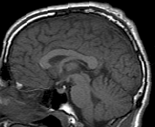
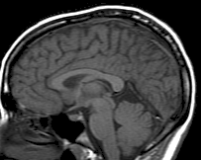
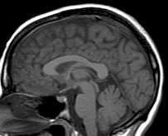
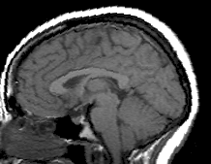
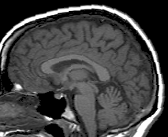
Brains are Heterogeneous
Slide from Duke course

Slide 5
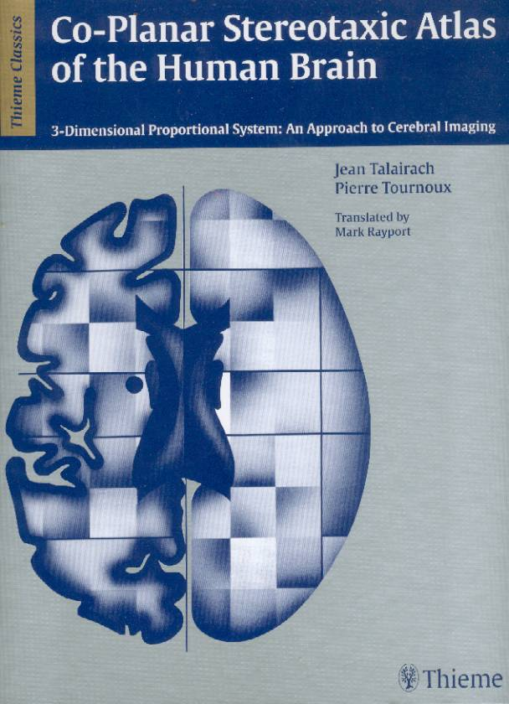
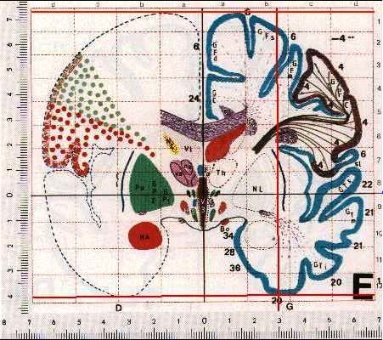
Talairach Coordinate System
Talairach & Tournoux, 1988
made an atlas based on one brain
any brain can be squished or stretched to fit hers and locations can be described using a 3D coordinate system (x, y, z)
… from an alcoholic old lady
Note: That’s TalAIRach, not TAILarach!

Slide 6
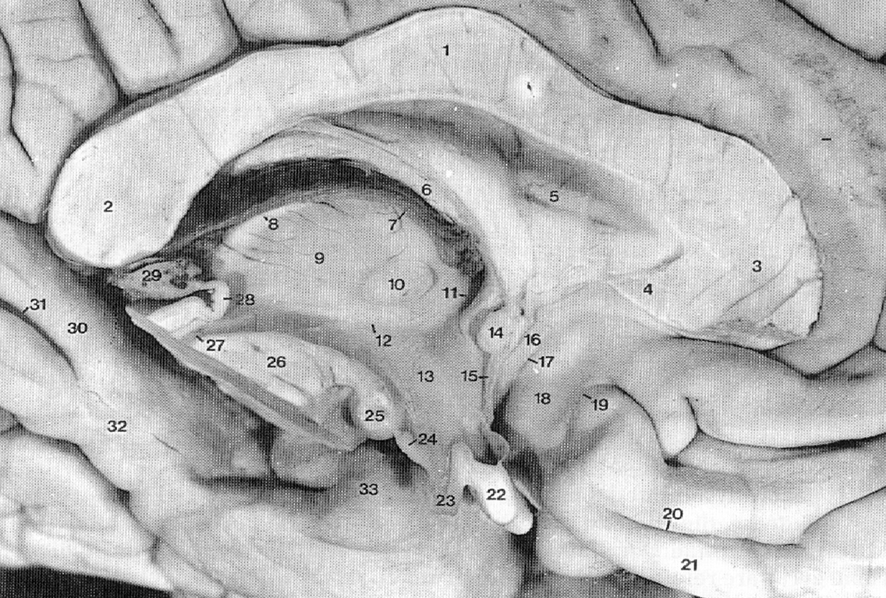
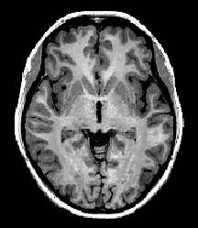
Rotate brain into ACPC plane
Corpus Callosum
Find anterior commisure (AC)
Find posterior commisure (PC)
Fornix
ACPC line
= horizontal axis
Note: official Tal says to use top of AC and bottom of PC but I suspect few people actually do this
Pineal Body
“bent asparagus”
Source: Duvernoy, 1999

Slide 7
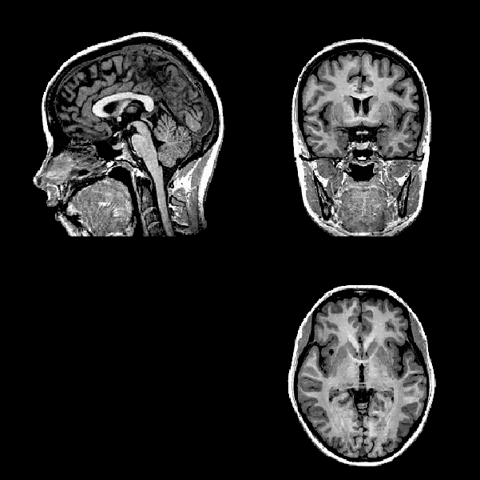
AC = Origin
x = 0
+
y = 0
z
z = 0
-
L
R
+
y
-
-
+
x

Slide 8
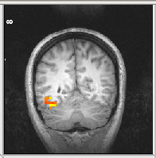
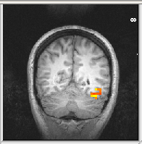
Left is what?!!!
Neurologic (i.e. sensible) convention
left is left, right is right
Note: Make sure you know what your magnet and software are doing before publishing left/right info!
L
R
-
+
x = 0
Radiologic (i.e. stupid) convention
left is right, right is left
R
L
+
-
x = 0

Slide 9
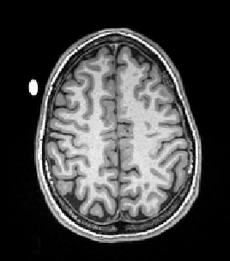
Pro Tip
Put a vitamin E capsule on the one side of the subject’s head or coil.

Slide 10
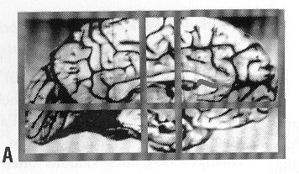
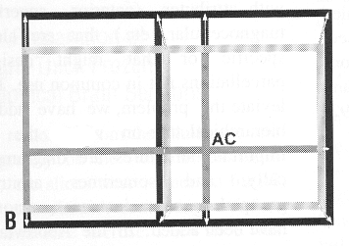
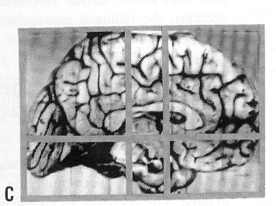
Deform brain into Talairach space
Mark 8 points in the brain:
anterior commisure
posterior commisure
front
back
top
bottom (of temporal lobe)
left
right
Squish or stretch brain to fit in “shoebox” of Tal system
z
y<0
AC=0
y>0
y
y>0
Extract 3 coordinates
ACPC=0
y<0
x (left < 0; right > 0)

Slide 11
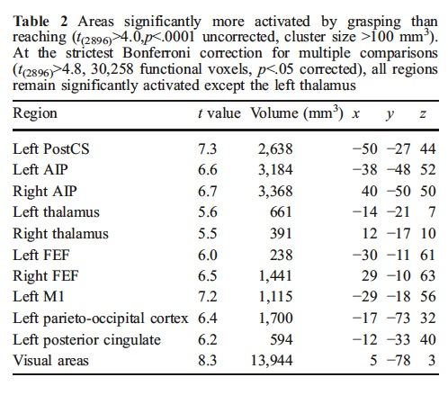
Coordinate Tables
Source: Culham et al., 2003, Exp. Brain Res.
Coordinates can be useful for other people to check whether their activation foci are similar to yours
Often it’s easiest to just put coordinates in a table to avoid cluttering text

Slide 12
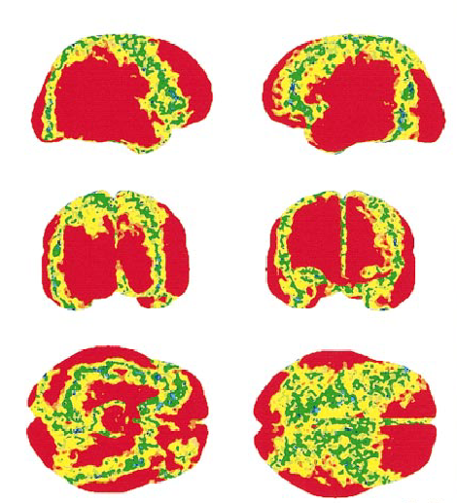
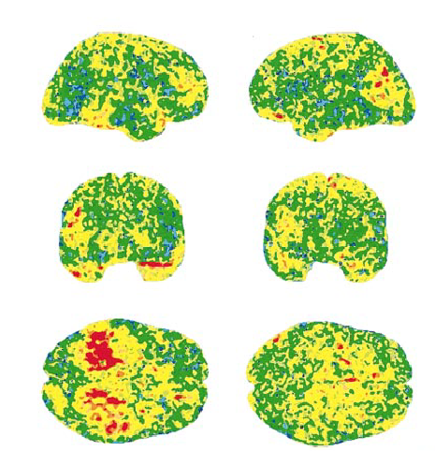
Do We need a “Tarailach Atras”?
Variability between Japanese
and European brains, both male
(red > yellow > green > blue)
Variability between male and female brains, both European
(red > yellow > green > blue)
Source: Zilles et al., 2001, NeuroImage

Slide 13
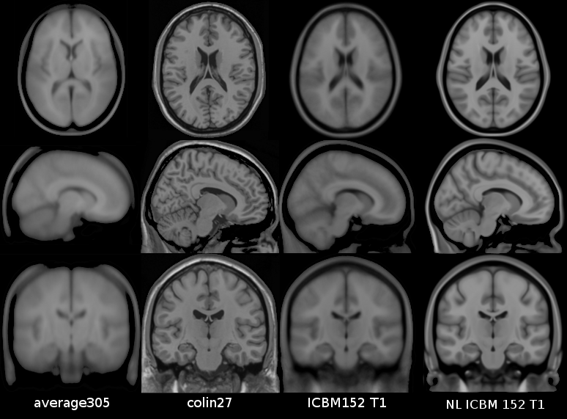
MNI Space
Researchers at the Montreal Neurological Institute (MNI) created a better template based on a morphed average of hundreds of brains
many different versions
http://en.wikibooks.org/wiki/MINC/Atlases/Atlases/History

Slide 14
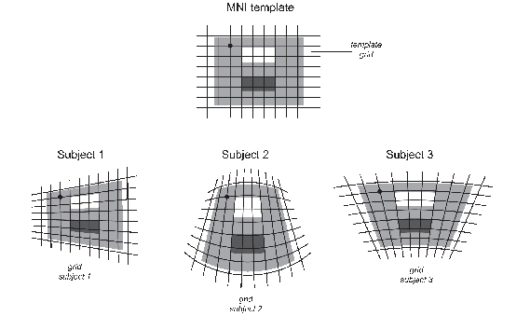
MNI Space
Benefits
MNI Space is based on many subjects not just one brain like Talairach space
MNI transformations use nonlinear warping, which leads to better intersubject alignment
Image Source

Slide 15
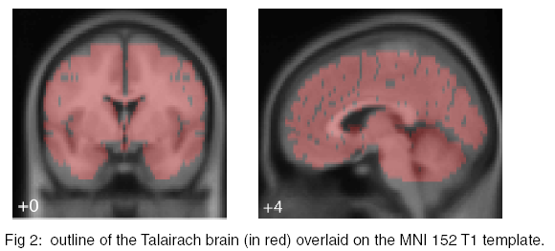
Converting Between MNI and Tal space
You many want to convert between the systems
Only Tal provides Brodmann’s areas
Need to convert for meta-analyses
The MNI and Talairach coordinates are similar but not identical
e.g., temporal lobes extend 10 mm lower in MNI brain
Caveat: careful comparison requires a transformation
-- converters can be found online http://www.brainmap.org/icbm2tal/
Source: http://www.mrc-cbu.cam.ac.uk/personal/matthew.brett/abstracts/MNITal/mniposter.pdf

Slide 16
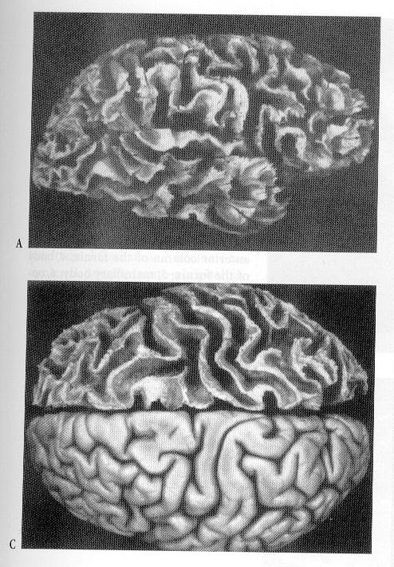
Anatomical Localization Sulci and Gyri
CROWN
gray matter
(dendrites &
synapses)
GYRUS
white matter
(axons)
pial surface
BANK
gray/white border
SULCUS
neuron
SULCUS
FISSURE
FUNDUS
GYRUS
Source: Ludwig & Klingler, 1956,
in Tamraz & Comair, 2000

Slide 17
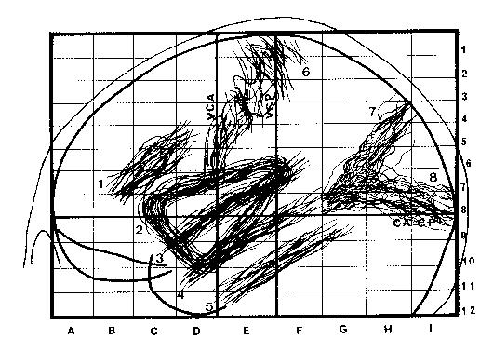
Variability of Sulci
Source: Szikla et al., 1977, in Tamraz & Comair, 2000

Slide 18
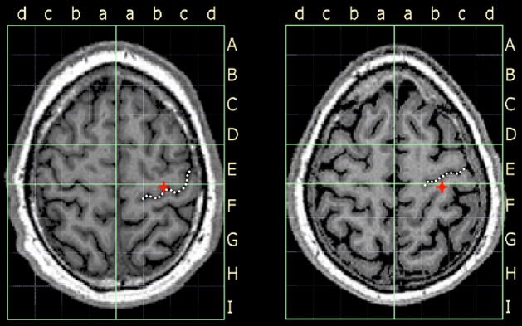
Effects of Sulcal Variability
Source: Frost & Goebel, 2012, NeuroImage

Slide 19
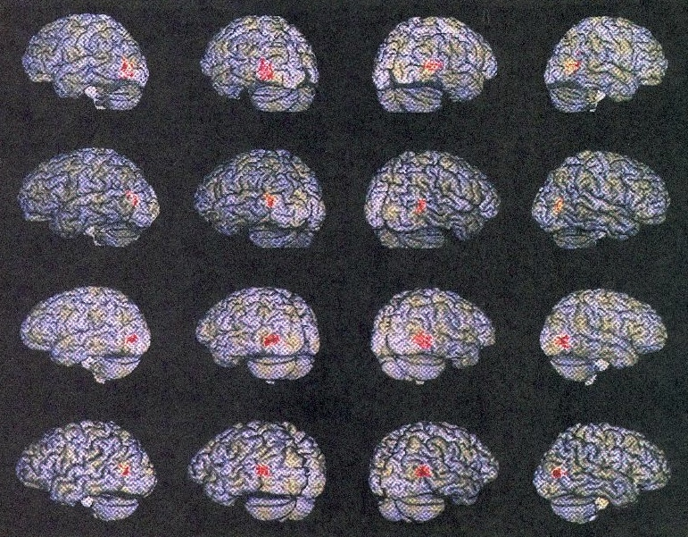
Variability of Functional Areas
Watson et al., 1995
- motion-selective area, MT+ (=V5) is quite variable in stereotaxic space
however, the area is quite consistent in its location relative to sulci
junction of inferior temporal sulcus and lateral occipital sulcus
see also Dumoulin et al., 2000

Slide 20
Cerebral cortex is a crumpled map

Slide 21
Cortical Surfaces
segment gray-white
matter boundary
render cortical surface
inflate cortical surface
sulci = concave = dark gray
gyri = convex = light gray

Slide 22
Cortical Inflation
Movie: unfoldorig.mpeg
http://cogsci.ucsd.edu/~sereno/unfoldorig.mpg
Source: Marty Sereno’s web page

Slide 23
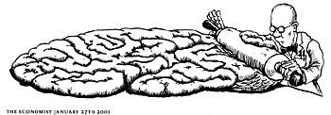
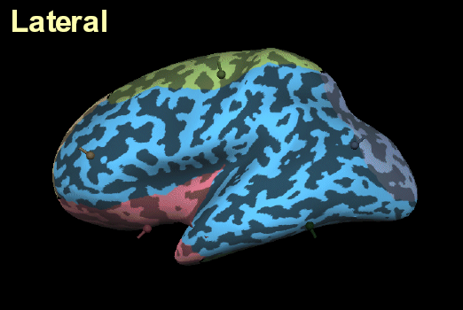
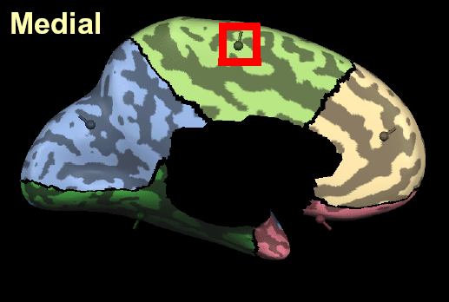
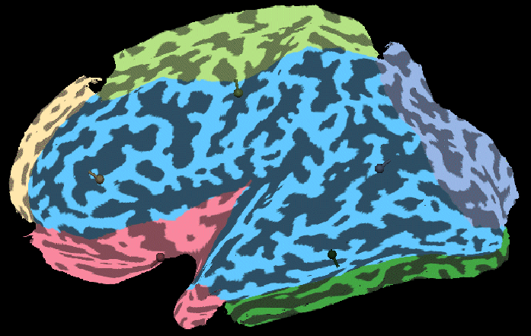
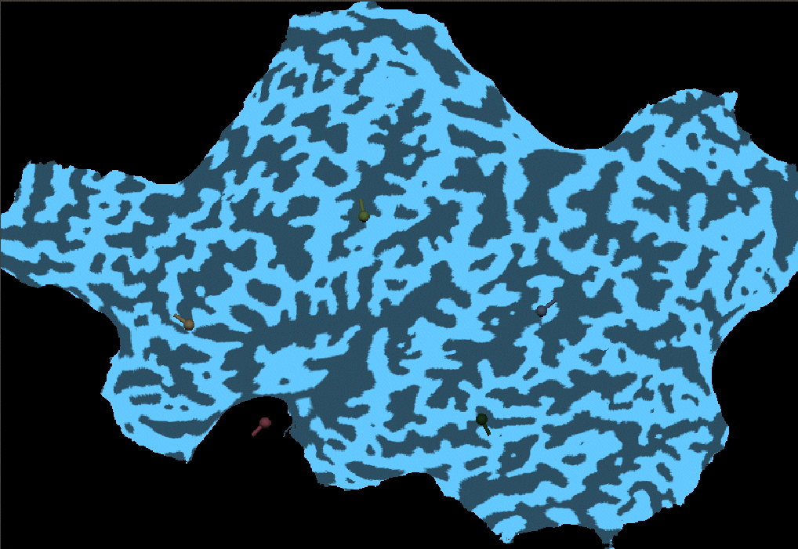
Cortical Flattening
2) make cuts along the medial surface
(Note, one cut typically goes along the fundus of the calcarine sulcus though in this example the cut was placed below)
1) inflate the brain
3) unfold the medial surface so the cortical surface lies flat
4) correct for the distortions so that the true cortical distances are preseved
Source: Brain Voyager Getting Started Guide

Slide 24
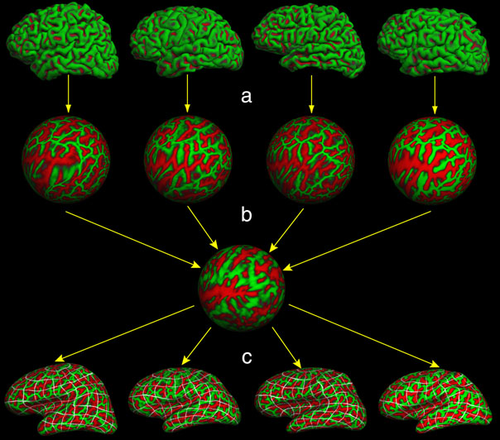
Spherical Averaging
Future directions of fMRI: Use cortical surface mapping coordinates
Inflate the brain into a sphere
Use sulci and/or functional areas to match subject’s data to template
Cite “latitude” & “longitude” of spherical coordinates
Source: Fischl et al., 1999

Slide 25
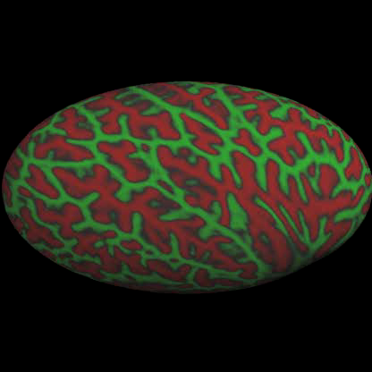
Spherical Averaging
Movie: brain2ellipse.mpeg
http://cogsci.ucsd.edu/~sereno/coord1.mpg
Source: Marty Sereno’s web page
Movie: morph-curv1.mpg
http://www.cogsci.ucsd.edu/~sereno/morph-curv1.mpg
Source: Marty Sereno’s web page
Source: Fischl et al., 1999

Slide 26
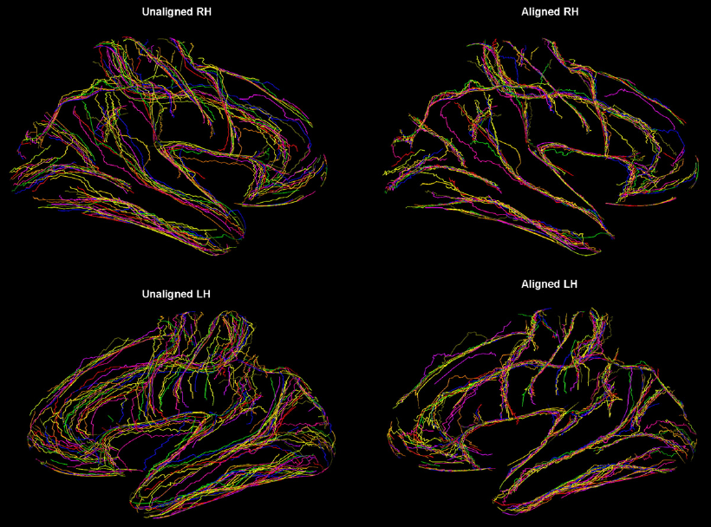
Before and After CBA
Source: Frost & Goebel, 2012, NeuroImage

Slide 27
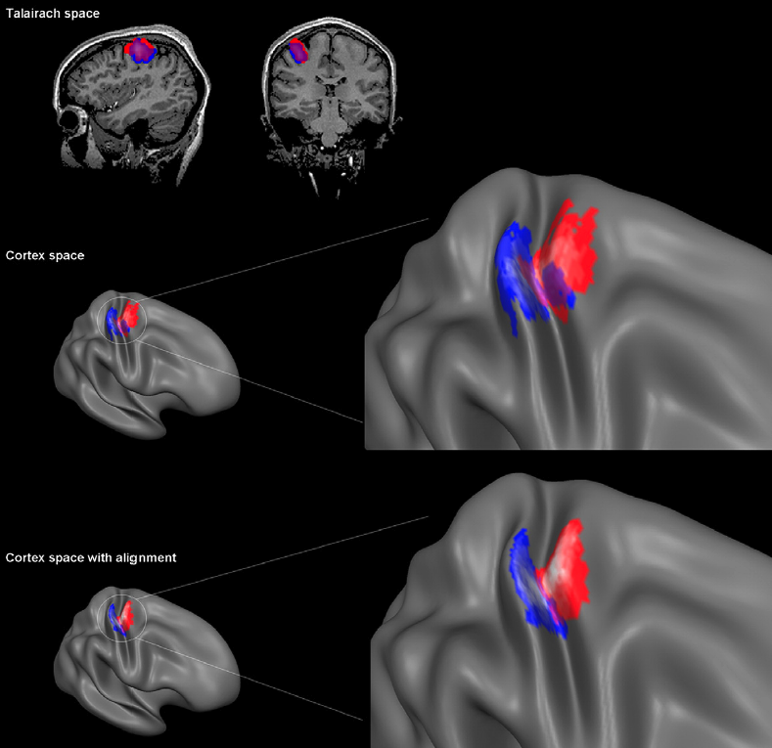
Before and After CBA
hand motor area (M1)
hand somatosensory area (S1)
Source: Frost & Goebel, 2012, NeuroImage

Slide 28
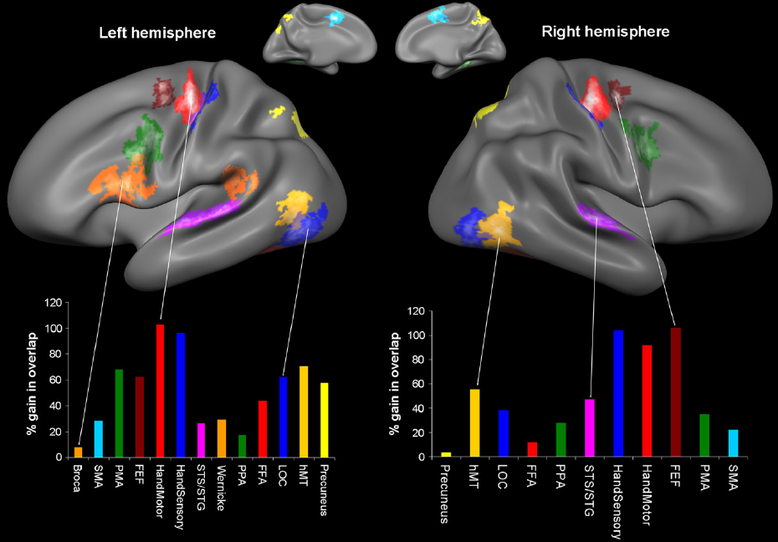
Gains in Overlap
Source: Frost & Goebel, 2012, NeuroImage

