Slide 1
Preprocessing

Slide 2
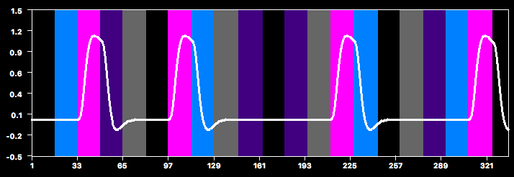
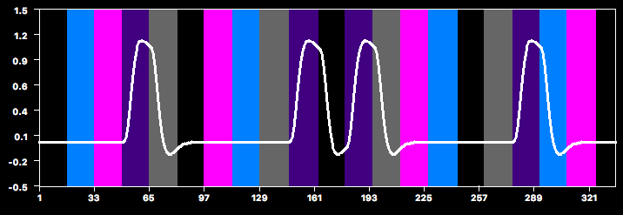
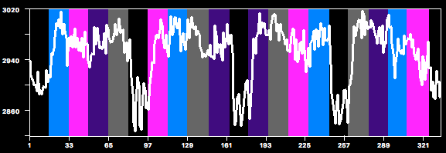
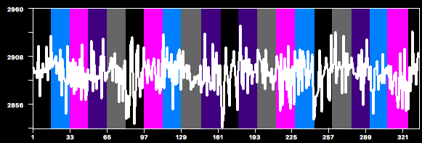
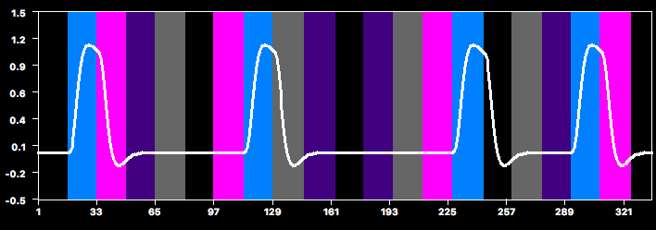
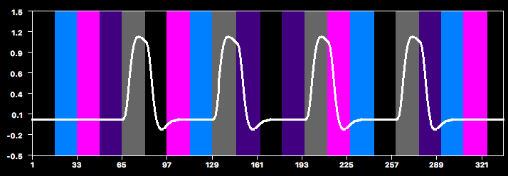
Example: GLM with 4 predictors
x β_{Faces}
+
x β_{Hands}
=
+
+
x β_{Bodies}
+
x β_{Scram}
fMRI Signal
=
Design Matrix
x
+
Betas
Residuals
“what we CAN explain”
“how much of it we CAN explain”
“what we CANNOT explain”
“our data”
=
x
+
Statistical significance is basically a ratio of explained to unexplained variance

Slide 3
So how can we improve our statistics?
Increase signal
slice scan time correction
spatial smoothing
Decrease residuals (noise)
spatial smoothing
motion correction
high-pass temporal filtering
Moving variance from unexplained (noise) to explained
predictors of no interest
motion parameters
signals from noisy areas (e.g., white matter)

Slide 4
Two Stages
Preprocessing of data before running GLM
Include PONIs in GLM

Slide 5
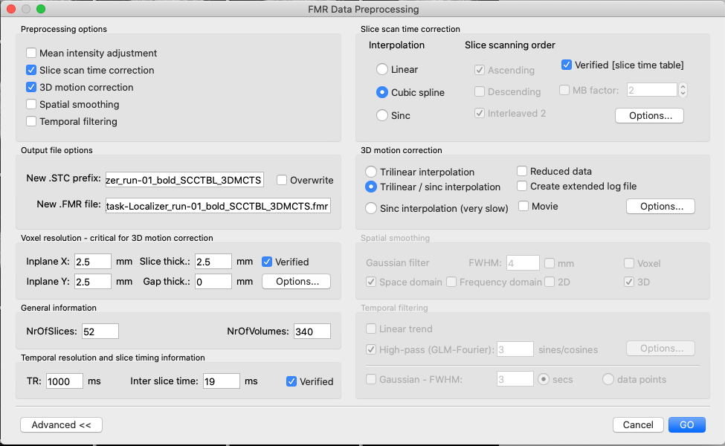
fMR Preprocessing

Slide 6
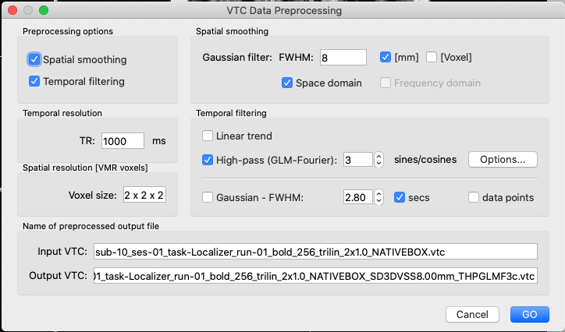
VTC Preprocessing

Slide 7
Increasing Signal
Slice Scan-time Correction

Slide 8
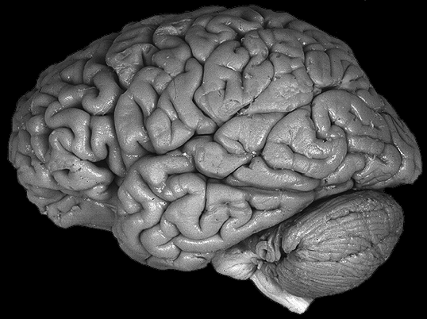
Slice Order
Non-
Interleaved;
Descending
If TR = 2, the first slice is collected almost a full TR (e.g., 2 s) before the last slice
Problem with non-interleaved slices:
excitation of one slice may carry over to next slice

Slide 9
Slice Order
Interleaved;
Descending
If TR = 2, the first yellow slice is collected almost a full TR (e.g., 2 s) before the last pink slice

Slide 10
Slice Order
Multiband Imaging
Collects multiple slices simultaneously
e.g., multiband 4 collects 4 slices at a time
allows you to sample the whole brain in a short TR
If TR = 1, the red slices are collected almost a full TR (e.g., 1 s) before the purple slices

Slide 11
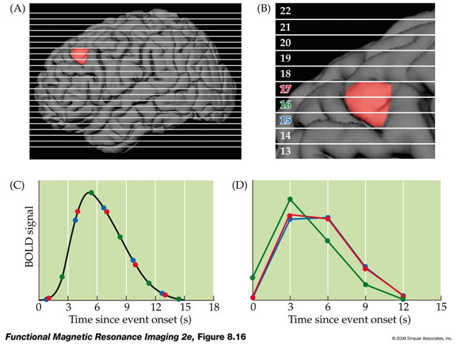
Slice Scan Time Correction

Slide 12
Slice Scan Time Correction
interpolates the data from each slice such that is is as if each slice had been acquired at the same time
Source: Brain Voyager documentation

Slide 13
SSTC: Not So Clear Cut
SSTC interacts with motion correction
Interpolation → motion affects multiple volumes instead of just one
Now that functional data is collected more rapidly (due to multiband imaging… stay tuned), we can collect whole-brain volumes with TR = 1 s
Nevertheless, BrainVoyager recommends applying SSTC

Slide 14
Increasing Signal; Decreasing Noise
Spatial Smoothing

Slide 15
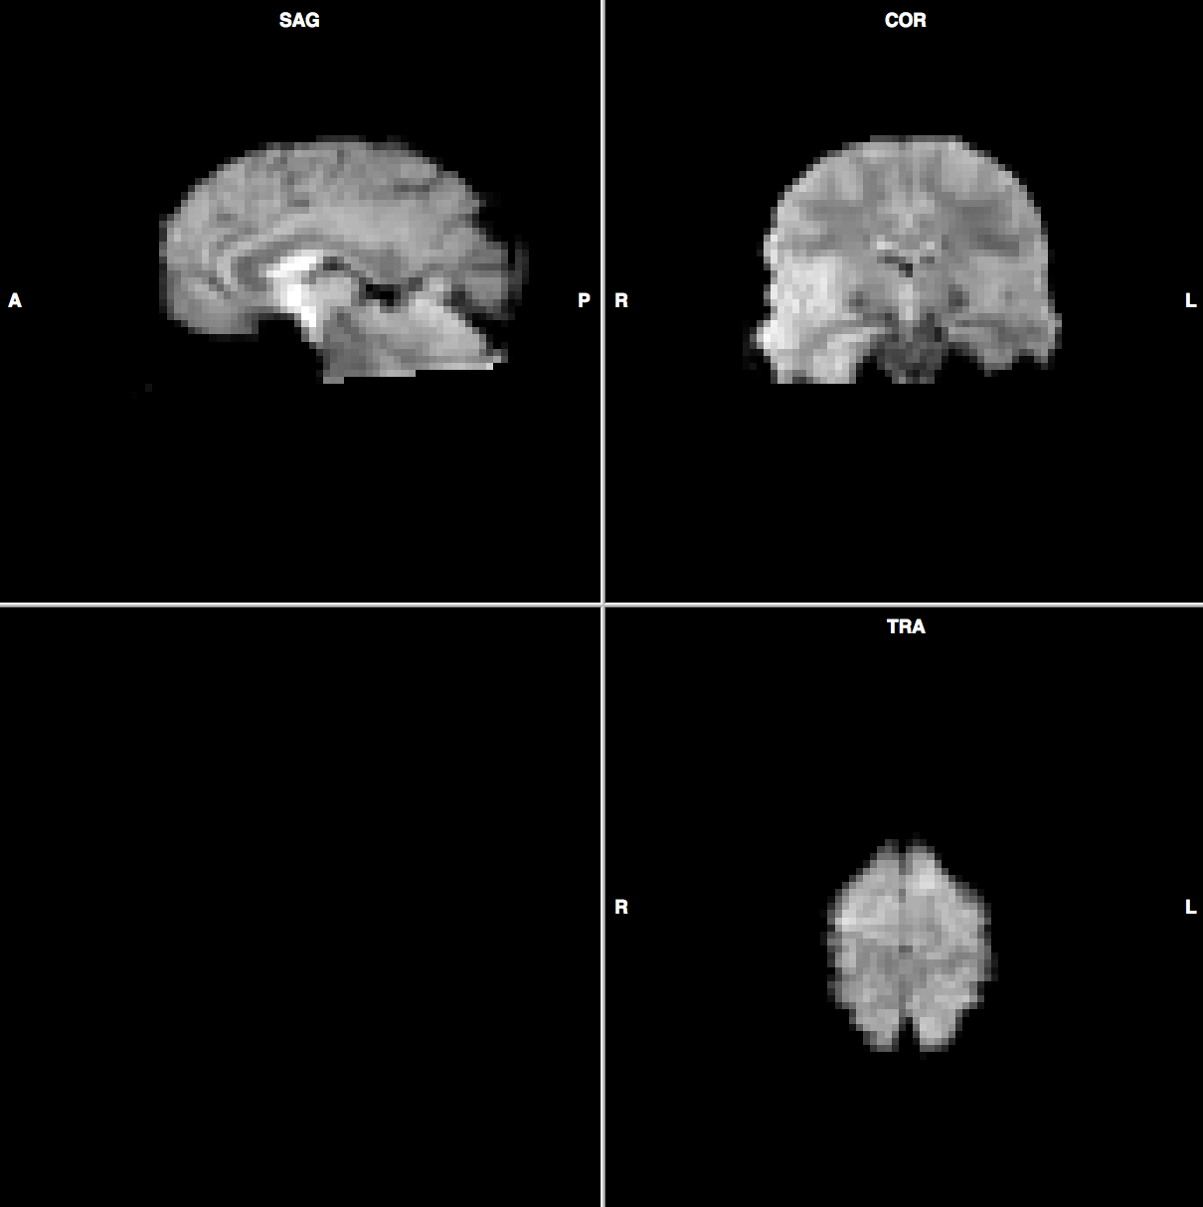
3D (No interpolation)

Slide 16
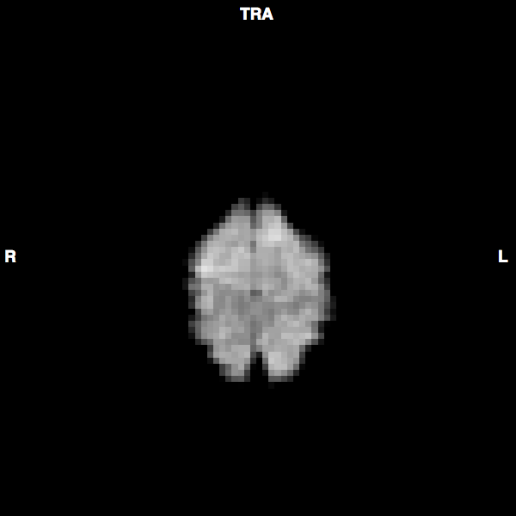
2D (No interpolation)

Slide 17
1D (No interpolation)

Slide 18
1D (No interpolation)
0 | 0 | 0 | 53 | 53 | 53 | 128 | 128 | 128 | 155 | 155 | 155 | 164 | 164 | 164 | 128 | 128 | 128 | 155 | 155 | 155 | 164 | 164 | 164 | 128 | 128 | 128 | 127 | 127 | 127 | 139 | 139 | 139 | 123 | 123 | 123
3-mm functional voxels shown at 1-mm resolution

Slide 19
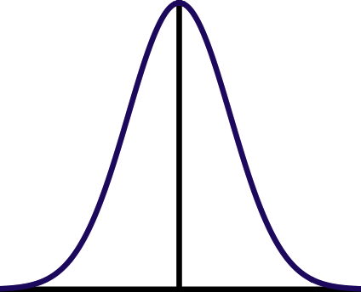
Spatial Smoothing
Gaussian kernel
smooth each voxel by a Gaussian or normal function, such that the nearest neighboring voxels have the strongest weighting
Maximum
Half-Maximum
Full Width at Half-Maximum
(FWHM)
-8
-7
-6
-5
-4
-3
-2
-1
0
1
2
3
4
5
6
7
8
FWHM = 6

Slide 20
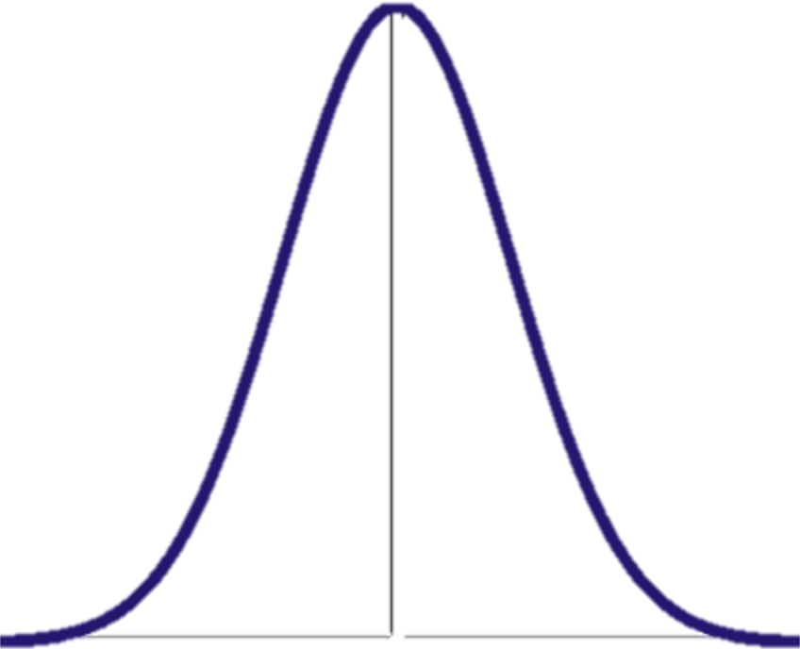
Gaussian Smoothing (4-mm) FWHM on One Voxel
0 | 0 | 0 | 53 | 53 | 53 | 128 | 128 | 128 | 155 | 155 | 155 | 164 | 164 | 164 | 128 | 128 | 128 | 155 | 155 | 155 | 164 | 164 | 164 | 128 | 128 | 128 | 127 | 127 | 127 | 139 | 139 | 139 | 123 | 123 | 123
Smoothed V₁₄ ~= 0.1xV₁₁ + 0.3xV₁₂ + 0.75xV₁₃ + 1xV₁₄ + 0.75xV₁₅ + 0.3xV₁₆ + 0.1xV₁₇
0.1 + 0.3 + 0.75 + 1 + 0.75 + 0.3 + 0.1

Slide 21
Repeat for every voxel…
0 | 0 | 0 | 53 | 53 | 53 | 128 | 128 | 128 | 155 | 155 | 155 | 164 | 164 | 164 | 128 | 128 | 128 | 155 | 155 | 155 | 164 | 164 | 164 | 128 | 128 | 128 | 127 | 127 | 127 | 139 | 139 | 139 | 123 | 123 | 123

Slide 22
Effect of Smoothing
pre-smoothing
post-smooothing (4-mm FWHM)

Slide 23
Gaussian Smoothing (8-mm) FWHM on One Voxel
0 | 0 | 0 | 53 | 53 | 53 | 128 | 128 | 128 | 155 | 155 | 155 | 164 | 164 | 164 | 128 | 128 | 128 | 155 | 155 | 155 | 164 | 164 | 164 | 128 | 128 | 128 | 127 | 127 | 127 | 139 | 139 | 139 | 123 | 123 | 123
Now voxels within +/- 8 mm have an effect

Slide 24
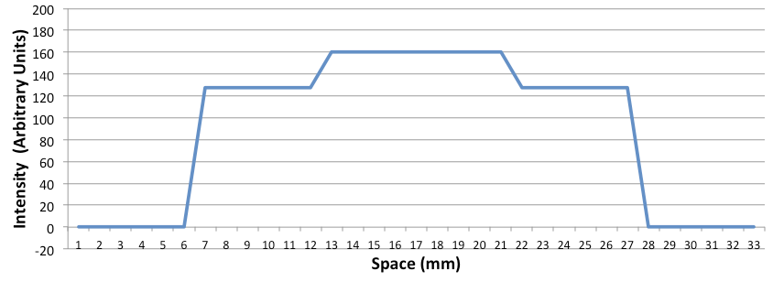
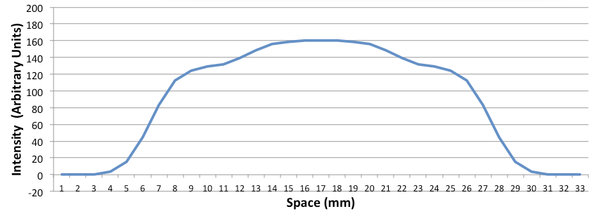
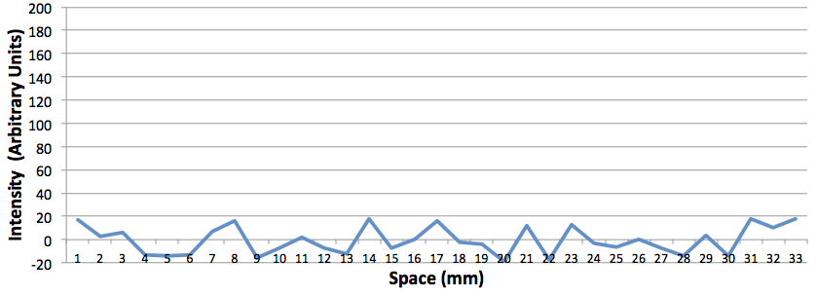
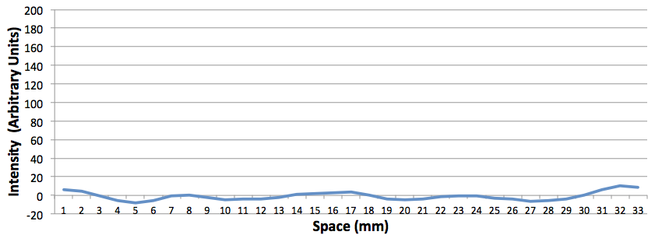
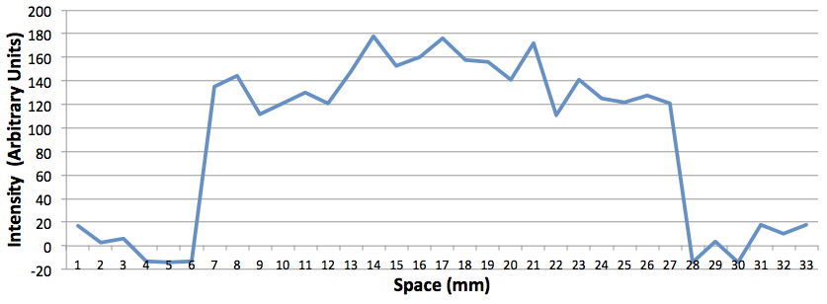
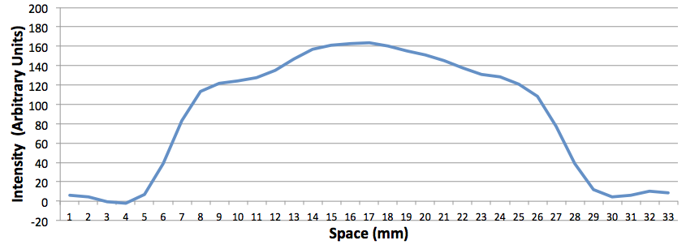
Why Smooth?
Signal
Smoothed Signal
outside
brain
gray
matter
white
matter
gray
matter
outside
brain
Noise
Smoothed Noise
(Signal + Noise)
Smoothed (Signal + Noise)
Signal sums
Random noise cancels

Slide 25
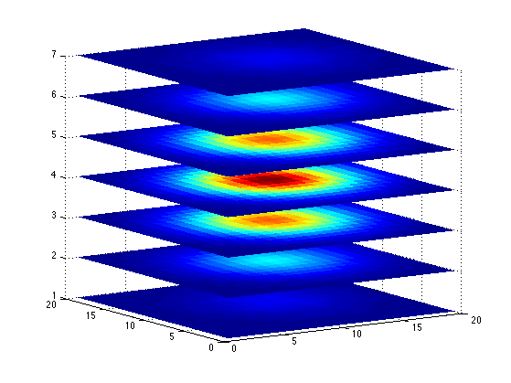
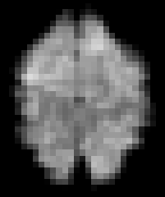
1D - 2D – 3D Gaussians

Slide 26
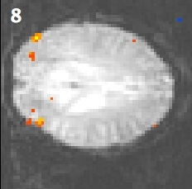
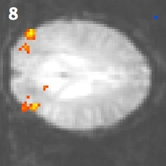
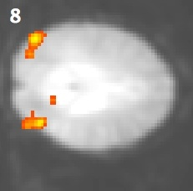
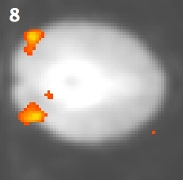
Effects of Spatial Smoothing on Activity
No smoothing
4-mm FWHM
7-mm FWHM
10-mm FWHM
Notes:
LO Localizer, 1 run, mt.10_06_03_10_MAG_THPGLMF2c_SD3DSSXXXXXmm.fmr, Intact > Scrambled, t>3.5

Slide 27
Should you spatially smooth?
Advantages
Increases Signal to Noise Ratio (SNR)
Matched Filter Theorem: Maximum increase in SNR by filter with same shape/size as signal
Reduces number of comparisons
Allows application of Gaussian Field Theory
May improve comparisons across subjects
Signal may be spread widely across cortex, due to intersubject variability
Disadvantages
Reduces spatial resolution
Challenging to smooth accurately if size/shape of signal is not known
“Why would you spend $4 million to buy an MRI scanner and then blur the data till it looked like PET?”
-- Ravi Menon
Slide from Duke course

Slide 28
Decreasing Noise
Temporal Filtering

Slide 29
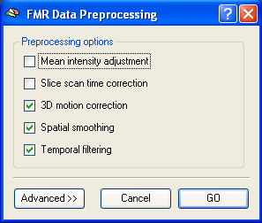
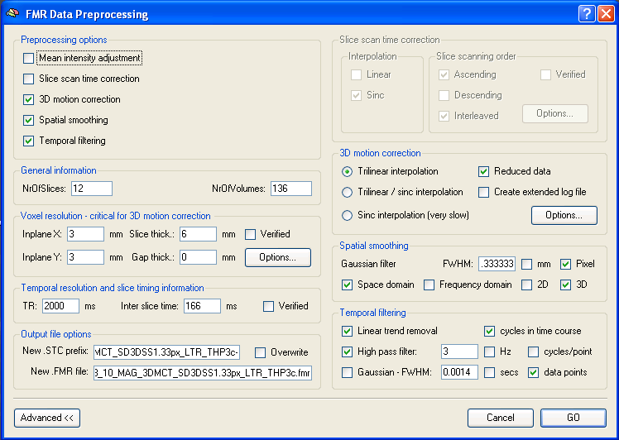
BV Preprocessing Options

Slide 30
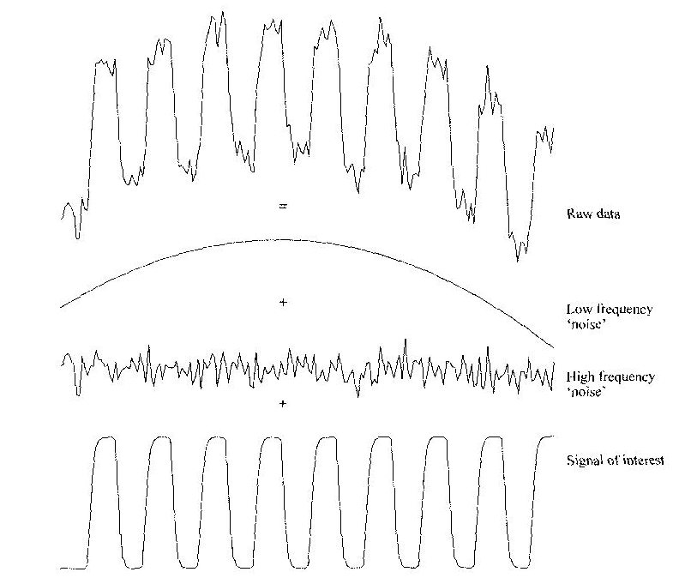
Components of Time Course Data
Source: Smith chapter in Functional MRI: An Introduction to Methods

Slide 31
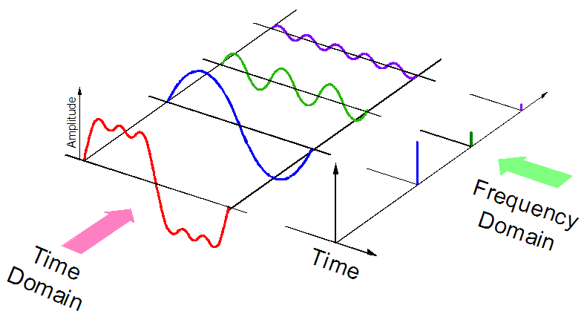
Fourier Analysis
Any waveform (like a time series) can be composed into a series of sine waves (each with a frequency and an amplitude). These sine waves can be plotted with amplitude as a function of frequency.

Slide 32
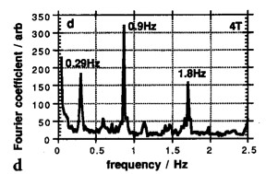
Fourier Spectrum for Data at Rest
Even in a “resting state scan” (i.e., when subject isn’t doing a task), certain frequencies are present
Respiration
every 4-10 sec (0.3 Hz)
moving chest distorts susceptibility
Cardiac Cycle
every ~1 sec (0.9 Hz)
pulsing motion, blood changes
Solutions
gating
avoiding paradigms at those frequencies

Slide 33
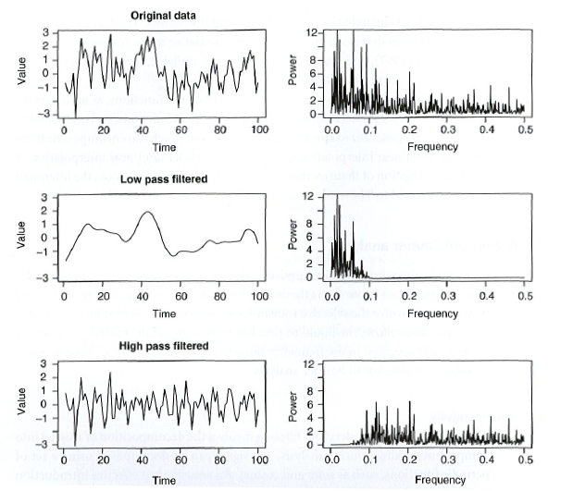
“Low-Pass” vs. “High-Pass”
Low-pass
pass the low frequencies through the filter
remove the high frequencies
you could also call this temporal smoothing
High-pass
pass the high frequencies through the filter
remove the low frequencies

Slide 34
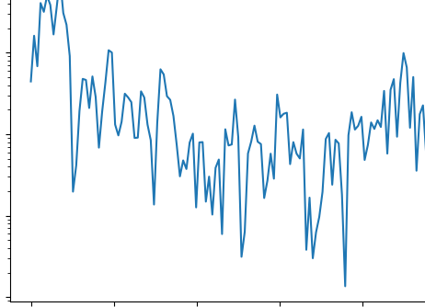
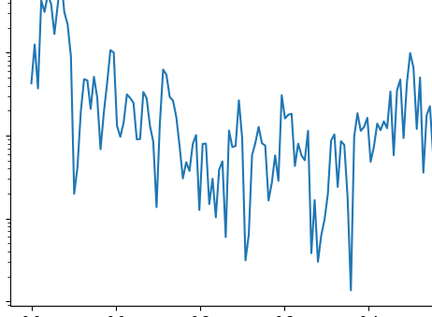
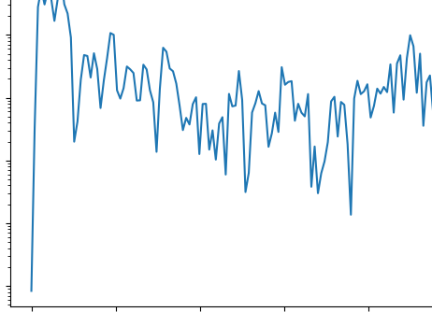
Temporal Filtering You Should Usually Do: LTR + High-Pass
Raw
Power
Frequency (Hz)
LTR
(linear trend removal)
Power
Frequency (Hz)
LTR
+
THP3c
(temporal high-pass 3 cycles/run)
Power
Frequency (Hz)

Slide 35
Temporal Filtering You Should Usually Do: LTR + High-Pass
Raw
Power
Frequency (Hz)

Slide 36
Temporal Filtering You Should Usually Do: LTR + High-Pass
Raw
Power
Frequency (Hz)
LTR
(linear trend removal)
Power
Frequency (Hz)

Slide 37
Temporal Filtering You Should Usually Do: LTR + High-Pass
Raw
Power
Frequency (Hz)
Block
Pass
LTR
(linear trend removal)
Power
Frequency (Hz)
there’s still low-frequency noise in the signal
e.g., frequencies below 3 cycles/run
… like 2 cycles/run
… or 1 cycle/run
… and other frequencies
we can remove these low frequencies from the signal
we want to stop the low frequencies from passing through our filter but let the high frequencies pass
∴ the filter we use is called a high-pass filter
cutoff = 0.009 Hz
3 cycles/run
= 3 cycles/340 s
= 0.009 cycles/s
= 0.009 Hz

Slide 38
Temporal Filtering You Should Usually Do: LTR + High-Pass
Raw
Power
Frequency (Hz)
Block
Pass
LTR
(linear trend removal)
Power
Frequency (Hz)
Block
Pass
LTR
+
THP3c
(temporal high-pass 3 cycles/run)
Power
Frequency (Hz)

Slide 39
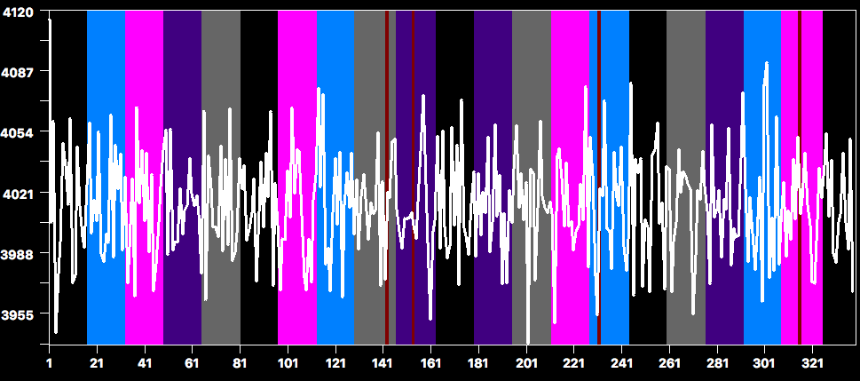
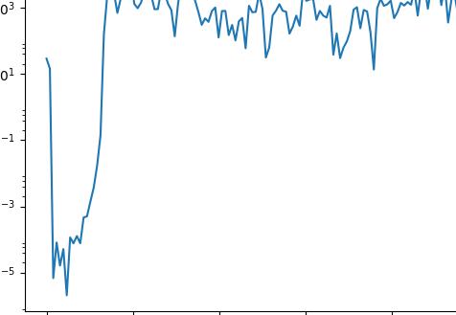
Temporal Filtering You Should Not Do: Aggressive High-Pass
Raw
Power
Frequency (Hz)
LTR
+
THP3c
(temporal high-pass 3 cycles/run
= .009 Hz)
Block
Pass
Power
Frequency (Hz)
WTF Happened?!
Block
Pass
LTR
+
THP24c
(temporal high-pass 24 cycles/run
= ? Hz)
Power
Frequency (Hz)

Slide 40
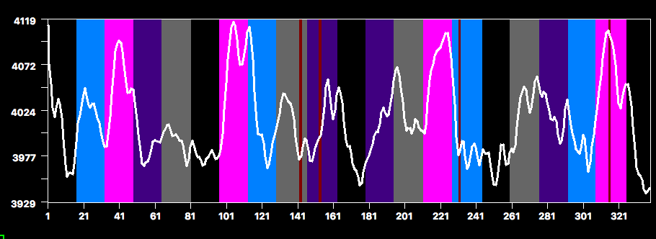
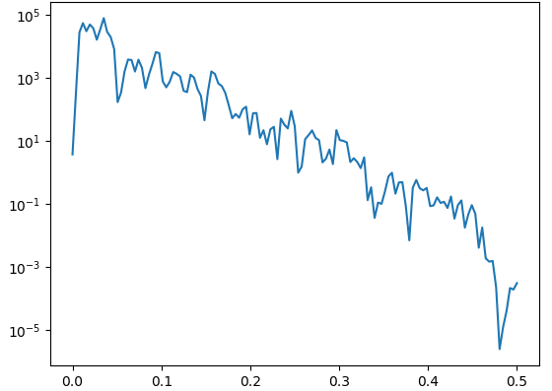
Low-Pass Filtering: Looks great but causes violations of statistical assumptions regarding autocorrelation
LTR
+
THP3c
(temporal high-pass 3 cycles/run
= .009 Hz)
Block
Pass
Power
Frequency (Hz)
LTR
+
THP3c
(temporal high-pass 3 cycles/run)
+
TDTS2.8s
(Time-domain temporal smoothing
Gaussian FWHM 2.8 s)
Block
Pass
Temporal smoothing reduces high-frequency power
Power
Frequency (Hz)

Slide 41
Moving Variance from Noise to Signal
Predictors of No Interest

Slide 42
Predictors of No Interest
Often there is variance that is known but not particularly interesting
We can create predictors that account for this variance and thus remove it from the residuals
Common examples
regressors for experimental components
motor responses
instruction periods
error trials
regressors for known sources of noise
motion
respiratory/cardiac signals
unknown noise

Slide 43
PONIs are not a panacea
noise sources do not always match their measurements
e.g., motion can lead to transient effects
can include derivatives
PONIs utilize degrees of freedom and including too many reduces statistical power
If PONIs are correlated with predictors of interest (POIs), they can reduce the significance of the POIs
common problem with motion predictors
common problem with events that must occur in a particular order (e.g. delay paradigms)

Slide 44
Order of Preprocessing Steps is Important
Thought question: Why should you run motion correction before temporal preprocessing (e.g., linear trend removal)?
If you execute all the steps together, software like Brain Voyager will execute the steps in the appropriate order
Be careful if you decide to manually run the steps sequentially. Some steps should be done before others.

Slide 45
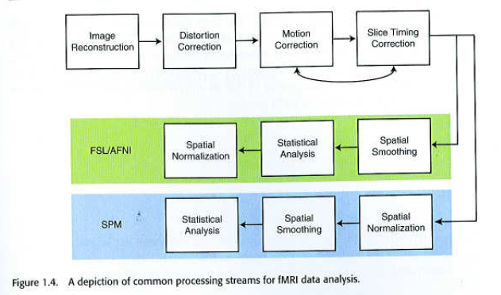
SSTC and 3DMC Interact

Slide 46
Take-Home Messages
Look at your data
Work with your physicist to minimize physical noise
Design your experiments to minimize physiological noise
Motion is the worst problem: When in doubt, throw it out
Preprocessing is not always a “one size fits all” exercise

