Slide 1
How to Think About Preprocessing and Modelling Confounds

Slide 2
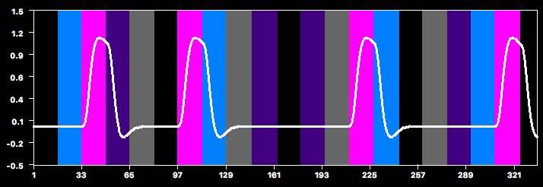
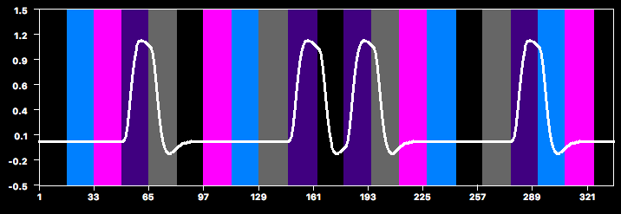
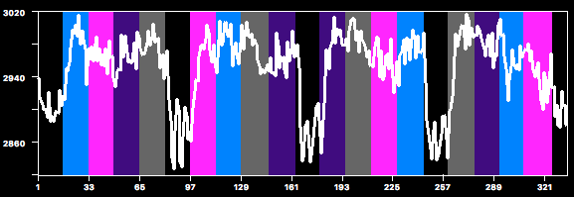
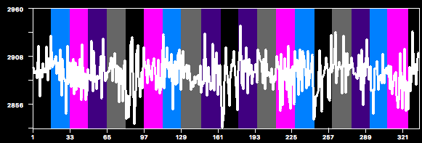
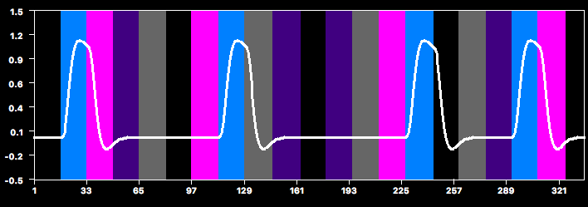
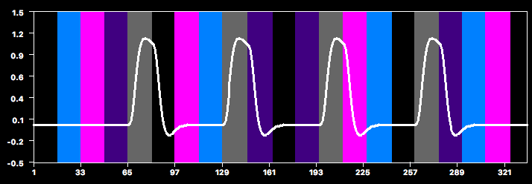
Example: GLM with 4 predictors
x β_{Faces}
+
x β_{Hands}
=
+
+
x β_{Bodies}
+
x β_{Scram}
fMRI Signal
=
Design Matrix
x
+
Betas
Residuals
“what we CAN explain”
“how much of it we CAN explain”
“what we CANNOT explain”
“our data”
=
x
+
Statistical significance is basically a ratio of explained to total (explained+unexplained) variance

Slide 3
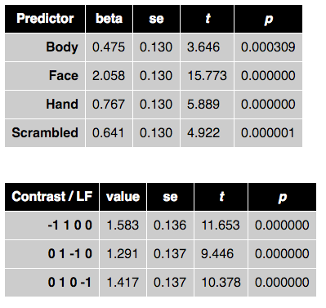
Is this Difference Significant?
se = noise estimate for contrast
t = signal/noise
=1.583/0.136
= 11.653
Look up t (df=340) = 11.653
→ p < .000001

Slide 4
No Spike vs. Spike
β-scaled predictor
data
β-scaled predictor
data

Slide 5
Residuals
β-scaled predictor
data
residuals
squared residuals

Slide 6
Spike!
β-scaled predictor
data
residuals
Because the error term is based on squared residuals, outliers have a disproportionalely large effect
squared residuals

Slide 7
SE increases with… (i.e., your stats get worse with…)
↑ residuals
↑ correlations between predictors
↓ degrees of freedom
↓ time points
usually we have a lot of time points though
↑ #predictors in model
formula for 2-predictor model

Slide 8
Example: GLM with 4 predictors
x β_{Faces}
+
x β_{Hands}
=
+
+
x β_{Bodies}
+
x β_{Scram}
fMRI Signal
=
Design Matrix
x
+
Betas
Residuals
“what we CAN explain”
“how much of it we CAN explain”
“what we CANNOT explain”
“our data”
=
x
+
Statistical significance is basically a ratio of explained to unexplained variance

Slide 9
So how can we improve our statistics?
Increase signal
slice scan time correction
spatial smoothing
Decrease residuals (noise)
spatial smoothing
motion correction
high-pass temporal filtering
Moving variance from unexplained (noise) to explained
predictors of no interest
motion parameters
signals from noisy areas (e.g., white matter)

Slide 10
Two Stages for Improvements
Preprocessing of data before running GLM
Include PONIs in GLM

Slide 11
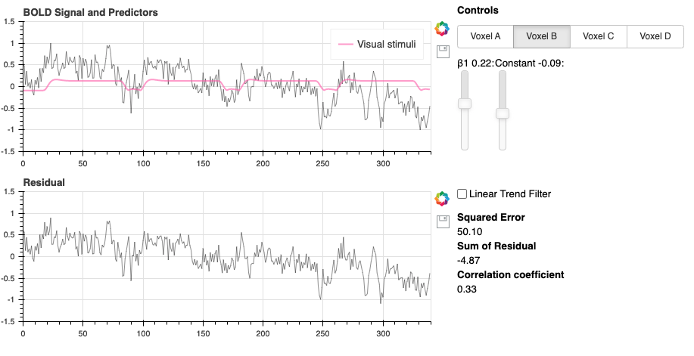
Known sources of noise Example: Linear Drift
Tutorial 2, Widget 2, Voxel B

Slide 12
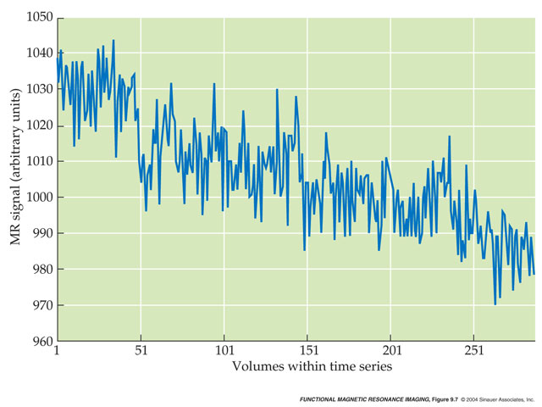
Linear Drift
activation levels can increase or decrease ~linearly based on several factors
as the scanner “warms up” there can be gradual changes in signal
as a participant lies in the scanner, they may gradually relax or sink into the foam surrounding the head

Slide 13
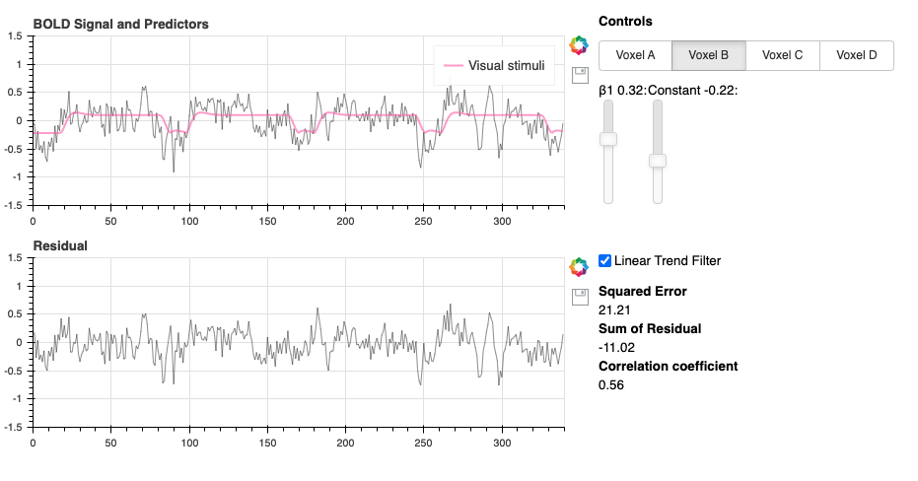
Two ways to deal with linear drift
Filter it out of the data
Tutorial 2, Widget 2, Voxel B

Slide 14
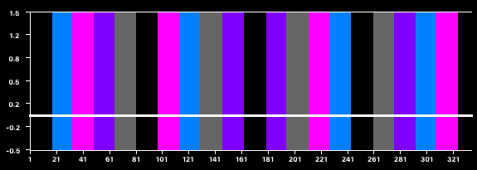
Two ways to deal with linear drift
Add a linear predictor to soak up variance
POI
PONI

Slide 15
Head Motion: Main Artifacts
Head motion leads to spurious activation
most noticeable at edges
Regions of interest shift over time
Motion of head (or any other large mass) leads to changes to field map

Slide 16
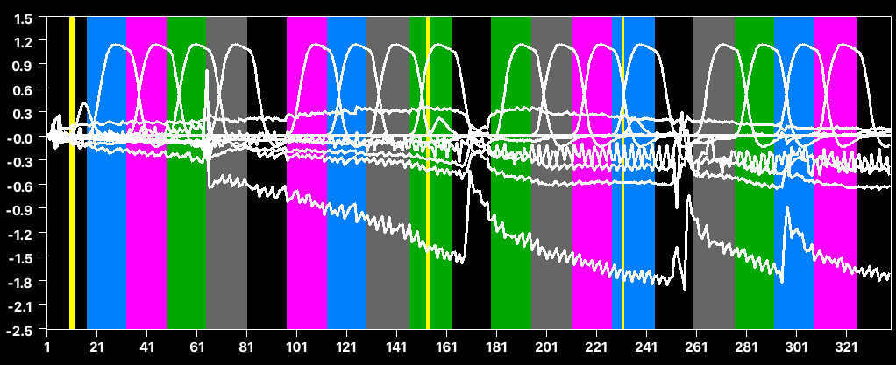
Including Motion Regressors
Model
4 POIs (Body, Face, Hand, Scram)
6 PONIs (x, y, z, roll, pitch, yaw)
1 constant

Slide 17
Pros and Cons of Motion Regressors
If motion artifacts are not correlated with your paradigm and thus with your POIs, then motion PONIs improve the data
If motion artifacts are correlated with your paradigm, then including motion PONIs can “steal” part of the ”activation”
Generally, including motion PONIs is recommended

