Slide 1
Motion Artifacts

Slide 2
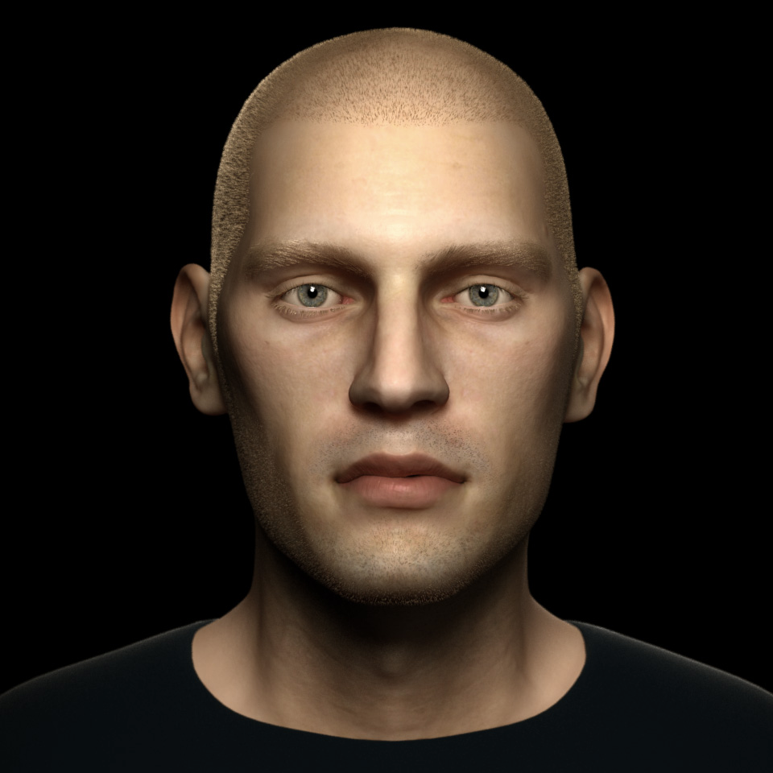
What’s the most common source of physiological noise?

Slide 3
Head Motion: Main Artifacts
  Head motion leads to spurious activation
    most noticeable at edges
  Regions of interest shift over time
  Motion of head (or any other large mass) leads to changes to field map

Slide 4
Head Motion: Main Artifacts
  Head motion leads to spurious activation
    most noticeable at edges
  Regions of interest shift over time
  Motion of head (or any other large mass) leads to changes to field map

Slide 5
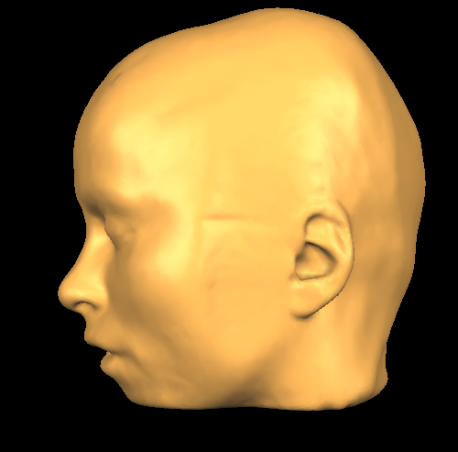
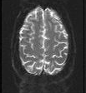

Motion Artifacts: z direction
Time1
Time2

Slide 6
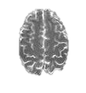

Motion Artifacts: z direction
Time1
Time2

Slide 7
Motion Artifacts: z direction
Time1
Time2

Slide 8

Motion Artifacts: z direction
Time1
Time2
Time1
-
Time2

Slide 9


Motion Artifacts: y direction
Time1
Time2
Time1
-
Time2

Slide 10
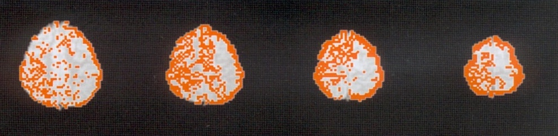
Spurious Activation at Edges

Slide 11
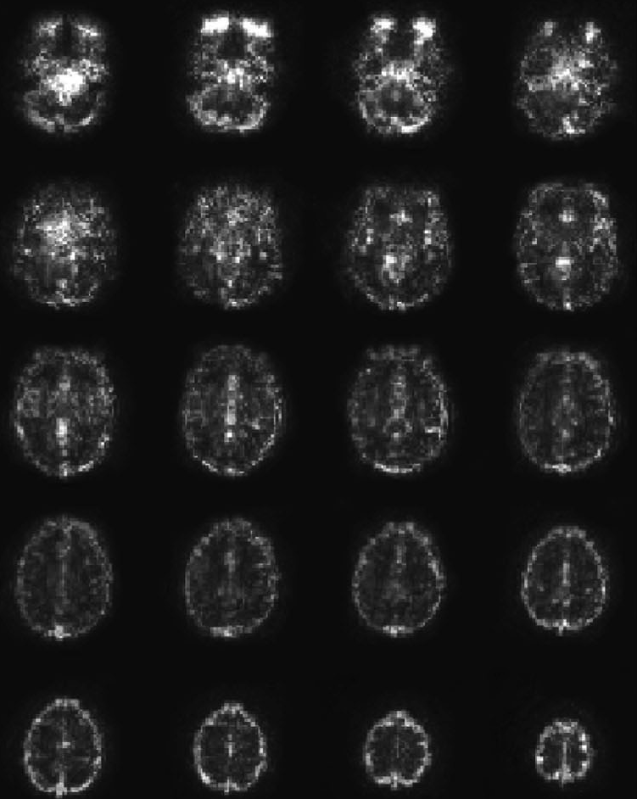
A Map of Noise
Huettel, Song & McCarthy, 2004, Functional Magnetic Resonance Imaging
voxels with high variability shown in white

Slide 12
Head Motion: Main Artifacts
  Head motion leads to spurious activation
    most noticeable at edges
  Regions of interest shift over time
  Motion of head (or any other large mass) leads to changes to field map
Time1
Time2

Slide 13
Motion Correction

Slide 14
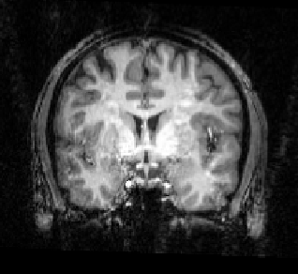
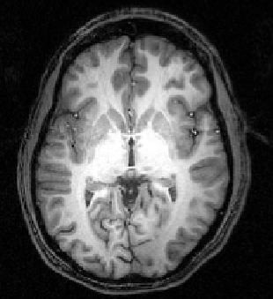
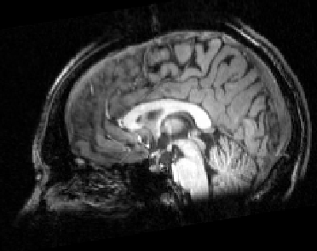
Motion Correction Algorithms
pitch
roll
yaw
z translation
y translation
x translation
Most algorithms assume a rigid body (i.e., that brain doesn’t deform with movement)
Align each volume of the brain to a target volume using six parameters: three translations and three rotations
Target volume: the functional volume that is closest in time to the anatomical image

Slide 15
Reference Volume
After motion correction, you want all of your data aligned to a functional reference volume and aligned to the anatomical scan
Strategy 1
  align each volume of each run to one reference volume (ideally the one that was collected closest in time to the anatomical scan)
Anat
R1V1
R1V2
R1V3
R1V4
R2V1
R2V2
R2V3
R2V4
Strategy 2
  align each volume of each run to one reference volume (ideally the one that was collected closest in time to the anatomical scan
Anat
R1V1
R1V2
R1V3
R1V4
R2V1
R2V2
R2V3
R2V4

Slide 16
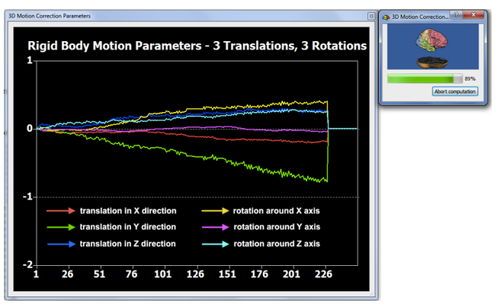
Motion Correction During Single Run

Slide 17
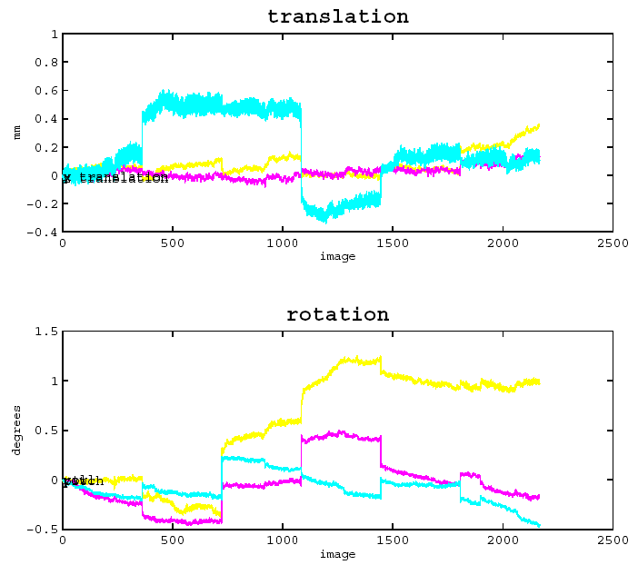
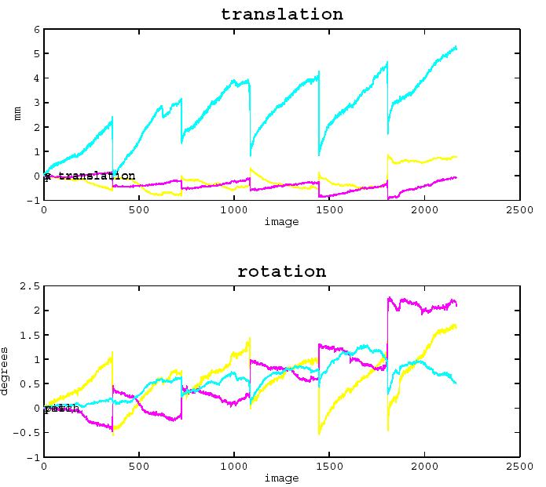
Head Motion: Good, Bad,…
run 1
run 2
run 3
run 4
run 5
run 6
Slide from Duke course

Slide 18
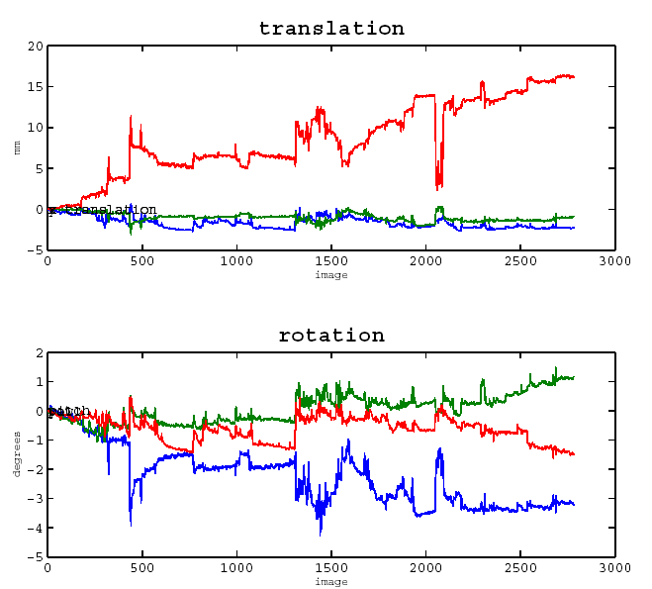
… and really, really ugly!
Slide from Duke course

Slide 19
Head Motion: Main Artifacts
  Head motion leads to spurious activation
    most noticeable at edges
  Regions of interest shift over time
  Motion of head (or any other large mass) leads to signal distortions

Slide 20
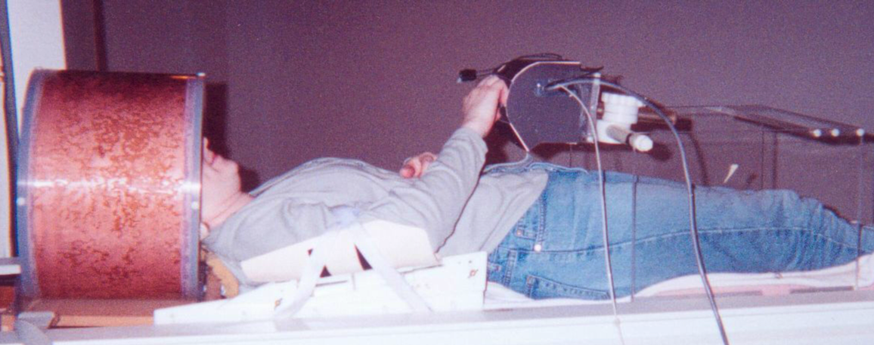
Mass Motion Artifacts
motion of any mass in the magnetic field, including the head, is a problem
grasparatus
gaze
head
coil
brace
arm brace

Slide 21
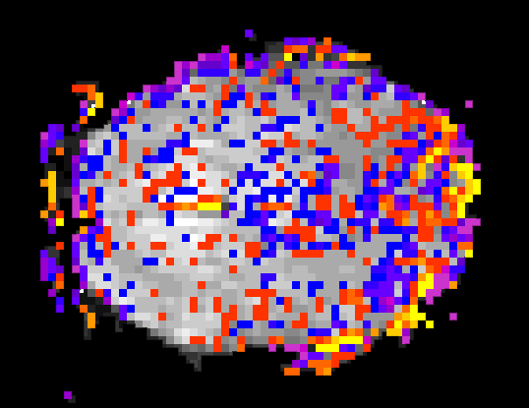

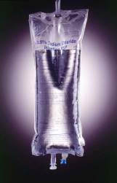


Mass Motion Artifacts
Grasping and reaching data from block designs
circa 1998
Even in the absence of head motion, mass motion creates huge problems
1.0
phantom
(fluid-filled
sphere)
Where is the signal correlated with the mass position?
.60
-.60
30 s
30 s
-1.0
r value
Time Course:
Motion Correction Parameters
7
Left
Right
Left
Right
Left
0.6
900
% Signal Change
Motion Detected (mm or degrees)
0
0
-4
0
0
0
30
60
90
120
150
-0.4
Time (seconds)
0
30
60
90
120
150
Time (seconds)
Culham, chapter in Cabeza & Kingstone, Handbook of Functional Neuroimaging of Cognition (2nd ed.), 2006

Slide 22
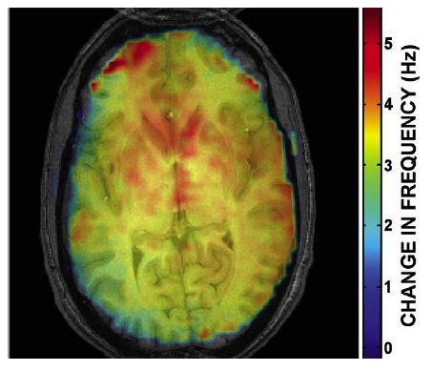
Mass Motion Distort Magnetic Field
Barry et al., 2009, Magnetic Resonance Imaging

Slide 23
Motion Correction Algorithms
Existing algorithms correct two of our three problems:
  Head motion leads to spurious activation
  Regions of interest move over time
  Motion of head (or any other large mass) leads to changes to field map
Sometimes algorithms can introduce artifacts that weren’t there in the first place (Friere & Mangin, 2001, NeuroImage)
√
√
X

Slide 24

The Fridge Rule
When it doubt, throw it out!

Slide 25
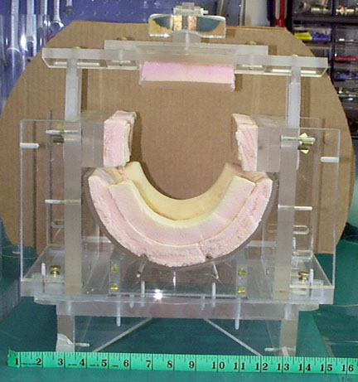
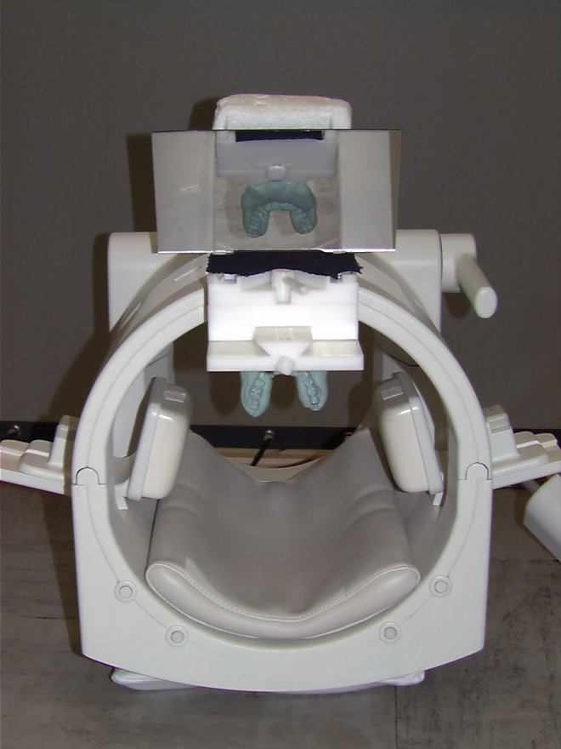
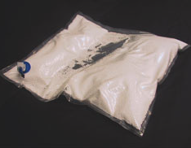
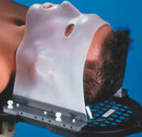

Head Restraint
Vacuum Pack
Head Vise
(more comfortable than it sounds!)
Bite Bar
Thermoplastic mask
Often a bunch of foam padding works as well as anything

Slide 26
Prevention is the Best Remedy
Tell your subjects how to be good subjects
  “Don’t move” is too vague
Make sure the subject is comfy going in
  avoid “princess and the pea” phenomenon
Emphasize importance of not moving at all during beeping
  do not change posture
  if possible, do not swallow
  do not change posture
  do not change mouth position
  do not tense up at start of scan
Discourage any movements that would displace the head between scans
Do not use compressible head support
For a summary of info to give first-time subjects, see
    http://www.culhamlab.com/participants/

Slide 27
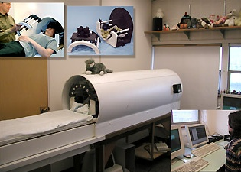
Mock “0 T” Scanners
Notes:
http://depts.washington.edu/chdd/iddrc/cores/bi.html

