Slide 1
Optimizing Statistics
Multiple comparisons

Slide 2
Statistical Errors
Is there a real activation difference in a given voxel?
Yes
No
Correct
decision
(true positive)
Type I Error
(false positive)
Limit ⍺ to p < .05
(5%)
Yes
Does the statistical test indicate an activation difference in the given voxel?
Correct
decision
(correct
rejection)
Type II Error
(incorrect
rejection)
No

Slide 3
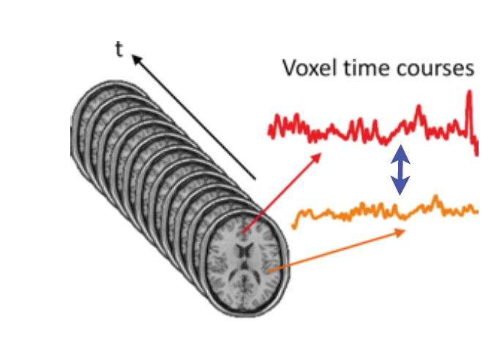
Mega-Multiple Comparisons Problem
Raw data
366,912 voxels x 0.05
=~18,346 voxels should be significant due to chance alone
Resampled data restricted to voxels inside the brain
~194,000 voxels [of (2 mm)^{3]} x 0.05
= ~9,700 voxels significant by chance

Slide 4
The Dead Salmon “Crisis”

Slide 5
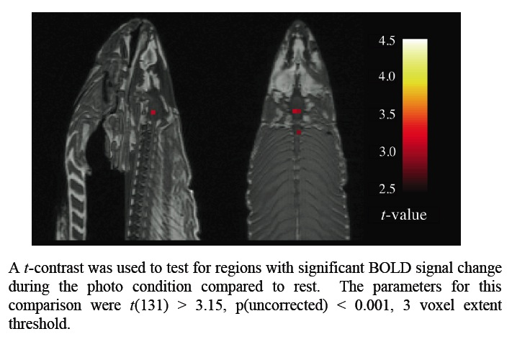
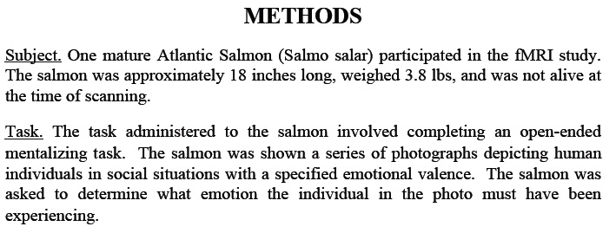
Dead Salmon
poster at Human Brain Mapping conference, 2009
130,000 voxels
no correction for multiple comparisons

Slide 6
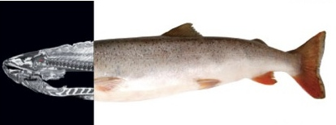
Fishy Headlines

Slide 7
Possible Solutions to Multiple Comparisons Problem
Bonferroni Correction (Family-wise Error, FWE Correction)
small-volume correction
Cluster Correction
Gaussian Random Field Theory
False Discovery Rate
Test-Retest Reliability

Slide 8
Bonferroni (FWE) Correction
divide desired p value by number of comparisons
Example:
desired p value: p < .05
number of voxels in brain: 194,004
required p value: p < .05 / 194,004 → p < .0000003
Drawback: overly conservative
assumes that each voxel is independent of others
not true – adjacent voxels are more likely to be similar in responses than non-adjacent voxels

Slide 9
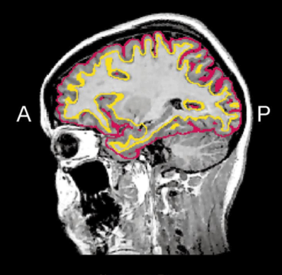
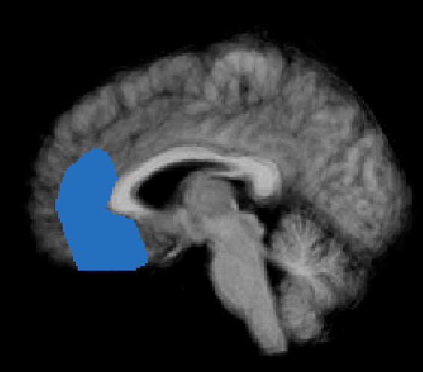
Small-Volume Correction
Apply a Bonferroni correction but only to a limited search volume
cortical gray-matter surface
zone of interest
reduces the number of voxels and thus the severity of Bonferroni

Slide 10
Cluster Correction
falsely activated voxels should be randomly dispersed
set minimum cluster size (k) to be large enough to make it unlikely that a cluster of that size would occur by chance
some algorithms assume that data from adjacent voxels are uncorrelated (not true)
some algorithm estimate and factor in spatial smoothness of maps
cluster threshold may differ for different contrasts
Drawbacks:
handicaps small regions (e.g., subcortical foci) more than large regions
an unscrupulous researcher can test many combinations of p values and k values and publish the one that looks the best

Slide 11
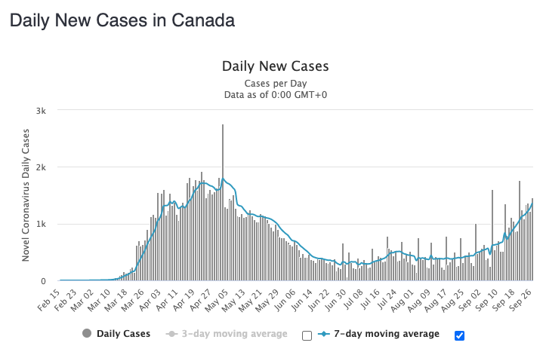
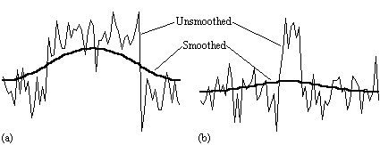
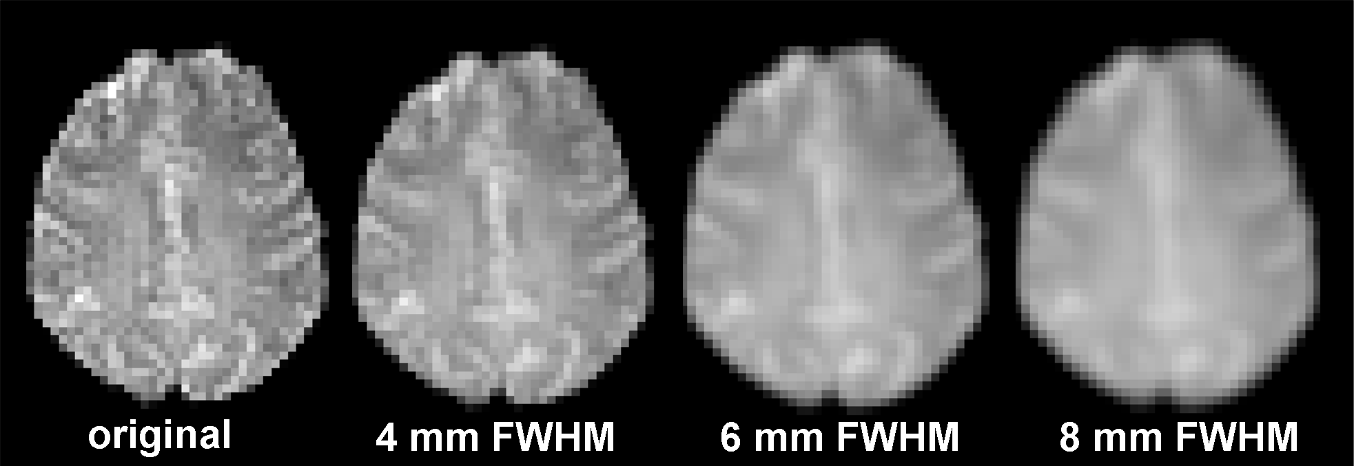
An Aside on Data Smoothness
temporal smoothing
spatial smoothing

Slide 12
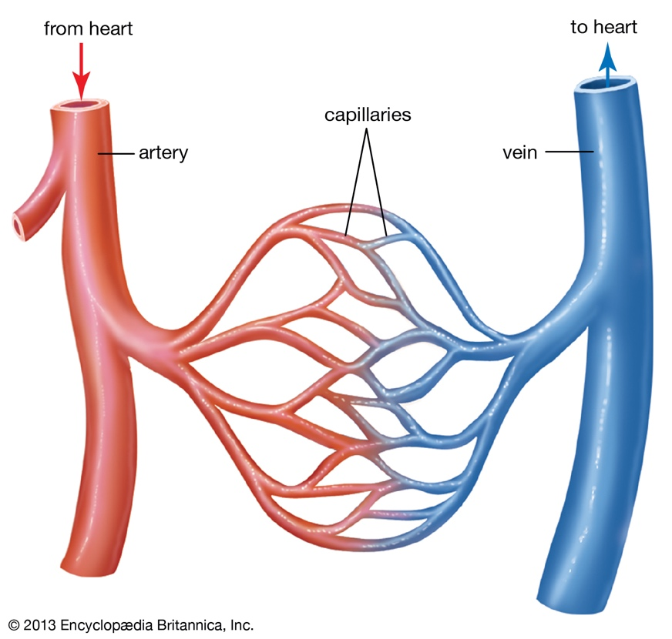
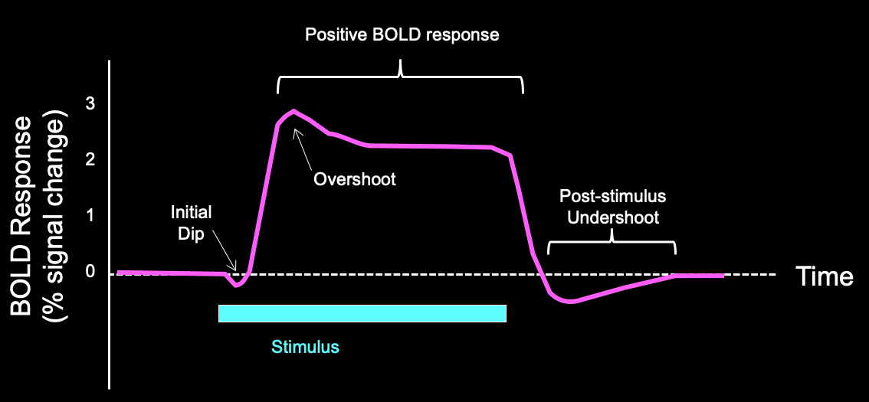
fMRI data has an inherent spatial and temporal smoothness
Signal levels are more similar between adjacent voxels than non-adjacent voxels
neural component
gray matter voxels are typically adjacent to other gray matter voxels with similar response properties
vascular component
adjacent voxels are more likely to share common blood vessels
Signal levels are more similar between subsequent time points than distant time points
neural/task component
neural processes typically occur over multiple time points
vascular component
vessel dilation and the BOLD signal change slowly (over seconds)
upstream vessels common to both voxels

Slide 13
How cluster correction works
Step 1: Choose a cluster-defining threshold (CDT)
Step 2: Estimate smoothness of maps
Step 3: Run Monte Carlo simulations on randomly generated maps with the smoothness determined in Step 2 to determine the likelihood of finding clusters of different sizes
assumes constant smoothness across brain
Step 4: Set a minimum cluster size (k) and exclude any clusters of voxels that are smaller

Slide 14
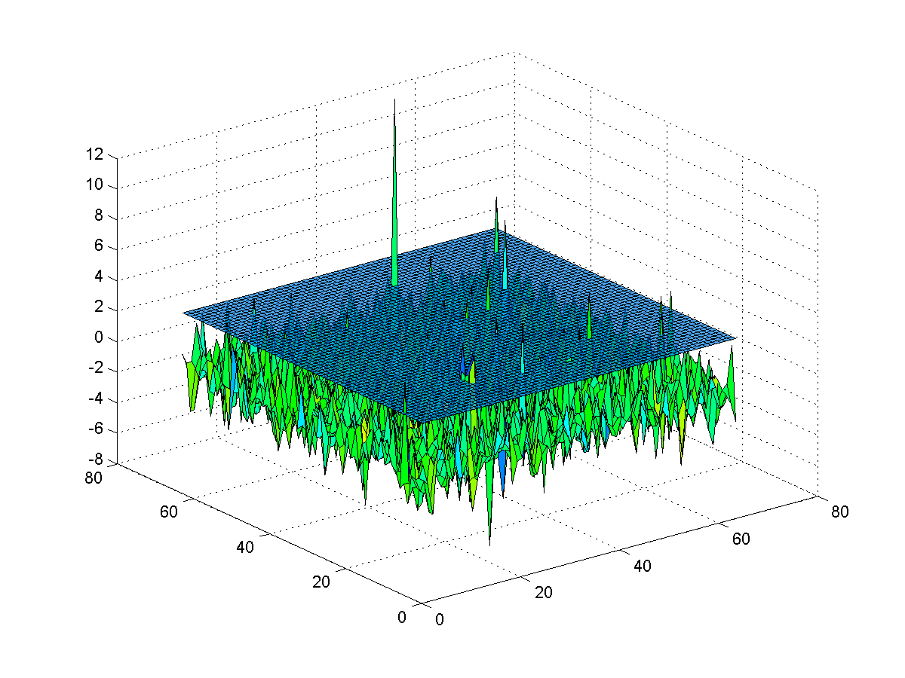
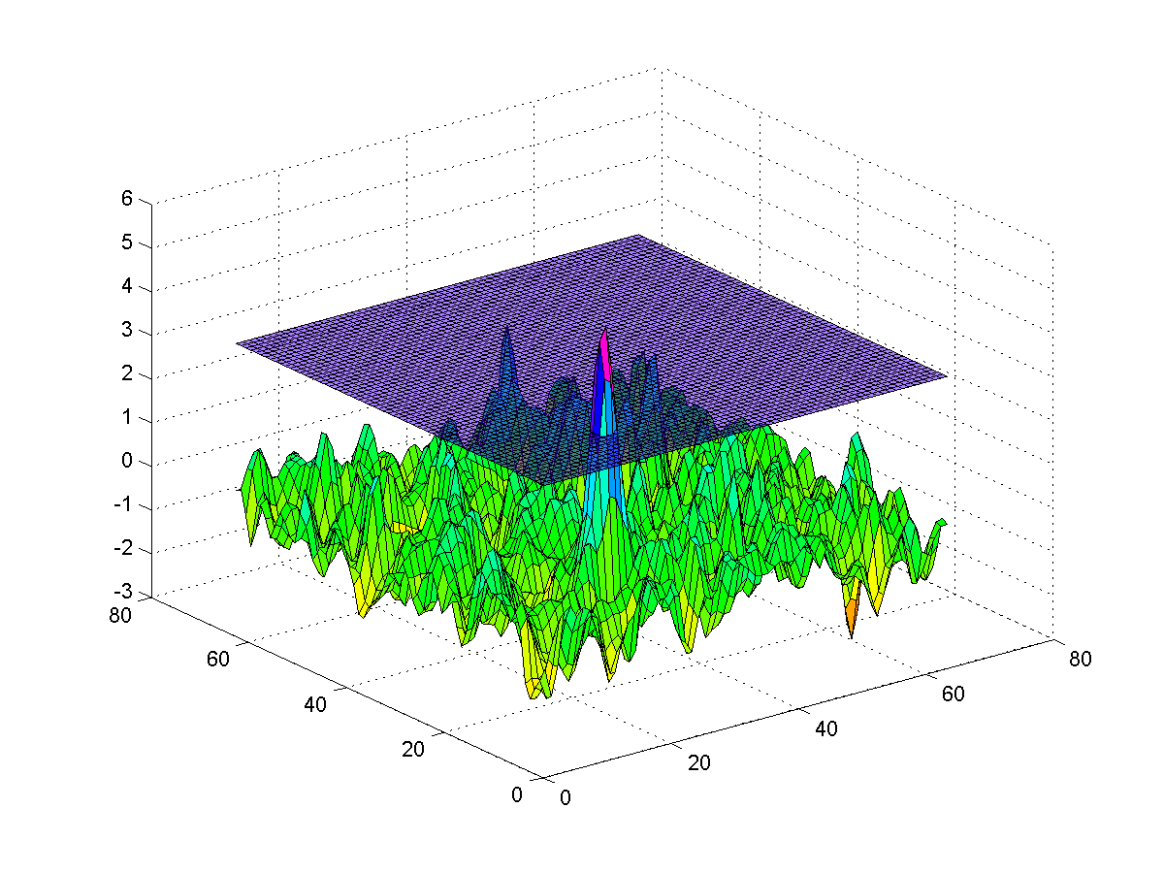
Gaussian Random Field Theory
Fundamental to SPM
Smoothing data reduces the number of “resolvable elements” (“resels”)
if you impose heavy smoothing, then you know the smoothness of the maps and can make accurate models
Drawback: Requires heavy smoothing
Slide modified from Duke course

Slide 15
Test-Retest Reliability
Perform statistical tests on each half of the data
The probability of a given voxel appearing in both purely by chance is the square of the p value used in each half
e.g., .001 x .001 = .000001
Alternatively, use the first half to select an ROI and the second half to test your hypothesis
Drawback: By splitting your data in half, you’re reducing your statistical power to see effects

Slide 16
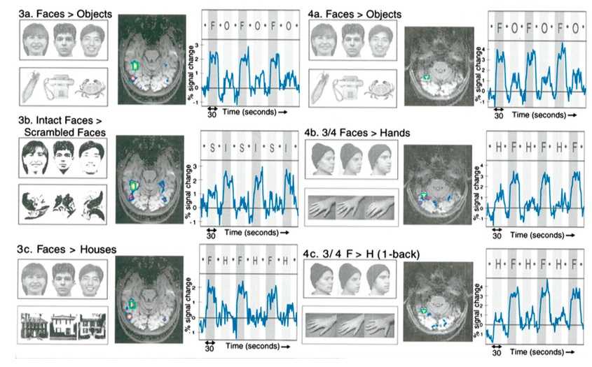
Experimental Reliability; Conceptual Replication
Replicate and extend in follow-up experiment
Kanwisher et al., 1997

Slide 17
Have We Been So Obsessed with Limiting Type I Error that Type II Error is Out of Control?
Is the region truly active?
Yes
No
HIT
Type I Error
Yes
Does our stat test indicate that the region is active?
No
Type II Error
Correct Rejection
Slide modified from Duke course

Slide 18
False Discovery Rate
controls the proportion of rejected hypotheses that are falsely rejected (Type II errors)
standard p value (e.g., p < .01) means that a certain proportion of all voxels will be significant by chance (1%)
FDR uses q value (e.g., q < .01), meaning that a certain proportion of the “activated” (colored) voxels will be significant by chance (1%)
Drawbacks
very conservative when there is little activation; less conservative when there is a lot of activation

Slide 19
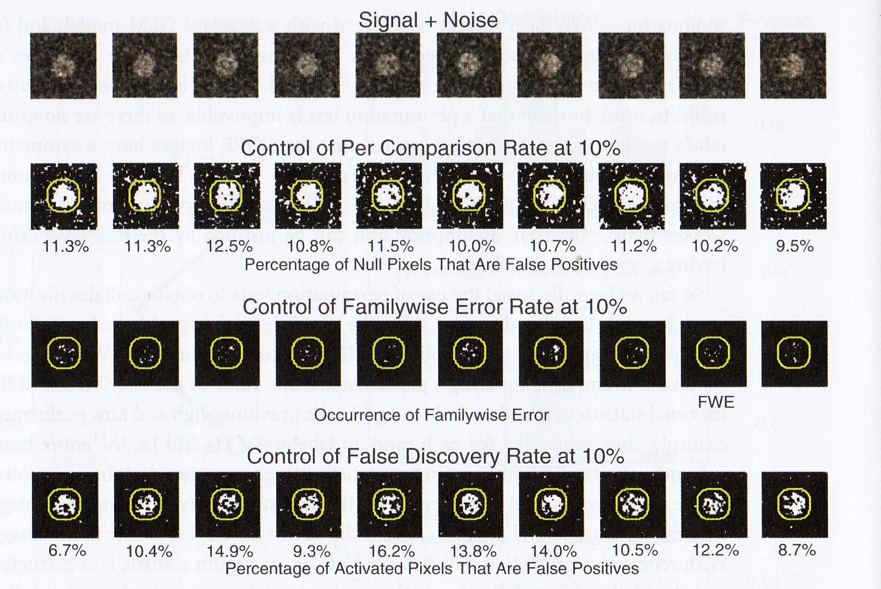
Comparison of Methods
simulated
data
uncorrected
-high Type I
-low Type II
Bonferroni
-low Type I
-high Type II
FDR
-low Type I
-low Type II
Poldrack, Mumford & Nichols, 2011 fMRI Data Analysis

Slide 20
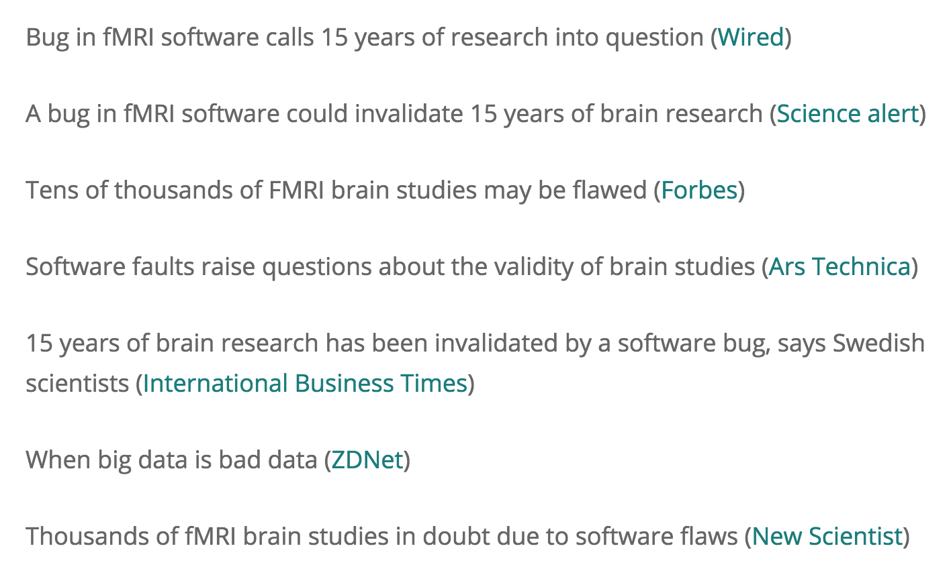
The Sky is Falling!

Slide 21
What a Clusterf… ailure!
2016
resting-state data from Functional Connectomes Project
applied stats to test for task-based “activation” using SPM, FSL and AFNI software packages
since there was no real task-based activation, false positives for cluster correction should be 5%
tested block designs and event-related designs with varying degrees of spatial smoothing (4-, 6-, 8-, and 10-mm FWHM)

Slide 22
What a Clusterf… ailure!
p=.05 EXPECTED
p>>>.05 ACTUAL
2016
n=20, FWHM = 6 mm
Cluster threshold p<.01
n=20 , FWHM = 6 mm
Cluster threshold p<.001
n=20 , FWHM = 6 mm
Voxel

Slide 23
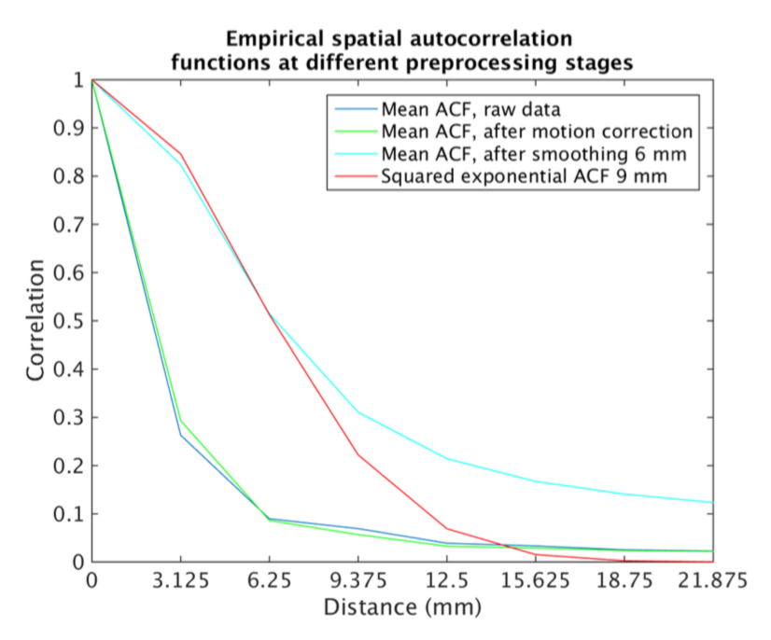
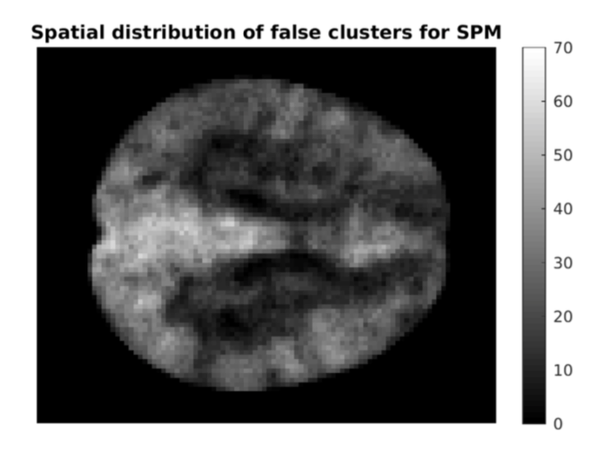
Why So Wrong?
AFNI had a bug for 15 years
Tests assume that spatial correlations have a particular shape (squared exponential distribution) – wrong!
Tests assume constant spatial smoothness across the brain – wrong!
Expected shape of spatial correlations does not match actual shape
Some areas (esp. posterior cingulate) have higher-than-average smoothness and thus higher false positives

Slide 24
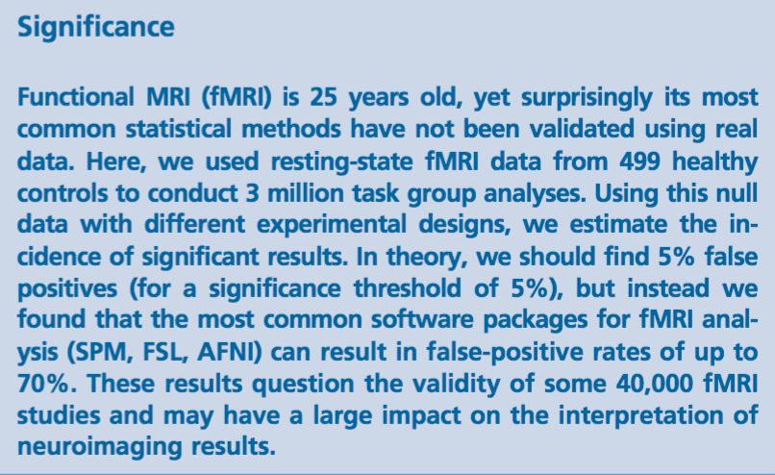
Beware scientific click-bait

Slide 25
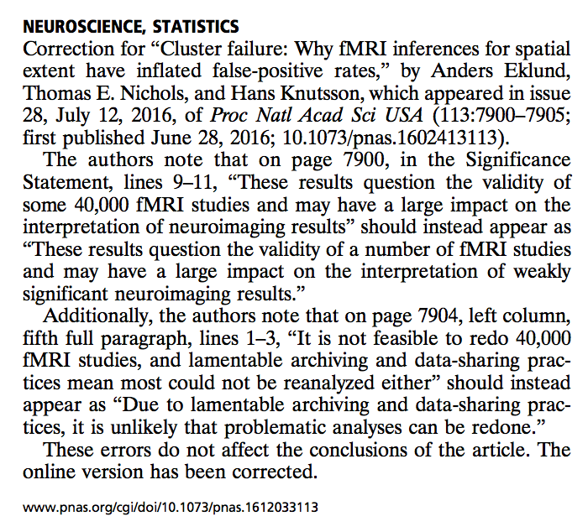

Slide 26
Not all blobs in all studies are vulnerable to this problem (many blobs sig above thresholds, not every study went fishing for blobs)
http://www.ohbmbrainmappingblog.com/blog/keep-calm-and-scan-on
http://blogs.discovermagazine.com/neuroskeptic/2015/12/07/false-positive-fmri-revisited/#.WA2DAZMrJsM
http://blogs.discovermagazine.com/neuroskeptic/2016/07/07/false-positive-fmri-mainstream
http://brainvoyager.com/bvresources/RainersBVBlog/files/a8a22212f9f1f01e4da11fef4ba91da8-34.html

Slide 27
Two solutions to save cluster-based methods
If you use a cluster-determining threshold at least as conservative as p < .001, the problem is not too severe (~10% false positives instead of 5%)
You can use permutation methods

Slide 28
Permutation testing with real data
rather than risking erroneous assumptions about the data (e.g., smoothness), you can use the data itself
generates an effective p value of .05 for resting state data
computationally intensive
requires multiple participants

Slide 29
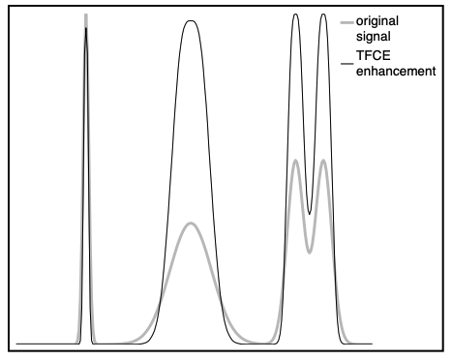
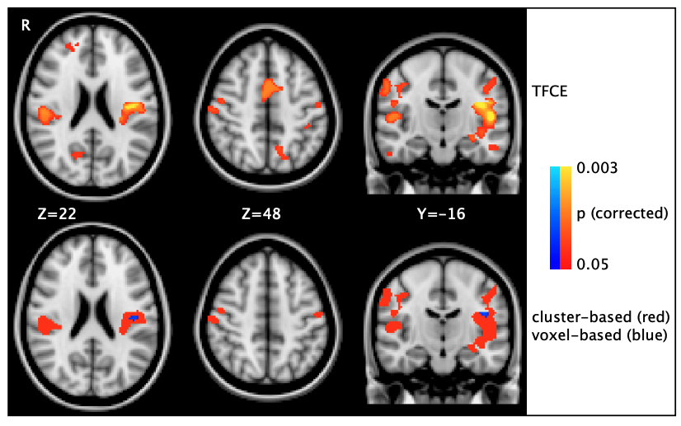
Threshold-free Cluster Enhancement
Takes into account both height and extent of activation to identify most robust blobs
Avoids arbitrary decisions and p hacking to find optimal combination of CDT and k
Gives better sensitivity than cluster-based and voxel-based approaches

Slide 30
Optimizing Statistics
Serial Correlations

Slide 31
fMRI data has an inherent spatial and temporal smoothness
Signal levels are more similar between adjacent voxels than non-adjacent voxels
neural component
gray matter voxels are typically adjacent to other gray matter voxels with similar response properties
vascular component
adjacent voxels are more likely to share common blood vessels
Signal levels are more similar between subsequent time points than distant time points
neural/task component
neural processes typically occur over multiple time points
vascular component
vessel dilation and the BOLD signal change slowly (over seconds)
upstream vessels common to both voxels

Slide 32
Correction for Temporal Correlations
When analyzing a single subject, statistics are based on residual degrees of freedom (#volumes – 1 -#POIs)
e.g., our run has 340 volumes, 4 POIs, df = 335
Statistical methods assume that each of these time points is independent.
In the case of fMRI, this assumption is false.
Even in a “screen saver scan”, activation in a voxel at one time is correlated with it’s activation within ~6 sec
This artificially inflates your statistical significance.

Slide 33
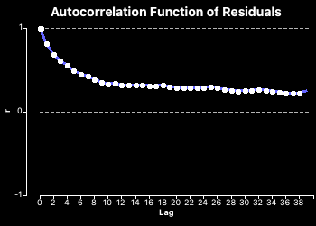
Autocorrelation function
Compute auto correlation function on residuals
Why the residuals? Minimize neural/task component
For a voxel or ROI, correlate its time course with itself shifted in time
Plot these correlations by the degree of shift
original
r = AR(1)
shift by 1 volume
r = AR(2)
shift by 2 volumes
time
Statistics assume data points are independent
If so, AR(1+) should = 0

Slide 34
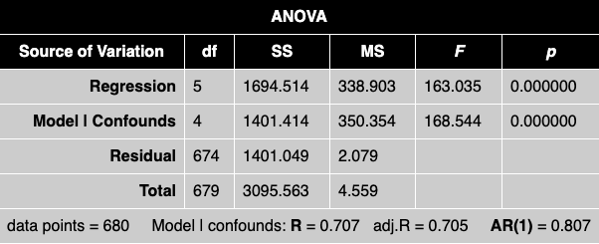

Slide 35
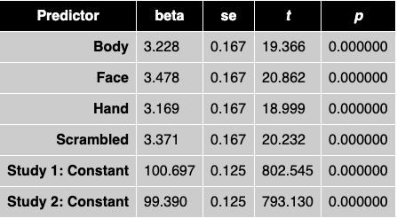
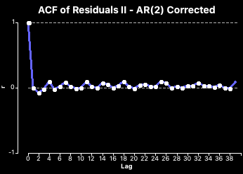
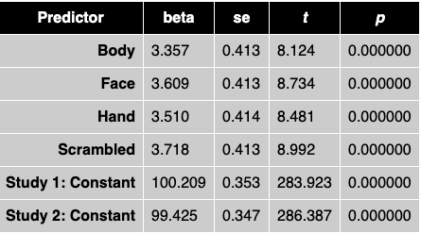
Example: Voxel A
BEFORE
BV can correct for the autocorrelation to yield revised (usually lower) p values
AFTER

Slide 36
Piloting vs. Publication

Slide 37
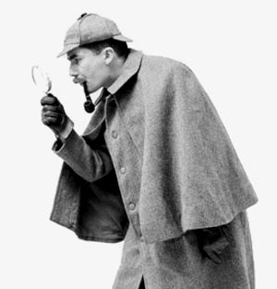
Strategies for Publication vs Piloting
Publication
Have a specific hypothesis/contrast planned
Run all your subjects
Run the stats as planned with all necessary corrections
Publish
Piloting
Run a few subjects to see if you’re on the right track
Spend a lot of time exploring the pilot data for interesting patterns
“Find the story” in the data
You may even change the experiment, run additional subjects, or run a follow-up experiment to chase the story
While you need to use rigorous corrections for publication, do not be overly conservative when exploring pilot data or you might miss interesting trends

Slide 38
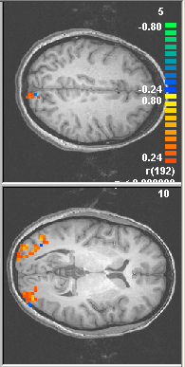
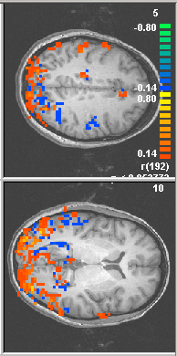
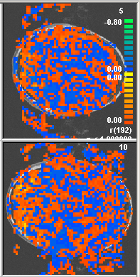
Sanity Checks: “Poor Man’s Bonferroni”
For casual data exploration, not publication
Jack up the threshold till you get rid of the schmutz (especially in air, ventricles, white matter – may be real)
If you have a comparison where one condition is expected to produce much more activity than the other, turn on both tails of the comparison
If two areas are symmetrically active, they’re less likely to be due to chance (only works for bilateral areas)
Jody’s rule of thumb: “If ya can’t trust the negatives, can ya trust the positives?”
Too subjective for serious use
Example: MT+ localizer data
Moving rings > stationary rings (orange)
Stationary rings > moving rings (blue)

Slide 39
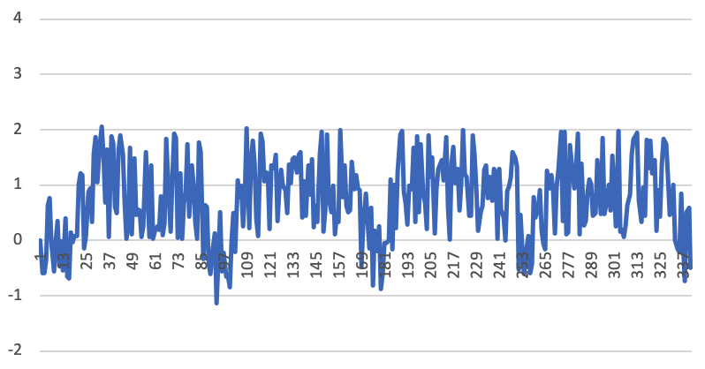
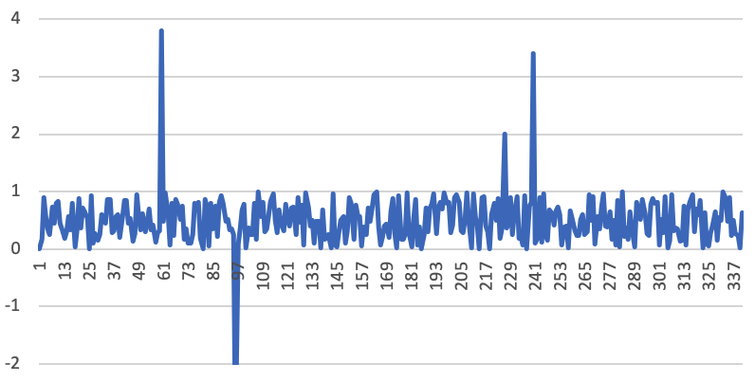
Look at the time courses of your data

