Slide 1
GLM Files and Contrasts

Slide 2
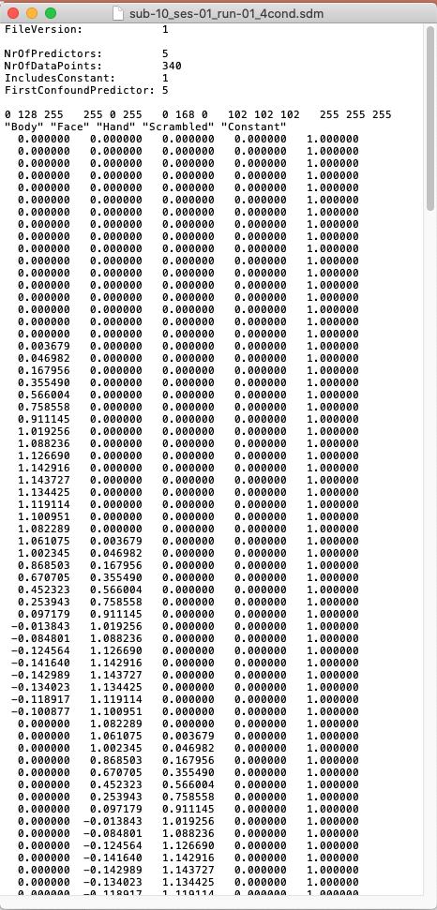
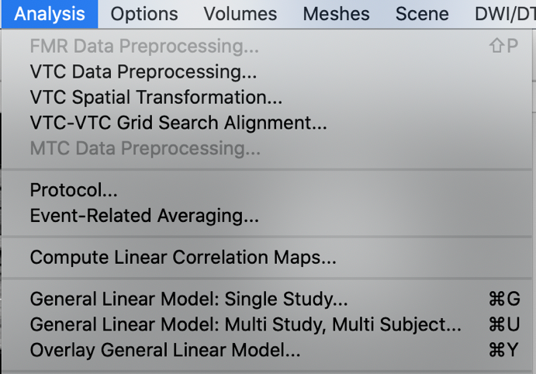
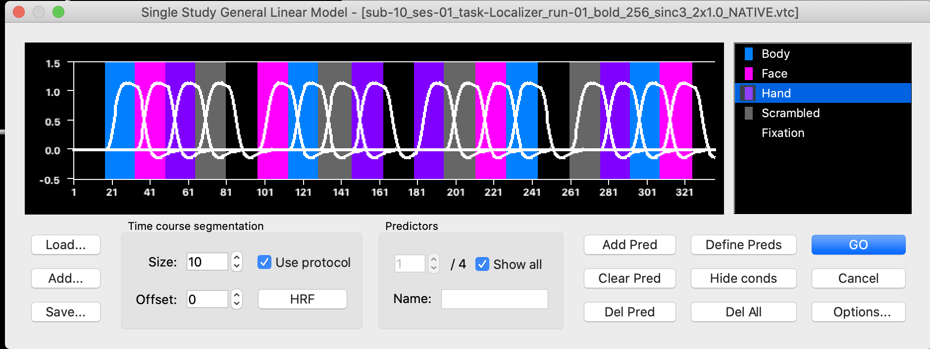
Single-study Design Matrix
Single-study design matrix: .sdm
Contains all the predictors for one run
Can be derived from protocol (.prt)
One column per predictor within a run
Need one .sdm per run
Text file (can be edited, generated with code)

Slide 3
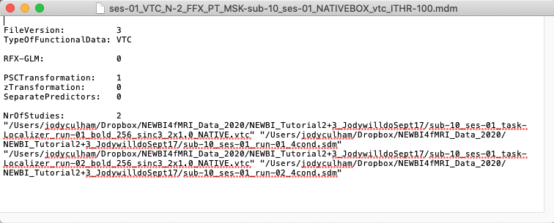
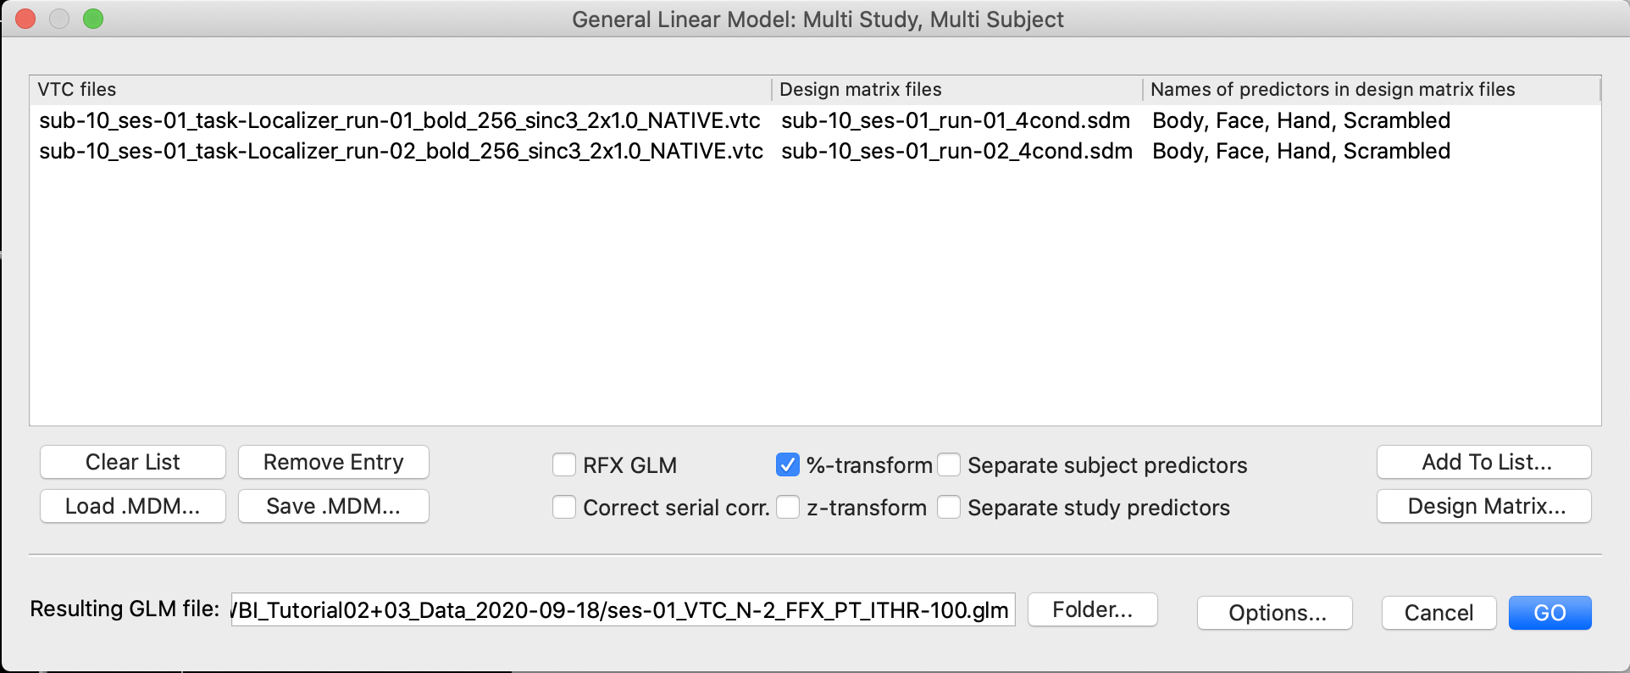
Multi-study, Multi-subject Design Matrix
Multi-study, multi-subject design matrix: .mdm
Lists each functional run (.vtc) and matches it with the corresponding .sdm
Predictors must be listed in same order in each run
Specifies details about the model
Text file
Models the data (voxelwise) and saves it as a .glm file

Slide 4
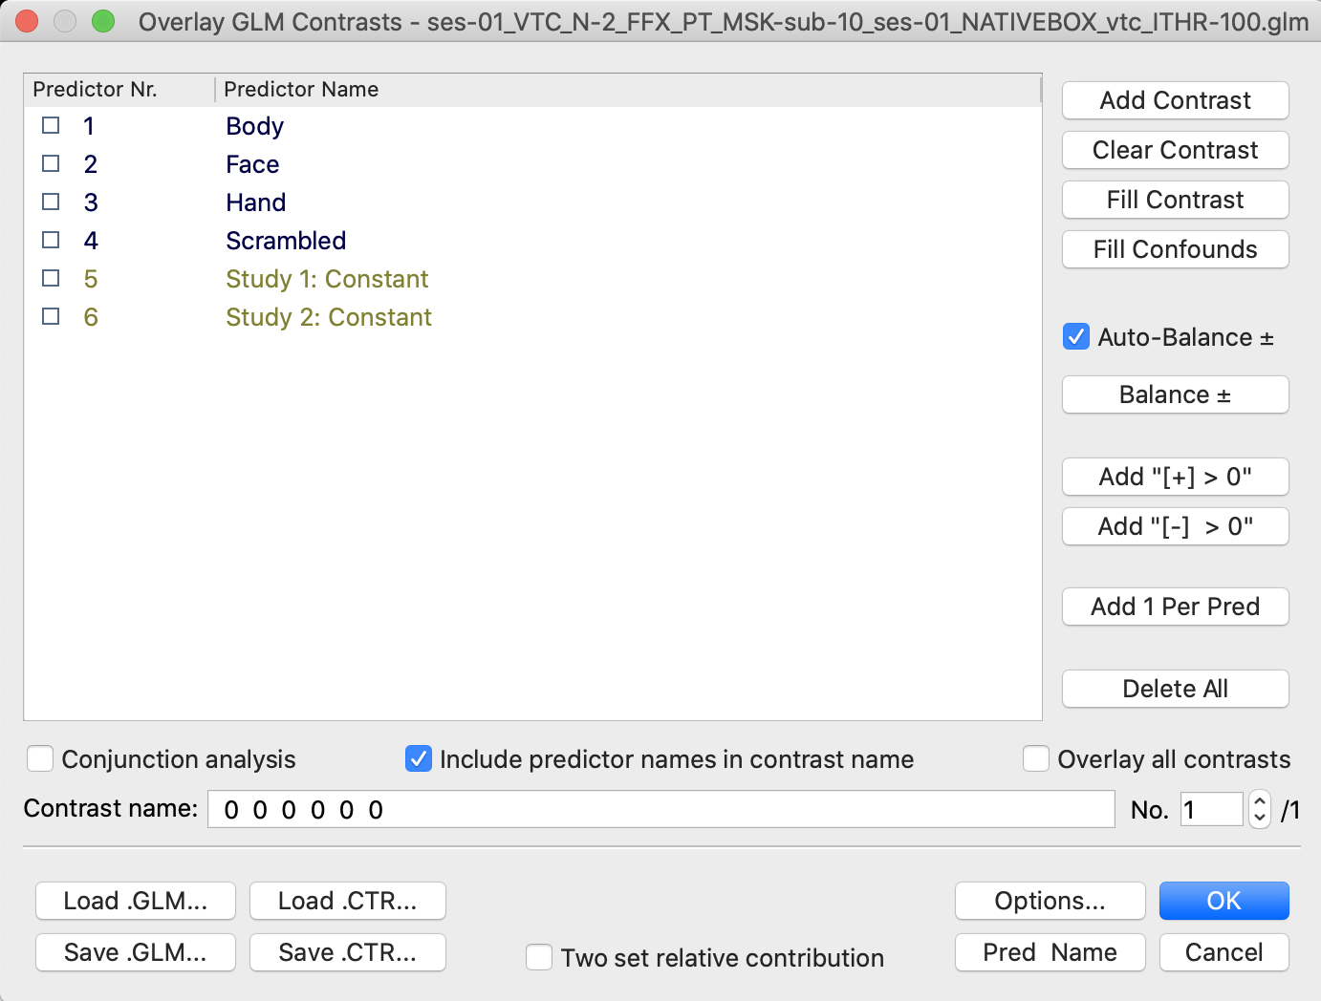
General Linear Model (.glm) File
General Linear Model: .glm
Data file that contains voxelwise output of the model
Loading (overlaying) it brings up a list of predictors, can be used to do contrasts
POIs in black font
PONIs in gray font

Slide 5
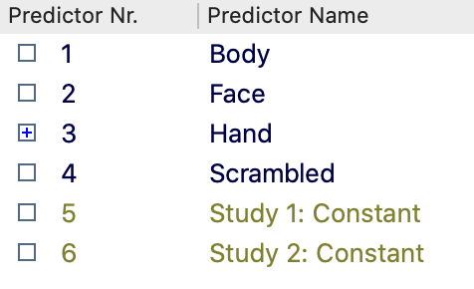
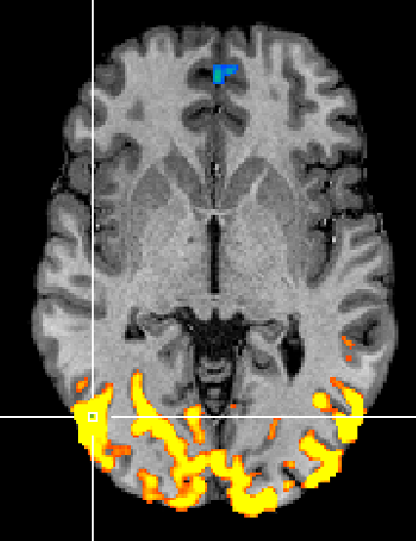
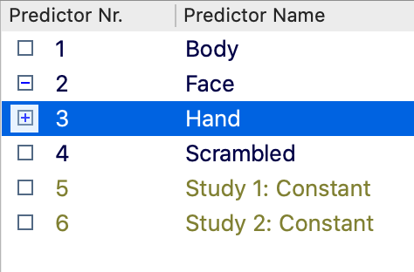
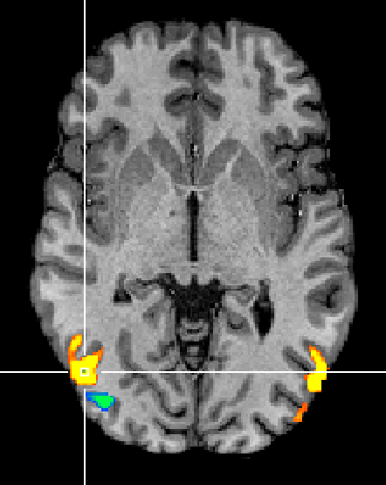
Contrasts in the GLM
We can examine whether a single predictor is significant (compared to the baseline)
R
L
We can also examine whether a single predictor is significantly greater than another predictor

Slide 6
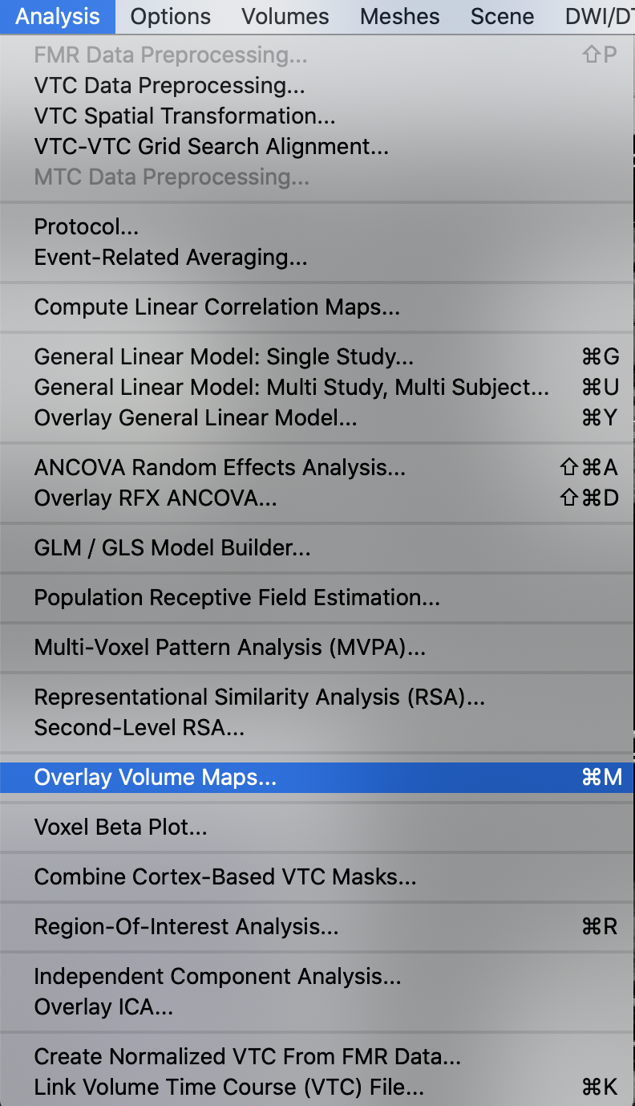
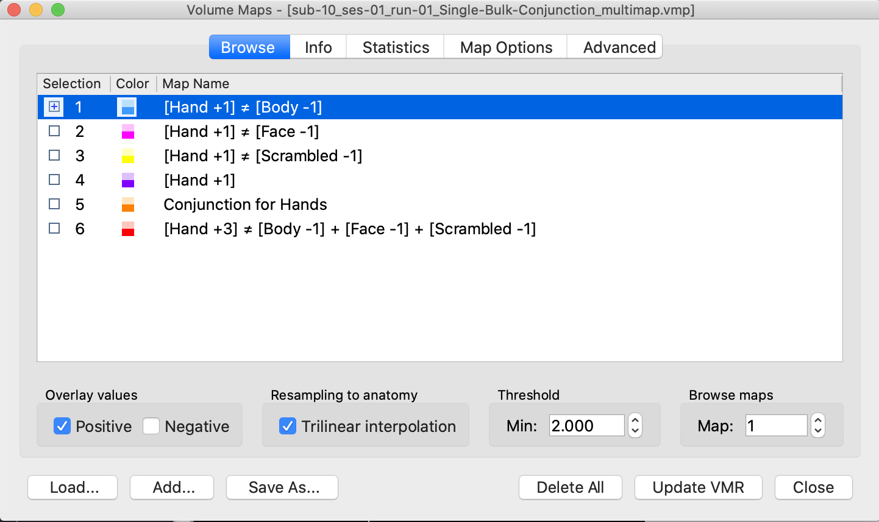
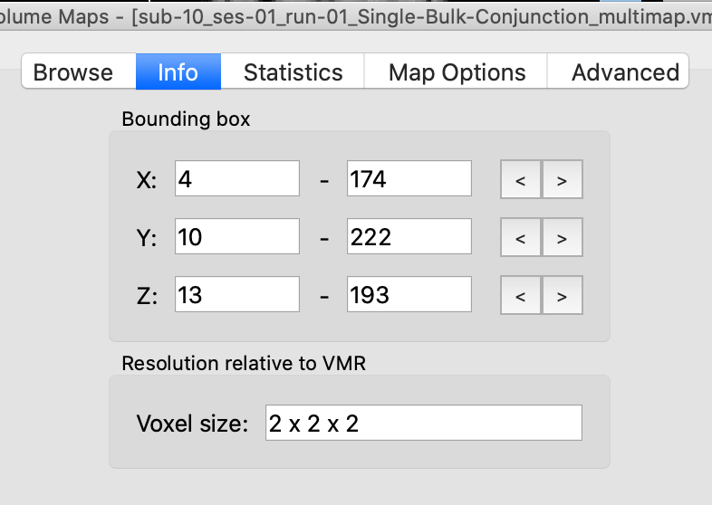
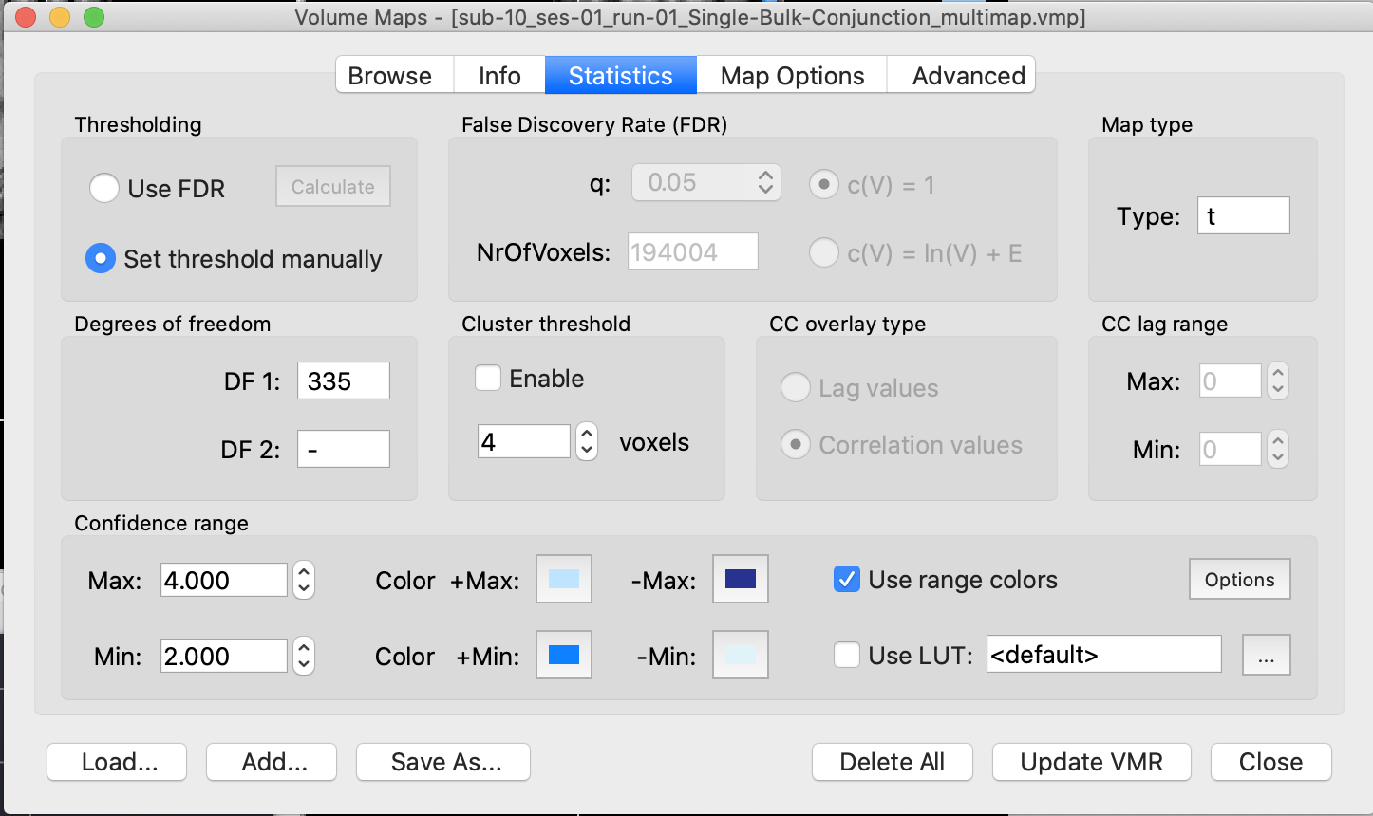
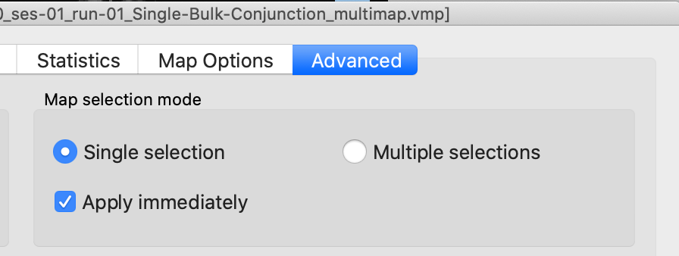
Volumetric Map (.vmp) File
Volumetric Map: .vmp
Data file that contains voxelwise output of a .glm contrast or multiple contrasts
Control panel can be used to adjust statistical choices (e.g., threshold)

Slide 7
Contrast Vectors
 | Body | Face | Hand | Scram
Hand - Baseline | 0 | 0 | +1 | 0
Hand - Body | -1 | 0 | +1 | 0
Hand - Face | 0 | -1 | +1 | 0
Hand - Scrambled | 0 | 0 | +1 | -1

Slide 8
Balanced Contrasts Sum of contrast vector should = 0
β
1
1
2
1
Condition
Unbalanced
Balanced
Contrast | -1 | -1 | +1 | -1 | Σ=-2
β | 1 | 1 | 2 | 1
Contrast xβ | -1 | -1 | 2 | -1 | Σ=-1
Contrast | -1 | -1 | +3 | -1 | Σ=0
β | 1 | 1 | 2 | 1
Contrast xβ | -1 | -1 | 6 | -1 | Σ=3
If you do not balance the contrast, you are comparing one condition vs. the sum of all the others
If you balance the contrast, you are comparing one condition vs. the average of all the others

Slide 9
Problems with Bulk Contrasts
β
β
1
1
2
1
2
1
2
0
Condition
Condition
Balanced: Hands vs. Other
Balanced: Hands vs. Other
Contrast | -1 | -1 | +3 | -1 | Σ=0
β | 1 | 1 | 2 | 1
Contrast xβ | -1 | -1 | 6 | -1 | Σ=3
Contrast | -1 | -1 | +3 | -1 | Σ=0
β | 2 | 1 | 2 | 0
Contrast xβ | -2 | -1 | 6 | 0 | Σ=3
To describe this in text: 3*Hand – (Body + Face + Scrambled) or “activation for hands vs. the average of the other three conditions”
Bulk contrasts can be significant if only a subset of conditions differ
Common mistake: Do a bulk contrast (Hands vs. other), find significant results and conclude that Hand are significantly higher than each of the other conditions. No.

Slide 10
Conjunctions (sometimes called Masking)
 | Body | Face | Hand | Scram
Hand - Baseline | 0 | 0 | +1 | 0
Hand - Body | -1 | 0 | +1 | 0
Hand - Face | 0 | -1 | +1 | 0
Hand - Scrambled | 0 | 0 | +1 | -1
conjunction
AND
AND
AND
To describe this in text:
[(Hand > Baseline) AND (Hand > Body) AND (Hand > Face) AND (Hand > Scrambled)]

Slide 11
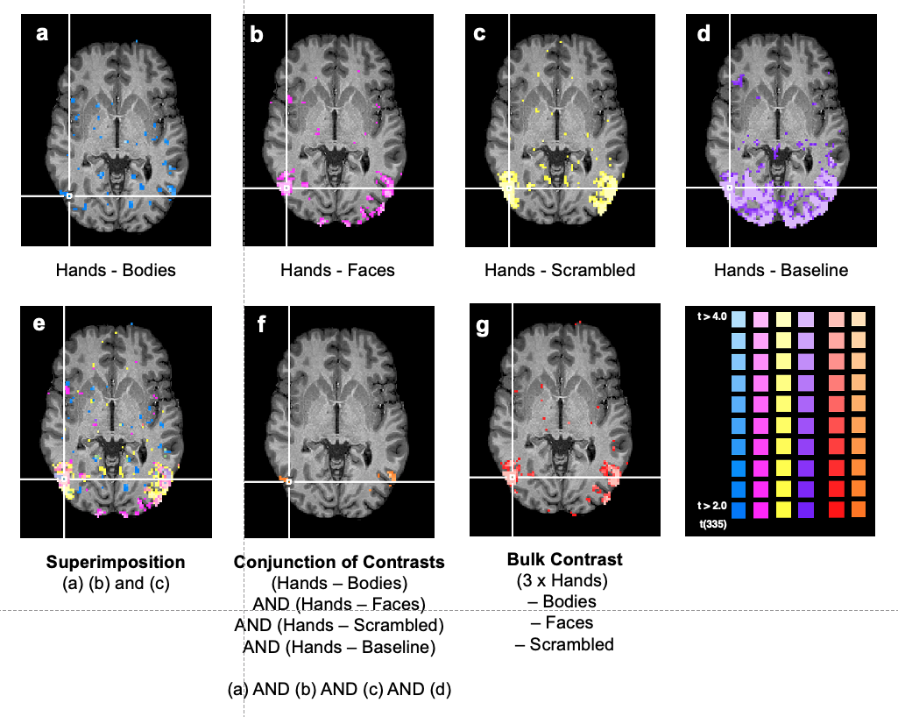
Conjunction Example

Slide 12
P Values for Conjunctions
Conjunctions are quite conservative
If the contrasts are independent:
e.g., [(Hand > Face) AND (Scrambled > Baseline)]
p_{combined} = (p_{singlecontrast})^{numberofcontrasts}
e.g., p_{combined} = (0.05)² = 0.0025
If the contrasts are non-independent:
e.g., [(Hand > Face) AND (Hand > Baseline)]
p_{combined} is not straightforward to compute
Notes:
http://mindhive.mit.edu/node/90

Slide 13
Always clearly specify your contrast
fMRI activation always has to be relative to something else
Common mistake: Being unclear about what the comparison condition was
e.g., “Figure 1 shows activation for Hands”
This could mean
Hands - Baseline
Hands – Faces
Hands – Bodies
Hands - Scrambled
3*Hand – (Body + Face + Scrambled)
[(Hand > Baseline) AND (Hand > Body) AND (Hand > Face) AND (Hand > Scrambled)]
Class projects: penalty for failing to specify contrasts

