Slide 1
Extending the GLM to more than two conditions

Slide 2
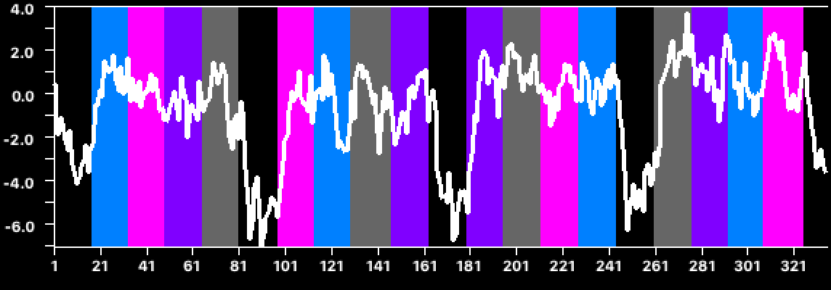
We actually had 4 conditions + Baseline
Faces
Hands
Bodies
Scrambled Images
Voxel A
Early Visual Cortex
We can’t model the activation well with just correlations because no one function will fit all voxels well
Need to model responses to different conditions separately
Voxel E
FFA
Voxel F
LOTC_{hand}

Slide 3
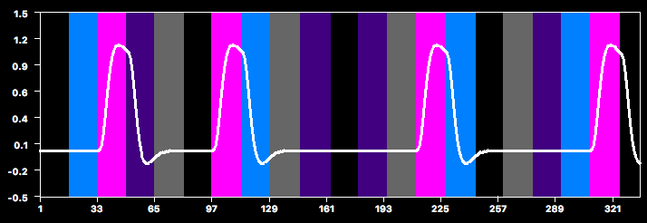
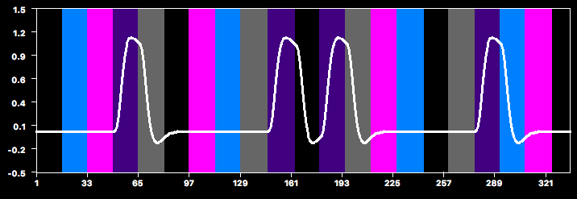
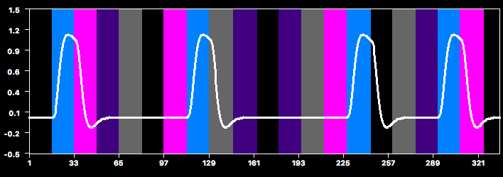
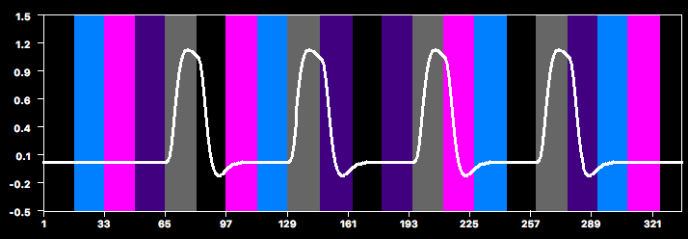
Model with 4 POIs (df)
Faces
Each predictor goes from 0 to 1
Hands
We can estimate the amount of activation for each condition by looking at how much we have to scale the predictor by its β
to best fit the data
Bodies
Scrambled
Images

Slide 4
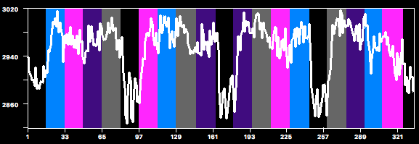
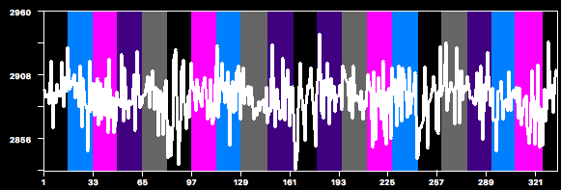
Example: GLM with 4 predictors
x β_{Faces}
+
x β_{Hands}
=
+
+
x β_{Bodies}
+
x β_{Scram}
fMRI Signal
=
Design Matrix
x
+
Betas
Residuals
“what we CAN explain”
“how much of it we CAN explain”
“what we CANNOT explain”
“our data”
=
x
+
stats depend on ratio of explained to
unexplained variance

Slide 5
β_{bodies}
x
β_{faces}
x
β_{hands}
x
β_{scram}
x
β_{constant}
x
data =
model
+ residuals
=
+

Slide 6
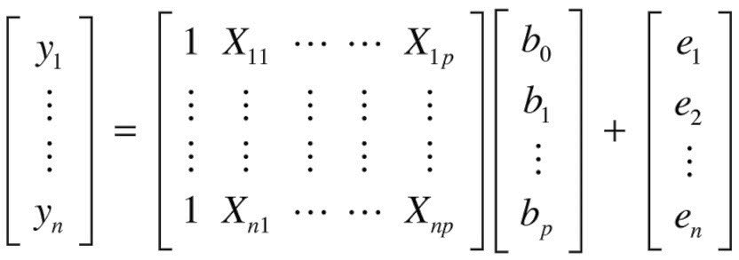
β_{bodies}
x
β_{faces}
x
β_{hands}
x
β_{scram}
x
β_{constant}
x
data =
model
+ residuals
=
+
In matrix algebra
y = Xb + e

Slide 7
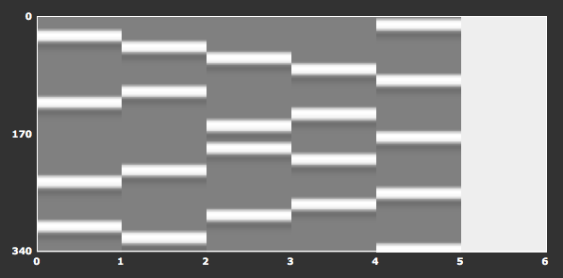
β_{bodies}
x
β_{faces}
x
β_{hands}
x
β_{scram}
x
β_{constant}
x
data =
model
+ residuals
=
+
Design matrix in SPM style
In matrix algebra
y = Xb + e

Slide 8
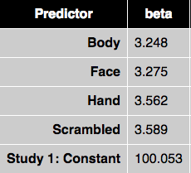
β_{bodies}
x
β_{faces}
x
β_{hands}
x
β_{scram}
x
β_{constant}
x
data =
model
+ residuals
=
+
Design matrix in SPM style
In matrix algebra
y = Xb + e
Output: Estimated β weights

Slide 9
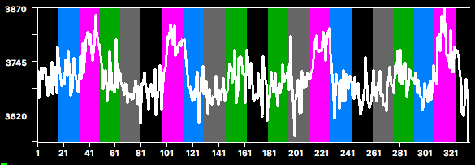
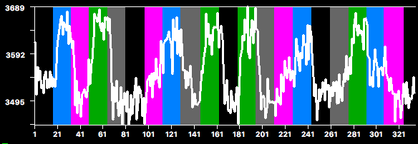
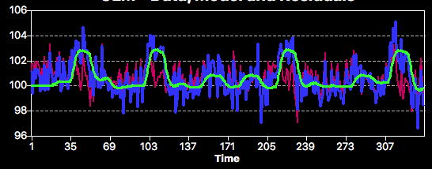
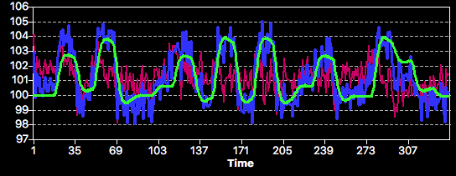
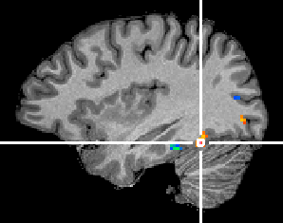
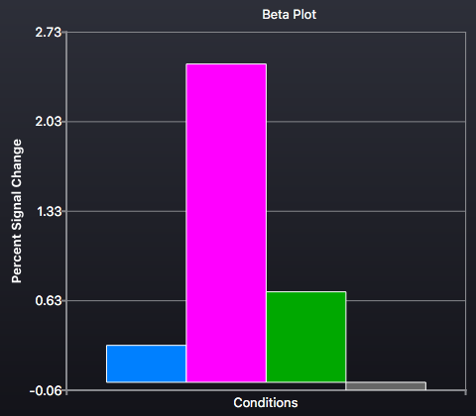
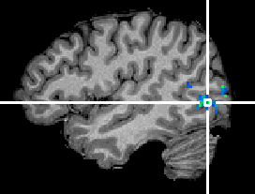
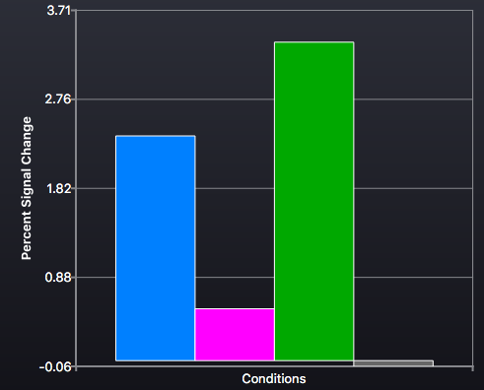
Examples
Voxel E (FFA)
Voxel F (LOTC_{hand})
Faces vs. Hands
Faces vs. Hands

Slide 10
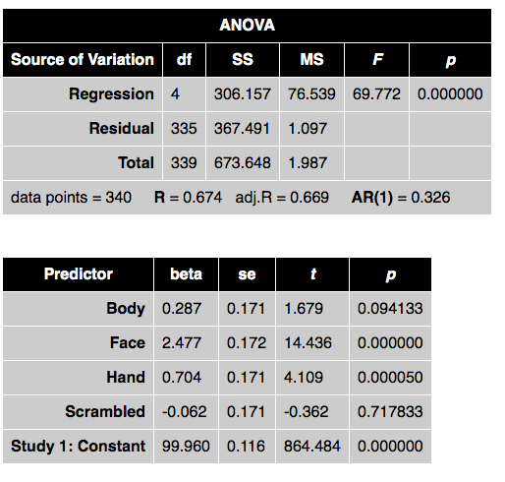
ROI-GLM Output: Voxel E (FFA)
Bodies > Baseline
Faces > Baseline
Hands > Baseline
Scrambled > Baseline

Slide 11
Contrasts
Often we want to know whether there is higher activation in one condition than another (not just baseline)
Calculate the size of the difference
Compare it to the noisiness of the data

Slide 12
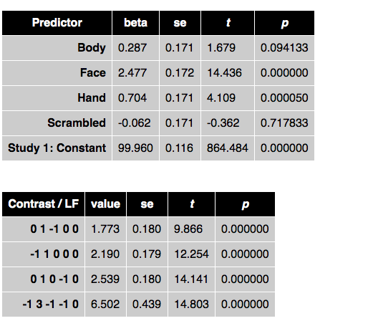
Contrasts for Voxel A
Bodies > Baseline
Faces > Baseline
Hands > Baseline
Scrambled > Baseline
noise term based on residuals
Faces > Hands
Faces > Bodies
Faces > Scrambled
3*Faces > (Hands + Bodies + Scrambled)
Example Contrast: Faces > Hands
Bodies
Faces
Hands
Scram
βs
0.287
2.477
0.704
-0.062
99.960
x
Contrast
0
+1
-1
0
0
=
0 + 2.477 – 0.704 + 0 + 0
1.773/0.180 = 9.866
t = 9.866 with df = 335 → p < .000001
=
1.773

Slide 13
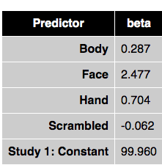
Newbie Mistake: Baseline Predictor
Mistake: 5 conditions (including baseline) → make 5 predictors
5th predictor = baseline - other
Why is this a mistake?
Short explanation
df = N-1
Model df = All Conditions – 1 = Non-baseline conditions
Longer explanation
Our predictor functions (and beta weights) already compare activation in each condition to the baseline
We know how much larger our visual conditions are compared to the baseline
Average of Body, Face, Hand and Scrambled = 0. 8515
Therefore, we know how much lower the baseline is compared to the other conditions (-0.8515)
Adding a baseline predictor is redundant. Moreover, it makes the model overdetermined, which makes the stats worse

Slide 14
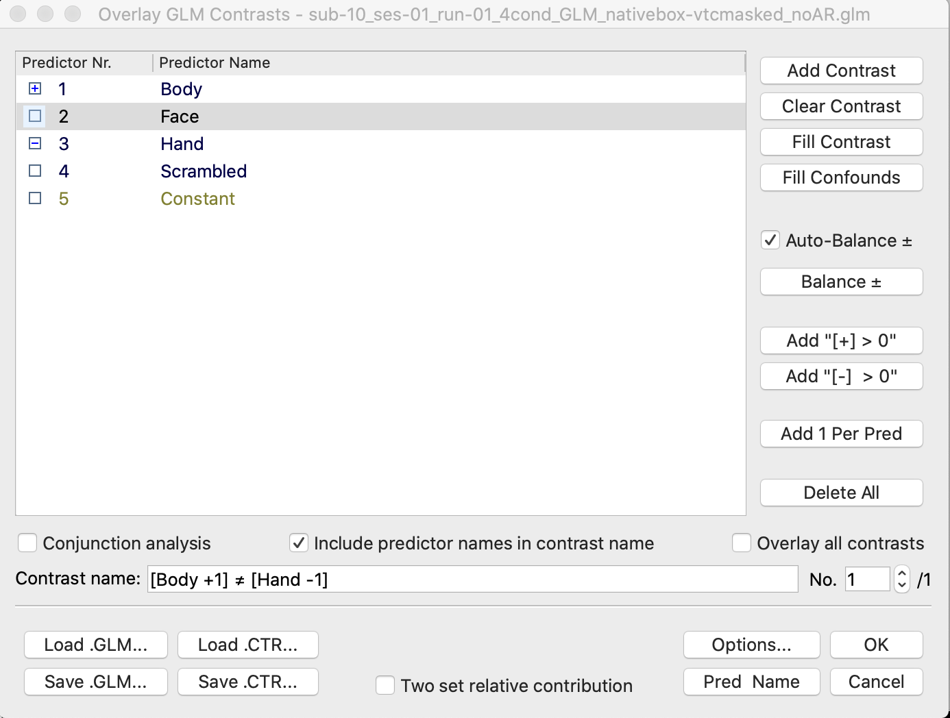
Voxelwise Contrasts

Slide 15
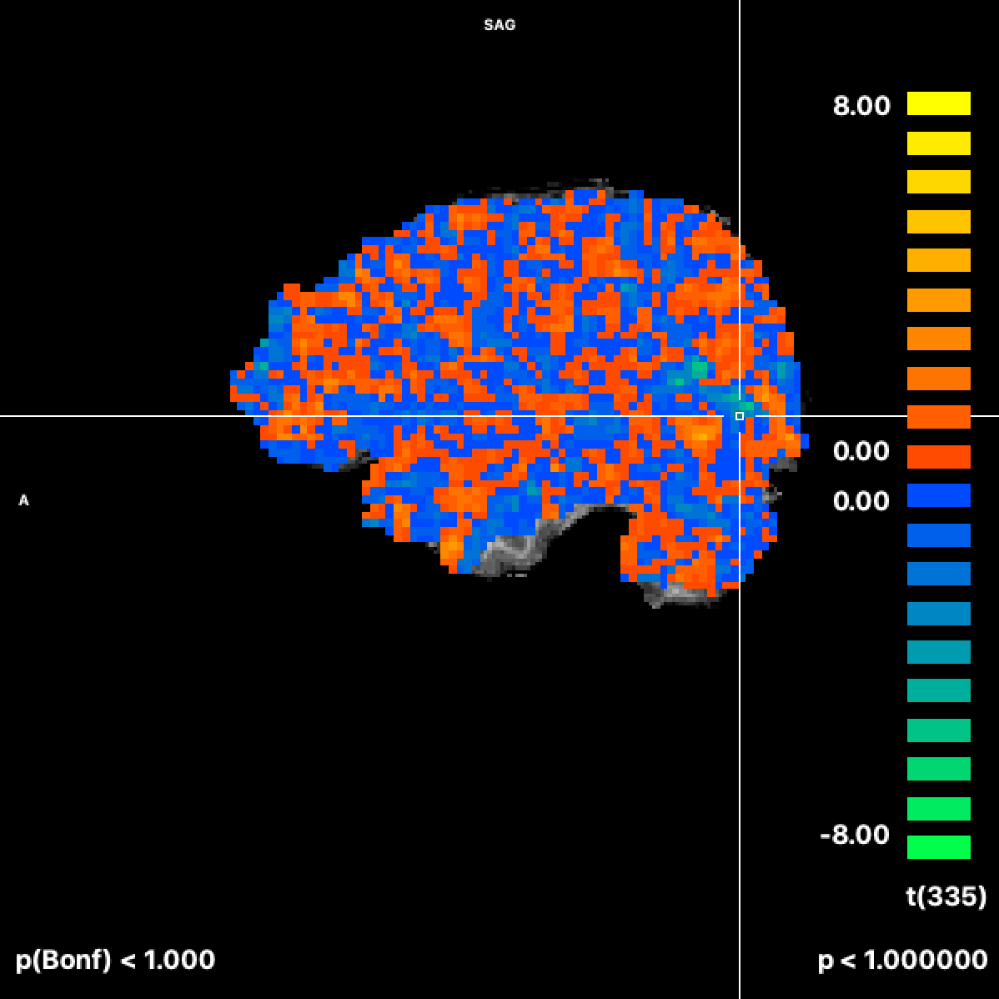
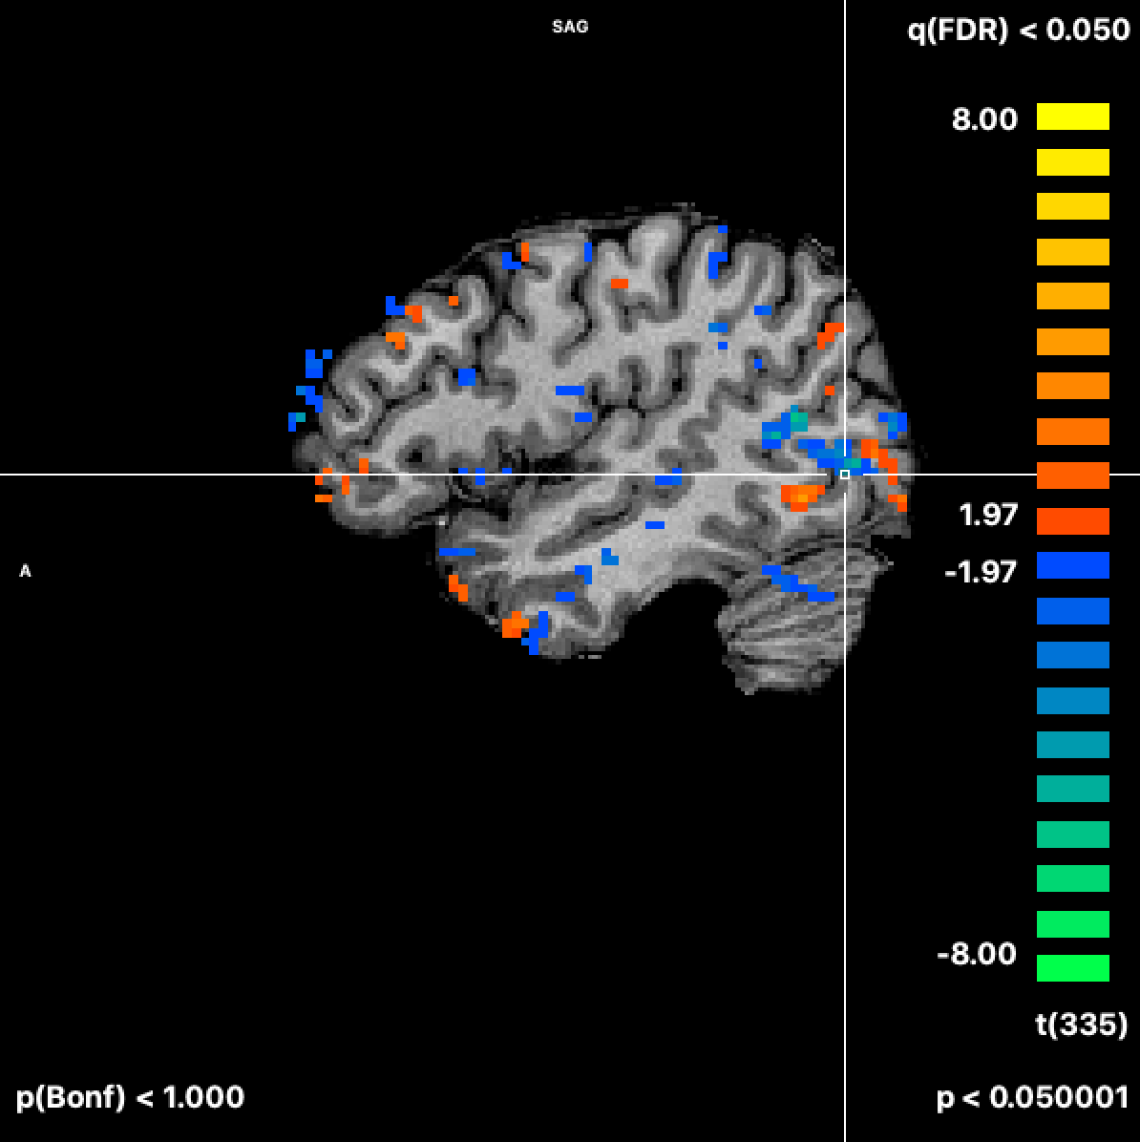
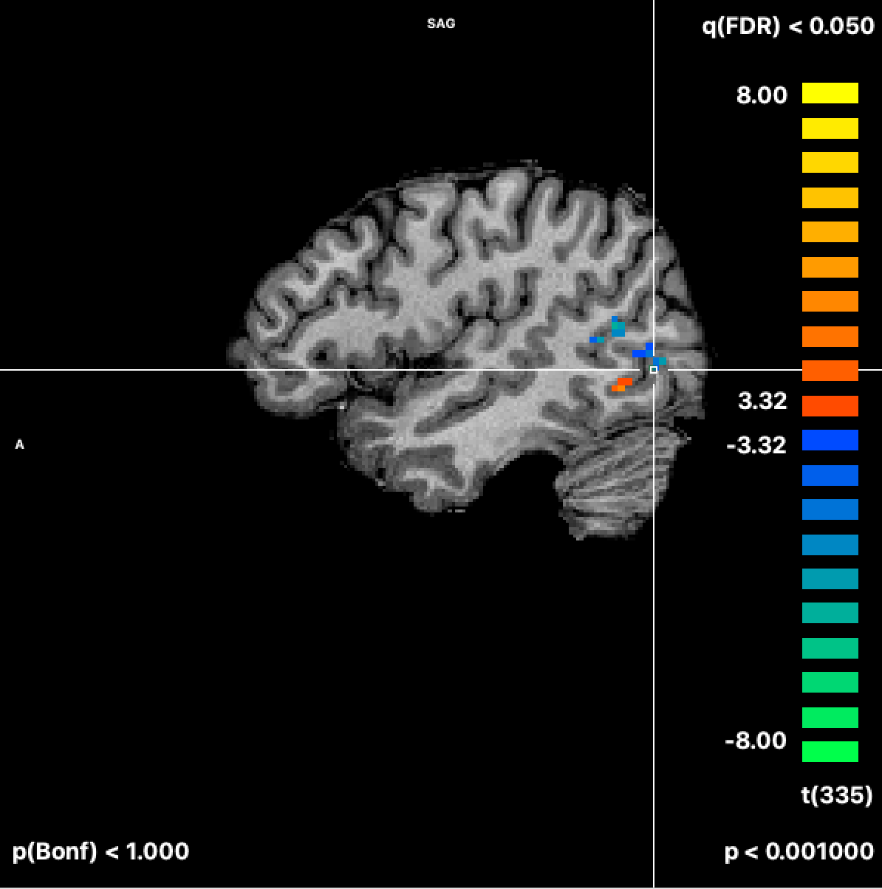
Voxelwise Contrast Map Faces > Hands
p < 1
p < .05
p < .001

Slide 16
Extending the GLM to more than one run

Slide 17
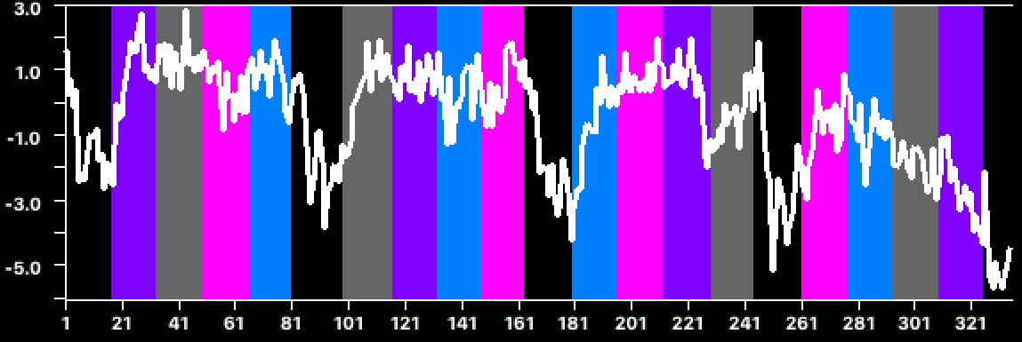
Two runs; Two GLMs
Localizer 1
Localizer 2
Bodies
Faces
Hands
Scram
Constants

Slide 18
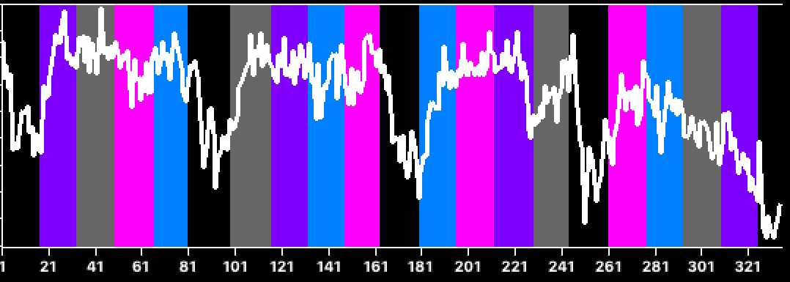
Two runs; One GLM
Localizer 1
concatenate
Localizer 2
Bodies
x β_{Bodies}
Faces
x β_{Faces}
x β_{Hands}
Hands
x β_{Scram}
Scram
Constants
x β_{C1}
x β_{C2}
but keep 2 constants

Slide 19
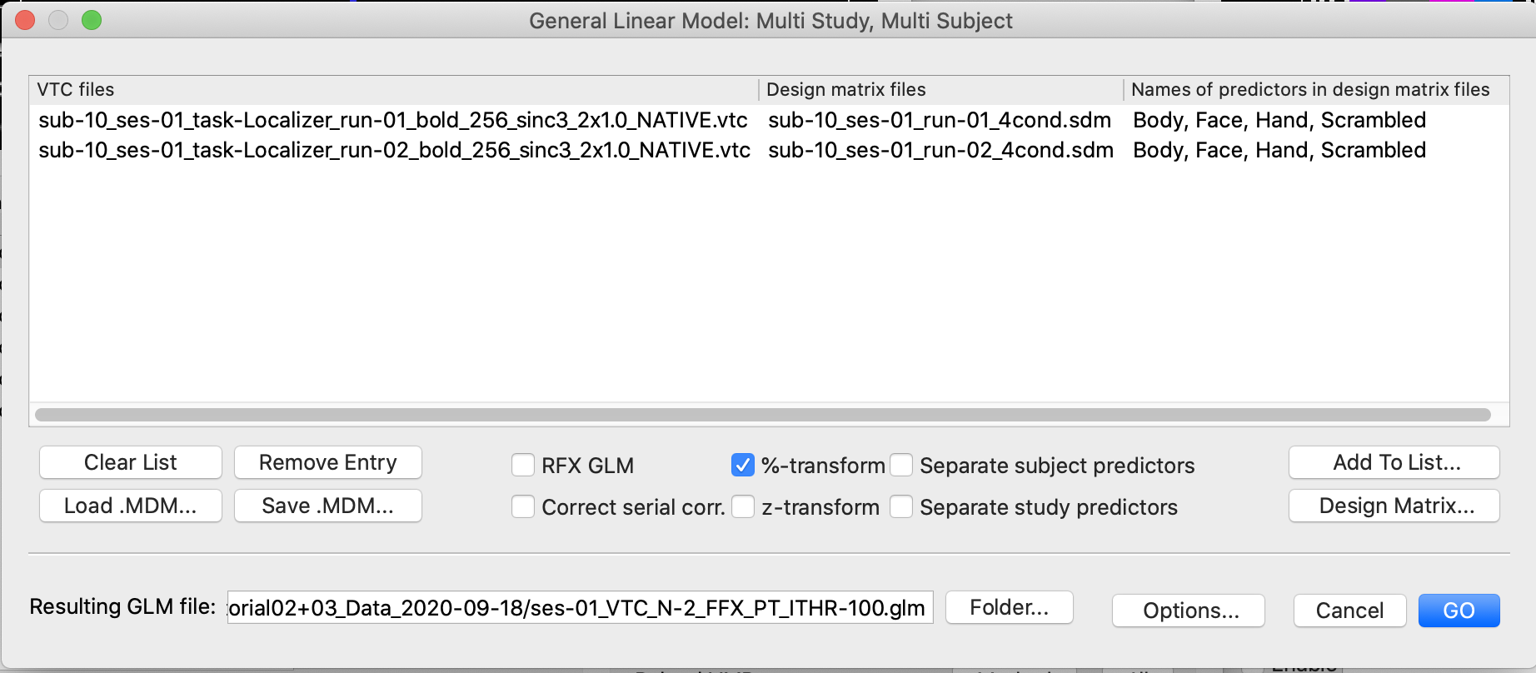
Two runs; One GLM
two runs (studies), 4 predictors, 2 constants

Slide 20
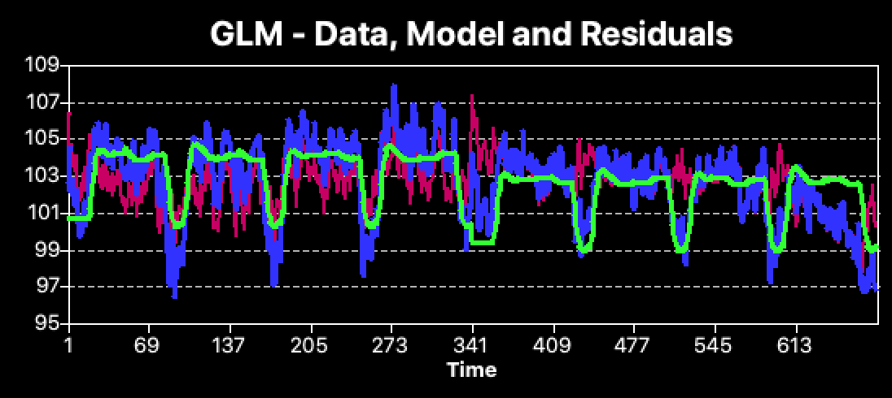
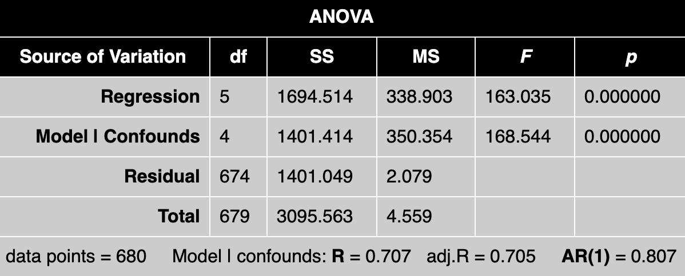
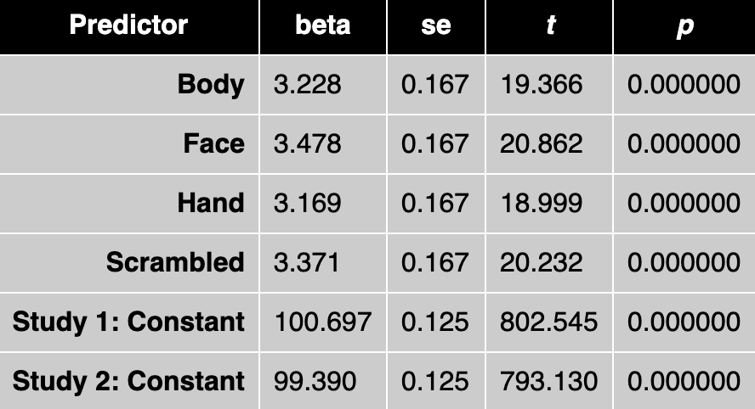
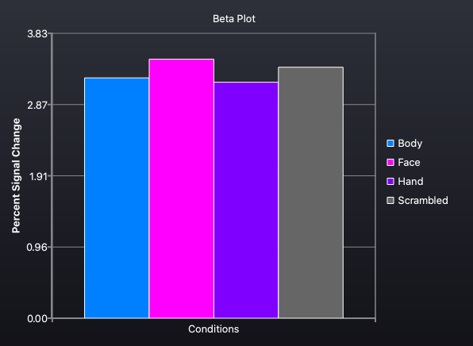
Two runs; One GLM

Slide 21
Two runs; One GLM; Sep Study
Bodies
x β_{Bodies1}
x β_{Bodies2}
Faces
x β_{Faces1}
x β_{Faces2}
x β_{Hands1}
x β_{Hands2}
Hands
x β_{Scram1}
x β_{Scram2}
Scram
Constants
x β_{C1}
x β_{C2}

Slide 22
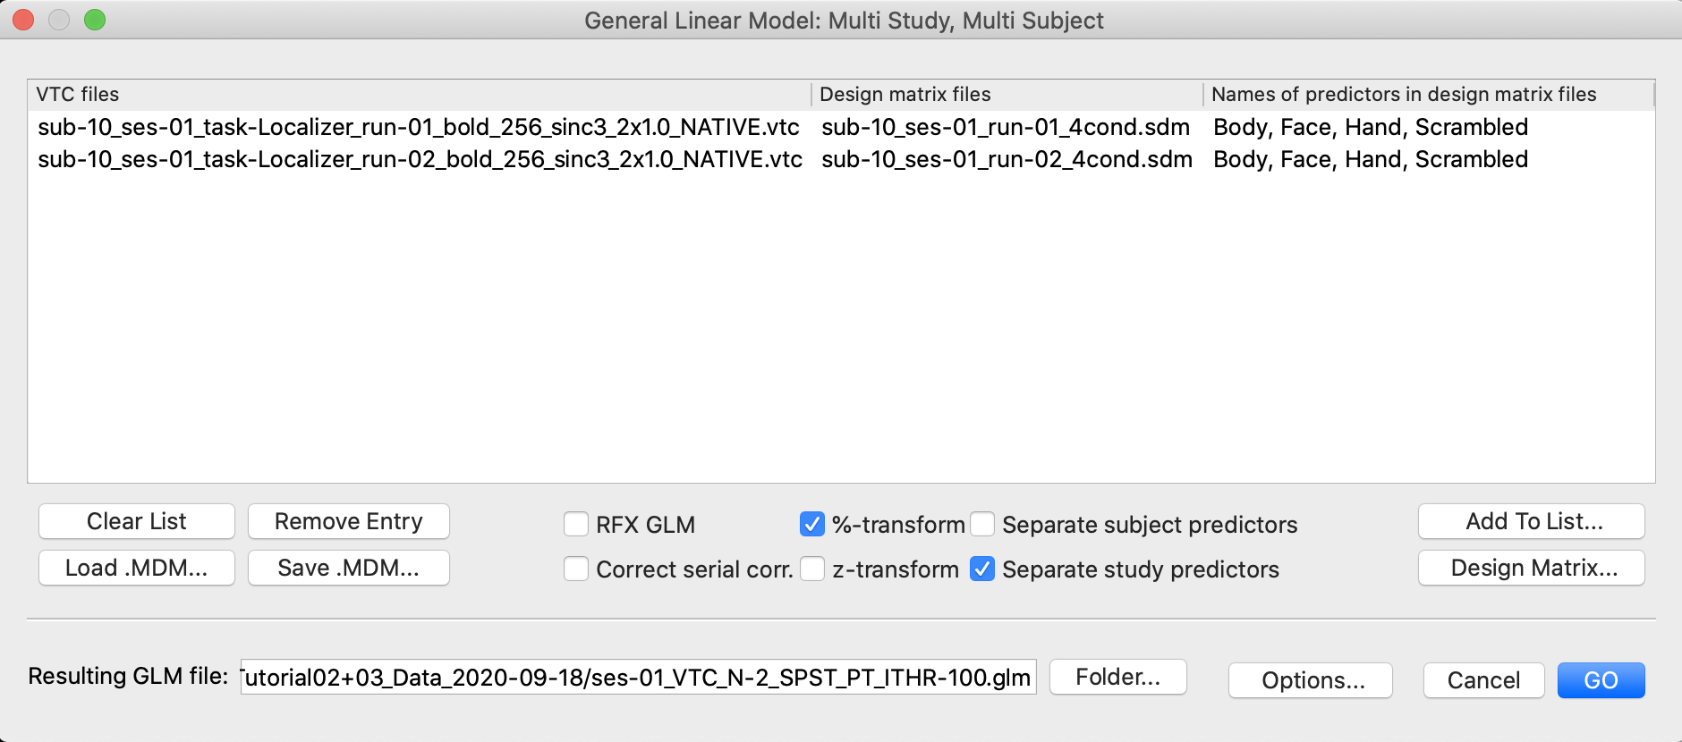
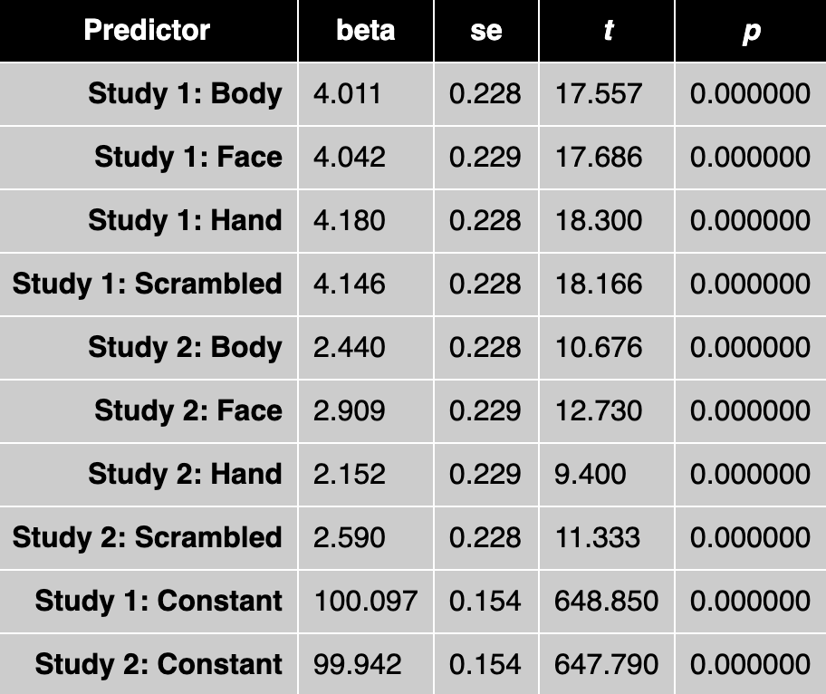
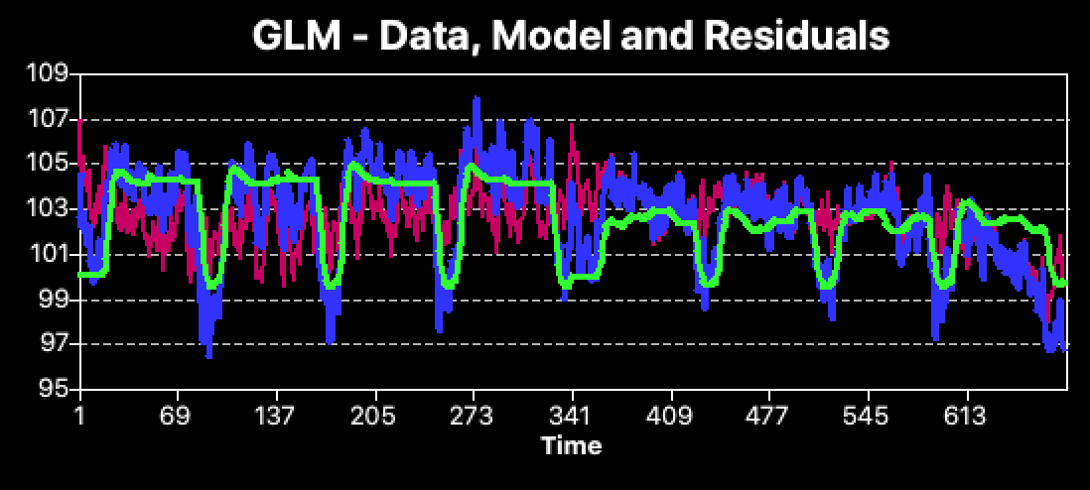
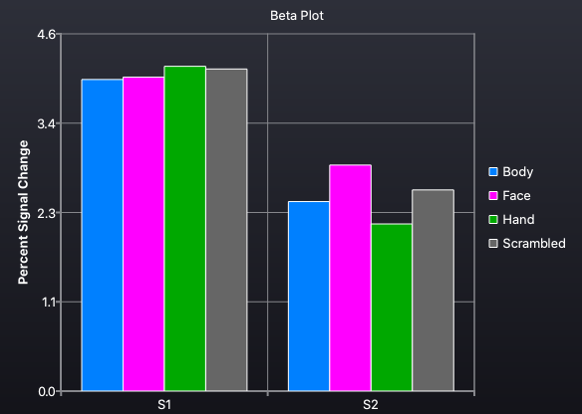
Two runs; One GLM; Sep Study

Slide 23
Combining Runs: Take Home
Most commonly, researchers use one beta per condition (without Sep Study predictors)
However, if you had reason to think that activation would change between runs (e.g., adaptation, learning), it would be reasonable to use separate study predictors

