Slide 1
Using the GLM to perform a correlation

Slide 2
General Linear Model The Swiss Army Knife of Statistics

Slide 3
The General Linear Model (GLM)
GLM definition from Huettel et al.:
a class of statistical tests that assume that the experimental data are composed of the linear combination of different model factors, along with uncorrelated noise
Model
statistical model
Linear
things add up sensibly (1+1 = 2)
note that linearity refers to the predictors in the model and not necessarily the BOLD signal
General
many simpler statistical procedures such as correlations, t-tests and ANOVAs are subsumed by the GLM

Slide 4
GLM for fMRI data
Make one predictor for each condition vs. baseline
Let’s start by considering all of the visual stimulation categories as one condition
Adjust the height of the predictor (slope) and the constant (intercept) to best fit the data

Slide 5
Predictor function

Slide 6
Beta = scaling factor (1 model df)
Adjust the height of the predictor function to match the data
β = 1
β = 2
β = 4
β = 0
β = -3
β = -5
4
3
2
1
0
-1
-2
-3
-4
-5

Slide 7
Constant = 1 model df
Adjust the intercept to best match the data
constant = 0
constant = 2
constant = 4
constant = -3
constant = -5
4
3
2
1
0
-1
-2
-3
-4
-5

Slide 8
Predictors of Interest (POIs) vs. Predictors of No Interest (PONIs)
predictors of interest
components of the model that are crucial to understanding the data
beta weights (slopes)
predictors of no interest
components of the model that are necessary for the model or improve the model but are not particularly important for understanding the data
constants (intercepts)
when we discuss preprocessing, we will learn about the benefits of other PONIs

Slide 9
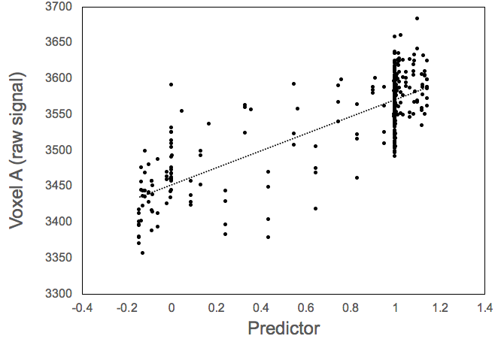
GLM works same as correlation
r = .8
r² = .64
β = slope
constant = intercept
R² = r² = goodness of fit

Slide 10
The beta weight is NOT a correlation
beta weight = slope = size of difference
correlation = goodness of fit
small ß
large r
small ß
small r
large ß
large r
large ß
small r

Slide 11
Residuals
model = β-scaled predictor
data
residuals
= data - model
predictor
𝛴
squared residuals

Slide 12
Residuals
Best fit model will minimize sum of squared residuals
r² = σ_{explained}/ (σ_{explained}+ σ_{unexplained})
r² = SS_{model} / (SS_{model} + SS_{residuals})

Slide 13
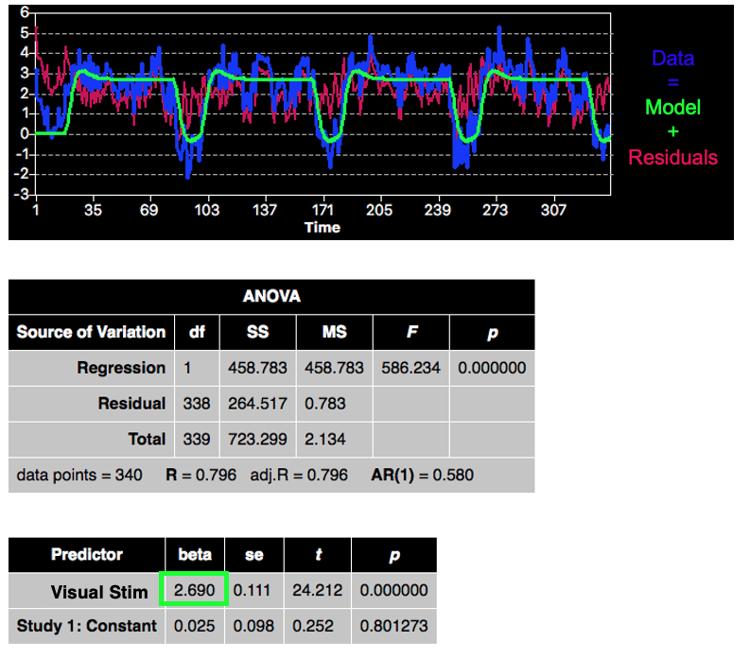
ROI-GLM output for Voxel A

