Slide 1
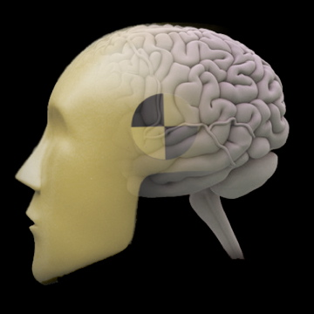
fMRI Analysis with emphasis on the General Linear Model
Jody Culham
Brain and Mind Institute
Department of Psychology
Western University
http://www.fmri4newbies.com/
Last Update: September 24, 2020
Last Course: Psychology 9223, F2020, Western University

Slide 2
Course Approach
Minimal math; intuitions
Start with one voxel in one run of one participant two conditions
correlation
GLM
Enhance understanding of GLM
Extend to multiple conditions
Extend to multiple runs
Consider corrections for violations of assumptions
Learn how preprocessing is beneficial
Extend to multiple participants
Extend to more complex situations (event-related deconvolution, parametric models, ANOVAs)

Slide 3
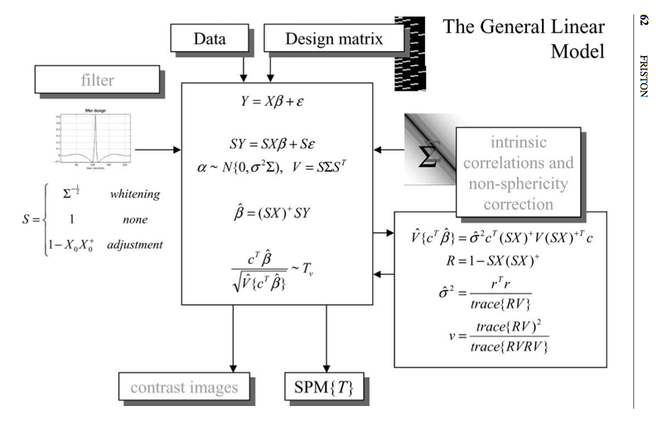
The GLM for Math Whizzes
Friston 2005, Ann. Rev. Psych.

Slide 4
A Simple Correlation

Slide 5
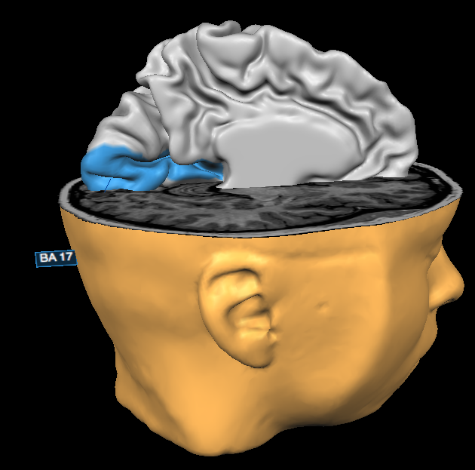
Visual Cortex (V1)
To begin, let’s examine one functional voxel in visual cortex
Visual cortex is at the back of the cerebral cortex, in the occipital lobe, with primary visual cortex (V1) falling in Brodman Area 17 (blue in left image below)
V1 and other visual areas are organized into a map of the visual field,
the centre (where our participant is fixating) at the pole and more periphearl locations represented farther forward
Because our stimuli were relatively small and near fixation, we expect parafoveal activation
Occipital Pole represents parafoveal vision (near fixation point) for early visual areas, V1/V2/V3

Slide 6
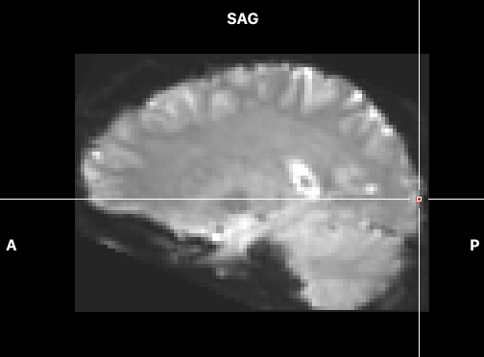
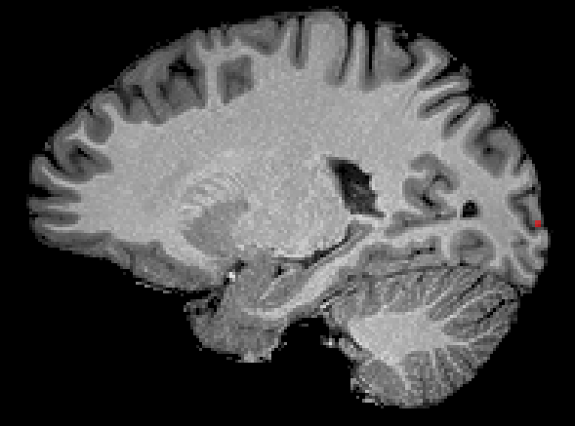
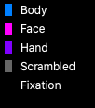
The simplest case: 1 voxel, 2 states
Early visual cortex
Visual stimulation
What would be the expected time course for a brain area (e.g., V1) that responded to visual stimulation?

Slide 7
Expected Neural Activity
Because we don’t know what units the y-axis is in, nor how big the effect will be, we can arbitrarily scale the predictor from 0 to 1

Slide 8
BOLD Time Course Blood Oxygenation Level-Dependent Signal
Positive BOLD response
3
2
Overshoot
BOLD Response (% signal change)
Post-stimulus Undershoot
1
Initial Dip
0
Time
Stimulus

Slide 9
Modelling the HRF: Two-gamma function

Slide 10
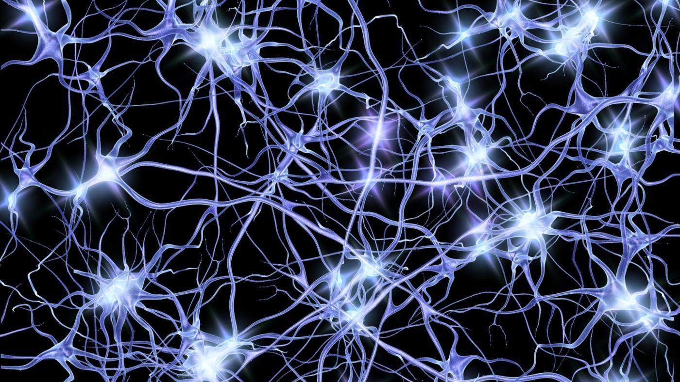
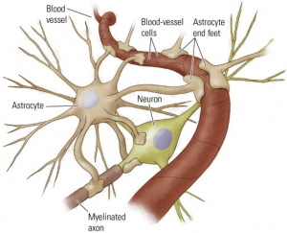
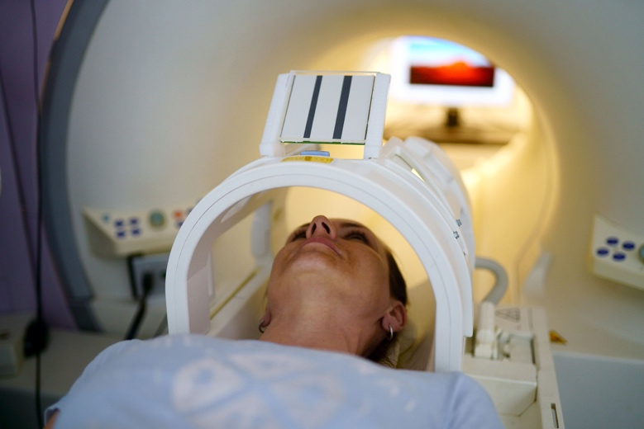
Incorporating the HRF
Neural activity
Neurovascular coupling
Signal measured in fMRI
=
convolution
Model of neural activity
Model of HRF
Model of expected BOLD signal

Slide 11
Predicted vs. Actual Time Course
Predicted BOLD response
Actual BOLD response in Voxel A

Slide 12
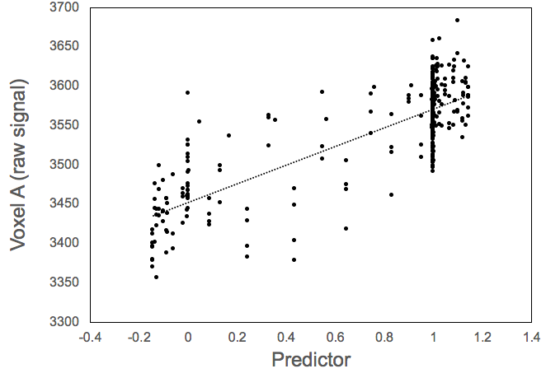
Pearson Correlation
r = .8
r² = .64

Slide 13
Y-Axis Converted to %BSC
Activation
(Raw Signal)
Time (1-s volumes)
Remember this is the change in BOLD, not neural activation
Block designs:
Big: several %
Moderate: 1%
Small: fraction of 1%
% BOLD Signal Change (%BSC) for each time point
Y_{%BSC} = (Y_{raw} – Y_{baseline})/Y_{baseline})*100
Activation
(% Signal Change)

Slide 14
Alternative to %BSC
z-score
Y_{z} = (Y_{raw} – Y_{mean})/Y_{SD over time})
units become SDs
Y_{mean} and Y_{SD} are specific to a run
works fine if all conditions are within one run
bad idea if different conditions are in different runs because different runs will have different SDs (due to potenitally different effect sizes and potentially different noise levels)

Slide 15
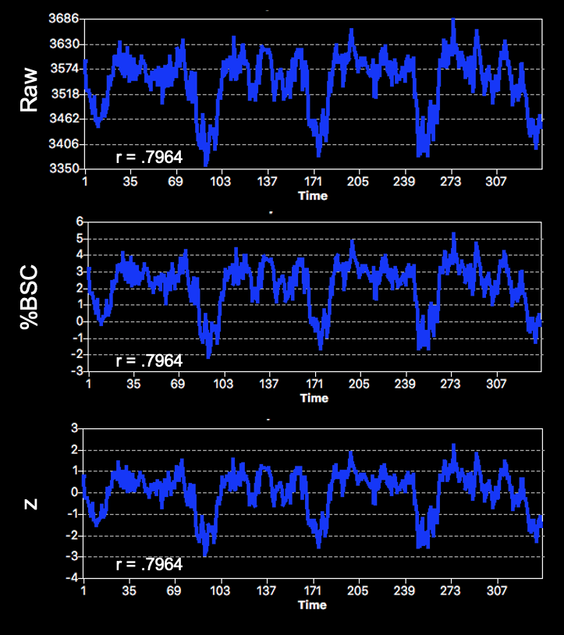
Units don’t affect r

Slide 16
Which time course shows the clearest evidence of a visual stimulation effect? Which shows the least?

Slide 17
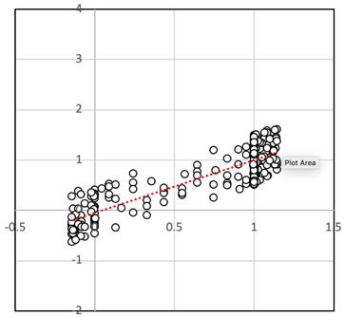
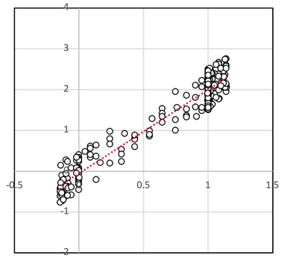
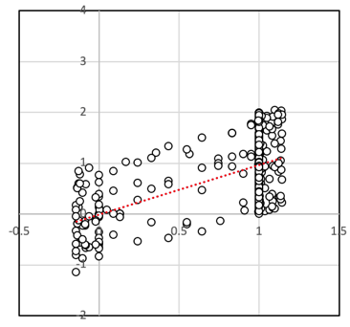
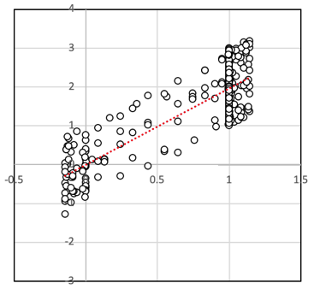
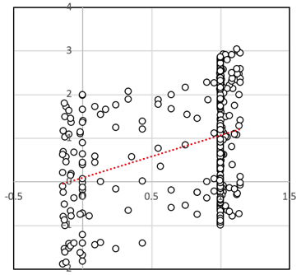
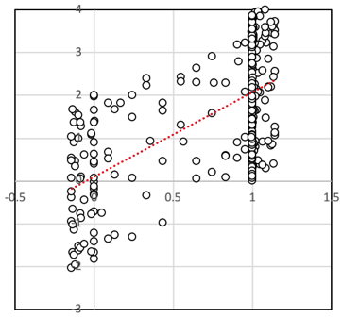
1% BSC effect
2% BSC effect
low noise
r² = .71
slope = 1.04
r² = .90
slope = 2.04
med noise
r² = .34
slope = 0.97
r² = .68
slope = 1.97
high noise
r² =.11
slope = 0.97
r² = .35
slope = 1.97

Slide 18
Understanding correlations
How big is the activation difference?
slope = activation difference between the two conditions
1% BSC or 2% BSC
How big is the activation difference, taking into account how noisy the data is?
σ = variance
r²
= σ_{explained}/ σ_{total}
= σ_{explained}/ (σ_{explained}+ σ_{unexplained})
How likely is it that an activation difference of this size could occur due to chance?
consider r² in light of how much data we have (df = degrees of freedom)

Slide 19
fMRI Statistics
The noisiness of the data can be derived from two possible sources
First level
variability over time
Second level
variability over participants
Because we only have one run from one participant, we can only do the former
When we discuss group data, we will learn how to do the latter

Slide 20
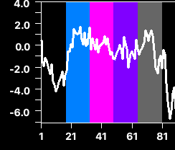
Which data is more trustworthy?

Slide 21
Degrees of Freedom
Total degrees of freedom = 340 data points (volumes)
Model degrees of freedom
For a correlation, there are 2 df (slope + intercept)
Residual degrees of freedom
Total – model
340 – 2 = 338

Slide 22
Statistical Errors
Is there a real activation difference in a given voxel?
Yes
No
Correct
decision
(true positive)
Type I Error
(false positive)
Limit ⍺ to p < .05
(5%)
Yes
Does the statistical test indicate an activation difference in the given voxel?
Correct
decision
(correct
rejection)
Type II Error
(incorrect
rejection)
No

Slide 23
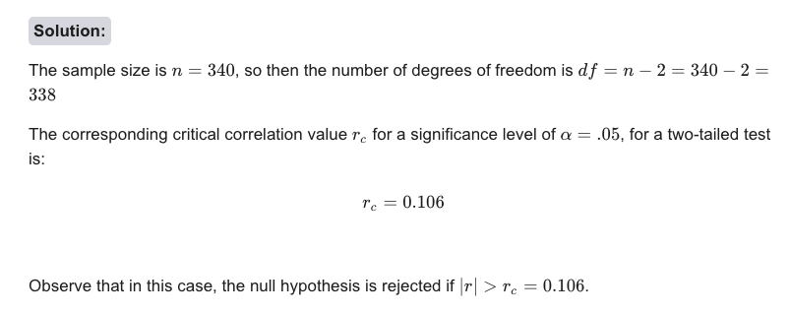
Statistical significance
alpha = .05 (two-tailed)
df = 338
r_{critical} = .106
|r| > .106 is statistically significant
https://mathcracker.com/critical-correlation-calculator#results

Slide 24
Voxelwise statistical tests Just a few more times…
BV resampled the functional data into standard (MNI) space at a resolution of 2 x 2 x 2 mm
We discarded voxels outside the brain in the volumetric functional (vtc) file
This led to 194,003 functional voxels
So we just have to do this 194,003 more times…

Slide 25
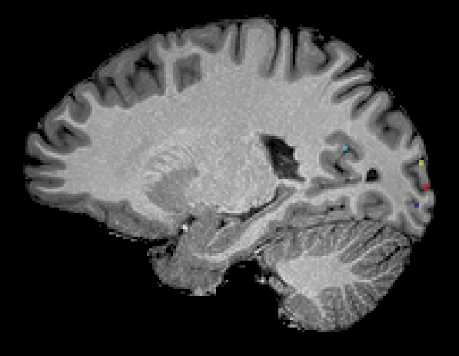
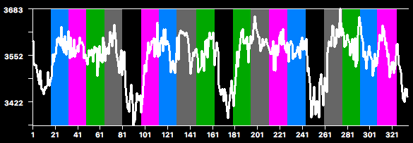
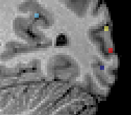
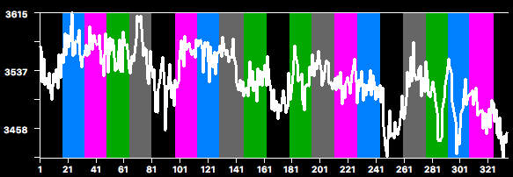
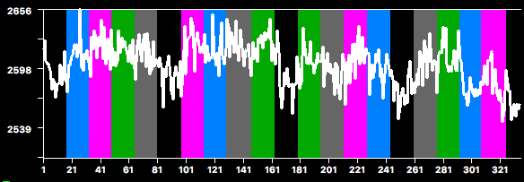
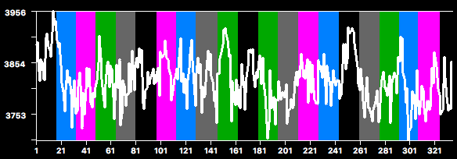
Visual Stimulation Predictor
x = 108
Voxel A
r = .796
D
C
A
B
Voxel B
r = .358
Voxel C
r = .457
Voxel D
r = -.374

Slide 26
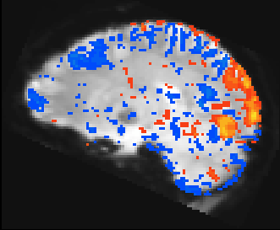
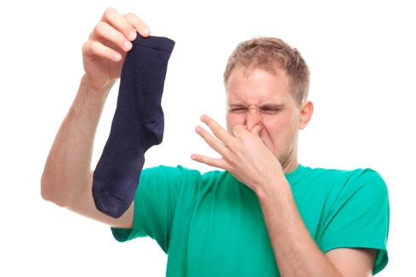
Maximum
Maximum
Positive Correlations
(Visual Stimuli > Baseline)
Negative Correlations
(Visual Stimuli < Baseline)
Minimum (Threshold)
Minimum (Threshold)
Sniff test failed!
Legitimate activation expected in gray matter clusters
Generally NO legitimate activation expected in
ventricles
outside head
in white matter unless experiments are done carefully (Gawryluk, Mazerolle & D’Arcy, 2014)
single voxels unless you’re in fine nuclei
r >= .11
(max r = 1)
voxelwise p < .05
g

Slide 27
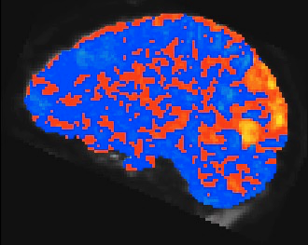
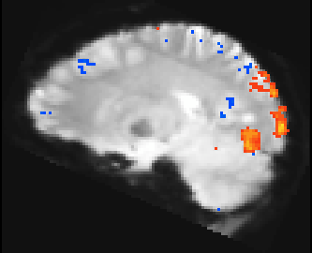
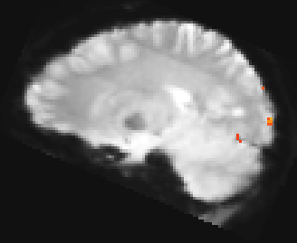
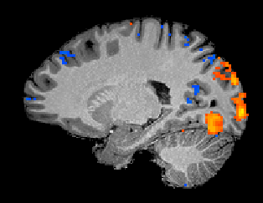
Maximum
Maximum
Positive Correlations
(Visual Stimuli > Baseline)
Negative Correlations
(Visual Stimuli < Baseline)
Minimum (Threshold)
Minimum (Threshold)
Effect of Changing Minimum (Threshold)
c
r > 0
(max r >= 1)
voxelwise p = 1
r >= .11
(max r > 1)
voxelwise p < .05
r >= .29
(max r >= 1)
voxelwise p < .00000026
[familywise (Bonferroni) p < .05]
r >= .6
(max r >= 1)
voxelwise p < 10⁻³⁴
superimposed on functional vs. anatomical scan

Slide 28
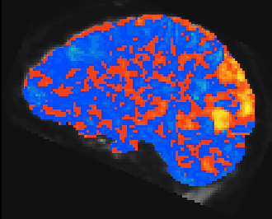
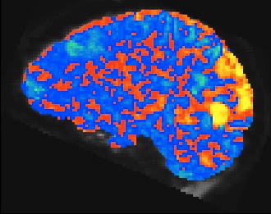
c
Maximum
Maximum
Positive Correlations
(Visual Stimuli > Baseline)
Negative Correlations
(Visual Stimuli < Baseline)
r > 0
(max r >= 1)
voxelwise p = 1
Minimum (Threshold)
Minimum (Threshold)
Recommendation:
Set maximum around the most significant voxel so that look-up table spans the full range
Effect of Changing Maximum
r > 0
(max r >= .8)
voxelwise p = 1
r > 0
(max r >= .5)
voxelwise p = 1

