Slide 1
Class Experiment
Data and Terminology

Slide 2
Timing Terminology

Slide 3
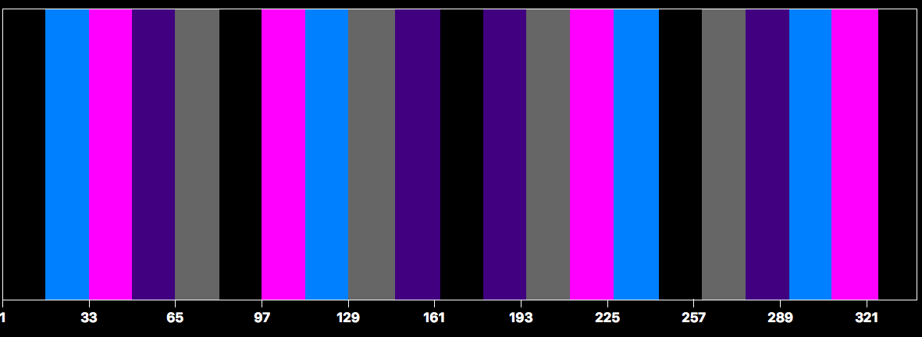
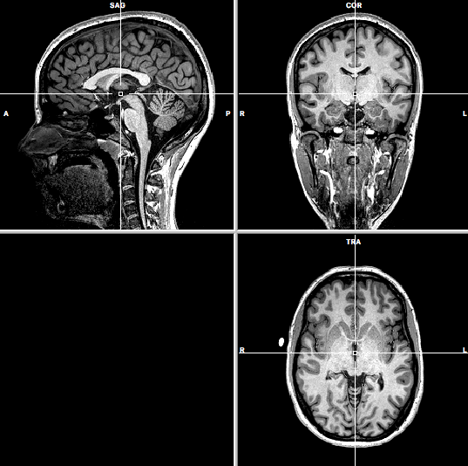
Our Experiment: One Session
Session: One set of functional and anatomical scans
e.g., In patients, may have one session before treatment and one after

Slide 4
Protocol File
Brain Voyager file type: .prt (protocol)
Text file (can be edited by a text editor

Slide 5
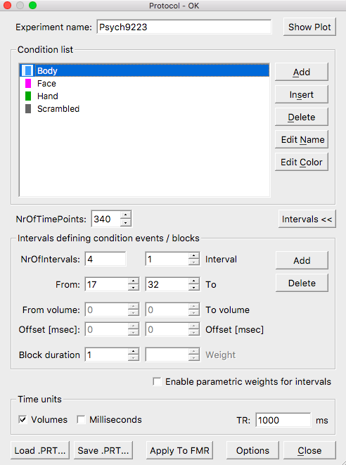
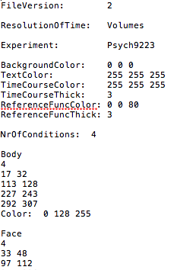
Protocol File
GUI view
Text Editor view
…

Slide 6
Protocol Terminology
bodies
faces
hands
scrambled
black = baseline fixation
5 conditions (or 4 conditions
+ baseline)
1 run
Run: Continuous collection of data over time
typically 3-10 minutes
Condition: type of stimuli or task
Some terminology varies between labs
e.g., “scan” can mean run, volume or session

Slide 7
Protocol Terminology
bodies
faces
hands
scrambled
black = baseline fixation
1st epoch
or block of faces
Epoch: One block of trials for a condition
Block Design: Experiment in which trials are grouped into blocks
-- typically ~15 s/block (range 10-30)

Slide 8
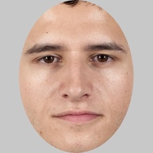
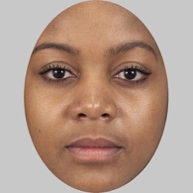
Protocol
1st face epoch
RUN
TIME→
TRIALS
Trial 1
Trial 2
Note for cognitive science sticklers: Because stimuli are unmasked and visual processing likely continues in iconic memory during the ITI (and because the HRF isn’t that great temporally anyway), our models will assume visual activation is high throughout the epoch and does not fluctuate between SD and ITI
200-ms
intertrial interval (ITI)
800-ms
stimulus
duration (SD)
1-s stimulus onset asynchrony (SOA)

Slide 9
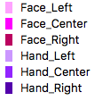
Protocol Terminology
1st trial
of faces left

Slide 10
What happens at the scanner in a session?

Slide 11
fMRI Experiment Stages
1) Prepare subject
Consent form
Safety screening
Instructions and practice trials if appropriate

Slide 12
fMRI Experiment Stages
2) Sagittal scout images
Take images along the midline to plan slices
Note: That’s one g, two t’s
In this example, these are the functional slices we want: 52 slices x 2.5 mm

Slide 13
fMRI Experiment Stages
3) Shimming
putting body in magnetic field makes it non-uniform
adjust 3 orthogonal weak magnets to make magnetic field as homogenous as possible in functionally scanned volume

Slide 14
fMRI Experiment Stages
4) Take anatomical (T1) images
high-resolution images (e.g., 1-mm resolution)
3D data: 3 spatial dimensions, sampled at one point in time
Anonymous
[defaced]
1 slice (sagittal)
2D

Slide 15
Zooming In
1 mm
1 mm
1 mm

Slide 16
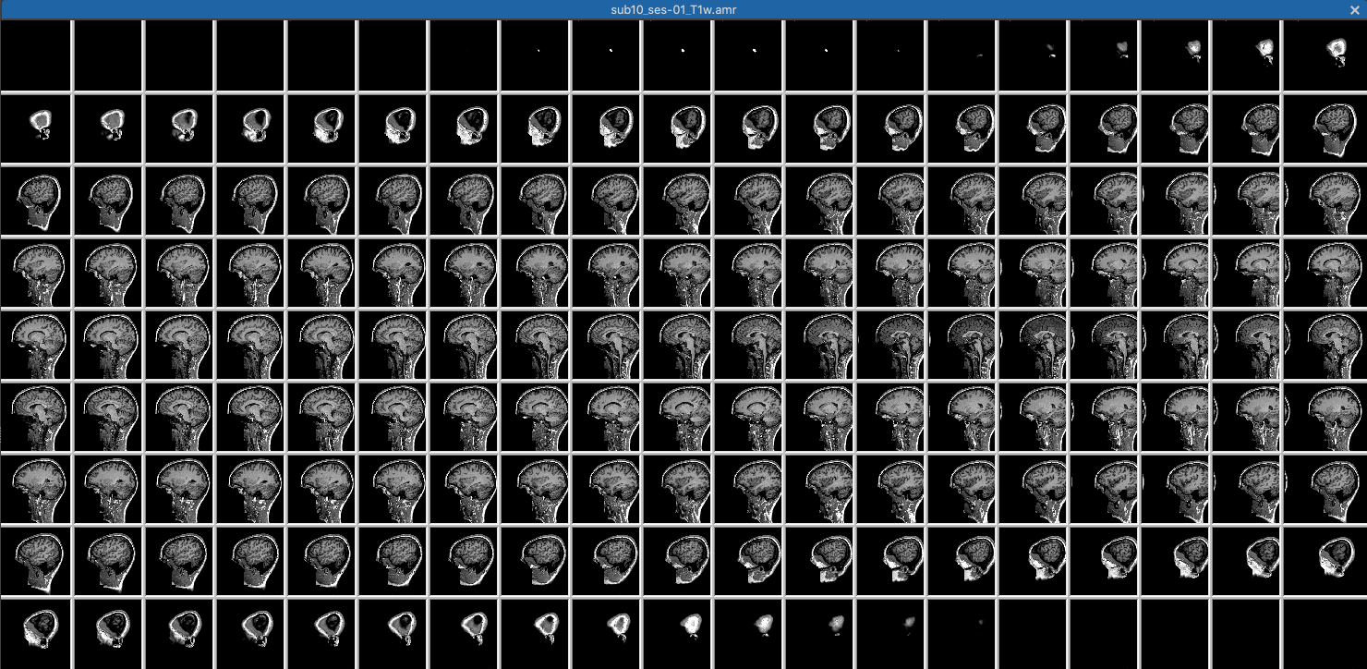
Anatomical (T1) Scan
Brain Voyager file type: .amr (anatomical MR)
3D (stack of 2D slices)
Our data: 176 slices at 1-mm isotropic resolution

Slide 17
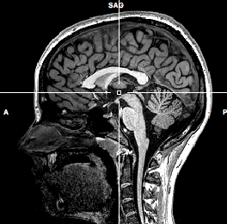
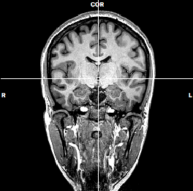
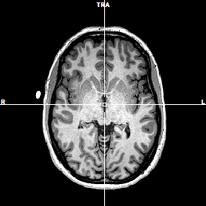
One Volume
Volume = One stacked set of slices that forms a full 3D sample of the desired brain volume
+
z
-
L
R
+
y
-
-
+
x
Brain Voyager file type: .vmr (volumetric MR)
3D
Our data: 176 slices at 1-mm isotropic resolution

Slide 18
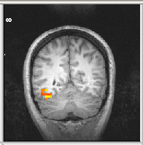
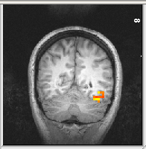
Left is what?!!!
Neurologic (i.e. sensible) convention
left is left, right is right
Note: Make sure you know what your magnet and software are doing before publishing left/right info!
L
R
-
+
x = 0
Radiologic (i.e. stupid) convention
left is right, right is left
R
L
+
-
x = 0

Slide 19
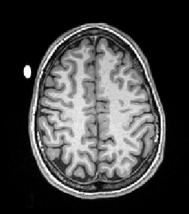
Pro Tip
Put a vitamin E capsule on the one side (always the same side!) of the subject’s head or coil.

Slide 20
fMRI Experiment Stages
5) Take functional (T2*) images
medium-resolution images (e.g., 2.5-mm resolution)
4D data: 3 spatial dimensions x time dimension

Slide 21
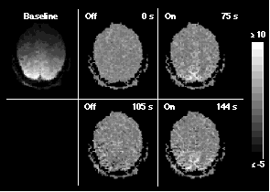
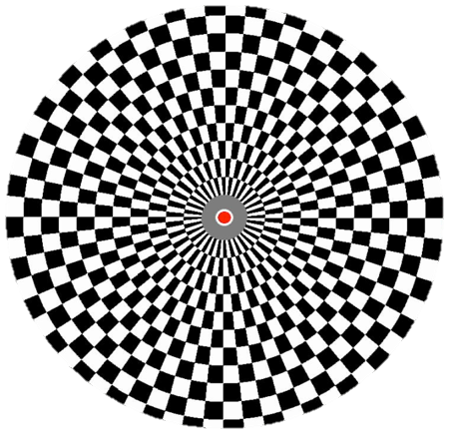
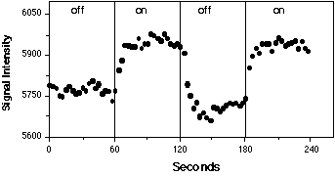
Functional Activation Changes Over Time
Flickering Checkerboard
OFF (60 s) - ON (60 s) - OFF (60 s) - ON (60 s)
Source: Kwong et al., 1992

Slide 22
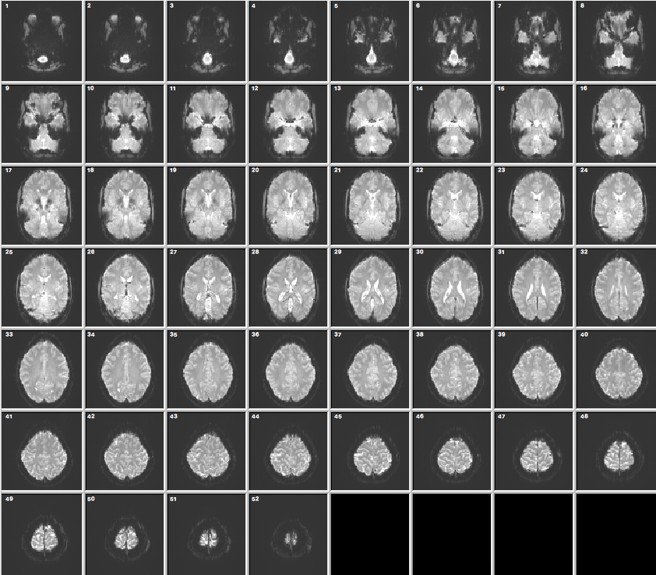
Functional Volume
Volume: One stacked set of slices that forms a full sample of the desired brain volume
Brain Voyager file type: .fmr (functional MR)
appears 3D (stack) but you can see 4th dimension (time) through movie
Our data: 52 slices at 2.5-mm isotropic resolution and 1-s temporal resolution

Slide 23
Volumes in Time
340 volumes
We collected one volume every second for 340 s
One can think of volumes as spatial (3D units) or temporal (e.g, 1 volume = 1 s)
… 340 volumes

Slide 24
Slice Terminology
SLICE THICKNESS
e.g., 2.5 mm
VOXEL
(Volumetric Pixel)
In-plane resolution
e.g., 210 mm / 84
= 2.5 mm
2.5 mm
2.5 mm
IN-PLANE SLICE
2.5 mm
Field of View (FOV)
e.g., 21.0 cm

Slide 25
Voxel Size
non-isotropic
isotropic
same size in 3 directions
non-isotropic
3 x 3 x 6
= 54 mm³
e.g., SNR = 100
3 x 3 x 3
= 27 mm³
e.g., SNR = 71
2.1 x 2.1 x 6
= 27 mm³
e.g., SNR = 71
In general, larger voxels buy you more SNR.
EXCEPT when the activated region does not fill the voxel (partial voluming)

Slide 26
Explain voxel sizes clearly … especially if Jody will be your thesis examiner!
Anatomical voxel sizes are typically 1-mm isotropic
Functional voxel sizes are typically 2- to 3-mm isotropic
Software may resample functional voxel sizes
e.g., Brain Voyager resamples functional voxels to 1-, 2- or 3-mm isovoxel resolution
Thus a statement like, ”[Region X] comprised Y voxels” is unclear.
Pop quiz: Which of the following is correct for describing 3-mm isovoxel resolution?
Functional voxels were 3 mm³.
Functional voxels were (3 mm)³.
A or B. They’re equivalent.

Slide 27
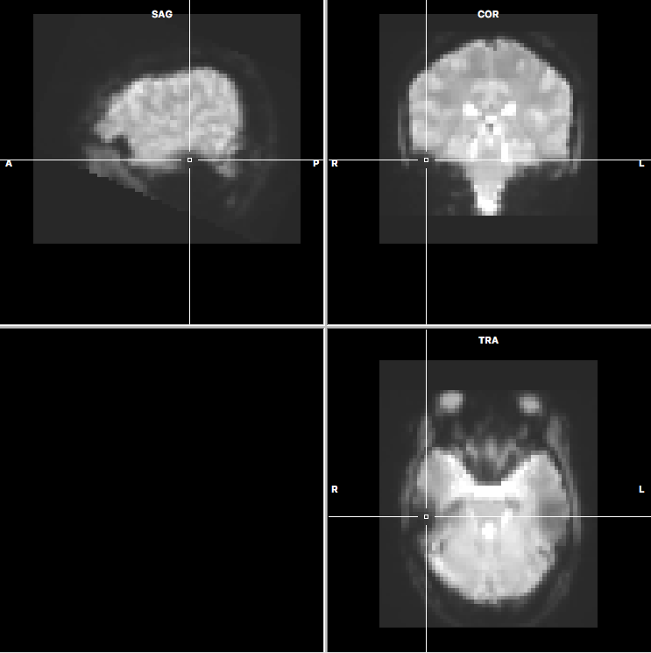
Volumetric Functional
We can render the functional data in the same volumetric coordinate system as the anatomical
This shows the first functional volume of the first localizer
Brain Voyager file type: .vtc (volumetric time course)
appears 3D (stack) but you has 4th dimension (time)

Slide 28
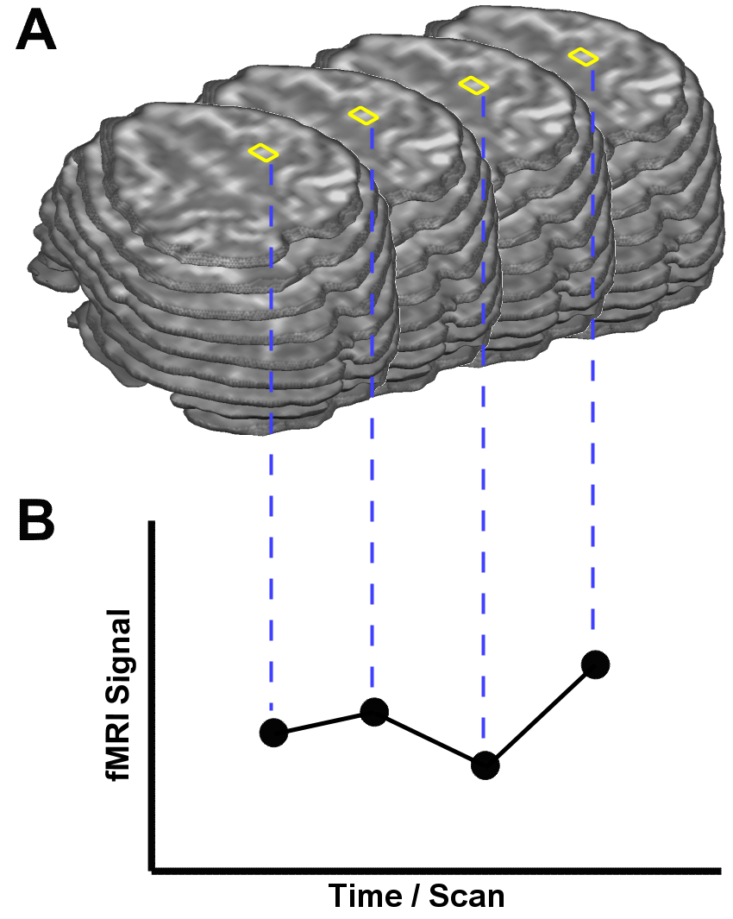
Thinking About Functional Data
Raw data
one run of our localizer
52 slices x 84 x 84
366,912 voxels
2.5-mm isovoxel resolution
340 volumes (time points) @ TR=1 → 5 min: 40 s/run
52 x 84 x 84 x 340 = 124M data points (value = signal intensity)
Processed data
4 dimensions
3 spatial dimensions
x, y, z
1 time dimension
One way to think about it
340 volumes
Another way to think about it
366,912 time courses
Functional data resampled to Native VTC with (2 mm)³ resolution and masked to exclude voxels outside the brain
194,003 functional voxels x 340 time points
…
t340
t3
t4
t1
t2
from Brain Voyager Documentation

Slide 29
Resampling and Masking
Raw data (fmr)
one run of our localizer
52 slices x 84 x 84
366,912 voxels of (2.5 mm)³
…
t340
t3
t4
t1
t2
Resampled data (vtc)
resample data to (2 mm)³ resolution
exclude voxels outside the brain
→ 194,003 functional voxels x 340 time points

Slide 30
Which ”voxel size”?
Native anatomical (slices)
1 mm isotropic
Native functional (slices)
2.5 mm isotropic
Resampled anatomical (volumetric vmr)
1 mm isotropic
Resampled anatomical (volumetric vtc)
2 mm isotropic
this is what matters most for data quality
should be <= native resolution (but making this really small gives you huge files that take a long time to process)
native = resolution collected from the scanner (unresampled)

Slide 31
Resampling
Data may have to be resampled
to go from slices to volumes
e.g., BrainVoyager offers vtc resolutions of (1 mm)³, (2 mm)³ or (3 mm) ³
to get all participants in the same spatial coordinate system so you can do group stats
when correcting for head motion
when doing different filtering (e.g., spatial smoothing)
Example
resampling from 2.5-mm .fmr to create 2-mm .vtc
white = 1 mm cubes for reference
green = 2.5 mm native func
red = 2 mm resampled func
e.g., highlighted red voxel can be derived from weighted combination of green voxels: (1 x lower left + 3 x lower right)/4

Slide 32
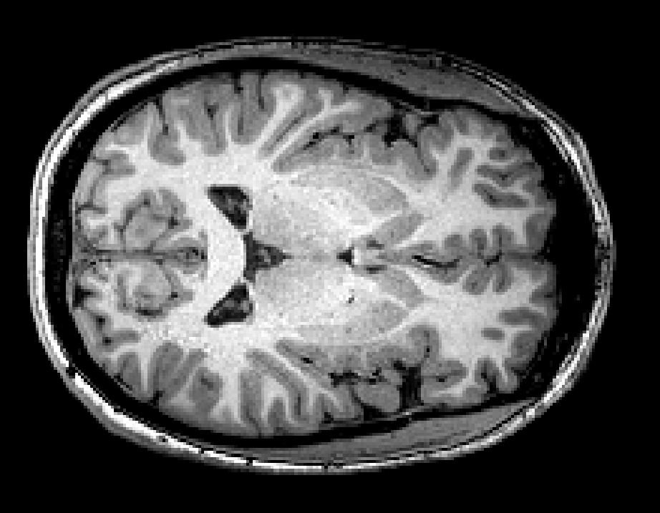
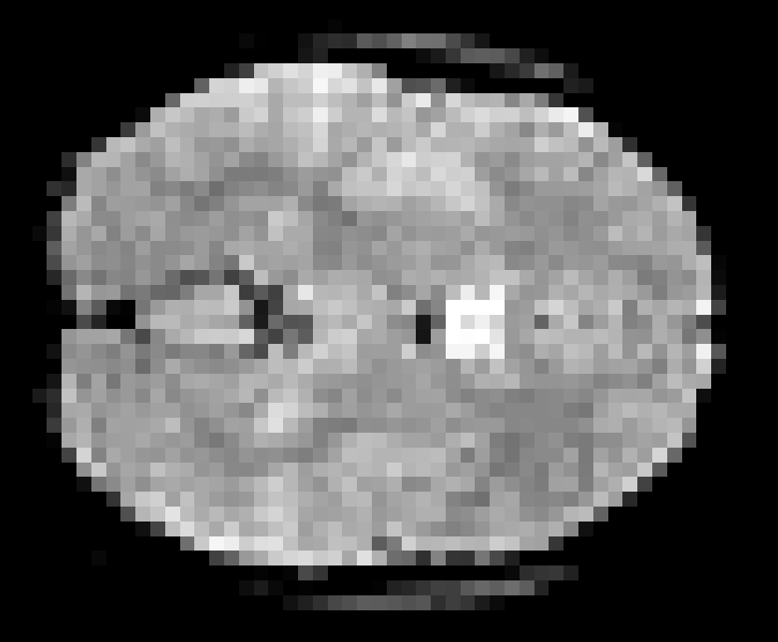
MRI vs. fMRI
MRI
fMRI
high resolution
(1 mm)
low resolution
(~2.5-3 mm)
One 3D volume
…
series of 3D volumes (i.e., 4D data)
(e.g., every 2 sec for 5 mins)
Notes:
I is for Imaging
Imaging parameters are different MRI ”Anatomicals” aim to maximize tissue contrast
fMRI to maximize functional contrast.

Slide 33
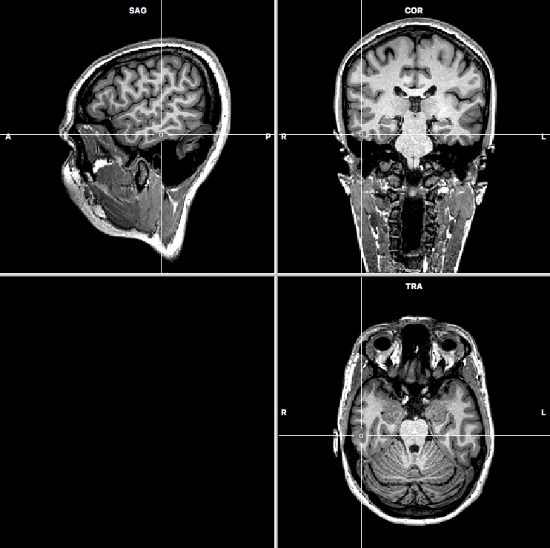
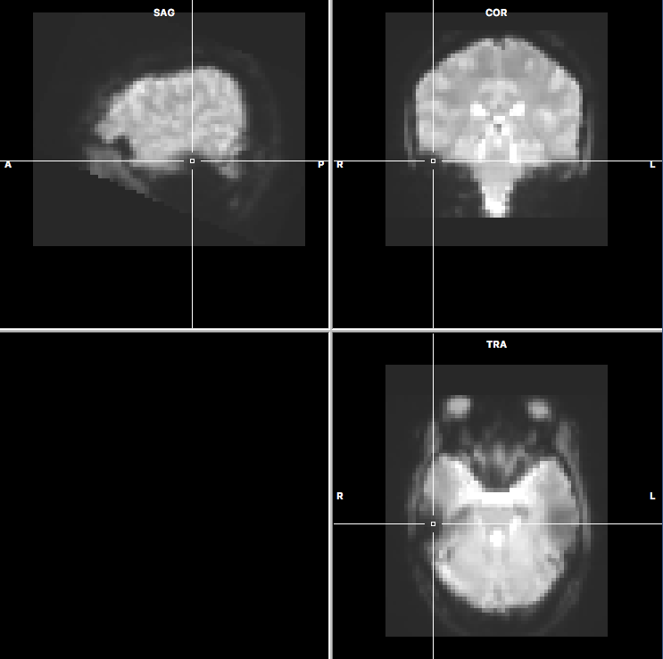
Spot the Differences

Slide 34
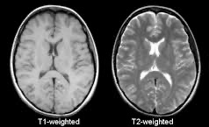
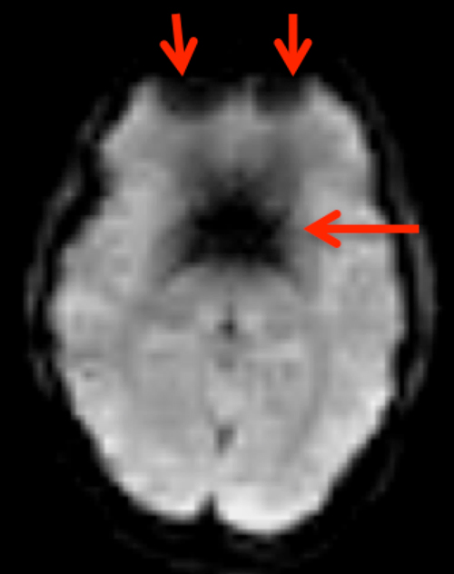
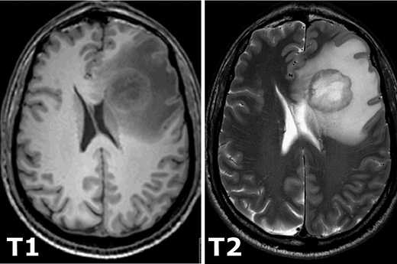
T1, T2 and T2*
T1 = “tee one” = anatomical scan, normal contrast (GM darker than WM), typical anatomical for cogneuro expts
T2 = “tee two” = anatomical scan, reverse contrast (GM brighter than WM), used in clinical scan and animal scans because sometimes it can give better contrast between tissues (e.g., tumor vs. normal tissue, GM vs. WM), susceptibility artifacts
T2* = “tee two star” = functional scan (usually EPI), reverse contrast (GM brighter than WM), susceptibility artifacts, sensitive to BOLD (which is a fine-scale susceptibility artifact)
normal brain in T1 vs. T2
normal brain in T2*, showing susceptibility artifacts
tumor in T1 vs. T2

Slide 35
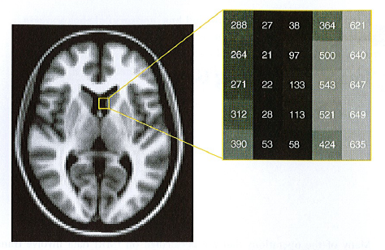
Data Organization
Image from Poldrack et al., 2011
Anatomical or functional data files are basically just matrices of intensity values
Matrices may be 2D for single slices or 3D for one volume or 4D for series of volumes

Slide 36
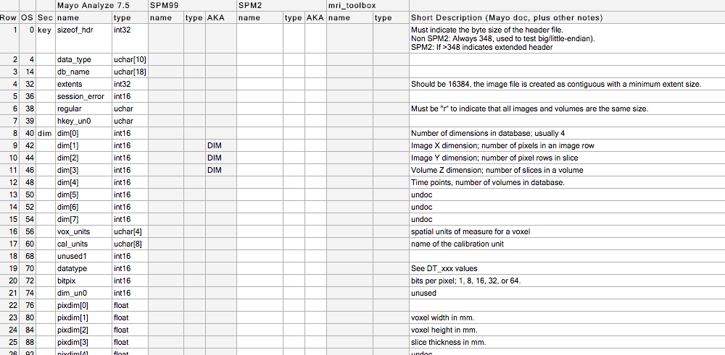
Header Information
Headers
contain info about scanning parameters in structured format
may be separate from data (e.g., SPM/Analyze uses separate .hdr and .img files) or combined with data (e.g., BV .vmr file includes both header and data)

Slide 37
Working With Data
Different scanners and packages use different formats
Examples
Siemens: DICOM format (Digital Imaging and Communications in Medicine)
SPM: Analyze
MNI: MINC
Brain Voyager: vmr, vtc, etc.
NIfTI (Neuroimaging Informatics Technology Initiative)
the new default for file formats
commonly used format useful for transferring data between software packages
other variants (e.g., GIfTI for surfaces)
Can often hack files (esp. text-only files) faster than modifying via GUIs

Slide 38
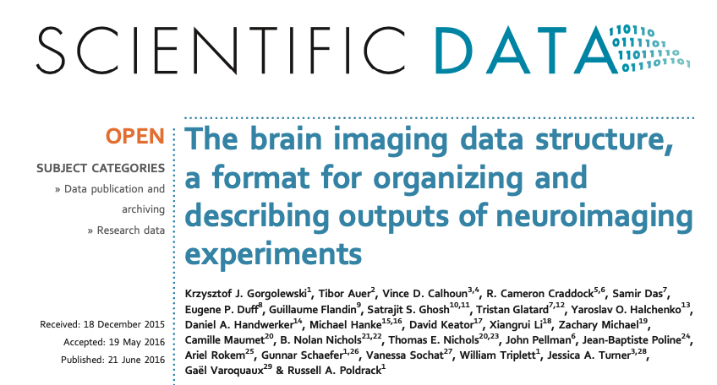
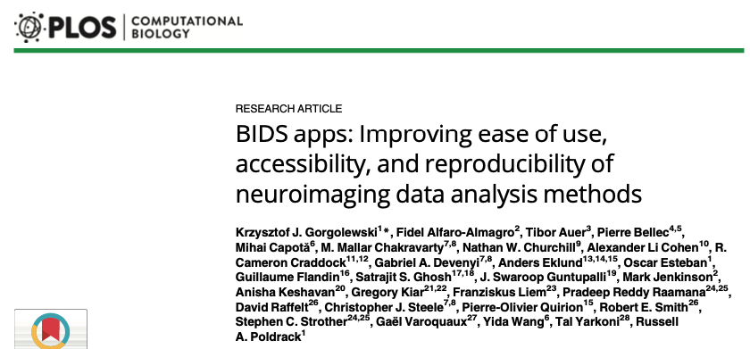
BIDS = Brain Imaging Data Structure

Slide 39
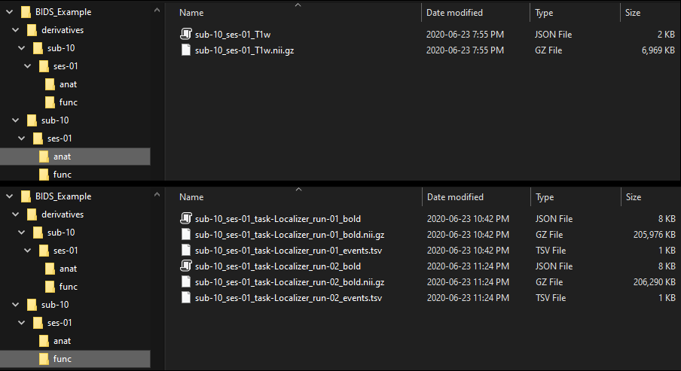
BIDS

Slide 40
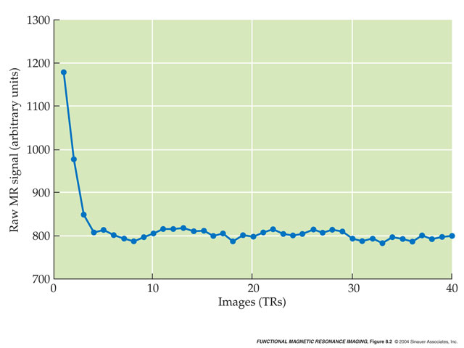
Dummy scans or Disdaqs
Discarded data acquisitions: trashed volumes at the beginning of a run before the magnet has reached a steady state
The scanner may throw out the disdaqs before it saves the data or it may save them too, in which case you have to discard them in your software
Sometimes it can take awhile for the subject to reach a steady state too -- Startle response!

Slide 41
Dummy Scans
Two options for dealing with dummy scans
Discard them at the scanner
Discard them in your analysis software
Example, for our localizer protocol we want 340 real (non-discarded) volumes (TR = 1 s). Say we decided to add 5 dummy scans.
Tell the MR technician to collect 345 volumes, count the first 5 as dummy scans and save only the last 340. In your software, do not skip any volumes.
Tell the MR technician to collect 345 volumes and save all of them. Tell your analysis software to skip the first 5.

Slide 42
Synchronizing your data collection and your stimulus/task software
All of our stats depend on modelling when things happened. If your model is misaligned with the data, say by 5 s in the previous example, your estimates of activation will be incorrect.

Slide 43
Protocol
If this is your protocol, you want to be sure that the first body was presented 16 s in (not 11 s or 21 s if you don’t properly account for the 5 s of dummy scans)

Slide 44
Timing Strategies at CFMM
The scanner console emits one “trigger” at the start of each volume (i.e., first slice), starting with the “real” (non-dummy) volumes (i.e., no trigger is sent for dummy volumes)
There is a trigger box that can plug into the USB port of your stimulus computer/laptop
The trigger is read in as the equivalent to the letter “T” (letter configuration) or the number “5” (number configuration, where 5 is the number above the T key but not 5 on the number pad)
The stimulus computer can count triggers to know when to present stimuli
e.g., presenting body #1 at the start of the 17th real volume (i.e., after 16 s), body #2 on the 18th real volume (i.e., after 17 s) and so on
You can also allow your software to be free running (e.g., present body #1 16 s after the program starts)
This is fine if both the stimulus computer and the scanner console have accurate timing but some people prefer to use triggers
Trigger timing is one of the things most likely to go wrong in an fMRI session so pilot test this carefully (in pilot time, when you’re not paying $150/h and you don’t have a participant getting bored in the scanner)

