Slide 1
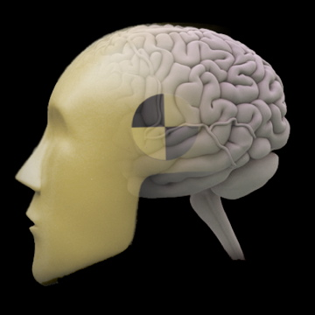
Class Experiment
Jody Culham
Brain and Mind Institute
Department of Psychology
Western University
http://www.fmri4newbies.com/
Last Update: September 15,2020
Last Course: Psychology 9223, F2020, Western University

Slide 2
Class Experiment
Background

Slide 3
Why this project for teaching fMRI?
We wanted:
brain areas that activate reliably
a question that can be addressed with both univariate techniques (subtractions between activation levels) and multivariate techniques (multivoxel pattern analysis)
to illustrate both block designs and event-related designs
to illustrate both region-of-interest and voxelwise analysis approaches
something that’s likely to work at least in part but still enable us to ask novel questions
moderate complexity
2x3 design allows testing of ANOVAs

Slide 4
Our Experiment: Background
When someone looks at you or points at you, it singles you out and catches your attention

Slide 5
Background: Gaze Cueing of Attention
Attention is cued by other people’s gaze and gestures
Posner paradigm – push a button when you see an asterisk on the left or right side of the screen
Valid trial, cartoon face
Invalid trial, photo face
https://www.ncbi.nlm.nih.gov/pmc/articles/PMC1950440/

Slide 6
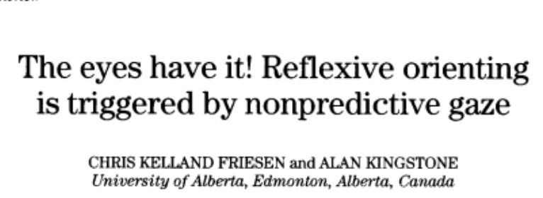
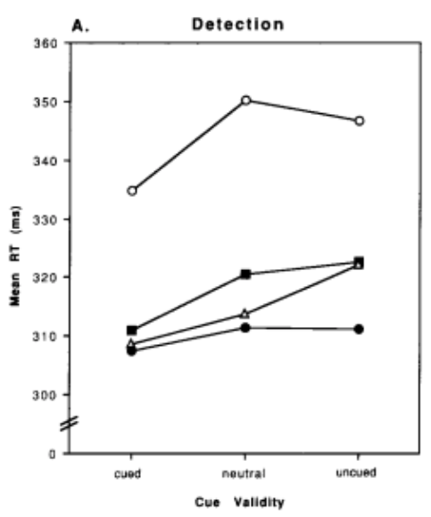
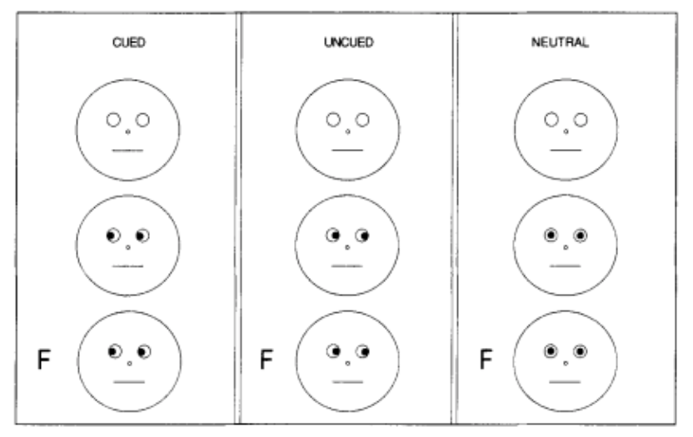
Background: Gaze Cueing of Attention
Gaze-Cued Target: Fast!
Neutral and Uncued Target Slow!

Slide 7
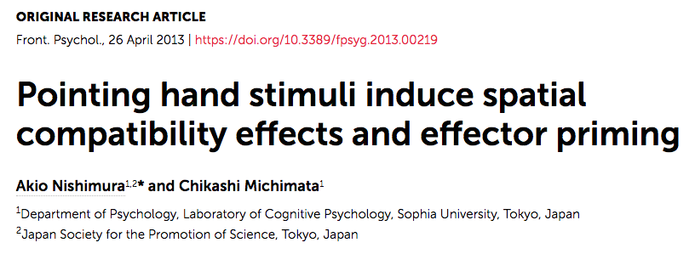
Background: Pointing-Hand Cueing
Posner cueing also works for arrow cues and pointing hand cues

Slide 8
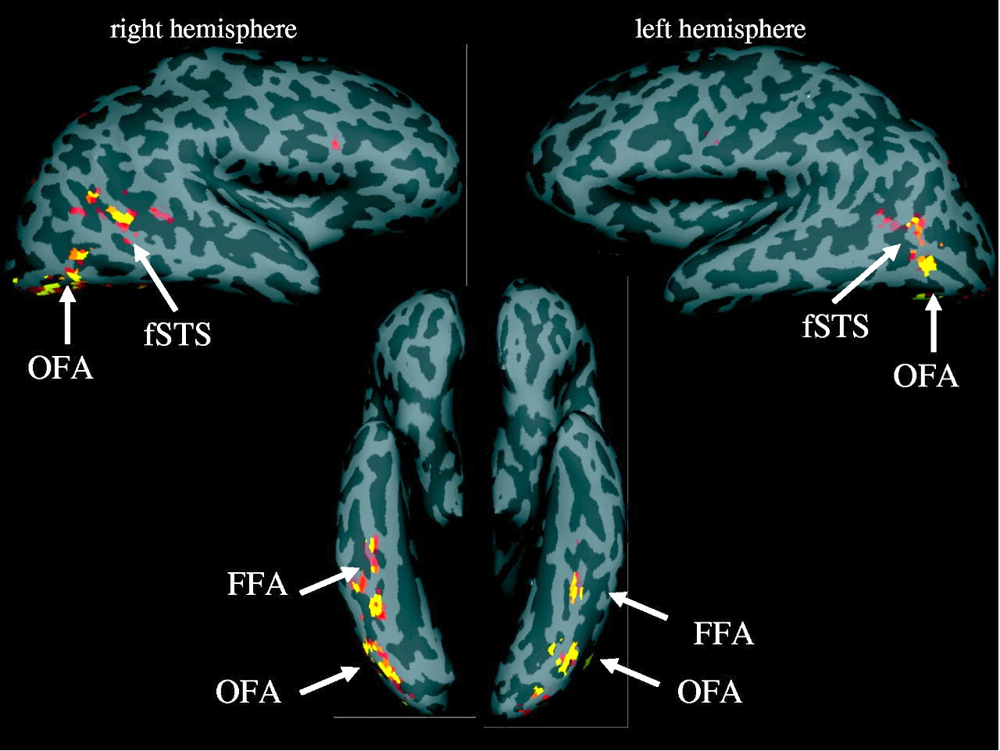
Background: Face-selective Brain Regions
Kanwisher & Yovel, 2006

Slide 9
Background: Fusiform Face Area

Slide 10
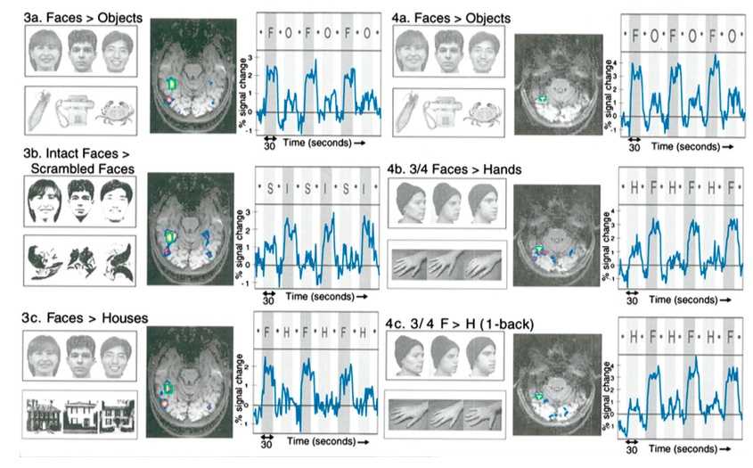
Background: Fusiform Face Area

Slide 11
Background: LOTC_{hand}

Slide 12
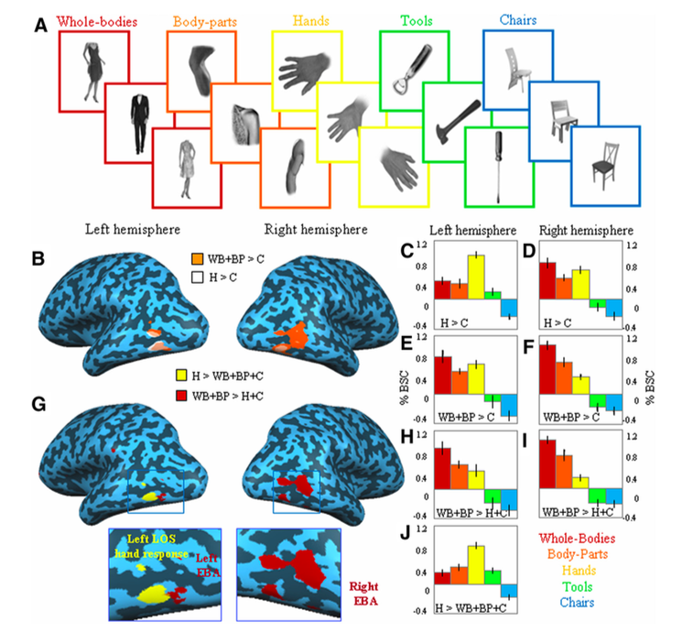
Background: LOTC_{hand}
Various regions of the lateral occipito-temporal cortex (LOTC) respond best to specific categories of visual stimuli (e.g., hands, objects, faces, bodies, tools)
LOTC_{hand} is the region that shows a preferential response for hand images
Extrastriate body area (EBA) is a region that shows a preferential response for body images
Bracci et al., 2010

Slide 13
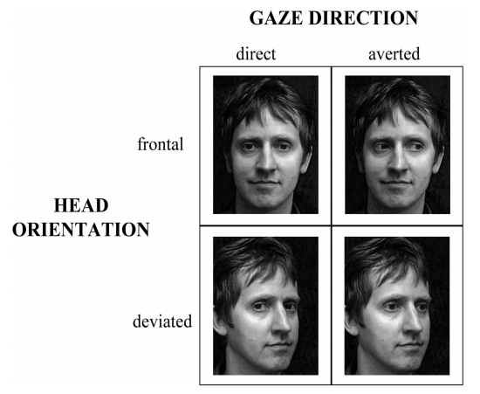
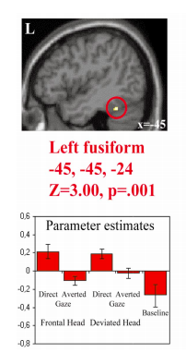
Gaze Direction Modulates fMRI Activity

Slide 14
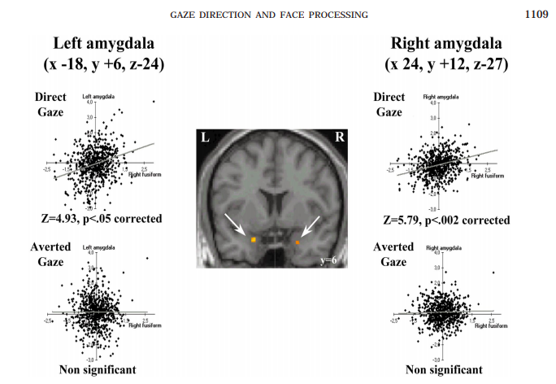
Gaze Direction Modulates fMRI Coupling
Activation in the fusiform gyrus and amygdala are correlated for direct gaze but not averted gaze

Slide 15
Primary Questions
Activation levels (univariate contrasts)
Can we replicate past studies showing greater activation for direct than indirect gaze in face-selective FFA and other areas?
Can we find greater activation for direct than indirect pointing in hand-selective LOTC_{hand} and other areas?
Activation patterns (multivoxel pattern analysis)
Can we find coding not just of direct-indirect stimuli but also left vs. right stimuli within faces and within hands?
Can we find cross-coding of direct, left and right between faces and hands?

Slide 16
Class Experiment
Design

Slide 17
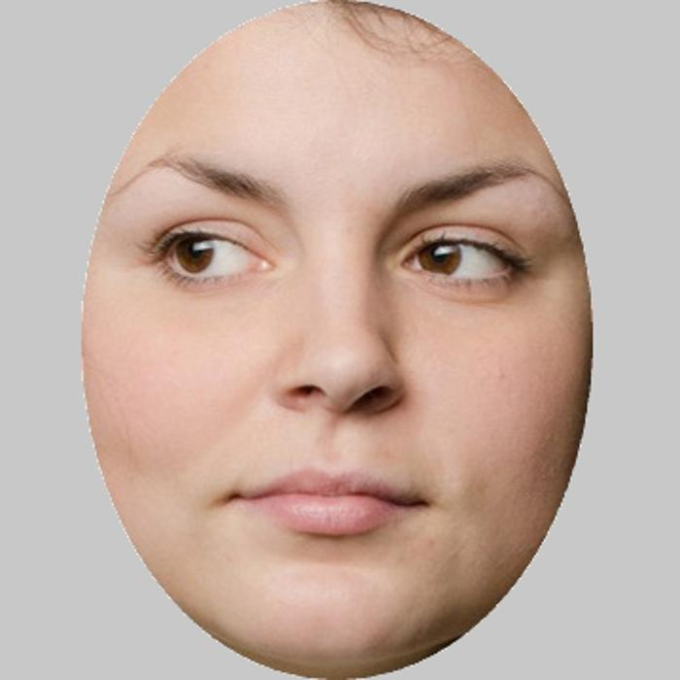
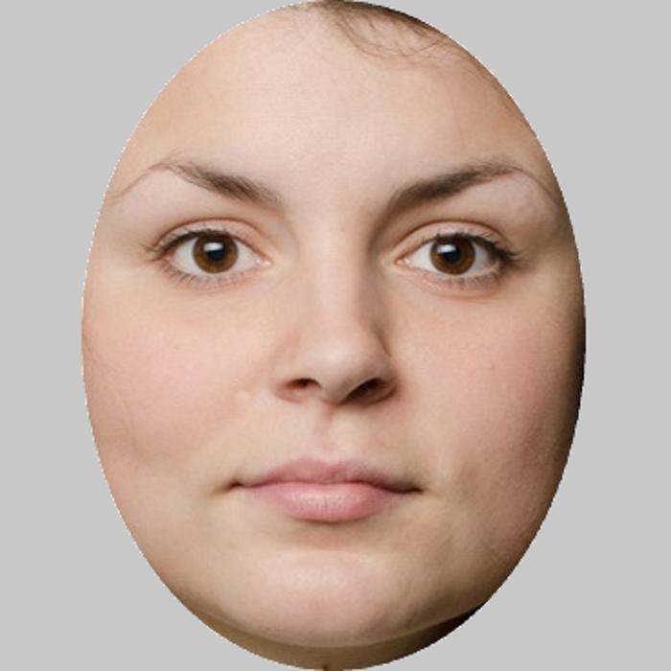
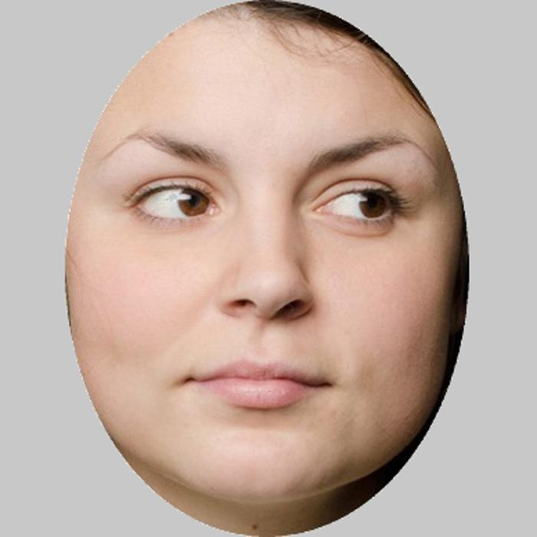
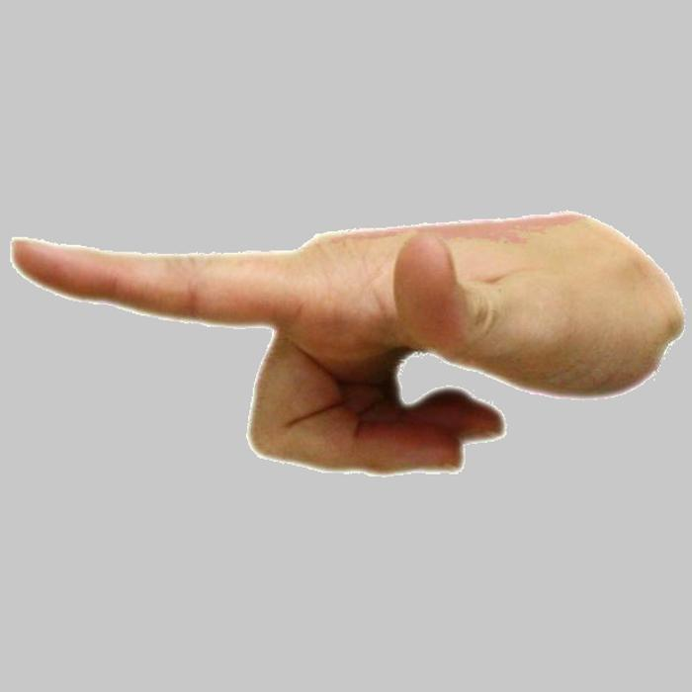
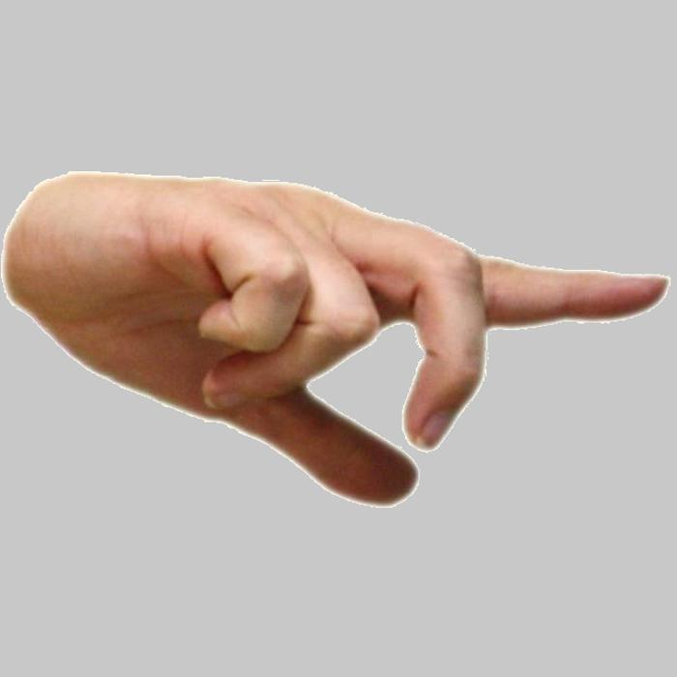
Main Experiment Stimuli
x 8 exemplars (4 men, 4 women)

Slide 18
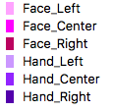
Main Experiment: Rapid Jittered Event-Related Design
x 6 runs with diff orders
rapid = trials every 4-8 s
jittered = irregular trial spacing
event-related = measure response to single events (i.e., trials)
optimized = each trial follows every type of trial an equal number of times

Slide 19
Main Experiment Movie Clip

Slide 20
One-back task
press a button every time you see the exact same image twice in a row
helps to maintain attention

Slide 21
Two approaches to analyzing data
“Whole-brain” or “voxelwise” approach
For every voxel in the scanned volume (typically but not necessarily the whole brain), do a statistical test to look for expected differences in activation
e.g., ANOVA
main effect of stimulus category (faces vs. hands)
main effect of direction (left, direct, right)
interaction
Pros
simple, only need experiment data
can find activation differences anywhere in the scanned volume
Cons
need to correct for massive multiple comparisons → need for stringent statistical corrections that make effects harder to find
may be difficult to know whether the regions you find activated are the expected ones or nearby ones
locations of specific regions may differ from participant to participant

Slide 22
Two approaches to analyzing data
Region-of-interest approach
Conduct separate “localizer” scan(s) to identify expected brain regions based on typical activation differences
e.g., Define FFA by a contrast of faces vs. other visual stimuli
e.g., Define LOTC_{hand} by a contrast of hands vs. other visual stimuli
regions can be identified in individual participants or across a group average
activation levels for different conditions can be extracted from main experiment data and tested
e.g., do one ANOVA for FFA and one ANOVA for LOTC_{hand}
Pros
because only a small number of regions are examined, there is not a massive multiple comparisons problem; easier to find differences if you don’t have to correct for the problem
regions can be identified in individuals so that inter-participant variability is not a problem
Cons
requires additional data
search is limited to expected regions and other regions may be missed

Slide 23
These two approaches are
NOT
mutually exclusive!
Can do ROI analysis to target expected regions and
voxelwise analysis to look for other regions

Slide 24
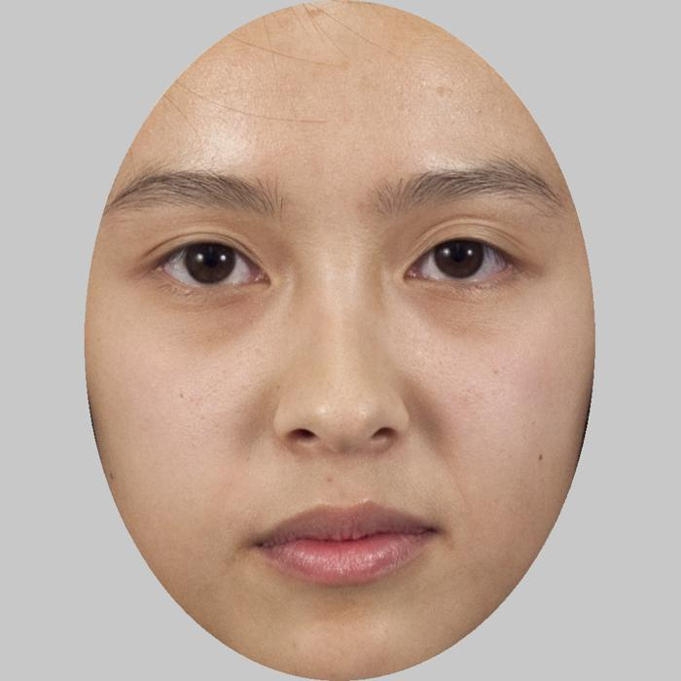
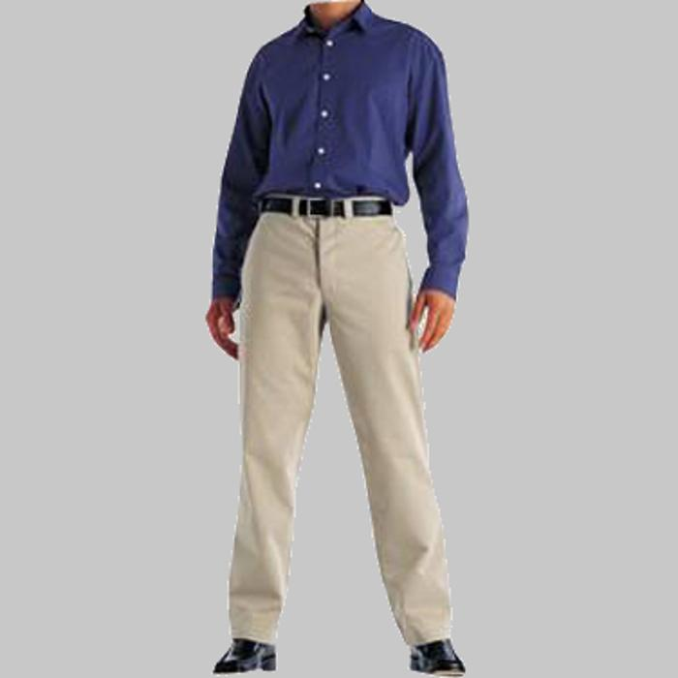
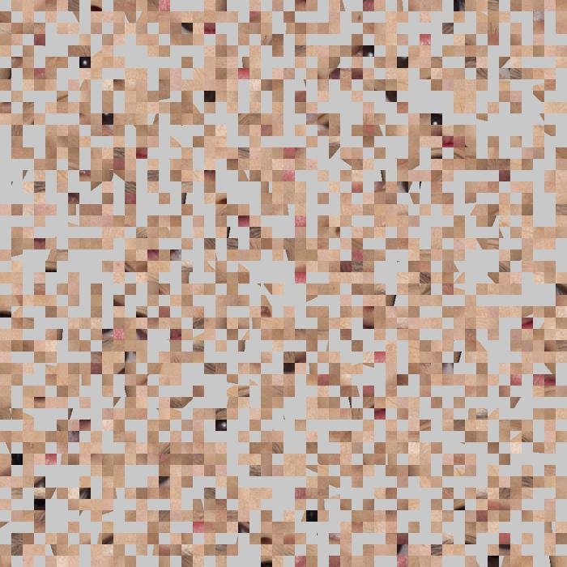
Localizer Stimuli
Faces
Hands
Bodies
Scrambled
Fixation Baseline

Slide 25
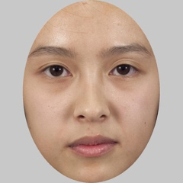
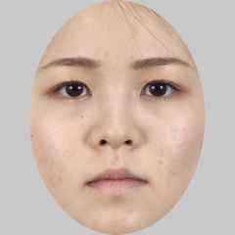
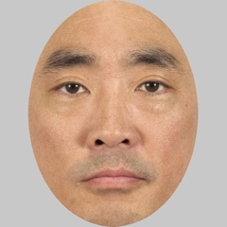
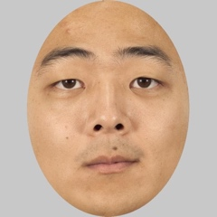
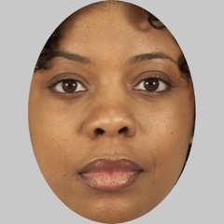
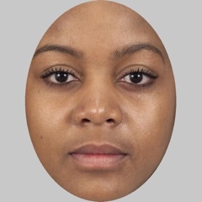
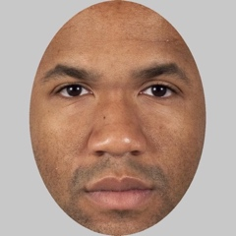
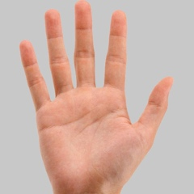
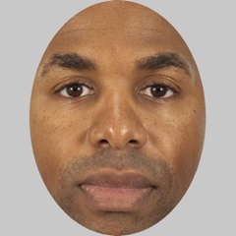
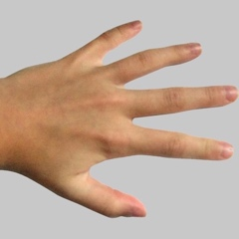
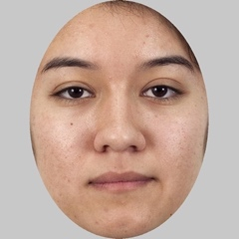
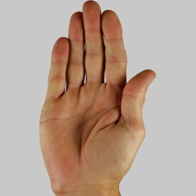
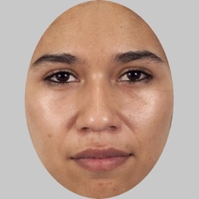
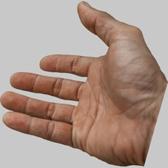
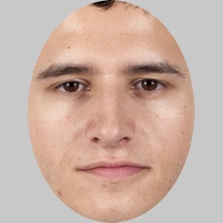
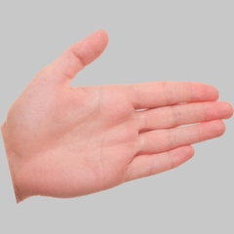
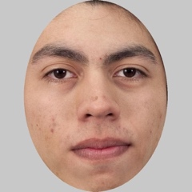
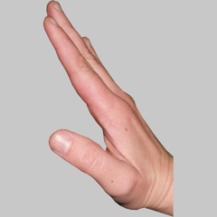
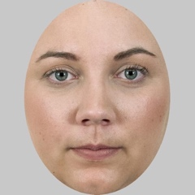
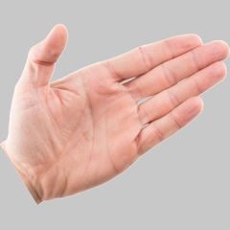
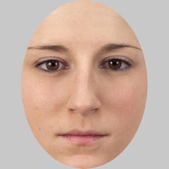
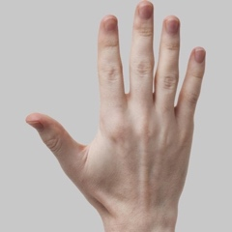
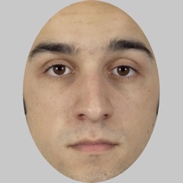
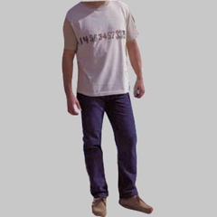
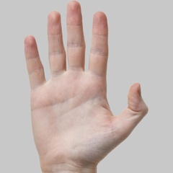
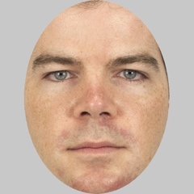
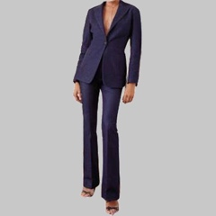
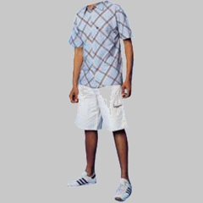
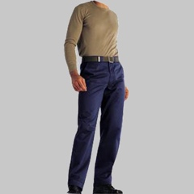
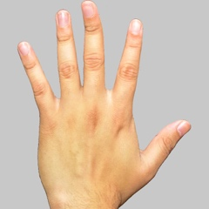
Localizer: All Stimuli
16 faces
16 hands
16 bodies
16+ scrambled

Slide 26
Block Design Kanwisher sequence with two orders
bodies
faces
hands
scrambled
black = baseline fixation
block design = measure response to blocks of events (i.e., trials)
Kanwisher design =
each of four conditions appears once in the 1^{st,} 2nd, 3rd or 4th position after a baseline period

Slide 27
Localizer Movie Clip

