Slide 1
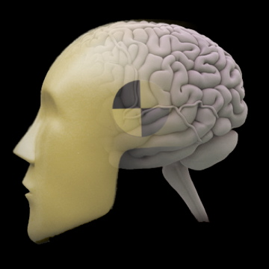
Basics of Neuroimaging
Jody Culham
Brain and Mind Institute
Department of Psychology
Western University
http://www.fmri4newbies.com/
Last Update: September 15, 2020
Last Course: Psychology 9223, F2020

Slide 2
General Intro to fMRI (and fNIRS)

Slide 3
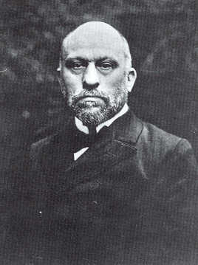
The First “Brain Imaging Experiment” (1884)
… and probably the cheapest one too!
Angelo Mosso
Italian physiologist
(1846-1910)
“[In Mosso’s experiments] the subject to be observed lay on a delicately balanced table which could tip downward either at the head or at the foot if the weight of either end were increased. The moment emotional or intellectual activity began in the subject, down went the balance at the head-end, in consequence of the redistribution of blood in his system.”
-- William James, Principles of Psychology (1890)

Slide 4
The First “Brain Imaging Experiment” (1884)
… and probably the cheapest one too!
E = mc²
Angelo Mosso
Italian physiologist
(1846-1910)
“[In Mosso’s experiments] the subject to be observed lay on a delicately balanced table which could tip downward either at the head or at the foot if the weight of either end were increased. The moment emotional or intellectual activity began in the subject, down went the balance at the head-end, in consequence of the redistribution of blood in his system.”
-- William James, Principles of Psychology (1890)

Slide 5
The First “Brain Imaging Experiment” (1884)
… and probably the cheapest one too!
E = mc²
Angelo Mosso
Italian physiologist
(1846-1910)
“[In Mosso’s experiments] the subject to be observed lay on a delicately balanced table which could tip downward either at the head or at the foot if the weight of either end were increased. The moment emotional or intellectual activity began in the subject, down went the balance at the head-end, in consequence of the redistribution of blood in his system.”
-- William James, Principles of Psychology (1890)

Slide 6
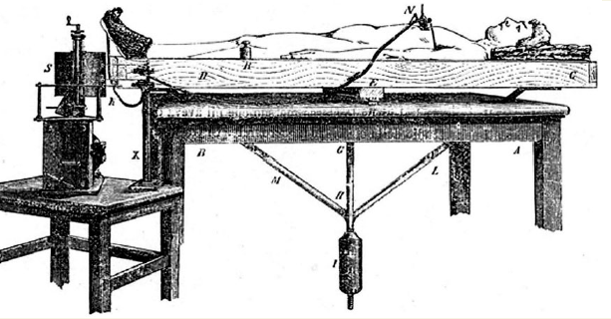
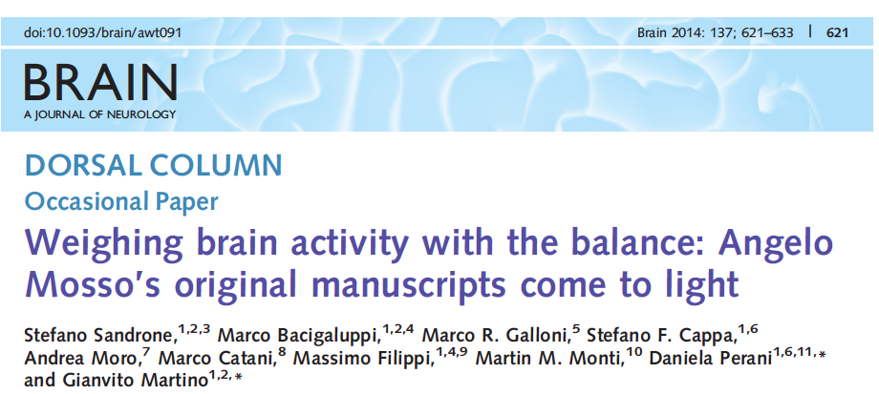
Mosso Revisited

Slide 7
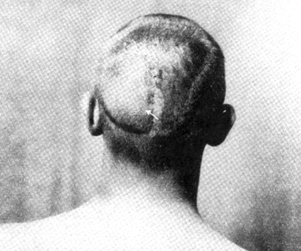
The Man Who Could Hear His Brain
Walter K, 1927
Whenever he opened his eyes, a gurgling sound could be heard at the back of his skull
Fulton, 1928, reported in Raichle, 2008
Notes:
There was no serious challenge to Leonard Hill's views until a remarkable clinical study of a patient Walter K. was reported by John Fulton in the 1928 issue of the journal Brain [10
]. During the course of his evaluation and treatment for a vascular malformation lying over his visual cortex, Walter K. remarked to his physicians that a noise (i.e. bruit) that he perceived in the back of his head increased in intensity when he was using his eyes. He said that he had often noticed this during the proceeding several years but had ‘never thought much of it’. As Fulton commented, ‘It was not difficult to convince ourselves that when the patient suddenly began to use his eyes after a prolonged period of rest in a dark room, there was a prompt and noticeable increase in the intensity of his bruit. Activity of his other sense organs, moreover, had no effect upon his bruit.’ The conclusion drawn from this remarkable case was that blood flow to visual cortices was sensitive to the attention paid to objects in the environment.

Slide 8
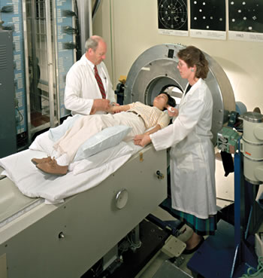
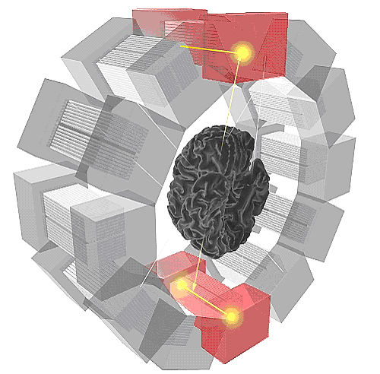
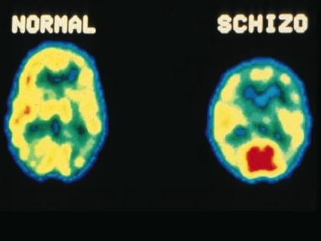
Functional Brain Imaging: PET Positron Emission Tomography
subject is given a radioactively tagged substance (e.g., sugar or water)
compute the locations of decaying radioisotopes that emit gamma rays
infer higher regional cerebral blood flow in areas that emit many positrons

Slide 9
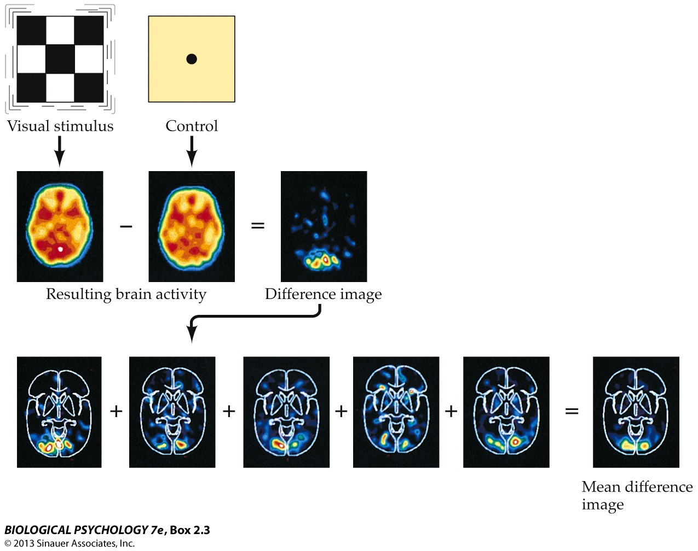
Subtracting Activation
This shows PET but the same approach is used in fMRI

Slide 10
Subtracting Activation
This shows PET but the same approach is used in fMRI

Slide 11
Subtracting Activation
This shows PET but the same approach is used in fMRI

Slide 12
Subtracting Activation
This shows PET but the same approach is used in fMRI

Slide 13
Pros and Cons of PET
exciting new technique to measure local brain activation in a live human
PET scanners are not that common
PET involves exposing participants to low levels of radiation so the number of scans is limited

Slide 14
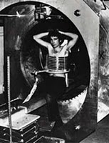
1970s: Anatomical MRI
slice through Minkoff’s torso
1977: First MR image of human body
Didn’t use EPI
Each voxel took 2 min; 106 voxels
4 hours to get one slice
Damadian’s grad student, Larry Minkoff, in “Indomitable”, first MRI scanner
https://www.smithsonianmag.com/science-nature/the-indomitable-mri-29126670/
Notes:
indomitable means untamable

Slide 15
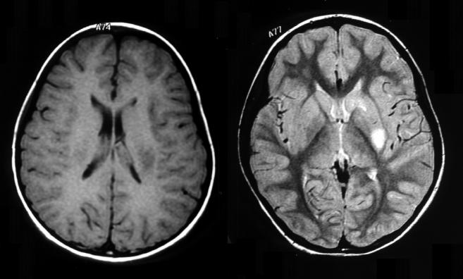
Magnetic Resonance Imaging
uses a very large Magnet
1.5 Tesla to ~10 Tesla scanners used with humans
for comparison: Earth’s magnetic field is 0.00005 Tesla
3 Tesla scanner = 60,000X earth’s magnetic field
orients atomic nuclei (typically hydrogen) with the magnetic field

Slide 16
Magnetic Resonance Imaging
uses a very large Magnet
1.5 Tesla to ~10 Tesla scanners used with humans
for comparison: Earth’s magnetic field is 0.00005 Tesla
3 Tesla scanner = 60,000X earth’s magnetic field
orients atomic nuclei (typically hydrogen) with the magnetic field
adds radio waves with frequencies that Resonate with atomic nuclei (typically hydrogen)

Slide 17
Magnetic Resonance Imaging
uses a very large Magnet
1.5 Tesla to ~10 Tesla scanners used with humans
for comparison: Earth’s magnetic field is 0.00005 Tesla
3 Tesla scanner = 60,000X earth’s magnetic field
orients atomic nuclei (typically hydrogen) with the magnetic field
adds radio waves with frequencies that Resonate with atomic nuclei (typically hydrogen)
to produce an Image

Slide 18
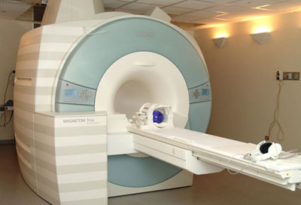
MRI Scanner: Three Key Components
Main
magnet
RF Coil
gradient coil
(inside)
For now, more Tesla is better, more coil channels is better

Slide 19
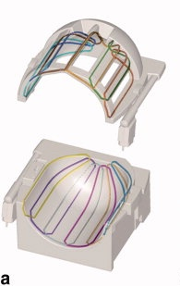
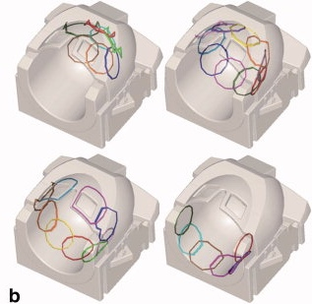
12- vs. 32-channel coil
Coils are like antennas; they receive (and sometimes transmit) radio waves
12 channels
32 channels
More antennas; better signal
Notes:
The two head coils compared in the present study and the layout of their individual RF receiving elements. a: 12-channel head matrix coil: its lower und upper part were symmetric and housed six RF receivers each. b: 32-channel phased-array head coil: 20 receivers were built on the lower and 12 on the upper part of the helmet. The RF elements had individual dimensions and were arranged in four parallel transverse planes (from top left to bottom right): top plane with seven elements, a circle of 10 elements, a row of nine elements and a bottom row of six elements.
Kaza, Klose & Lotze, 2011, JMRI
http://onlinelibrary.wiley.com/doi/10.1002/jmri.22614/full

Slide 20
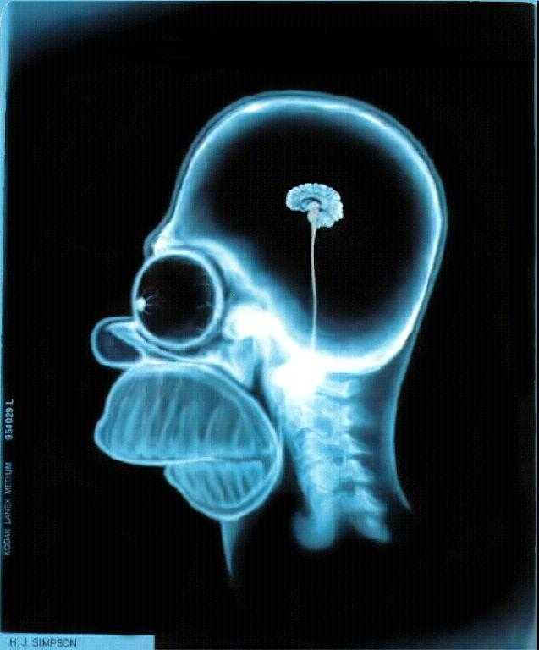
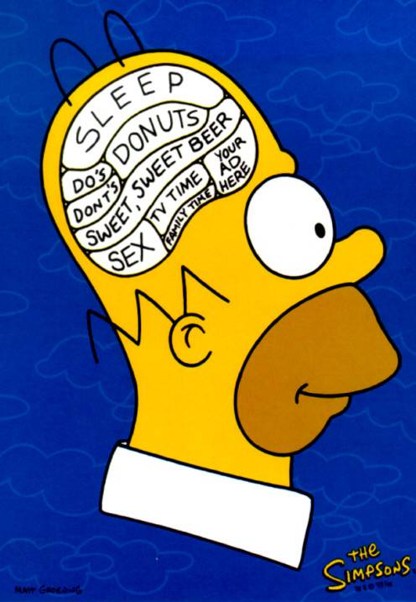
MRI vs. fMRI
Functional MRI (fMRI) studies brain function.
MRI studies brain anatomy.

Slide 21
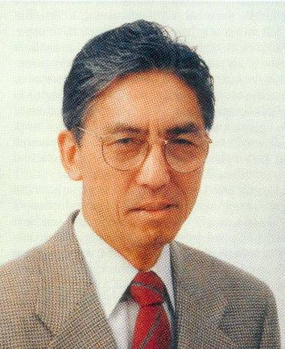
1992: Functional MRI
Seiji Ogawa
Ken Kwong

Slide 22
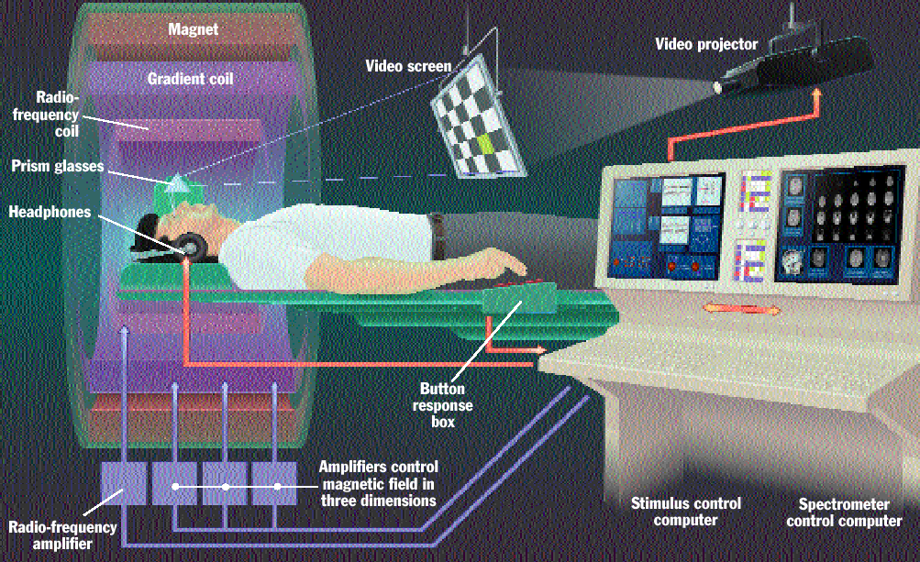
fMRI Setup
fMRI for Newbies web site

Slide 23
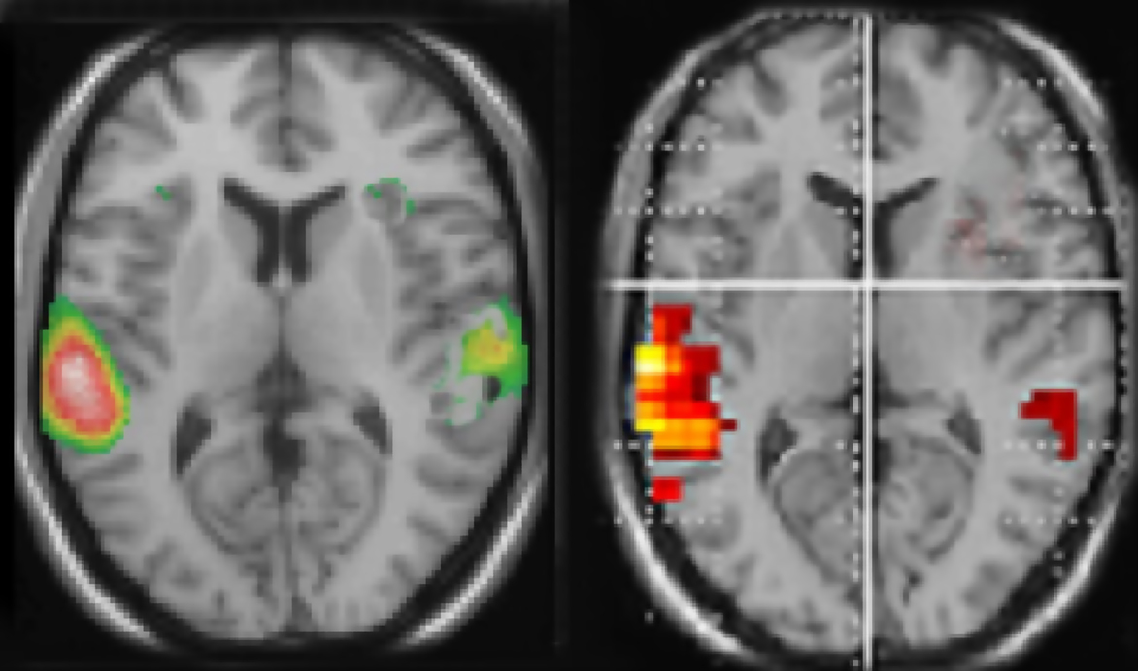
PET vs. fMRI
fMRI has better spatial resolution and better temporal resolution
Auditory
activation
PET
fMRI
4-6 s to peak
Activation
in Brain Region
Activation
in Brain Region
1 s
Resting
for 10 min
Hearing
for 10 min
Resting
Hearing
Resting
TIME
(Hugdahl et al., 2008, Front. Hum. Neurosci.)

Slide 24
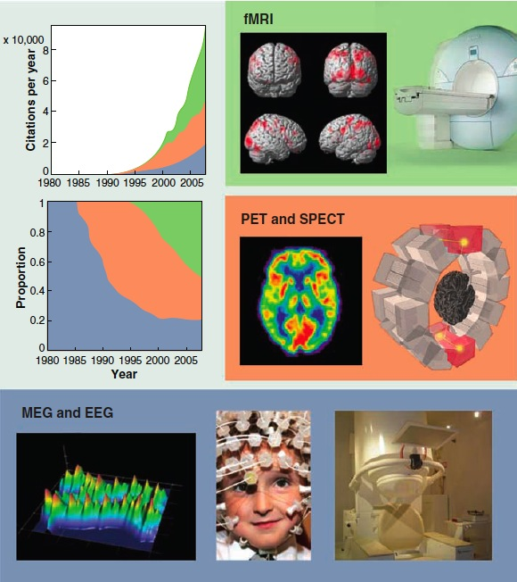
The Rise of fMRI
Friston, 2010,
Science

Slide 25
Bare Bones Basics of BOLD

Slide 26
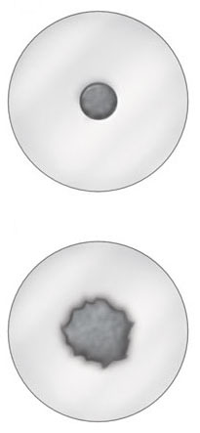
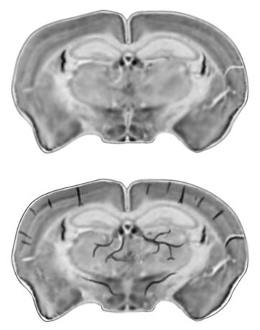
Deoxygenated Blood → Signal Loss
Oxygenated blood?
No signal loss…
Deoxygenated blood?
Signal loss!!!
Images from Huettel, Song & McCarthy, 2004, Functional Magnetic Resonance Imaging
fMRI for Newbies web site

Slide 27
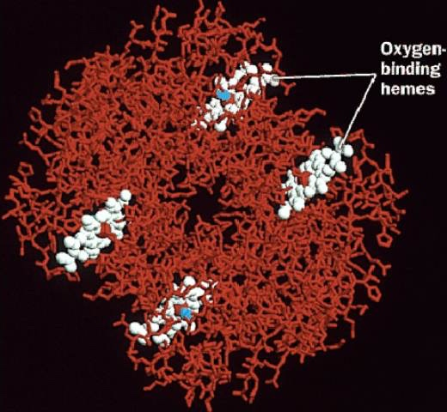
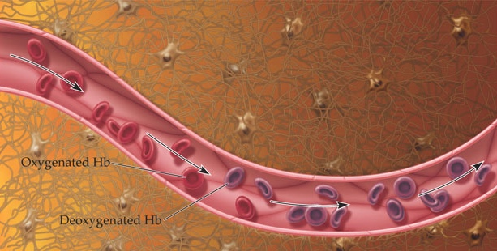
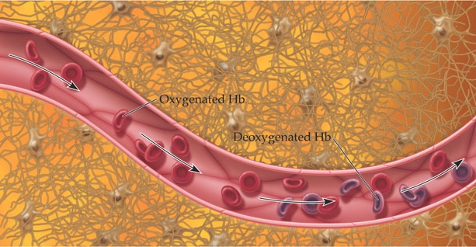
Hemoglobin
Figure Source, Huettel, Song & McCarthy, 2004, Functional Magnetic Resonance Imaging
fMRI for Newbies web site

Slide 28
BOLD Time Course Blood Oxygenation Level-Dependent Signal
Positive BOLD response
3
2
Overshoot
BOLD Response (% signal change)
Post-stimulus Undershoot
1
Initial Dip
0
Time
Stimulus

Slide 29
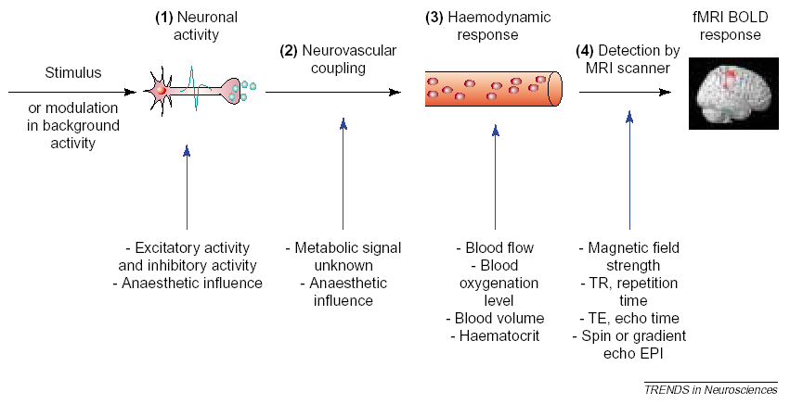
Stimulus to BOLD
Source: Arthurs & Boniface, 2002, Trends in Neurosciences

