Slide 1
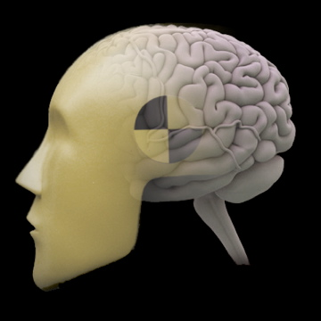

Advanced Designs for fMRI
Jody Culham
Brain and Mind Institute
Department of Psychology
Western University
http://www.fmri4newbies.com/
Last Update: December 5, 2016
Last Course: Psychology 9223, F2016, Western University

Slide 2
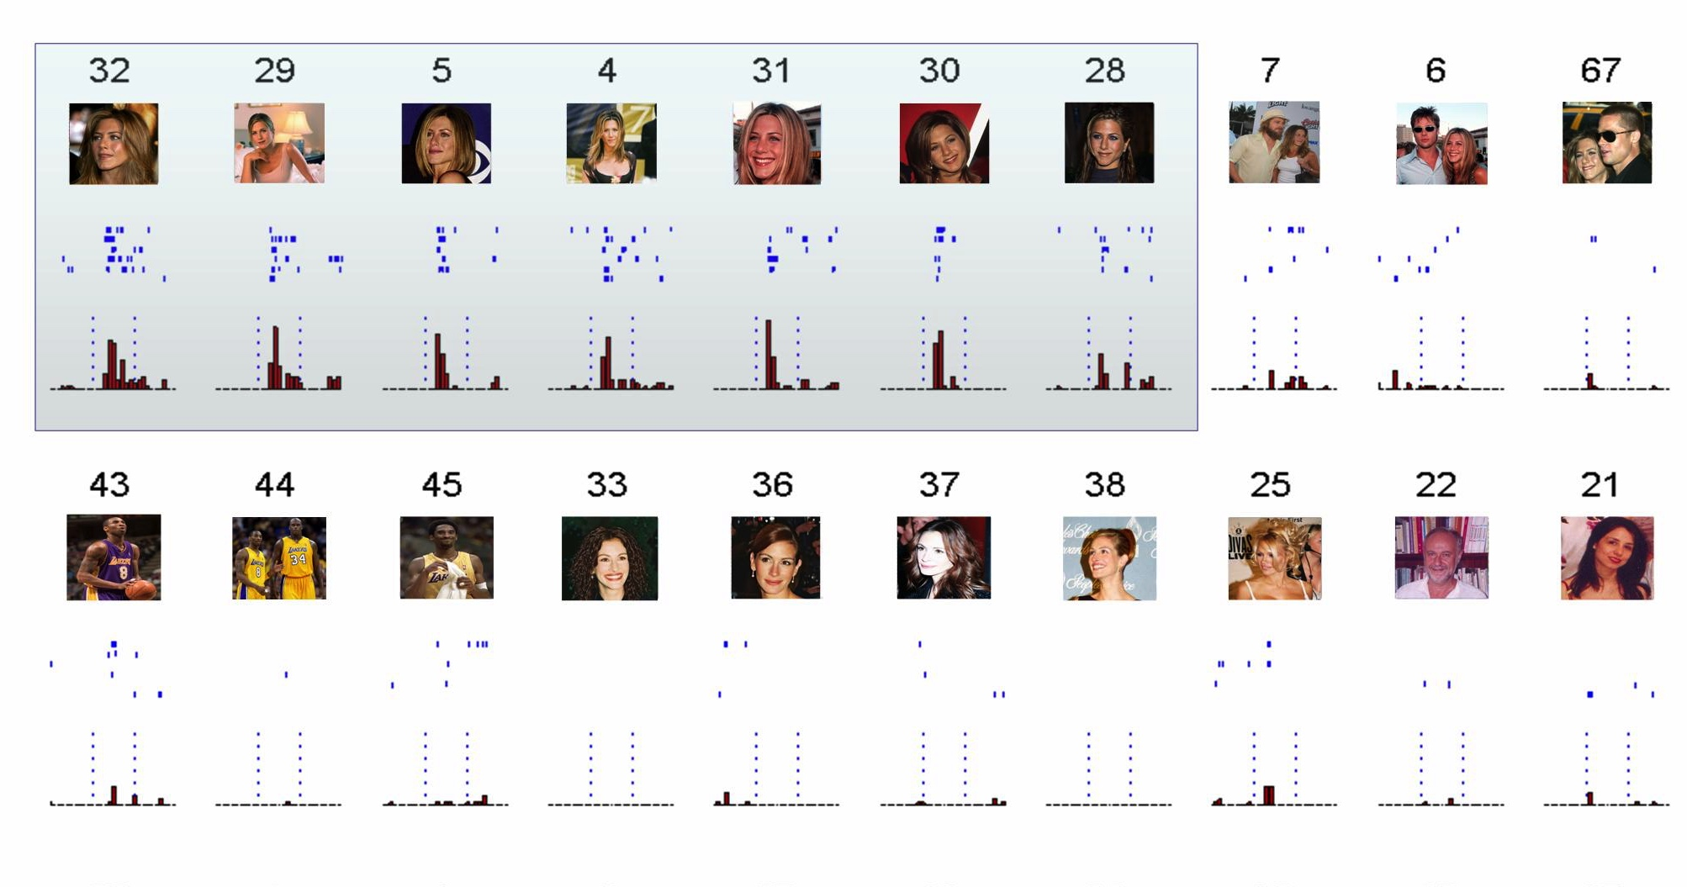
Limitations of Subtraction Logic
Example: We know that neurons in the brain can be tuned for individual faces
“Jennifer Aniston” neuron in human medial temporal lobe; Quiroga et al., 2005, Nature

Slide 3
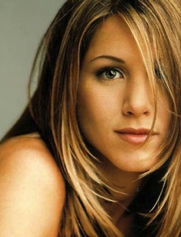
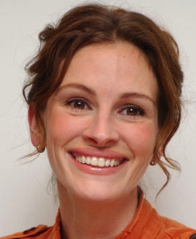
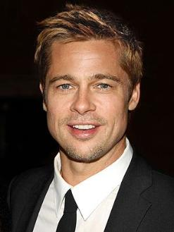
Limitations of Subtraction Logic
fMRI resolution is typically around 3 x 3 x 6 mm so each sample comes from millions of neurons. Let’s consider just three neurons.
Neuron 1
“likes”
Jennifer Aniston
Neuron 2
“likes”
Julia Roberts
Neuron 3
“likes”
Brad Pitt
Even though there are neurons tuned to each object, the population as a whole shows no preference
Firing Rate
Firing Rate
Firing Rate
Activation

Slide 4
Two Techniques with “Subvoxel Resolution”
“subvoxel resolution” = the ability to investigate coding in neuronal populations smaller than the voxel size being sampled
fMR Adaptation
(or repetition suppression or priming)
Multivoxel Pattern Analysis
(or decoding)

Slide 5
fMR Adaptation
(or repetition suppression or priming…)

Slide 6

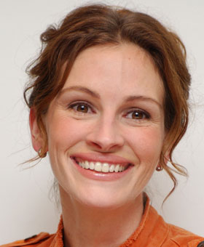
fMR Adaptation
If you show a stimulus twice in a row, you get a reduced response the second time
Hypothetical Activity in
Face-Selective Area (e.g., FFA)
Unrepeated
Face
Trial
→
Activation
Repeated
Face
Trial
→
Time

Slide 7


fMRI Adaptation
“different” trial:
500-1000 msec
“same” trial:
Slide modified from
Russell Epstein

Slide 8
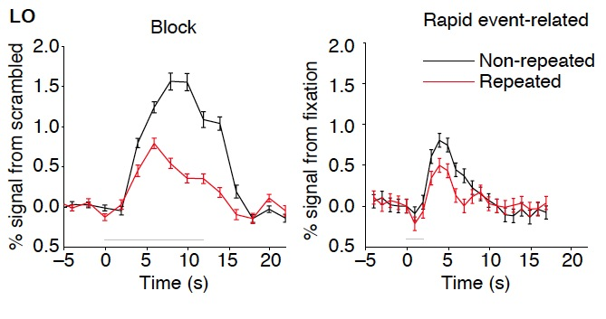






Block vs. Event-Related fMRA

Slide 9


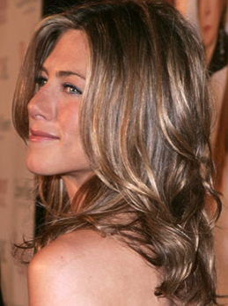

Why is adaptation useful?
Now we can ask what it takes for stimulus to be considered the “same” in an area
For example, do face-selective areas care about viewpoint?
Viewpoint selectivity:
area codes the face as different when viewpoint changes
Repeated Individual,
Different Viewpoint
Activation
Viewpoint invariance:
area codes the face as the same despite the viewpoint change
Time

Slide 10
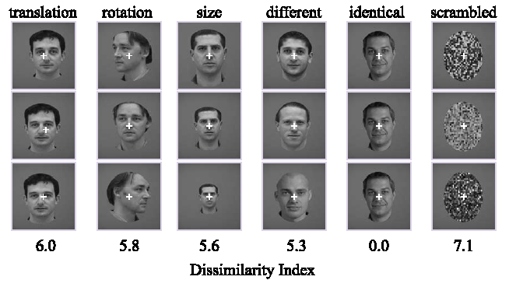
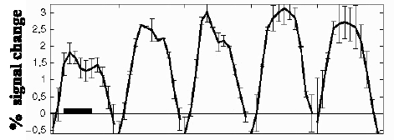
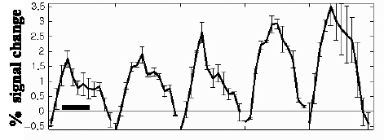
Actual Results
LO
pFs (~=FFA)
Grill-Spector et al., 1999, Neuron

Slide 11
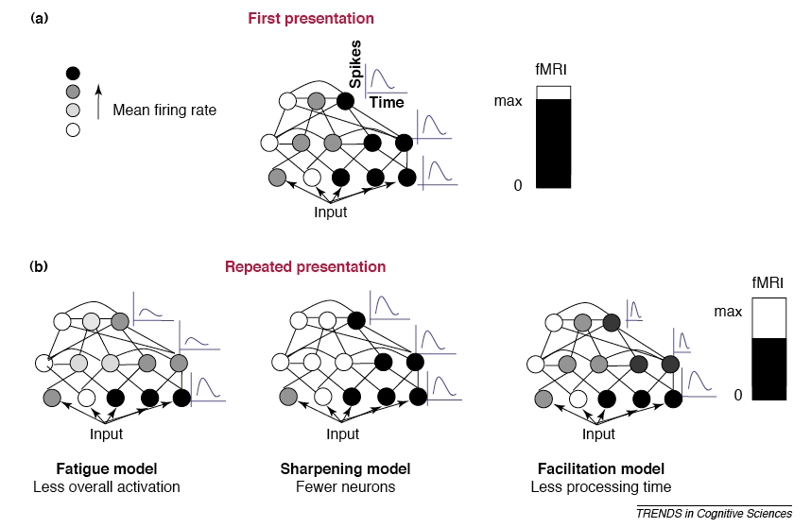
Models of fMR Adaptation
Grill-Spector, Henson & Martin, 2006, TICS

Slide 12
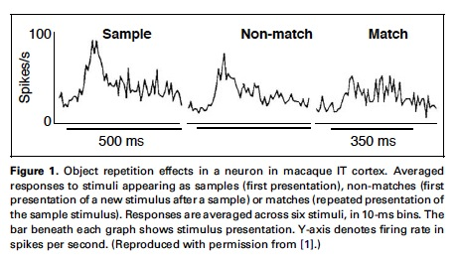
Evidence for “Fatigue” Model
Data from: Li et al., 1993, J Neurophysiol
Figure from: Grill-Spector, Henson & Martin, 2006, TICS

Slide 13
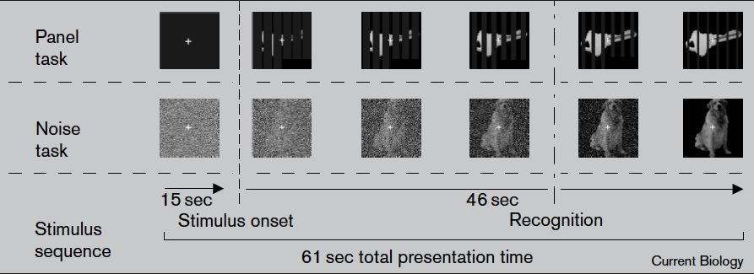
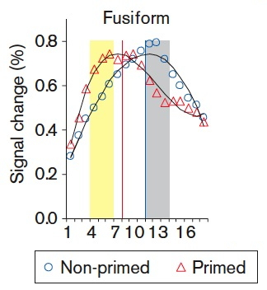
Evidence for Facilitation Model
James et al., 2000, Current Biology

Slide 14
Caveats in Interpreting fMR Adaptation Results

Slide 15
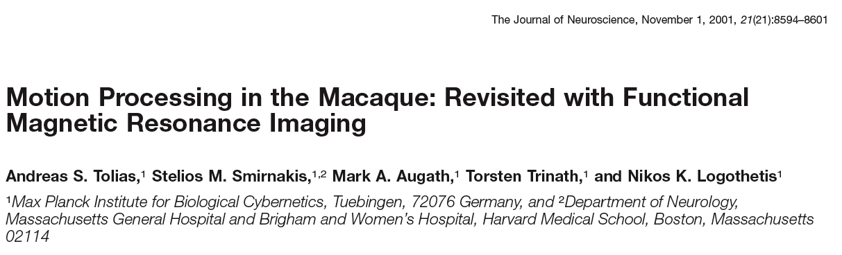

Slide 16
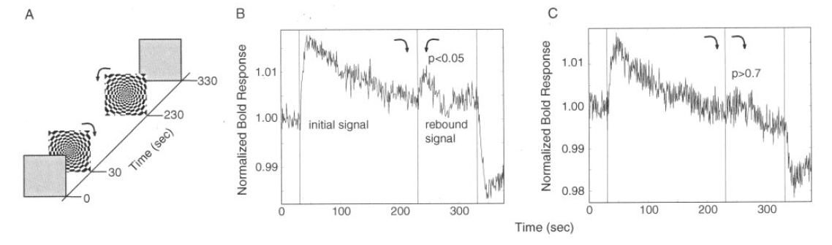
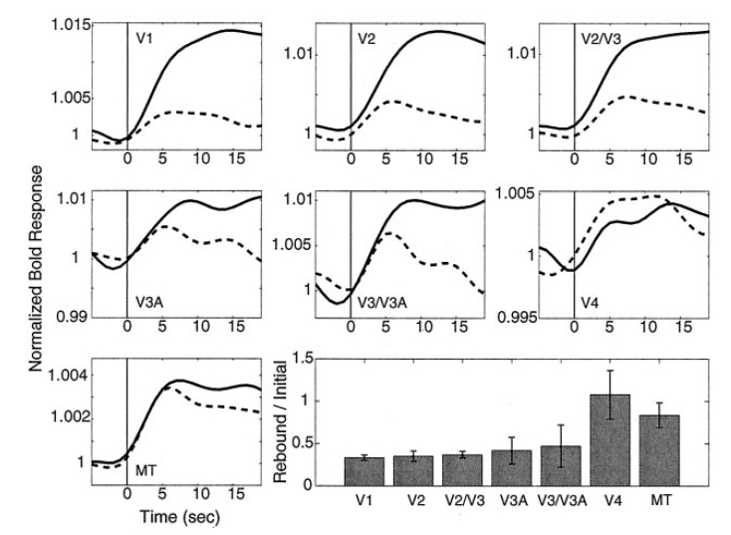
fMRA Does Not Accurately Reflect Tuning
MT+: most neurons are direction-selective (DS), high DS in fMRA
V4: few (20%?) neurons are DS, very high DS in fMRA
perhaps fMRA is more driven by inputs than outputs?
Tolias et al., 2001,
J. Neurosci

Slide 17
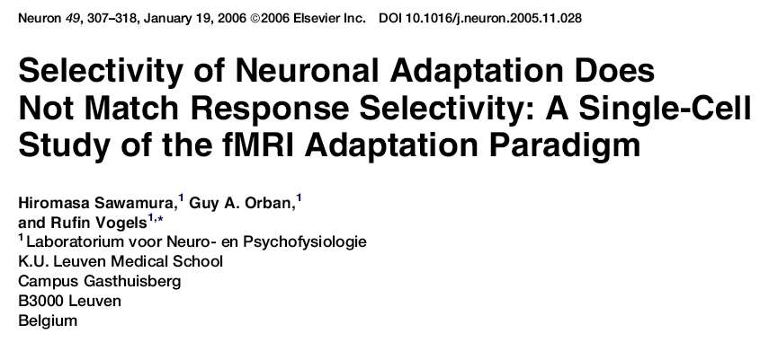

Slide 18



Basic Assumption/Hypothesis
if a neuronal population responds equally to two stimuli, those stimuli should yield cross-adaptation
Neural Response
Predicted
fMRI Response
A
B
C
A-A
B-B
A-B
C-A

Slide 19
Experimental Question
the human lateral occipital complex (LOC) is arguably analogous/homologous to macaque inferotemporal (IT) cortex
both human LOC and macaque IT show fMRI adaptation to repeated objects
Does neurophysiology in macaque IT show object adaptation at the single neuron level?

Slide 20
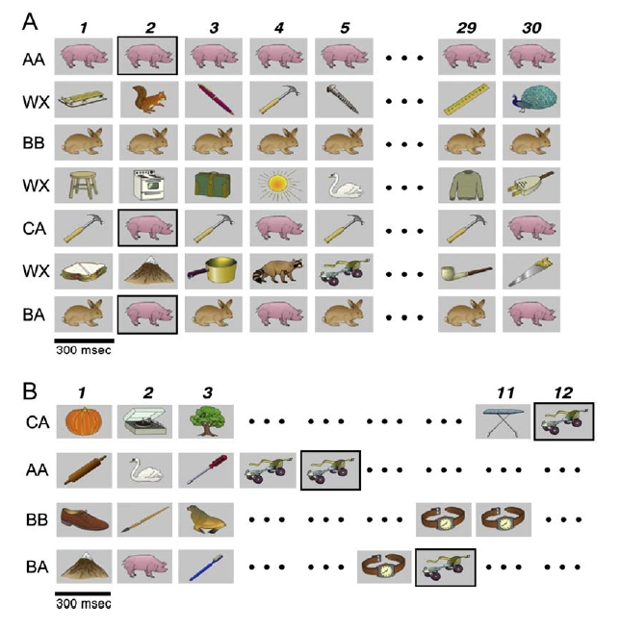
Design
Example neuron selective for pig (A) + bunny (B)
Experiment 1
Block Design Adaptation
Example neuron selective for rollerskate (A) + watch (B)
Experiment 2
Event-Related
Adaptation
Sawamura et al., 2006, Neuron

Slide 21
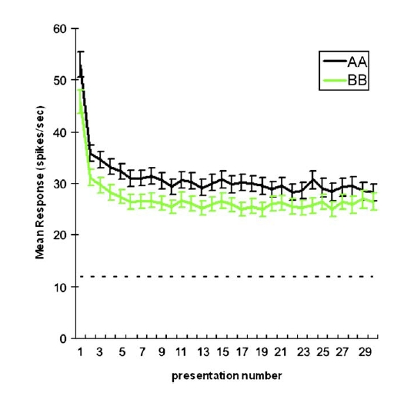
Yes, neurons do adapt
Sawamura et al., 2006, Neuron

Slide 22
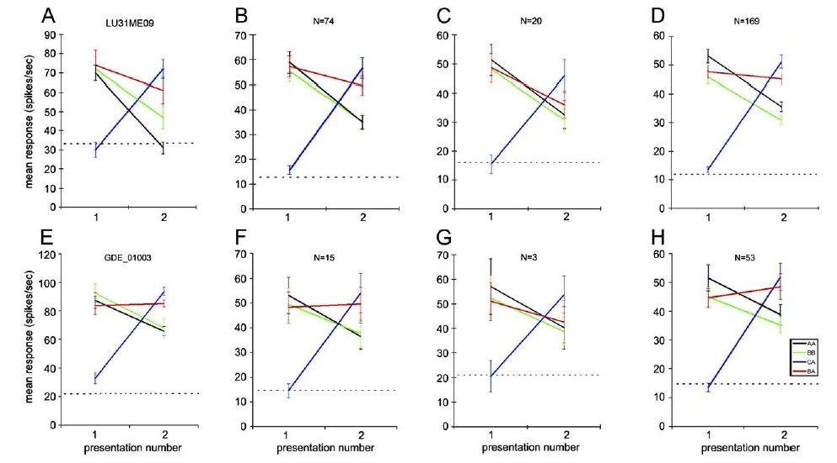
… but cross-adaptation is less clear
EXAMPLE
A-A ADAPT
A=B
B-A ADAPT
A=B
WHOLE
POPULATION
BLOCK
A-A
B-B
C-A
B-A
EVENT-
RELATED
Sawamura et al., 2006, Neuron

Slide 23
Sawamura et al. Conclusions
Evidence for cross-adaptation at the single-neuron level is not as strong as expected, particularly for event-related designs
They don’t think it’s just attention
Something special about repeated stimuli

Slide 24
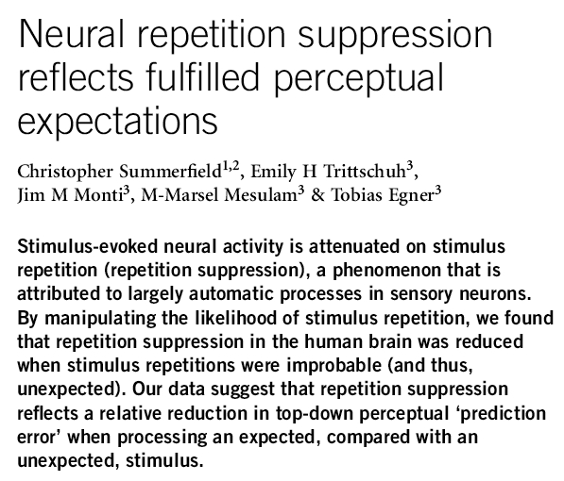

Sept. 2008

Slide 25
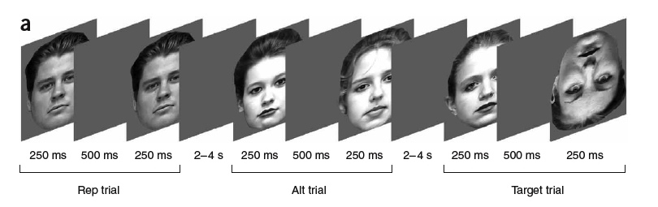
Design
Task: press button for inverted face
REP BLOCK (75% rep trials, 25% alt trials)
AA BB CD EE FF GH II JJ…
ALT BLOCK (25% rep trials, 75% alt trials)
AB CC DE FG HI JK LM NN…
Summerfield et al., 2008, Nat Neurosci

Slide 26
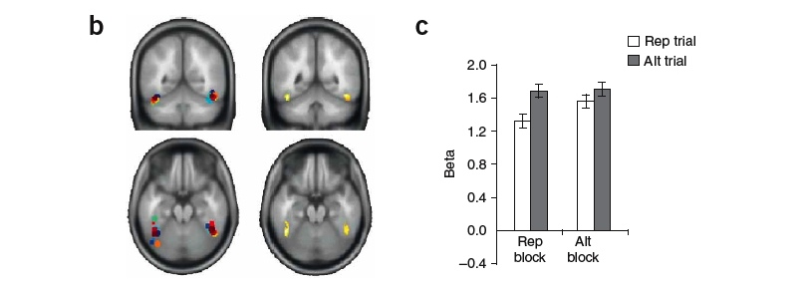
Results
22%
p<.001
9%
p<.05
Individual
FFA
ROIs
SIG INTERACTION:
stronger fMRA in blocks with freq. reps
Summerfield et al., 2008, Nat Neurosci

Slide 27
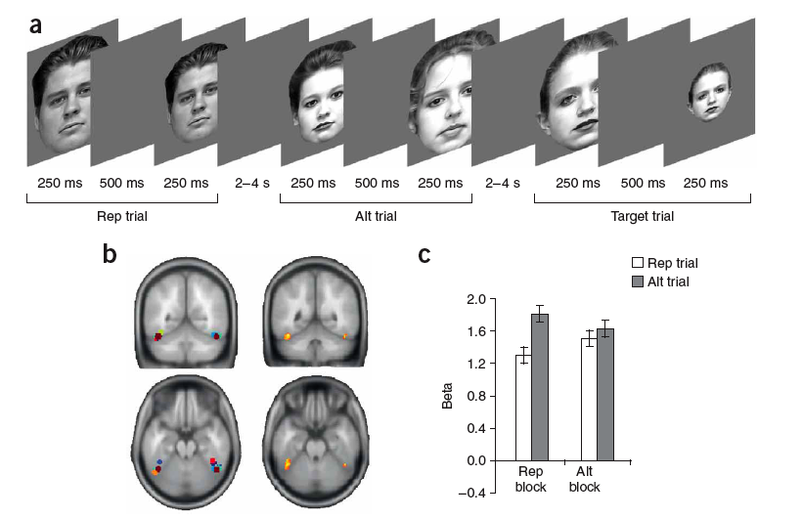
Replication
Task: press button for small face
results were replicated with a different task
Summerfield et al., 2008, Nat Neurosci

Slide 28
New Explanation of fMRA
“repetition suppression reflects a reduction in perceptual ‘prediction error’”
mismatch between expectations and stimulus increases fMRI activation
mismatch is higher on novel trials than repetition trials

Slide 29
Additional Caveats
Adaptation effects are larger when sequence is predictable (Summerfield et al., 2008, Nat. Neurosci.)
Adaptation effects can be quite unreliable
  variability between labs and studies
  even effects that are well-established in neurophysiology and psychophysics don’t always replicate in fMRA
    e.g., orientation selectivity in primary visual cortex
The effect may also depend on other factors
  e.g., time elapsed from first and second presentation
    days, hours, minutes, seconds, milliseconds?
    number of intervening items
  attention (especially in block designs)
  memory encoding
Different areas may demonstrate fMRA for different reasons
  reflected in variety of terms: repetition suppression, priming

Slide 30
So is fMRA dead? No.
Criticism: fMRA may reflect inputs rather than outputs
Response: This is a general caveat of all fMRI studies. Inputs are interesting too, just harder to interpret. Focus on outputs oversimplifies neural processing when presumably feedback loops are an essential component.
Criticism: fMRA may not reveal cross-adaptation even in populations that do show cross-coding
Response: This suggests that caution is especially warranted when there is a failure to find cross-adaptation. However, cross-adaptation sometimes does occur.
Note within-item adaptation (A-A or B-B) did occur, so this criticism does not apply in that case.

Slide 31
So is fMRA dead? No.
Criticism: None of the basic models of fMRA seem to work.
Response: In some ways, it doesn’t matter. The essential use of fMRA is to determine whether neural populations are sensitive to stimulus dimensions. The exact mechanism for such sensitivity may not be critical.
Criticism: fMRA, and maybe fMRI in general, is just responding to predictions.
Response: Prediction is interesting too.
Regarding fMRA, why do some brain areas make predictions about a stimulus while others don’t?
It may be very interesting to figure out how the hemodynamic response can be predictive.

Slide 32
Parametric Designs

Slide 33
Why are parametric designs useful in fMRI?
As we’ve seen, the assumption of pure insertion in subtraction logic is often false
  (A + B) - (B) = A
In parametric designs, the task stays the same while the amount of processing varies; thus, changes to the nature of the task are less of a problem
  (A + A) - (A) = A
  (A + A + A) - (A + A) = A

Slide 34
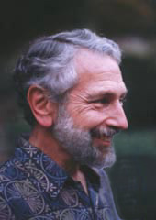
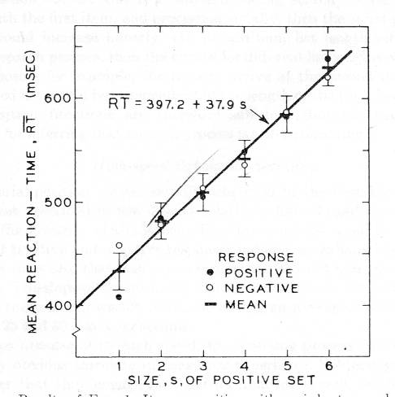
Parametric Designs in Cognitive Psychology
introduced to psychology by Saul Sternberg (1969)
asked subjects to memorize lists of different lengths; then asked subjects to tell him whether subsequent numbers belonged to the list
  Memorize these numbers: 7, 3
  Memorize these numbers: 7, 3, 1, 6
  Was this number on the list?: 3
Saul Sternberg
longer list lengths led to longer reaction times
Sternberg concluded that subjects were searching serially through the list in memory to determine if target matched any of the memorized numbers
Notes:
34

Slide 35
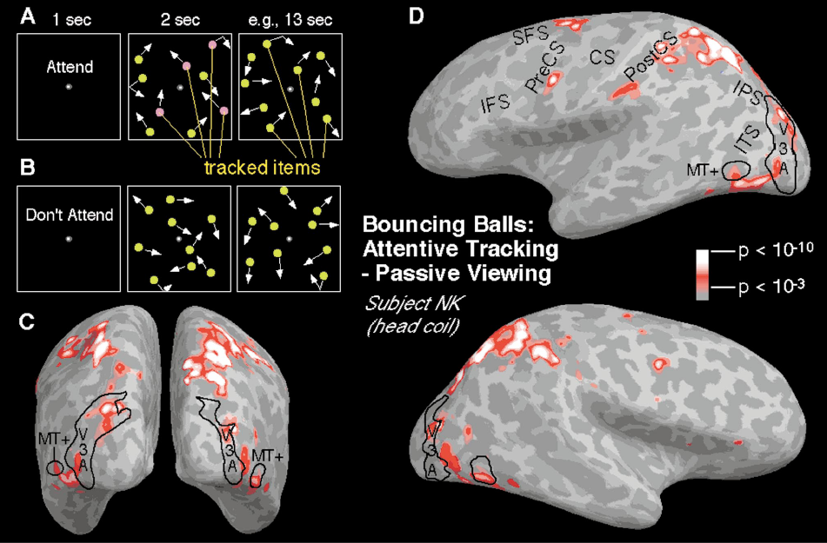
An Example
Culham et al., 1998, J. Neuorphysiol.
Notes:
35

Slide 36
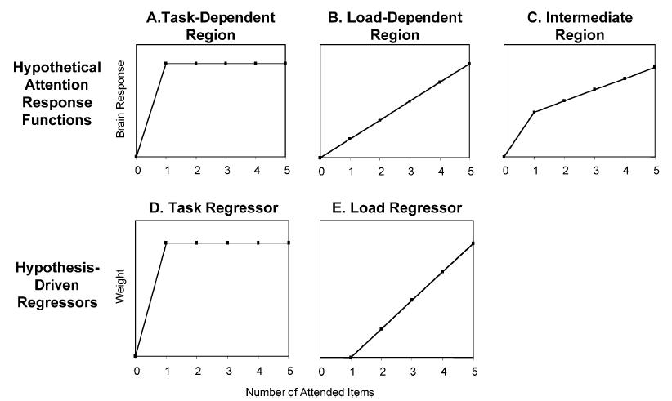
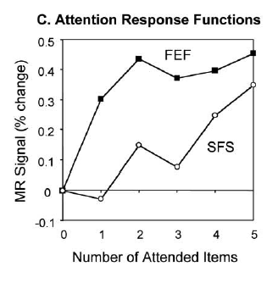
Analysis of Parametric Designs
parametric variant:
passive viewing and tracking of 1, 2, 3, 4 or 5 balls
Culham, Cavanagh & Kanwisher, 2001, Neuron
Notes:
36

Slide 37
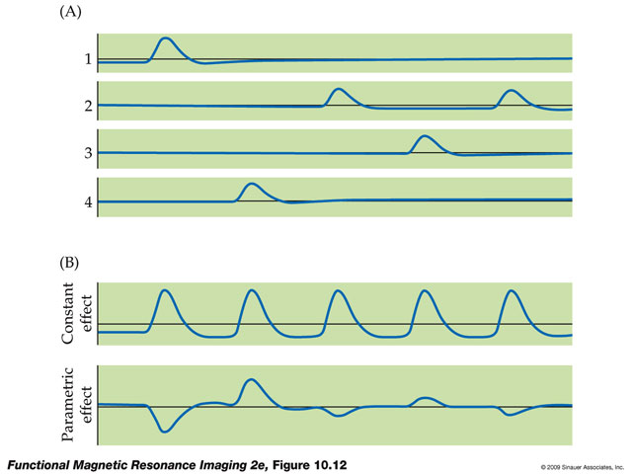
Parametric Regressors
Huettel, Song & McCarthy, 2008

Slide 38
Potential Problems
Ceiling effects?
  If you see saturation of the activation, how do you know whether it’s due to saturation of neuronal activity or saturation of the BOLD response?
Perhaps the BOLD response cannot go any higher than this?
BOLD
Activity
Parametric variable
  Possible solution: show that under other circumstances with lower overall activation, the BOLD signal still saturates

Slide 39
Factorial Designs

Slide 40
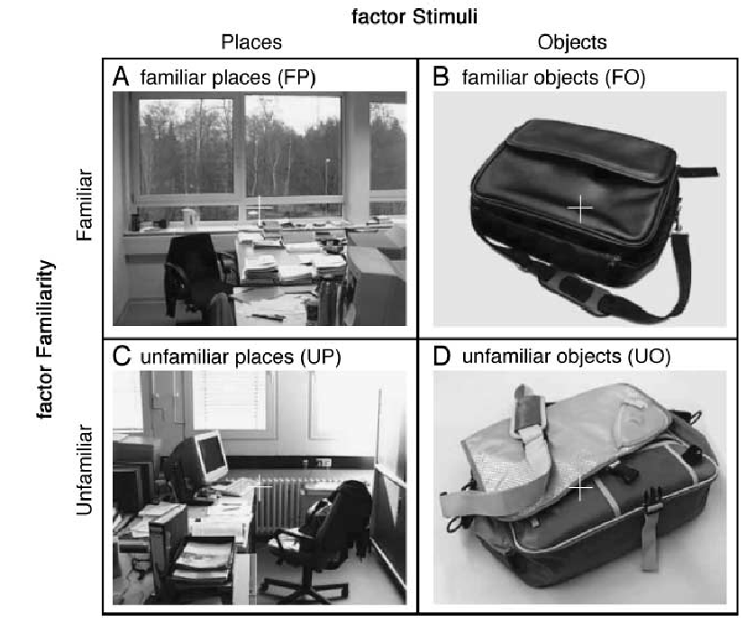
Factorial Designs
Example: Sugiura et al. (2005, JOCN) showed subjects pictures of objects and places. The objects and places were either familiar (e.g., the subject’s office or the subject’s bag) or unfamiliar (e.g., a stranger’s office or a stranger’s bag)
This is a “2 x 2 factorial design” (2 stimuli x 2 familiarity levels)

Slide 41
Factorial Designs
Main effects
  Difference between columns
  Difference between rows
Interactions
  Difference between columns depending on status of row (or vice versa)

Slide 42
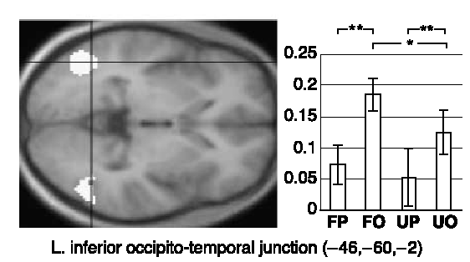
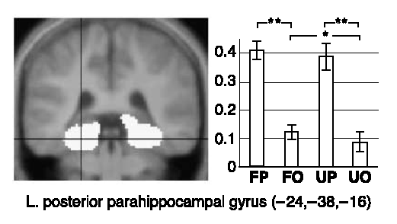
Main Effect of Stimuli
In LO, there is a greater activation to Objects than Places
In the PPA, there is greater activation to Places than Objects

Slide 43
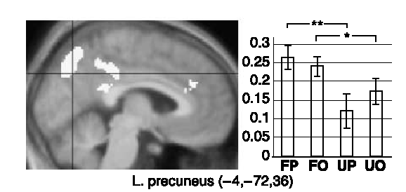
Main Effect of Familiarity
In the precuneus, familiar objects generated more activation than unfamiliar objects

Slide 44
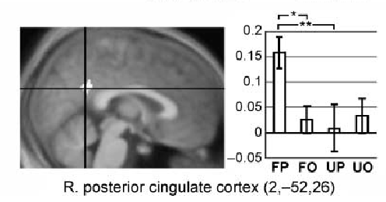
Interaction of Stimuli and Familiarity
In the posterior cingulate, familiarity made a difference for places but not objects

Slide 45
Why do People like Factorial Designs?
If you see a main effect in a factorial design, it is reassuring that the variable has an effect across multiple conditions
Interactions can be enlightening and form the basis for many theories

Slide 46
Understanding Interactions
Places
Brain
Activation
Objects
Unfamiliar
Familiar
Interactions are easiest to understand in line graphs -- When the lines are not parallel, that indicates an interaction is present
Notes:
46

Slide 47
Combinations are Possible
Hypothetical examples
Places
Places
Brain
Activation
Objects
Objects
Unfamiliar
Familiar
Unfamiliar
Familiar
Main effect of Stimuli
+
Main Effect of Familiarity
No interaction (parallel lines)
Main effect of Stimuli
+
Main effect of Familiarity
+
Interaction
Notes:
47

Slide 48
Problems
Interactions can occur for many reasons that may or may not have anything to do with your hypothesis
A voxelwise contrast can reveal a significant for many reasons
Consider the full pattern in choosing your contrasts and understanding the implications
Brain
Activation
(Baseline = 0)
0
Places
Objects
0
0
0
Unfamiliar
Familiar
Unfamiliar
Familiar
Unfamiliar
Familiar
Unfamiliar
Familiar
All these patterns show an interaction. Do they all support the theory that this brain area prefers familiar places?
Notes:
48

Slide 49
One Solution: Conjunctions (Masks in SPM-speak)
Brain
Activation
(Baseline = 0)
0
Places
Objects
0
0
0
Unfamiliar
Familiar
Unfamiliar
Familiar
Unfamiliar
Familiar
Unfamiliar
Familiar
You can use a conjunction of contrasts to eliminate some patterns inconsistent with your hypothesis.
Contrast | Significant? | Significant? | Significant? | Significant?
(FP – UP) – (FO – UO) | Yes | Yes | Yes | Yes
FP – UP | Yes | Yes | No | Yes
FP > 0 | Yes | Yes | Yes | No
UP > 0 | Yes | Yes | Yes | No
For example:
    [(FP-UP)>(FO-UO)] AND [FP>UP] AND [FP>0] AND [UP>0]
    would show only the first two patterns but not the last two
Notes:
49

Slide 50

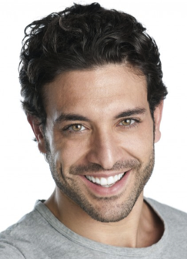
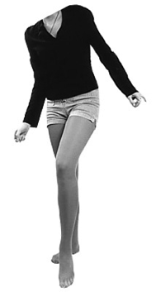

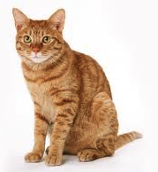

Another Solution: ROI Approach
Benefit: Localizer is now based on data independent from experimental run
Cost: We have some redundancy between the localizer and experimental run
Localizer
Experimental
Run
Notes:
50

Slide 51
Problems
Interactions become hard to interpret
  one recent psychology study suggests the human brain cannot understand interactions that involve more than three factors
Take home message: Don’t use designs with more than three factors
The more conditions you have, the fewer trials per condition you have
→ Keep it simple!
Notes:
51

Slide 52
Group Comparisons: ANOVA

Slide 53
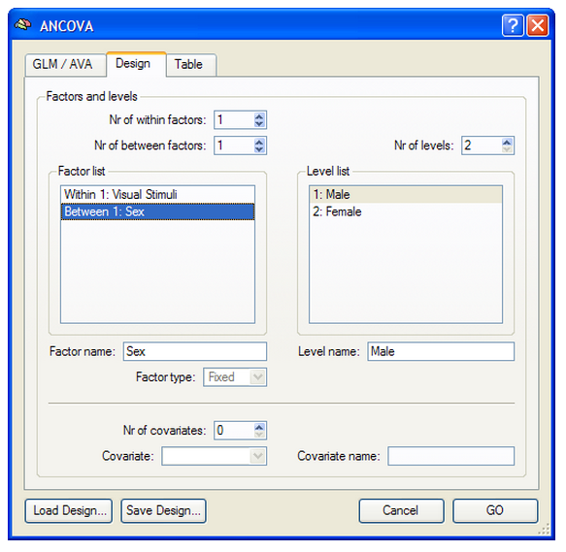
Sample Problem
1 between-subjects factor
  Sex
    Male (Group 1)
    Female (Group 2)
1 within-subjects factor
  Visual stimulus
    Faces
    Houses
    Objects
    Patterns
http://www.brainvoyager.com/bvqx/doc/UsersGuide/BrainVoyagerQXUsersGuide.html

Slide 54
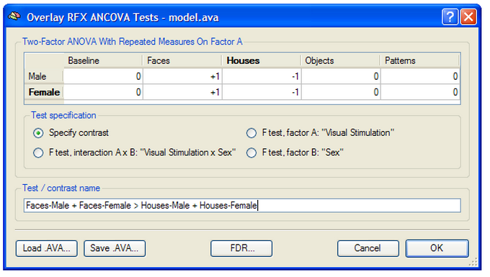
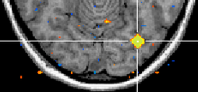
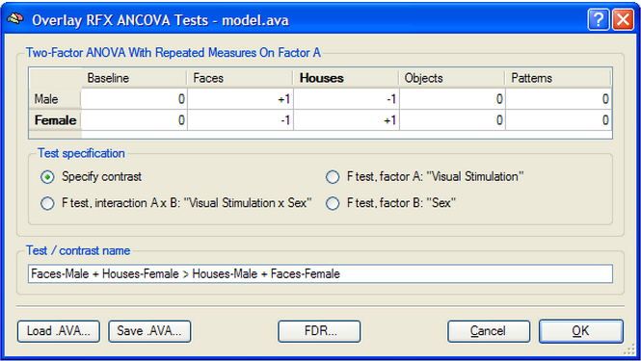
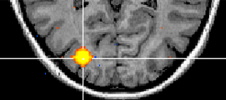
Contrasts
We can still generate contrasts using weights that sum to zero
http://www.brainvoyager.com/bvqx/doc/UsersGuide/BrainVoyagerQXUsersGuide.html

Slide 55
Group Comparisons: ANCOVA

Slide 56
ANCOVA Example
Let’s say we have run a face localizer in a group of subjects and want to know if there is a difference in activation between females and males
We may also be concerned about whether age is a confound between groups
We can run an Analysis of Covariance (ANCOVA) to examine the effect of sex differences while controlling for age differences
  We say that the effect of age is “partialed out”
  This is like pretending that all the subjects were the same age
This reduces the error term for group comparisons, thus increasing statistical power
Between-subjects factor
  Sex
Covariate
  Age
http://www.brainvoyager.com/bvqx/doc/UsersGuide/BrainVoyagerQXUsersGuide.html

Slide 57
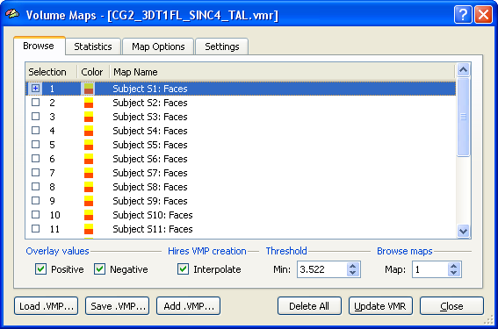
Example Design Matrix
 | Sex | Age
Subject 1 | 1 | 39
Subject 2 | 1 | 42
Subject 3 | 1 | 19
Subject 4 | 1 | 55
Subject 5 | 1 | 66
Subject 6 | 1 | 70
Subject 7 | 1 | 20
Subject 8 | 1 | 31
Subject 9 | 2 | 21
Subject 10 | 2 | 44
Subject 11 | 2 | 57
Subject 12 | 2 | 63
Subject 13 | 2 | 40
Subject 14 | 2 | 18
Subject 15 | 2 | 69
Subject 16 | 2 | 36
1 map per subject
e.g., map of face activation
The same approach can be used on other maps (e.g., DTI FA maps, cortical thickness maps, etc.)
http://www.brainvoyager.com/bvqx/doc/UsersGuide/BrainVoyagerQXUsersGuide.html

Slide 58
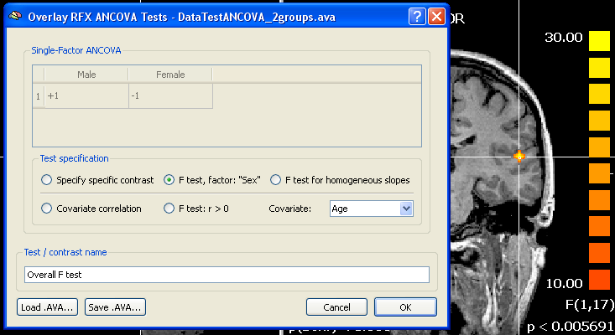
Example Voxelwise Map: Sex Differences
http://www.brainvoyager.com/bvqx/doc/UsersGuide/BrainVoyagerQXUsersGuide.html

Slide 59
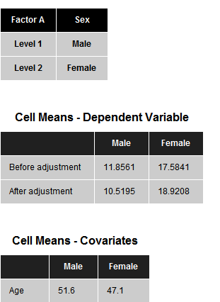
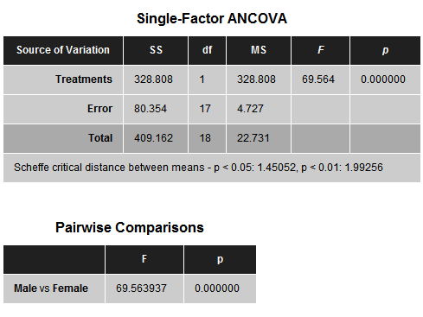
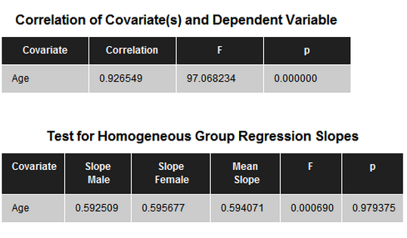

Sample Output for ROI
Sex
After adjustment = with age covaried out
Female
Male
http://www.brainvoyager.com/bvqx/doc/UsersGuide/BrainVoyagerQXUsersGuide.html

Slide 60
Mental Chronometry

Slide 61
Mental chronometry
study of the timing of neural events
long history in psychology
Notes:
61

Slide 62

Variability of HRF Between Areas
Possible caveat: HRF may also vary between areas, not just subjects
  Buckner et al., 1996:
    noted a delay of .5-1 sec between visual and prefrontal regions
    vasculature difference?
    processing latency?
  Bug or feature?
    Menon & Kim – mental chronometry
Buckner et al., 1996
Notes:
62

Slide 63

Latency and Width
Menon & Kim, 1999, TICS
Notes:
63

Slide 64



Mental Chronometry
Superior Parietal Cortex
Superior Parietal Cortex
Data: Richter et al., 1997, NeuroReport
Figures: Huettel, Song & McCarthy, 2004
Notes:
64

Slide 65



Mental Chronometry
Vary ISI
Measure
Latency
Diff
Menon, Luknowsky & Gati, 1998, PNAS
Notes:
65

Slide 66
Challenges
Works best with stimuli that have strong differences in timing (on the order of seconds)
It can be really challenging to reliably quantify the latency in noisy signals
Notes:
66

Slide 67
Data-Driven Approaches

Slide 68
Hypothesis- vs. Data-Driven Approaches
Hypothesis-driven
Examples: t-tests, correlations, general linear model (GLM)
a priori model of activation is suggested
data is checked to see how closely it matches components of the model
most commonly used approach
Data-driven
Example: Independent Component Analysis (ICA)
blindly separates a set of statistically independent signals from a set of mixed signals
no prior hypotheses are necessary

Slide 69



ICA example
Thanks to Matt Hutchison for providing this great example!
Notes:
Scenario: there are 4 stereos playing simultaneously in the same room, and there are also 4 microphones placed around the room recording the songs

Slide 70

Math behind the method
Thanks to Matt Hutchison for providing this great example!
Notes:
Each microphone (x) signal can be modeled as linear superpositions of the recorded source signals (s) (linear mixture by unknown matrix A)
W= unmixing matrix
u = Uncovered signals
The objective of BSS is to find a matrix (W) allowing to recover the original source signals.
The cocktail party problem applies to EEG recordings. Indeed, at each electrode location, the signal recorded can be considered as a linear mixture of underlying neural generators.

Slide 71




Applying ICA to fMRI data
Threshold = temporal correlation between each voxel and the associated component
1
threshold
7
Magnitude =
Strength of relationship
Signal change (%)
Time (s)
Thanks to Matt Hutchison for providing this great example!
Notes:
The voxel time courses were factored into 40 independent spatial components and then scaled to empirically derived z-scores by dividing the standard deviation of the original time sequence.
The z-scores approximate the temporal correlation between each voxel and the associated component in which the magnitude of the z-score specifies the strength of the linear relationship
Established threshold
71

Slide 72

Pulling Out Components
Huettel, Song & McCarthy, 2008

Slide 73

Components
Huettel, Song & McCarthy, 2008
each component has a spatial and temporal profile

Slide 74

Sample Output

Slide 75


Default Mode Network (DMN)
LP
PCC
mPFC
LTC
decreases activity when task demand increases
self-reflective thought
unconstrained, spontaneous cognition
stimulus-independent thoughts (daydreaming)
(Raichle et al., 2007)
Notes:
DMN Includes:
Posterior cingulate cortex(PCC)/precuneus
Medial prefrontal cortex (mPFC)
Bilateral lateral inferior parietal lobe (LP)
Bilateral lateral temporal cortex (LTC)

Slide 76
ICA doesn’t know positive vs. negative

Slide 77
Uses of ICA
see if ICA finds components that match your hypotheses
  but then why not just use hypothesis-driven approach?
use ICA to remove noise components
use ICA for exploratory analyses
  may be especially useful for situations where pattern is uncertain
    hallucinations, seizures
use ICA to analyze resting state data
  stay tuned till connectivity lecture for more info

Slide 78
Making Sense of Components
how many components?
  too many
    splitting of components
    hard to dig through
  too few
    clumping of components
  20-40 recommended
  some algorithms can estimate # components
how do you make sense of them?
  visual inspection
  sorting
  fingerprints

Slide 79
Sorting Components
variance accounted for by component
spatial correlation with known areas
  regions of interest (e.g., fusiform face area)
  networks of interest (e.g., default mode network)
temporal correlation with known events
  task predictors

Slide 80


Brain Voyager Fingerprints
fingerprint = multidimensional polar plot characterization of the properties of an ICA component
A good BV fingerprint looks like a slightly tilted Mercedes icon
real activation should be clustered
real activation should have power in medium temporal frequencies
real activation should show temporal autocorrelation
DeMartino et al., 2007, NeuroImage

Slide 81

Expert Classification
“activation”
motion
artifacts
susceptibility
artifacts
vessels
spatially
distributed
noise
temporal
high freq
noise
DeMartino et al., 2007, NeuroImage

Slide 82


Fingerprint Recognition
train algorithm to characterize fingerprints on one data set; test algorithm on another data set
DeMartino et al., 2007, NeuroImage

Slide 83
Miscellaneous

Slide 84


Intersubject Correlations: Step 1
Scan a bunch of subjects while they’re all doing the same thing, e.g., watching a movie
Hasson et al., 2008, Projections

Slide 85

Intersubject Correlations: Step 2
For each voxel in normalized space (e.g., Talairach or MNI space), calculate the correlation of the time courses between pairs of subjects
Hasson et al., 2008, Projections

Slide 86

Intersubject Correlations: Step 3
Calculate the average between-Ss correlation of each voxel
Hasson et al., 2008, Projections

Slide 87

Intersubject Correlations: Step 4
Make a map of voxels with significant intersubject correlations
Hasson et al., 2004, Science
Notes:
87

Slide 88


Intersubject Correlations: Step 5 (optional)
Go back to the movie clips to find the common feature that may have been driving the intersubject consistency
Hasson et al., 2004, Science
Notes:
88

Slide 89

Comparison of Audio and Visual ISCs
Hasson et al., 2008, Projections

Slide 90


Not all movies are equivalent
“Creation is based on an exact science of audience reactions”
-- Alfred Hitchcock
Hasson et al., 2008, Projections

Slide 91



Interspecies Activity Correlation
Mantini et al., 2012, Nature Methods

Slide 92

Neurofeedback
Huettel, Song & McCarthy, 2008

Slide 93

Example: Turbo-BrainVoyager
http://www.brainvoyager.com/products/turbobrainvoyager.html

Slide 94

Neurofeedback
areas that have been modulated in neurofeedback studies
Weiskopf et al., 2004, Journal of Physiology

Slide 95
Uses of Real-Time fMRI
detect artifacts immediately and give subjects feedback
training for brain-computer interfaces
reduce symptoms
  e.g., pain perception
neurocognitive training
ensuring functional localizers worked
studying social interactions

Slide 96

Interactive Scanning
Huettel, Song & McCarthy, 2008

Slide 97



21st Century “Brain Pong”
1970s
2000s

Slide 98
Monkey fMRI

Slide 99

Monkey fMRI
compare physiology to neuroimaging (e.g., Logothetis et al., 2001)
enables interspecies comparisons
  missing link between monkey neurophysiology and human neuroimaging
  species differs but technique constant
Notes:
99

Slide 100


Monkey fMRI
2006 Science
can tell neurophysiologists where to stick electrodes
Notes:
100

Slide 101
Limitations of Monkey fMRI
concerns about anesthesia
awake monkeys move
monkeys require extensive training
concerns about interspecies contamination
“art of the barely possible” squared?
Notes:
101

